Slide 1
Online Sales Data
Kayinat Naveed

Slide 2
Online Sales Data
Introduction
Dataset Overview
Analysis Questions
Initial Analysis
Frequency Table
Cross Table
Descriptive Statistics
T-Test
OLS
Q/A

Slide 3
Introduction
Online shopping has become increasingly popular in recent years
Analyzing online sales data is crucial for businesses in the digital age as it provides valuable insights into consumer behavior, market trends, and competitive dynamics.
By analyzing this data, businesses can gain insights into what products customers are interested in, how they shop, and what influences their purchasing decisions.
This understanding is essential for tailoring marketing strategies, product offerings, and customer experiences to meet the needs and preferences of target audiences.

Slide 4
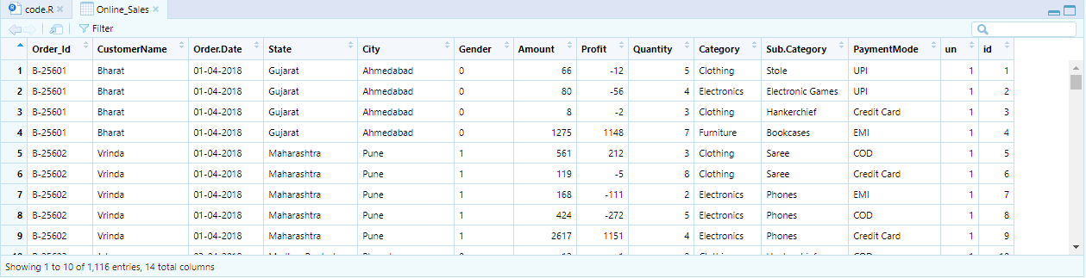
Dataset Overview

Slide 5
Analysis Questions
1. Which gender spend more on online shopping?
2. Which gender order more products from online stores?

Slide 6
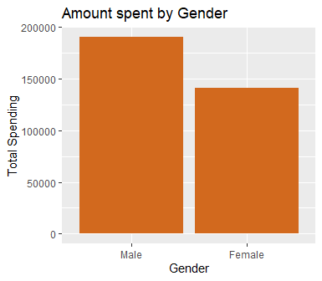
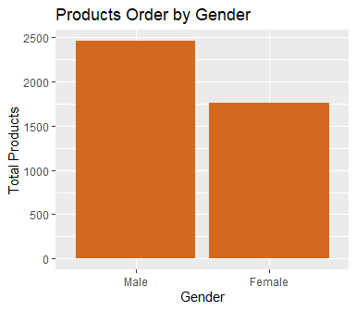
Initial Analysis

Slide 7

Frequency Table
Male
Number of entries for each gender
Female

Slide 8
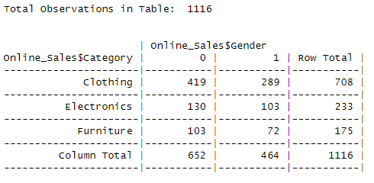
Cross Table

Slide 9
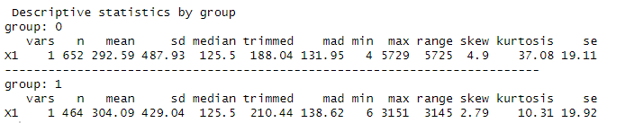
Descriptive Statistics

Slide 10
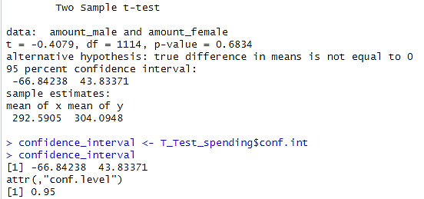
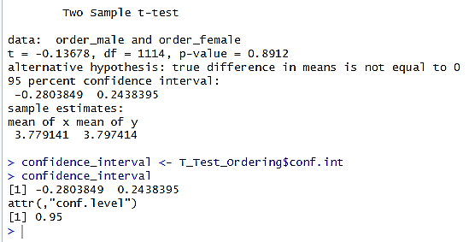
T-Test
Amount Spent
Products Ordered

Slide 11
T-Test
Amount Spent
Products Ordered

Slide 12
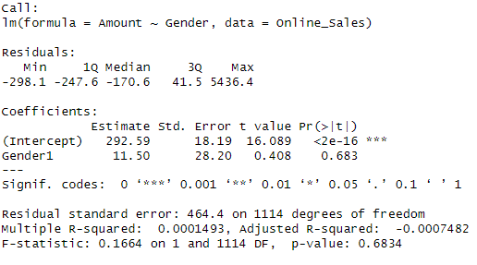
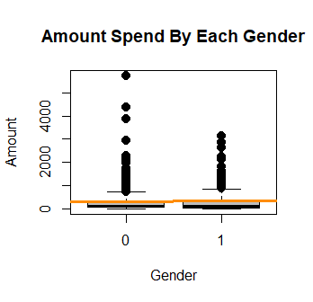
OLS

Slide 13
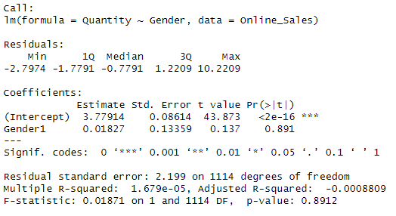
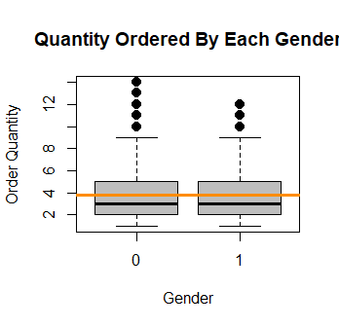
Regression Model

Slide 14

Q
A

Slide 15
Thank
You

