Slide 1
Sportify
Helping people connect through sport

Slide 2
My inspiration
I have a great passion for sport but in my friendship circle there wasn’t anyone to share it with, so I felt quite isolated .
I realised I wasn’t the only one once I started going to my gymnastics club and soon found many friends who felt the same!
My idea, Sportify was born and I hope it will impact at least one person’s life and help them find new people to enjoy their favourite hobby with!

Slide 3
Facts about the sports industry
In 2014, it was estimated that £2.8 billion pounds was spent on keeping fit and fitness in general! And that was only in 2014!
An average British sports fanatic is estimated to spend about £76.50 on fitness equipment.
1 in 8 people living in the UK have a gym membership.
There are about 6,312 fitness facilities in the UK.

Slide 4
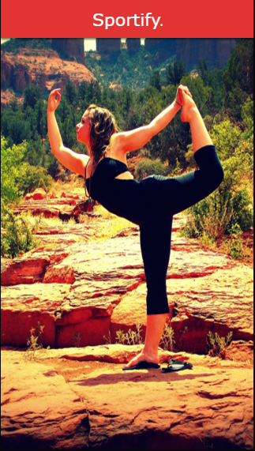
My prototype
This is first thing you see when you first log onto Sportify!

Slide 5
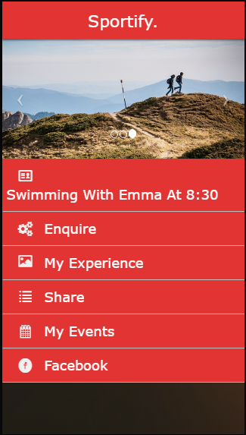
Amy’s account
And this is her home page, she is a first time user so she only has 1 event so far! Can you see where it is?

Slide 6

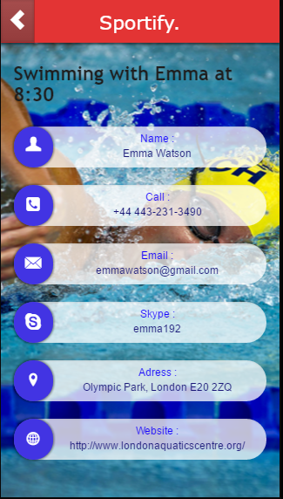
A notification appears on your homepage. It is a event that is planned.

Slide 7

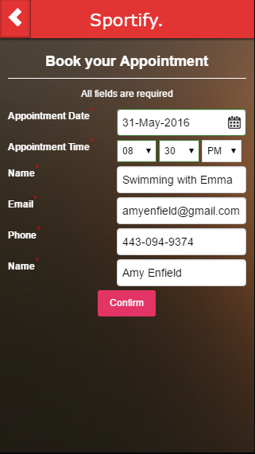
This is what the enquiry page would look like if you find an event that you like. This is the first step to finding your long lost companion!

Slide 8

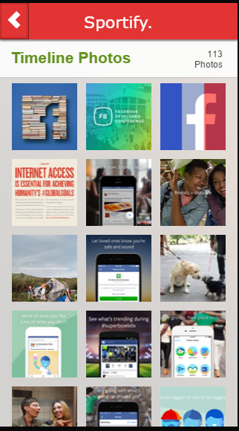
This page is where you come to share your pictures and experience via social media (only if you wish to).

Slide 9


The events that you advertise
for people to come to will be stored here, whereas the events that you will be GOING to will be
a notification on your homepage.

Slide 10


Last of all, the social media of your choice will be the last button in which it will redirect you straight to it.

