Slide 1

Building Blocks of Computers and Programs
This work is licensed under a Creative Commons Attribution-ShareAlike 4.0 International License.
Loop and decision graphics by vecteezy.com

Slide 2
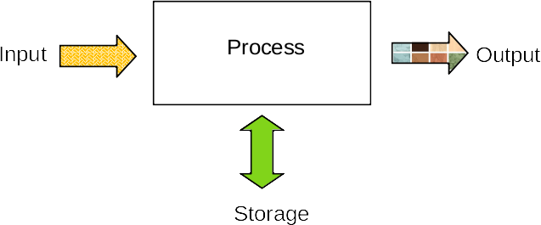
4 Basic Operations of a Computer

Slide 3
4 Basic Operations of a Computer
Input – Data is entered into the computer (text, sound, video, taps and swipes)
Process – Data is transformed into information
Storage – Data or information is recorded for retrieval
Output – Information is produced by the computer (print, display, sound, video)

Slide 4
What is a computer program?
Programs are composed of
Sequences of statements
Decision statements (selection)
Repeated statements (iteration)
Computer programs are descriptions of solutions (people describe the steps to solve the problem)
Computers carry our (execute) the instructions

Slide 5
What is a computer program?
Data is transformed by a program into information.
A program is a set of steps that will accomplish a specific task.
A set of steps that always performs a specific task is called an algorithm.
A program is the implementation of an algorithm into a form that a computer can understand.

Slide 6
Algorithms vs. Heuristics
Algorithm – a stepwise procedure (or process) that always accomplishes a specific task. Algorithms never fail.
Heuristic – a stepwise procedure (or process) that usually accomplishes a specific task. Heuristics might fail.
Note: Algorithms (and heuristics) can be performed with or without a computer.

Slide 7
Program Building Blocks
Sequence
Selection
Iteration
These three building blocks are all that is needed for a program.
All programs use a combination of these three building blocks.
There are other building blocks that are used as programs become more complex, but they are not necessary. The other building blocks organize code and data to make them easier for humans to manage.

Slide 8
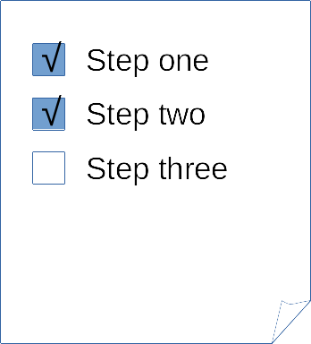
Program Building Blocks
Sequence – a linear or sequential set of steps

Slide 9

Program Building Blocks
Selection – a decision step (also called a conditional)

Slide 10

Program Building Blocks
Iteration – repetition or repeating steps (also called looping)
Technically iteration is one form of looping.
The other type of looping is called recursion and we will ignore it.

Slide 11
Programming Languages
Because natural languages like English or Spanish are ambiguous, computer programs are written in special, more restrictive languages called programming languages
Programming languages may be textual or graphical (words or pictures)
Programs are also called code or more formally source code
Source code is translated (using programs) into very simple instructions that the machine can understand

