Slide 1
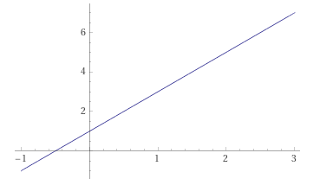

Program Variables
This work is licensed under a Creative Commons Attribution-ShareAlike 4.0 International License.

Slide 2
What is a variable?
Computer programs use variables to store data
In math, a variable is a name or symbol that represents some value, usually an unknown value
In computer science, a variable is a named region of memory used to store a value that can change

Slide 3

What is a variable?
For example: If we have a program that computes the Y intercept of a line, we will create four (4) variables.
X_coordinate
Y_coordinate
Slope
Intercept
Each one of these is a name/symbol that we use to reference a value stored in the computer’s memory.

Slide 4
What is a variable?
Example program for finding the Y intercept:
1. Input X_coordinate
2. Input Y_coordinate
3. Input Slope
4. Subtract the product of the X_coordinate and the Slope
from the Y_coordinate, Store the result in Intercept
5. Output Intercept

Slide 5
What is a variable?
Example program for finding the Y intercept:
1. Input X_coordinate
2. Input Y_coordinate
3. Input Slope
4. Intercept = Y_coordinate - X_coordinate X Slope
5. Output Intercept

Slide 6
What is a variable?
We (the programmer) do not need to know the details of how the computer manages variables
We (the programmer) only need to know the name of the variable to use it
Use the name in an Input statement
Use the name in an Output statement
Use the name in a Processing (computation) statement

Slide 7
Terminology about variables
Identifier – the name of the variable
Programming languages have rules for making names (rules for valid identifiers)
Usually the rules say start with a letter or underscore and then use any letter, digit, or underscore

Slide 8
Terminology about variables
Data type – kind of data the variable can store
Integer
Floating point (real) number
Character
Boolean (true or false)

Slide 9
Terminology about variables
Initialize – assign a value when the variable is created (declared)
Assign – store a value in the variable
Uninitialized – we (the programmer) did not assign a value to the variable. Unlike in math, all computer variables have some value (no unknowns).

Slide 10
Steps to use a variable
Create (declare) the variable
Assign a value to the variable
Initialize the variable
Assign a value
Use the variable in input, output, or computation

