Slide 1
Repeated subtraction Micro:bit activity
Cindy Stenger

Slide 2
objectives
Program with multiple variables
Review program design
Review flow chart
Practice/review using block code in MakeCode environment
Review downloading code to your micro:bit
Gain conceptual understanding of modulo operator through repeated subtraction

Slide 3
Problem statement: In computing, the modulo operation returns the remainder or signed remainder of a division, after one number is divided by another (called the modulus of the operation).
Create a program that will solve a modulo problem using repeated subtraction.
e.g., 14 mod 3 = 2
Since 14-3=11
11-3=8
8-3=5
5-3=2

Slide 4
Program design
We need to perform five tasks in our program based on the problem statement.
#1 Name 3 variables for a mod b = c exploration through repeated subtraction.
#2 Store the first number and display it
#3 Store the second number and display it
#4 Display the difference in the first and second number
#5 Reset the display (SHAKE IT)
REPEAT until the difference is less than the second number

Slide 5

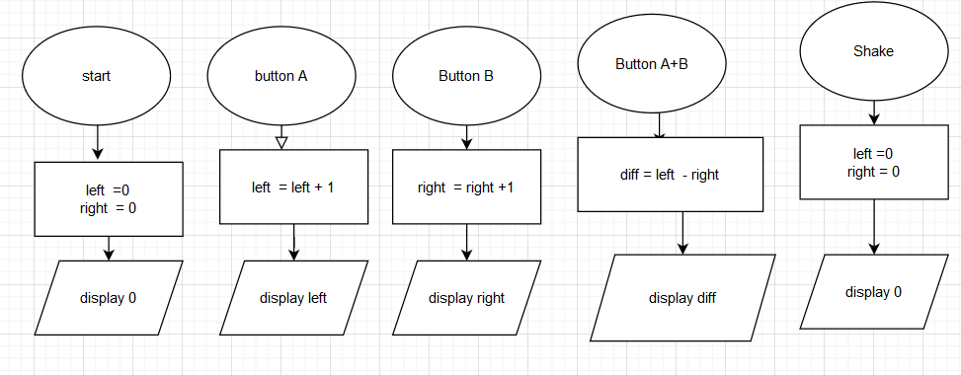
Let’s make the flowchart in drawio
We will call the variable that stores the first number left since we are storing it in the left button
We will call the variable that stores the second number right since we are storing it in the right button
We only have one option left on the micro:bit. We will hold down the left and right buttons to subtract and store the difference
Shake to reset
Repeat as needed

Slide 6
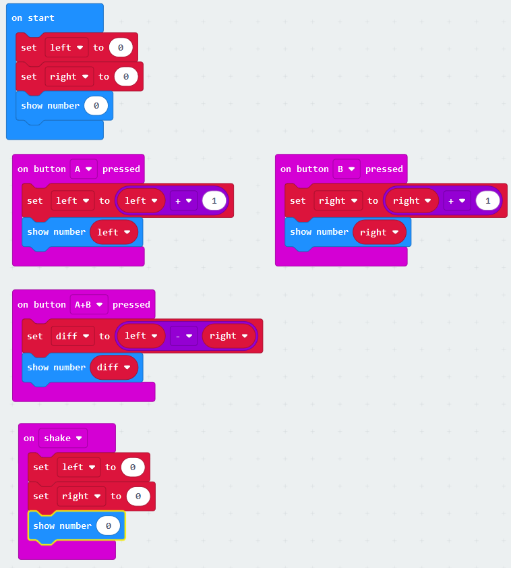
Lets write our program in MakeCode https://makecode.microbit.org
We have 5 blocks in our design, 5 blocks in our flow chart and 5 blocks in our code.
Block one names and initializes
Block two uses the left button to increment to the first number
Block 3 uses the right button to increment to the second number
Block 4 finds the difference when we hold down both buttons
Block 5 resets the variables to 0

Slide 7
Load the program on your micro:bit Click download Find your file, right click and send to micro:bit
Let’s record our repeated subtraction each iteration.
For 14 mod 3 = 2
We have 14-3=11
11-3=8
8-3=5
5-3=2

Slide 8
Let’s work through several mod problems and record the repeated subtraction
For 11 mod 2 = 1
We have 11-2=9
9-2=7
7-2=5
5-2=3
3-2=1
For 11 mod 3 = 2
We have 11-3=8
8-3=5
5-3=2

Slide 9
Tinker and record
Conjecture: If a is even, then a mod 2 = 0. If a is odd, then a mod 2=1.
Convincing argument:
Case 1:a is even. Then there exists n so that a = 2n.
So a mod 2 = 2n mod 2 = 0 since 2 divides 2n.
Case 2: a is odd. Then there exists m so that a = 2m +1.
So a mod 2 = (2m+1) mod 2
Recall that in base 2 there are only 2 options for the remainder 0 or 1.
For the contradiction, suppose a mod 2 = 0. then 2 divides 2m+2, for any m. This is a contradiction.
Thus (2m + 1) mod 2 = 1.
Case1 and 2 together give our result. QED
5 mod 2 = 1
4 mod 2 = 0
3 mod 2 = 1
2 mod 2 = 0
I see a pattern…

Slide 10
What would make this program better?
if we could perform the repeated subtraction in a loop?

