Slide 1
Intro to functions
Cindy stenger

Slide 2
functions:
One of the coolest structures
in the computer science world is the function.
Functions (sometimes called procedures)
are mini programs that you can use
over and over inside of your bigger program.
This lesson will help you intuitively
understand why combining chunks of code
into functions can be such a helpful practice.

Slide 3

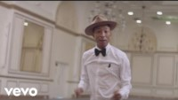
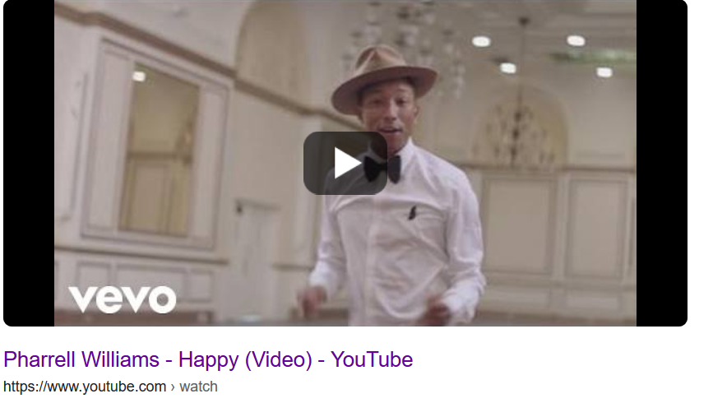

Let’s start with a song:
I thought we were talking about functions

Slide 4
It might seem crazy what I'm about to say Sunshine she's here, you can take a break I'm a hot air balloon that can go to space With the air, like I don't care baby by the way (come on)
Because I'm happy Clap along if you feel like a room without a roof Because I'm happy Clap along if you feel like happiness is the truth Because I'm happy Clap along if you know what happiness is to you Because I'm happy Clap along if you feel like that's what you wanna do (hey)
Here come bad news talking this and that (yeah) Well, give me all you got, and don't hold it back (yeah) Well, I should probably warn you, you'll be just fine (yeah) No offense to you, don't waste your time (Here's why)
Because I'm happy Clap along if you feel like a room without a roof Because I'm happy Clap along if you feel like happiness is the truth Because I'm happy Clap along if you know what happiness is to you Because I'm happy Clap along if you feel like that's what you wanna do
Here go (Happy) Bring me down Can't nothing (happy) Bring me down My level's too high (happy) To bring me down
To bring me (Let me tell you now) Bring me down Can't nothing Bring me down His level's too high To bring me down To bring me down
Because I'm happy Clap along if you feel like a room without a roof Because I'm happy Clap along if you feel like happiness is the truth Because I'm happy Clap along if you know what happiness is to you Because I'm happy Clap along if you feel like that's what you wanna do
Because I'm happy Clap along if you feel like a room without a roof Because I'm happy Clap along if you feel like happiness is the truth Because I'm happy Clap along if you know what happiness is to you Because I'm happy Clap along if you feel like that's what you wanna do

Slide 5
It might seem crazy what I'm about to say Sunshine she's here, you can take a break I'm a hot air balloon that can go to space With the air, like I don't care baby by the way (come on)
Because I'm happy Clap along if you feel like a room without a roof Because I'm happy Clap along if you feel like happiness is the truth Because I'm happy Clap along if you know what happiness is to you Because I'm happy Clap along if you feel like that's what you wanna do (hey)
Here come bad news talking this and that (yeah) Well, give me all you got, and don't hold it back (yeah) Well, I should probably warn you, you'll be just fine (yeah) No offense to you, don't waste your time (Here's why)
Because I'm happy Clap along if you feel like a room without a roof Because I'm happy Clap along if you feel like happiness is the truth Because I'm happy Clap along if you know what happiness is to you Because I'm happy Clap along if you feel like that's what you wanna do
Here go (Happy) Bring me down Can't nothing (happy) Bring me down My level's too high (happy) To bring me down
To bring me (Let me tell you now) Bring me down Can't nothing Bring me down His level's too high To bring me down To bring me down
Because I'm happy Clap along if you feel like a room without a roof Because I'm happy Clap along if you feel like happiness is the truth Because I'm happy Clap along if you know what happiness is to you Because I'm happy Clap along if you feel like that's what you wanna do
Because I'm happy Clap along if you feel like a room without a roof Because I'm happy Clap along if you feel like happiness is the truth Because I'm happy Clap along if you know what happiness is to you Because I'm happy Clap along if you feel like that's what you wanna do

Slide 6
It might seem crazy what I'm about to say Sunshine she's here, you can take a break I'm a hot air balloon that can go to space With the air, like I don't care baby by the way
CHORUS
Here come bad news talking this and that Well, give me all you got, and don't hold it back Well, I should probably warn you, you'll be just fine No offense to you, don't waste your time
CHORUS
Bring me down Can't nothing Bring me down My level's too high To bring me down
Bring me down Can't nothing Bring me down His level's too high To bring me down To bring me down
CHORUS
CHORUS
Chorus:
Because I'm happy Clap along if you feel like a room without a roof Because I'm happy Clap along if you feel like happiness is the truth Because I'm happy Clap along if you know what happiness is to you Because I'm happy Clap along if you feel like that's what you wanna do

Slide 7


For your homework, find a song your class would enjoy and show how you could apply the concept of function to your song

Slide 8
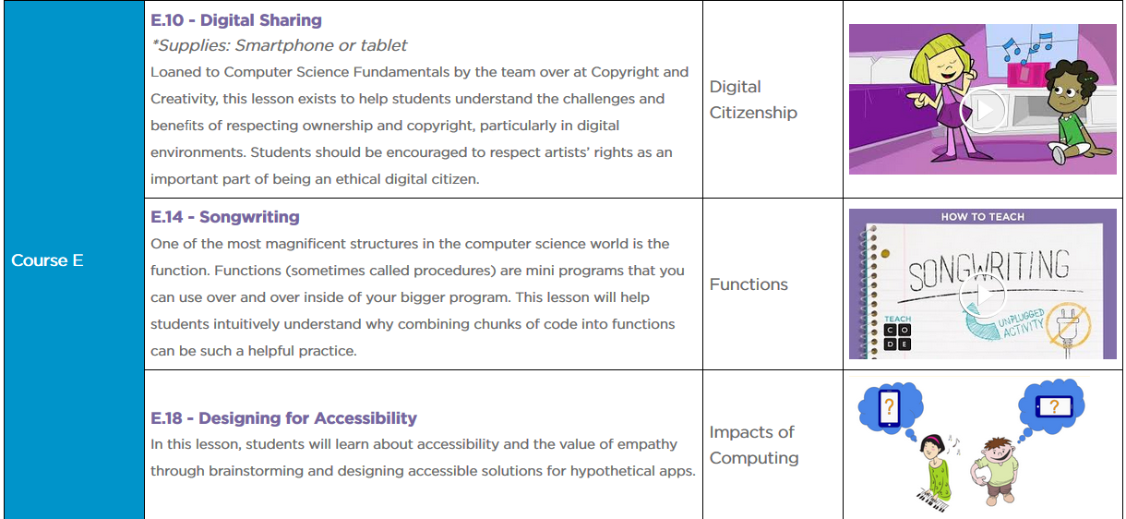
You can find a similar lesson at Cs Unplugged
https://code.org/curriculum/unplugged

