Slide 1

TIME SERIES OF PRECIOUS METALS AND THEIR MARKET PRICE
Kayla Brown
D214: Graduate Capstone Project
Task 3: Presentation of Findings

Slide 2
My Background
Name: Kayla Brown
Age: 26 years old
Location: Chicago, IL
Profession: Graduate Student at Western Governors University
Learned skills: SQL, Python, Machine Learning

Slide 3
Problem Statement & Related Hypothesis
To what extent can NeuralProphet accurately predict variable “cost” for precious metals “Gold”, “Silver”, “Platinum”, and “Palladium” over a forecast period of 365 days?
NeuralProphet can predict the market closing price of precious metals over a forecast period of 365 days with at least 75% accuracy.

Slide 4
Data Analysis Process Summary
1) Initialize programming environment with Jupyter Notebook and Python
2) Upload CSV data file to Python environment
3) Clean the data and keep only significant columns and their related entries
4) Manipulate original data for Neural Prophet to be functional
5) Combine the Neural Prophet time series analysis model to the manipulated data
6) Predict and forecast the market closing price for Gold, Silver, Platinum, and Palladium over a period of 365 days
7) Evaluate the accuracy by comparing the trained dataset and validation dataset

Slide 5
Findings Related to the Model
The default Neural Prophet model achieves an average of 88.87% accuracy
This model is prone to validation metric complications due to high risk of overfitting. This is due to not having an adequate amount of data in the trained dataset to compare to the validation dataset (AWS, 2023).

Slide 6
Findings Related to the Precious Metals Forecast
Gold, silver, and palladium demonstrate positive trends for a growing closing market price with platinum stagnant in trend linearity.
Silver is the least profitable for active trading due low cost and historical decline since early 2010s.
Palladium is the riskiest active trading item due to approximately $1,500 in fluctuation intervals.
The gold forecast and historical data demonstrates the most positive trend of all four metals in addition to having the most profitable closing prices as upward as $3,000 for maximum closing price.

Slide 7
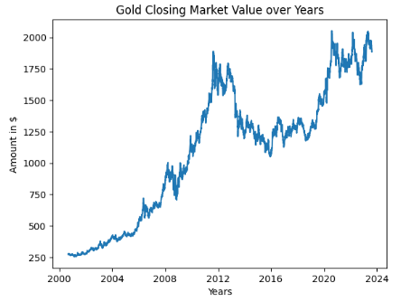
Visualization of past and current closing market prices:
GOLD

Slide 8
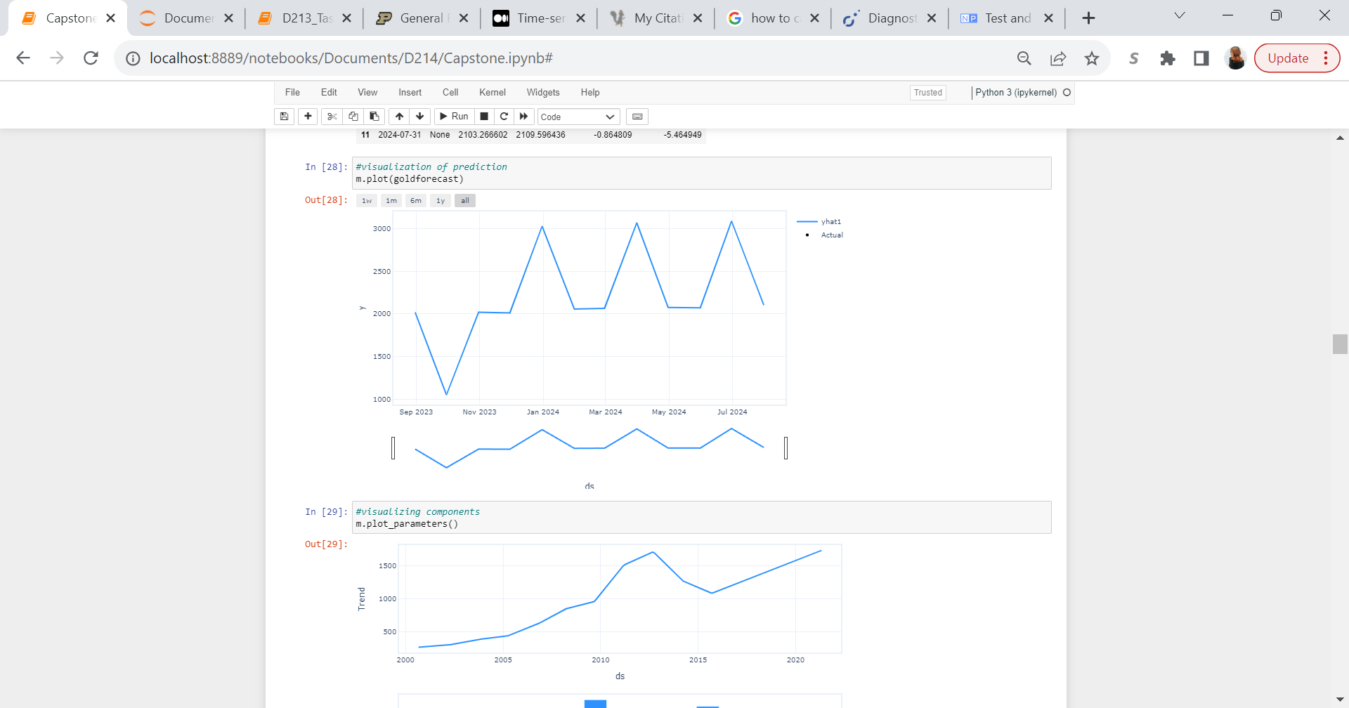
Visualization of forecasted closing market prices:
GOLD
Model Accuracy: 95.91% per MAPE

Slide 9
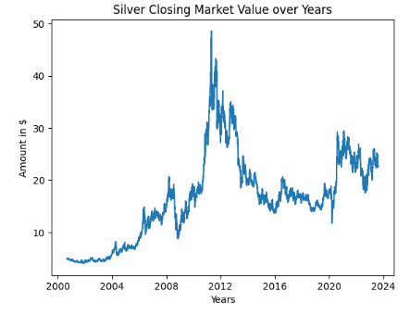
Visualization of past and current closing market prices:
Silver

Slide 10
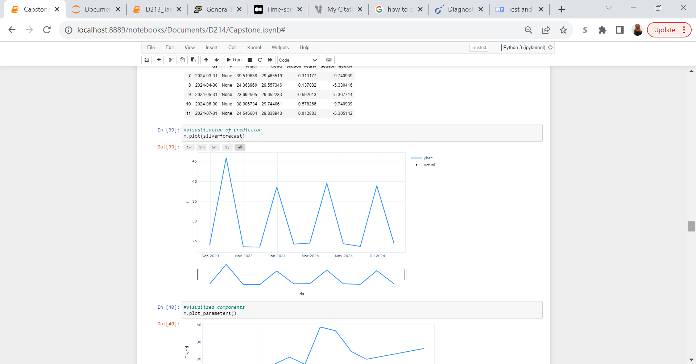
Visualization of forecasted closing market prices:
Silver
Model Accuracy: 90.12% per MAPE

Slide 11
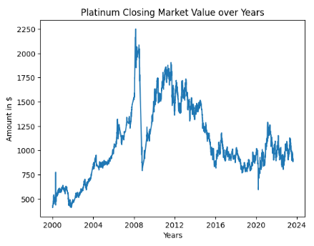
Visualization of past and current closing market prices:
Platinum

Slide 12
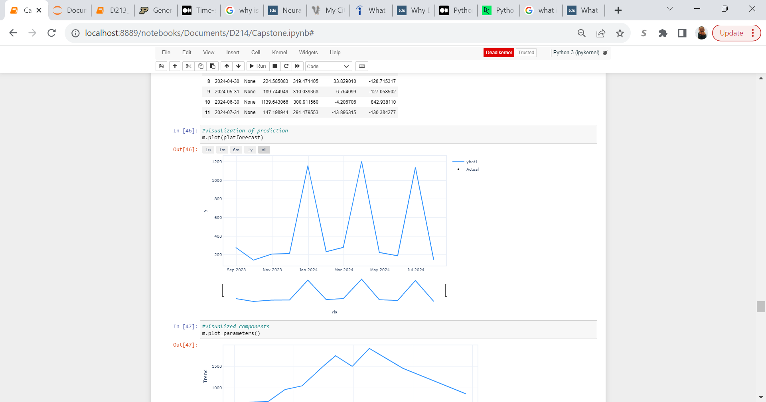
Visualization of forecasted closing market prices:
Platinum
Model Accuracy: 92.85% per MAPE

Slide 13
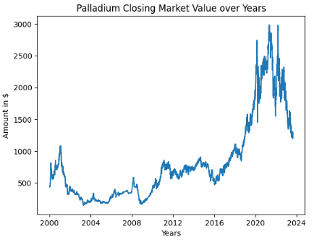
Visualization of past and current closing market prices:
Palladium

Slide 14
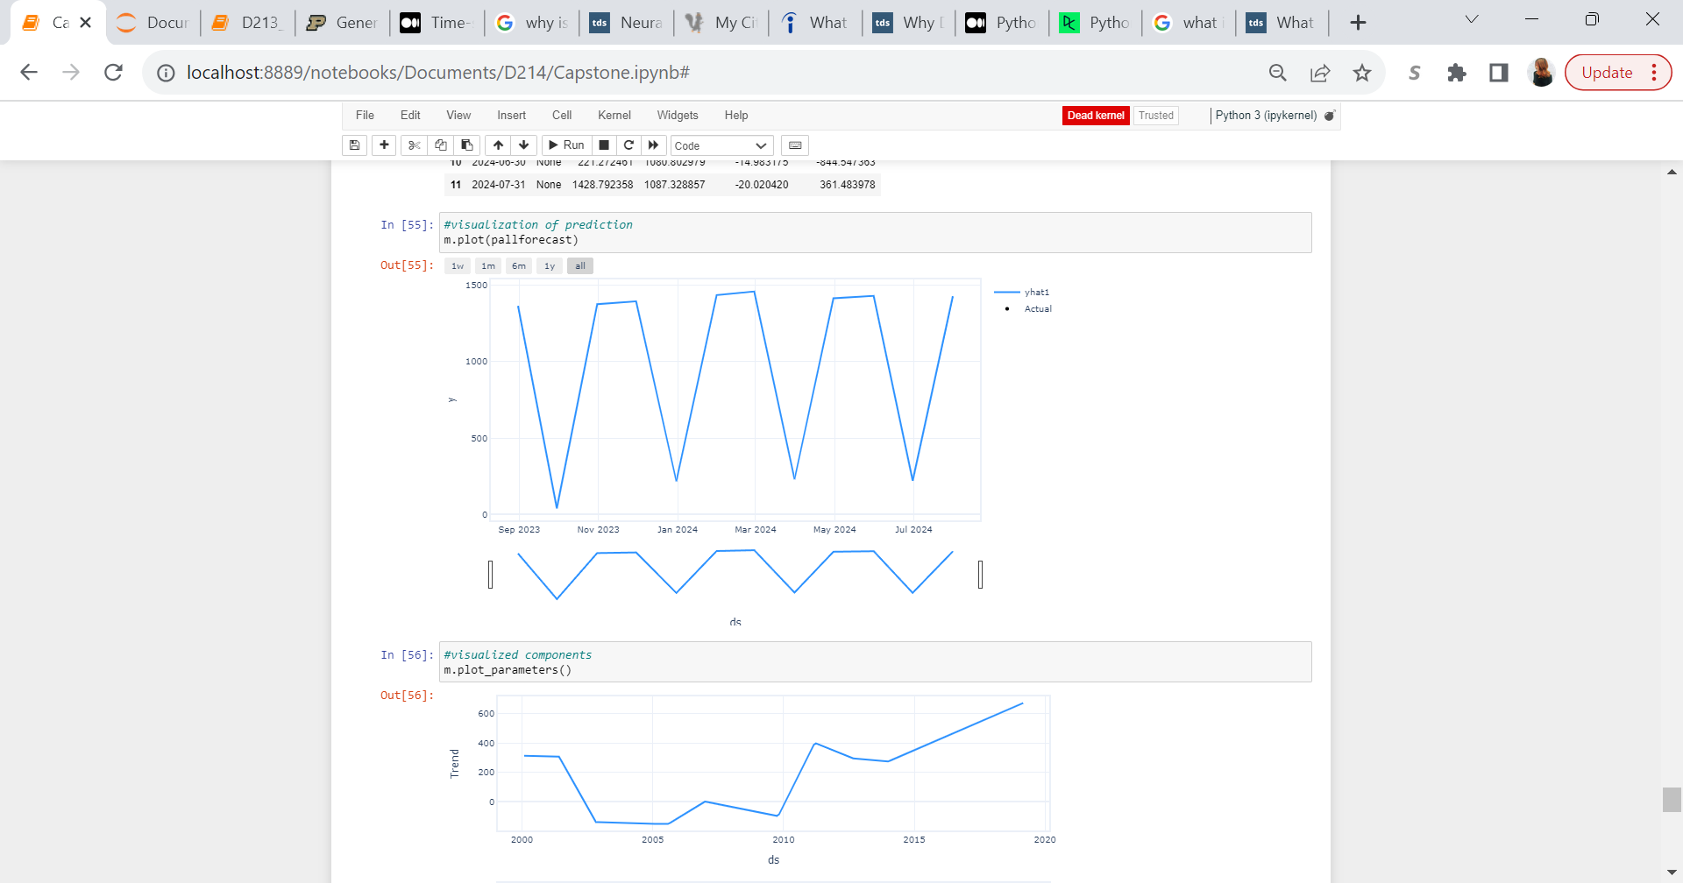
Visualization of forecasted closing market prices:
Palladium
Model Accuracy: 76.6% per MAPE

Slide 15
Limitations of Techniques and Tools
Neural Prophet utilizes a feed-forward neural network in which the machine learning model can only learn from new data (Laptev et al., 2021). This means that if the data size is too small, the model will produce poor results.
Additionally, as stated in “Findings”, overfitting is prone for this model of time series analysis (Cassiman, 2021).
Lastly, Python was utilized rather than R for this time series model. R is a programming language designed for data analytics and is less prone to human error in comparison Python (Manokhin, 2023).

Slide 16
Proposed Actions
Perform model updates with each interval period of new data collected. As an example, re-run the model every month for more accurate predictions as new data is collected
Decrease the forecast period from 365 days to smaller forecast periods such as quarterly, 30 days, and daily for an increased accuracy. Accuracy becomes worse as forecast period lengths are extended so users and analysts can benefit from forecasting with shorter periods

Slide 17
Expected Study Benefits
NeuralProphet proves itself as a primary time series analysis tool that is user-friendly for any experience level data analyst. I expect that manually tuning the hyperparameters to adjust to individual datasets can yield better accuracy
This model is highly appropriate for quarterly profit measurements with the forecast period prediction at 90 days for the first quarter, 91 for the second and third quarter, and 92 days for the fourth quarter. Weekly model performance can be highly beneficial for active traders as well with an even higher accuracy than the 365-day period and quarterly period.

Slide 18
Sources
AWS. (2023). What Is Overfitting?. Amazon. https://aws.amazon.com/what-is/overfitting/#:~:text=Overfitting%20occurs%20when%20the%20model,%E2%80%A2
Laptev, N., Triebe, O., & Hewamalage, H. (2021, November). Neuralprophet: The neural evolution of meta’s prophet. Meta AI. https://ai.meta.com/blog/neuralprophet-the-neural-evolution-of-facebooks-prophet/#:~:text=NeuralProphet%20improves%20on%20Prophet%20by,with%20standard%20deep%20learning%20methods.
Cassiman, J. (2021, June 22). Is Neuralprophet Better than prophet for sales forecasting?. Medium. https://blog.ml6.eu/is-neuralprophet-better-than-prophet-for-sales-forecasting-de45527163dc
Valeriy Manokhin, P. (2023, January 26). Python vs R for time-series forecasting. Medium. https://valeman.medium.com/python-vs-r-for-time-series-forecasting-395390432598

