Slide 1
H-1B Visa Petitions
2011-2016
Group 4 - Fantastic Four
Likun Li Yuanjing Yao
Kaviya Sachi Xintong Liu

Slide 2
Background
H1B is a visa in the United States under the Immigration and Nationality Act, section 101(a)(15)(H) that allows U.S. employers to temporarily employ foreign workers in specialty occupations. A specialty occupation requires the application of specialized knowledge and a bachelor's degree or the equivalent of work experience.
This dataset contains five years’ worth of H-1B petition data, with approximately 3 million records overall, from 2011 to 2016.

Slide 3

1. Data Preprocessing
Import dataset Read h1b_kaggle.csv file to import the data
Sort values by the year Sort data for random forest algorithm
Review data and drop columns Clean data and drop extra, empty and other useless columns
Data impute Impute the longitude and the latitude

Slide 4
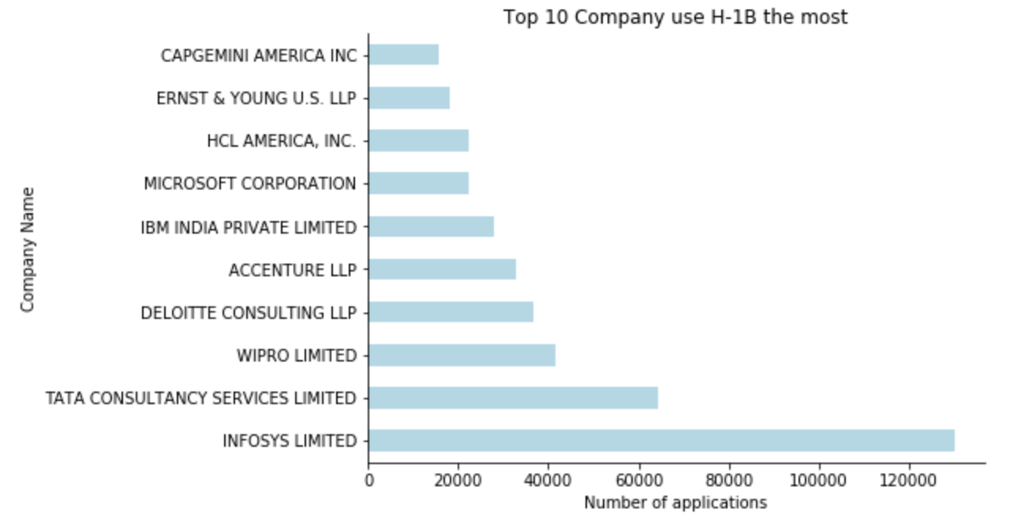
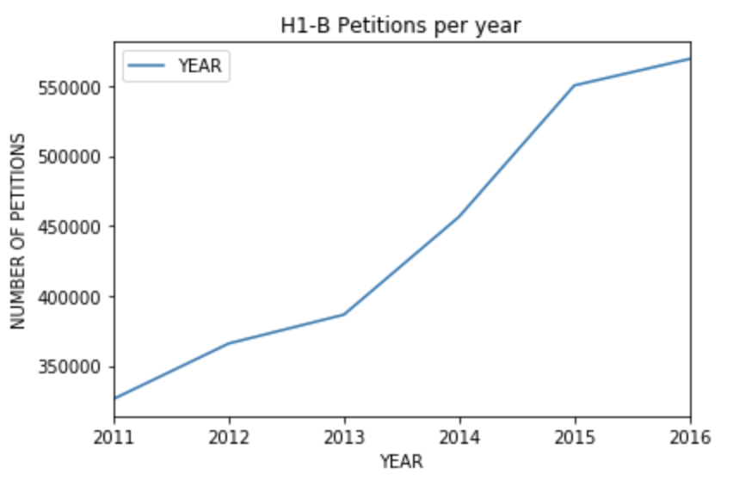
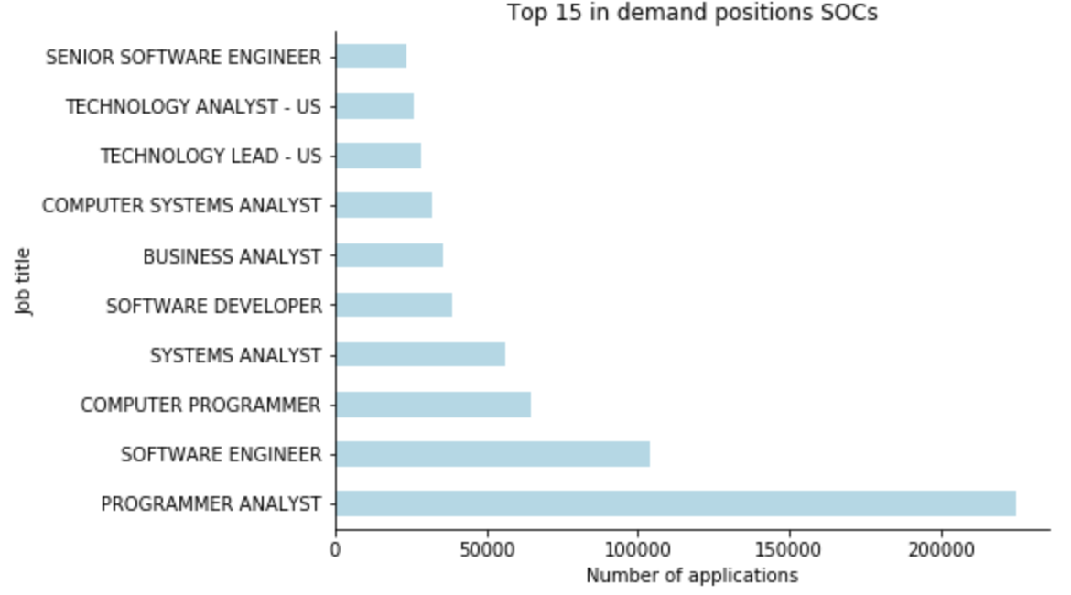
2. Data Analysis
The top company use H-1B is InfoSys
The top jobs for applicants is programmer analyst and all positions are tech related
H-1B Petitions grows every year, especially fast from 2013 to 2015

Slide 5
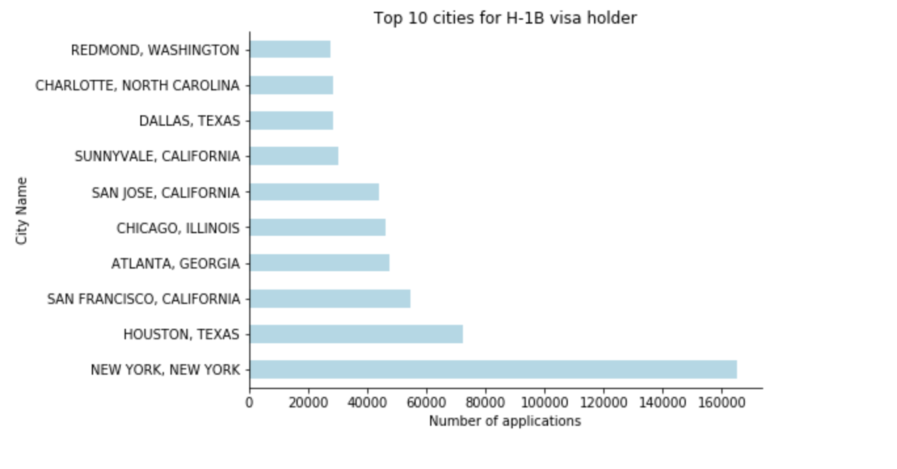
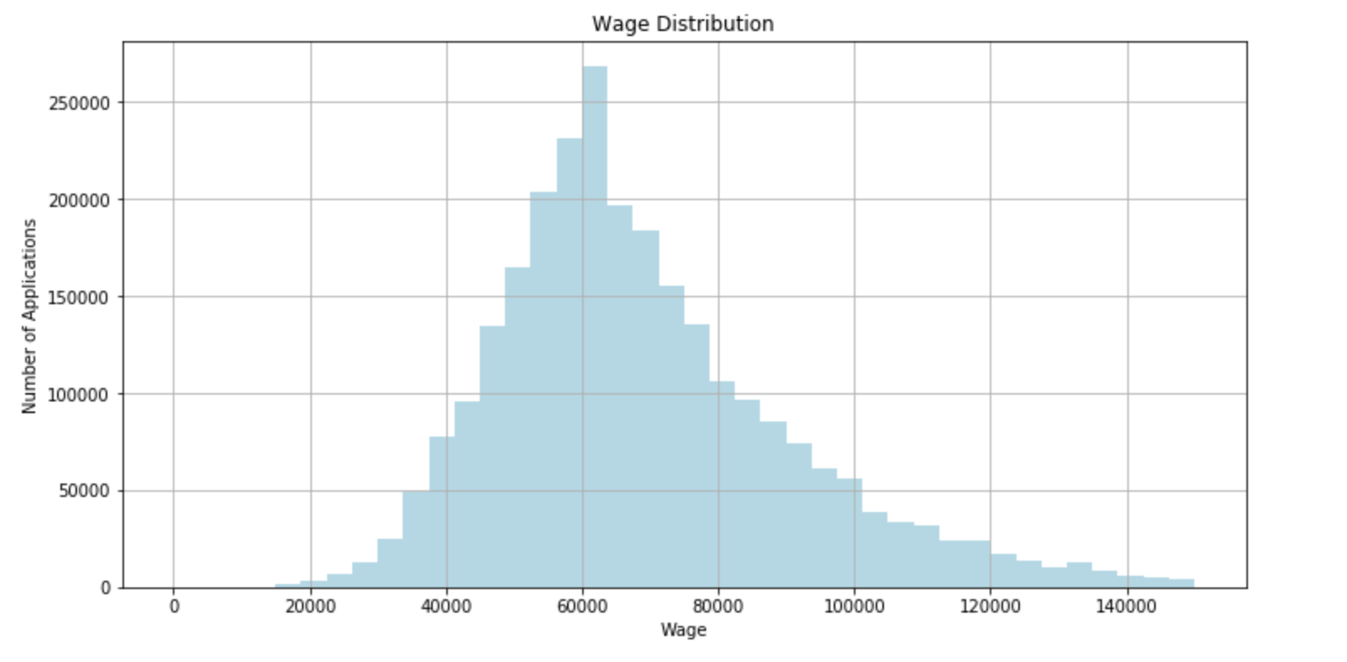
2. Data Analysis
Most people’s wage are at 60,000. The max is more than 140,ooo and the minimum is less than 20,000
The top city is New York and the second is Huston. Three of them are in California.

Slide 6
3. H-1B Case Status Prediction
3.1 Prepare for prediction
Drop off some rows, keep a good ratio between 'CERTIFIED' and 'DENIED’
Encoding categorical features
Standard Scaler
Split target columns
Split train, validation and test dataset
Feature Selection

Slide 7
3. H-1B Case Status Prediction
3.2 Model Selection
Function definition
def plot_confusion_matrix(cm, target_names, title, cmap, normalize)
def roc_plot(y_test, y_pred)
def model_evaluate(model, x_test, y_test)
Random Forest Classifier
Do Random Forest Grid Search and apply to Random Forest model
Gradient Boosting Classifier
Do Gradient Boosting Grid Search and then apply to Gradient Boosting model
Apply to deep learning model

Slide 8
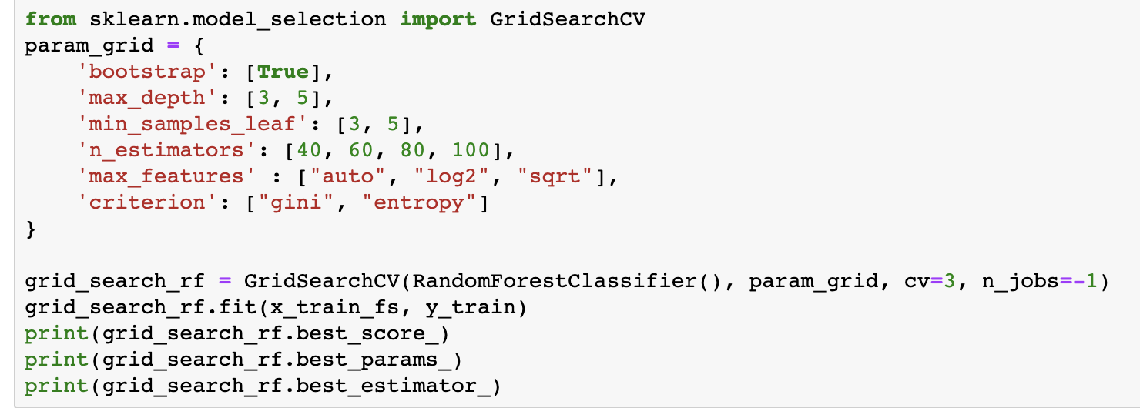
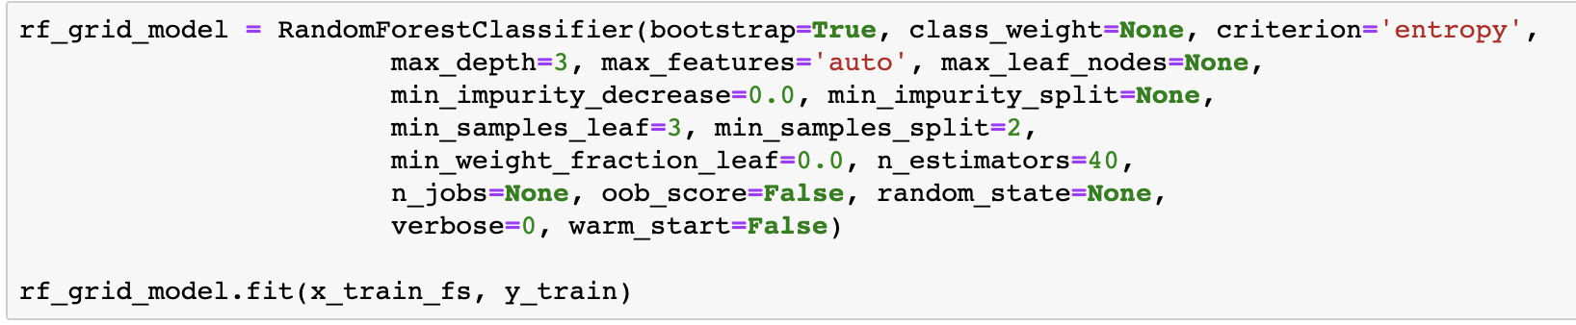
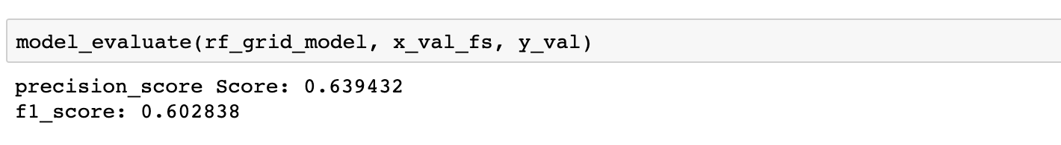
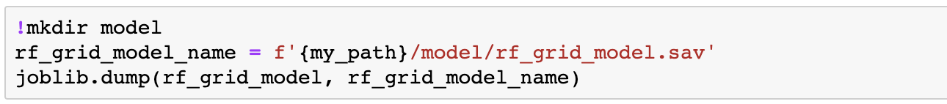
Grid Search - Hyperparameters tuning
Random Forest Classifier
Apply to Random Forest Model
Evaluation
Export the model to .sav file

Slide 9
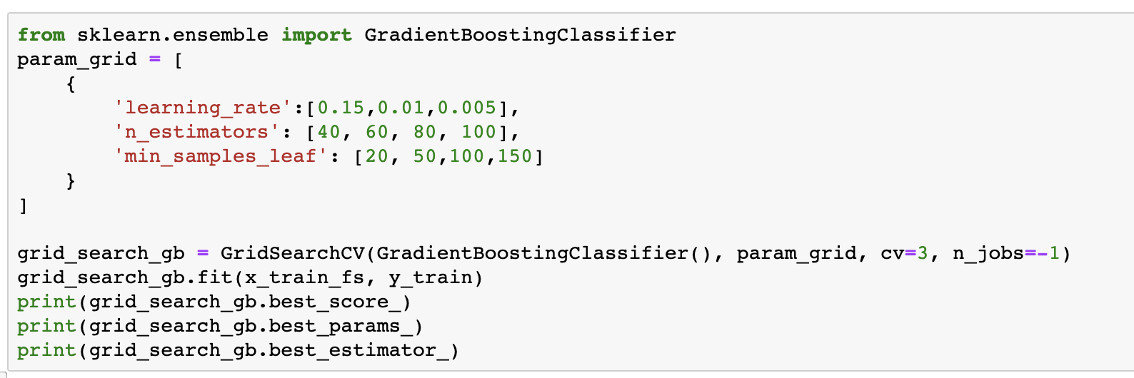
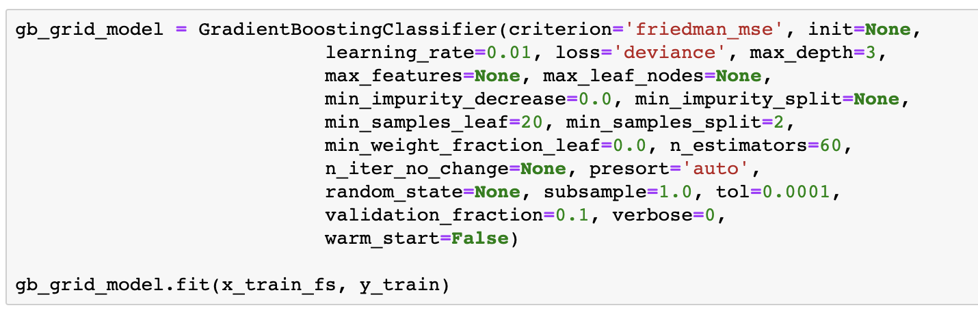
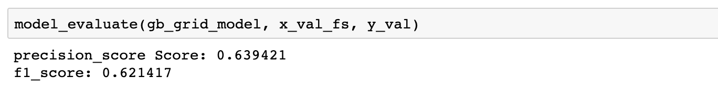
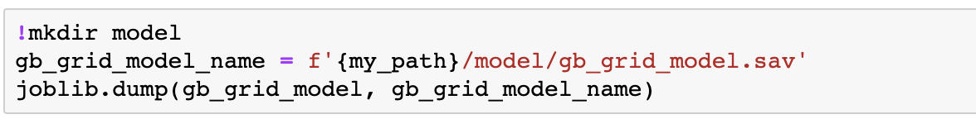
Grid Search - Hyperparameters tuning
Gradient Boosting Classifier
Apply to Gradient Boosting Classifier Model
Evaluation
Export the model to .sav file

Slide 10
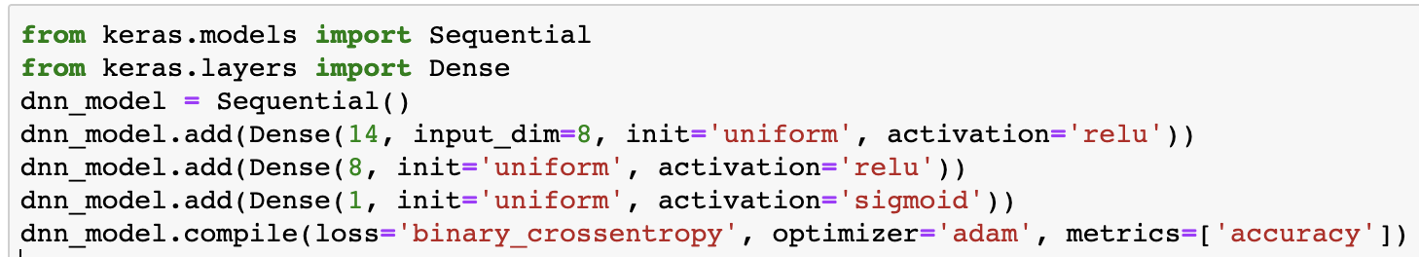
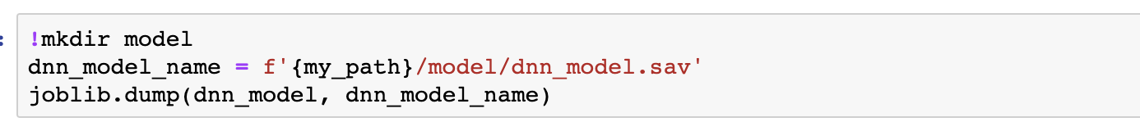
Apply to Gradient Boosting Classifier Model
Deep Neural Network
Apply to Gradient Boosting Classifier Model
Export the model to .sav file

Slide 11
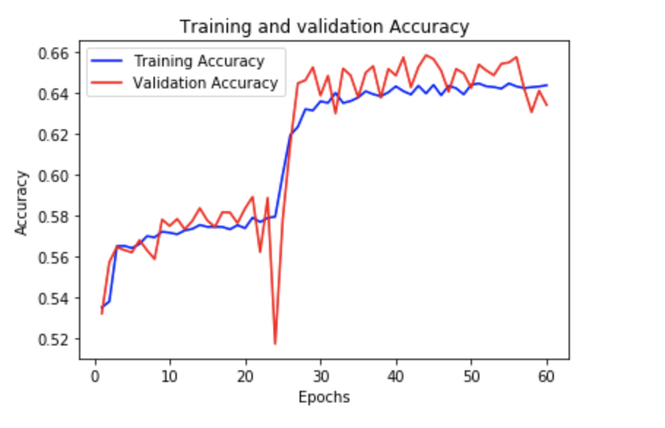
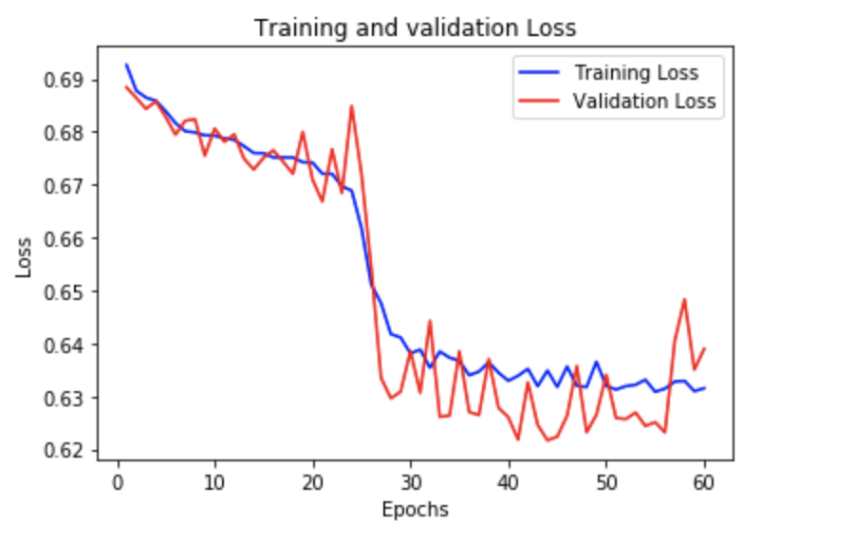
Deep Learning
Epoch vs Training and Validation Accuracy

Slide 12
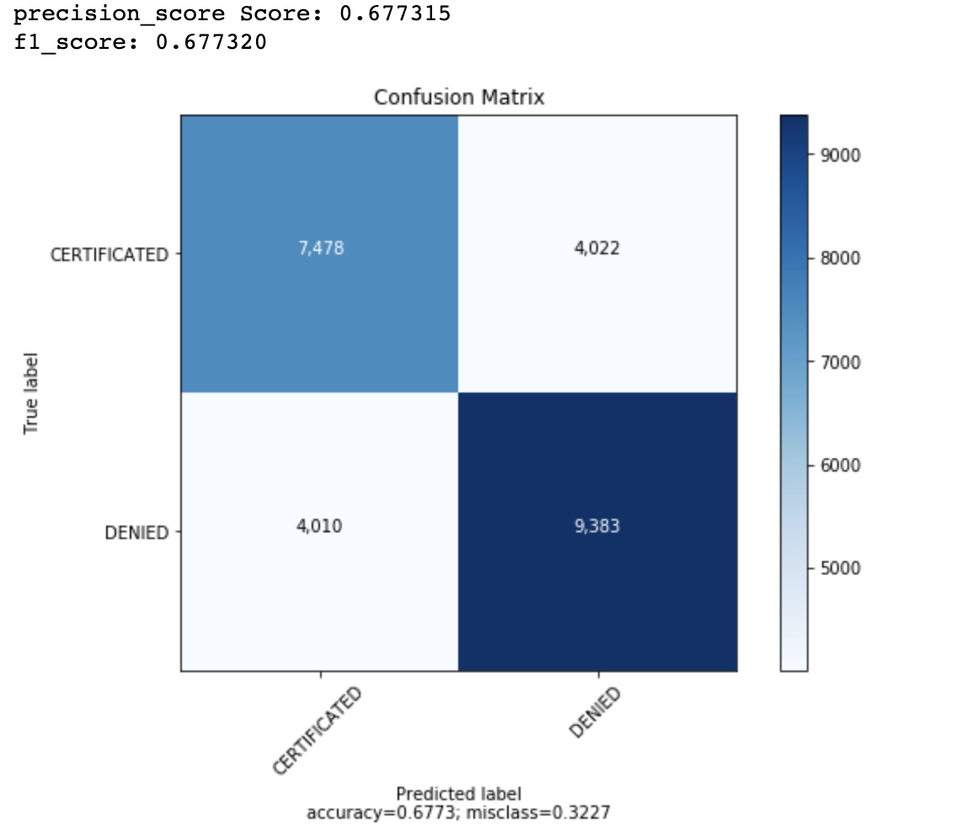
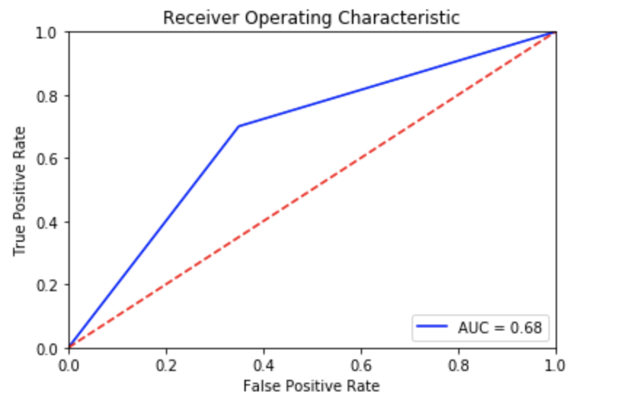
4. Test
Random Forest Classifier
Evaluate the performance of Imported Random Forest Model

Slide 13
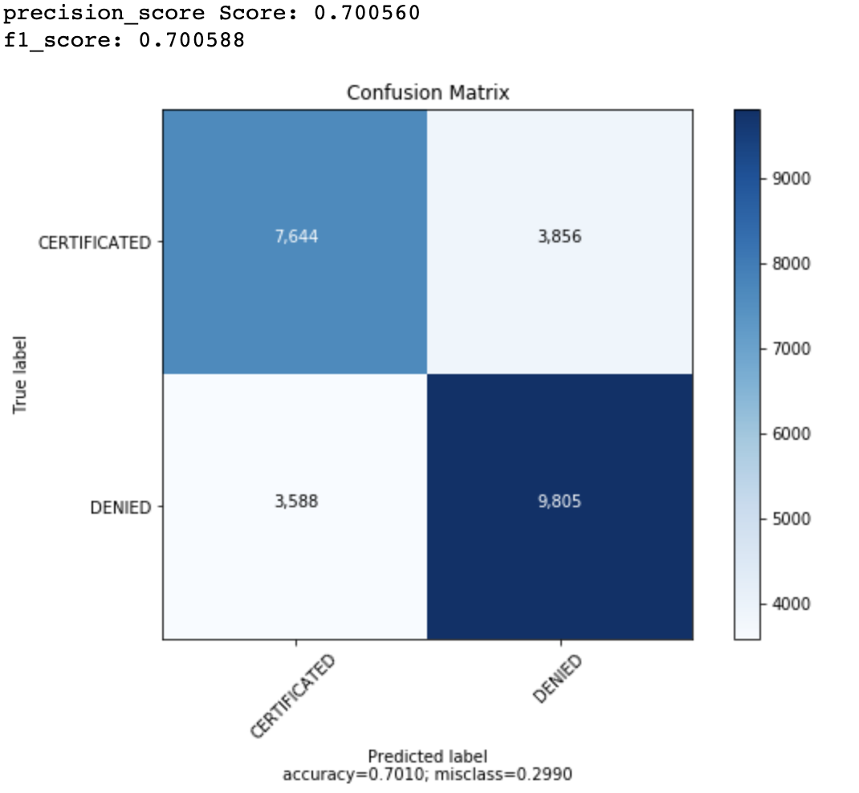
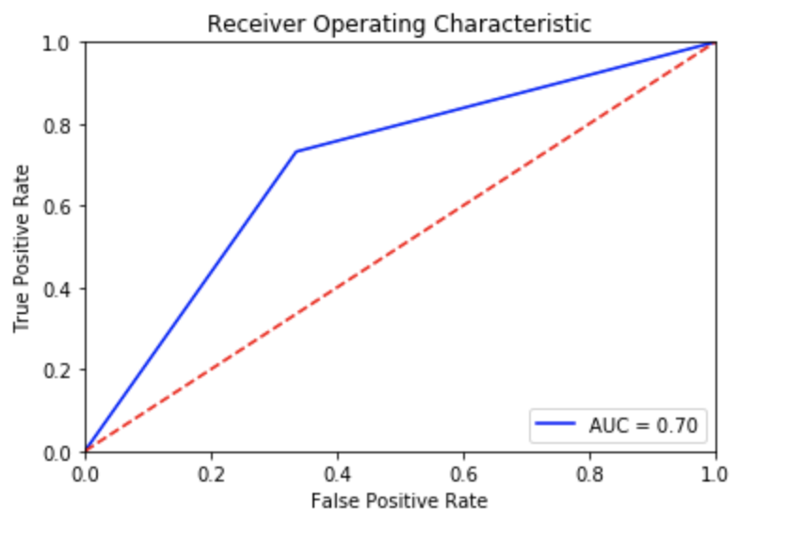
Gradient Boosting Classifier
Evaluate the performance of Imported Gradient Boosting Model

Slide 14
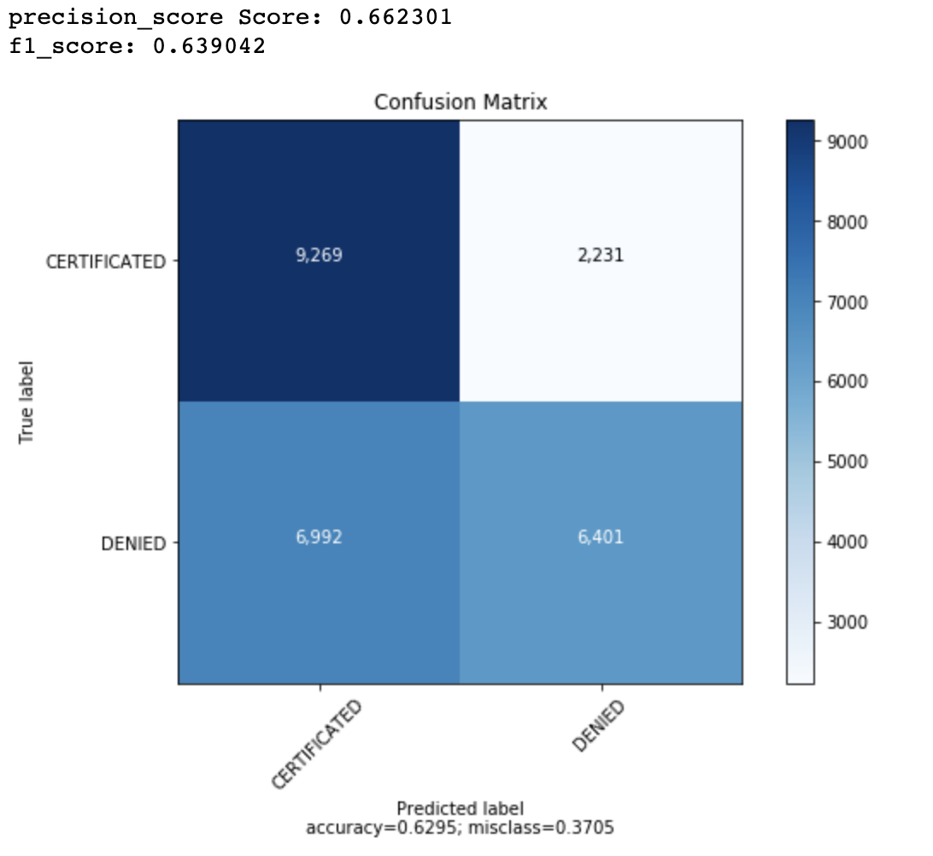
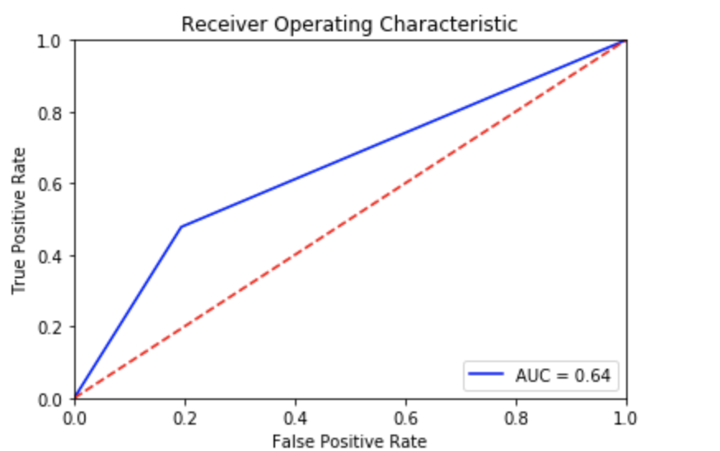
DNN
Evaluate the performance of Imported DNN Model, using model.predict_classes for calculating precision/f1-score with DNN model

Slide 15
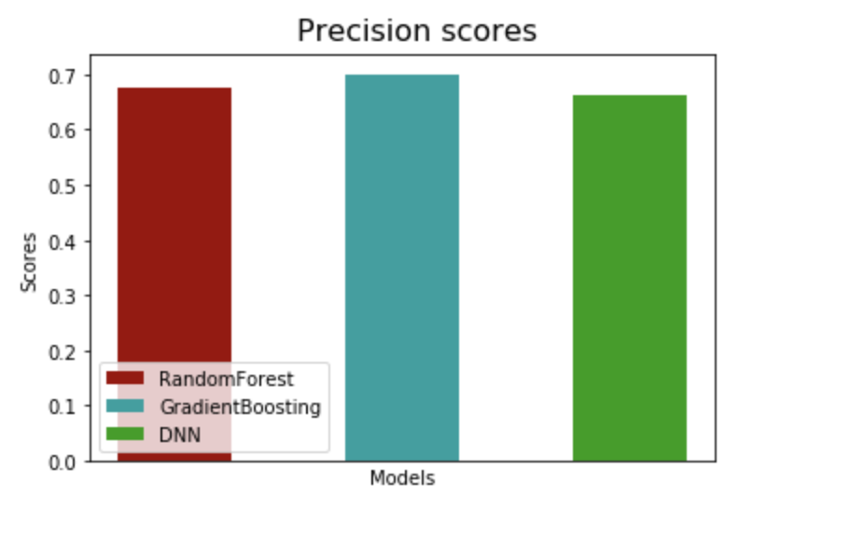
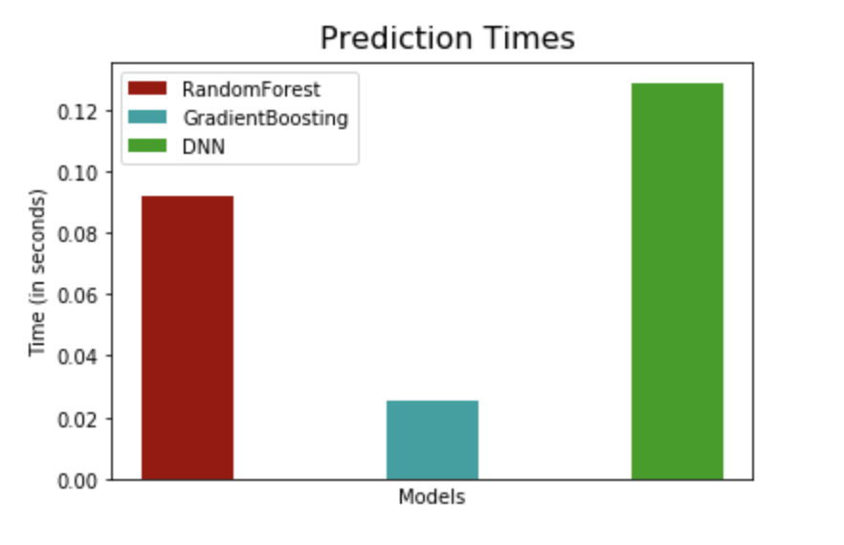
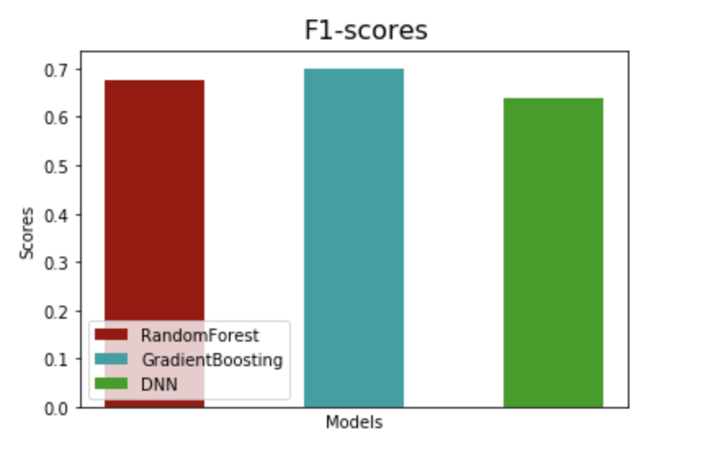
4. Test
According to F1 scores histogram, Random Forest and Gradient Boosting are better than DNN.
Also, their prediction time are smaller and precision are higher.

