Slide 1
The Judicious Wine
A wine quality prediction system
Kaylee Pham, Shant Melikyan, Hovik Hovakimyan, Narbeh Movsesian, Bezan Lilauwala
COMP 542
Department of Computer Science
California State University, Northridge

Slide 2

Outline
Introduction
Data Exploration
Data Preprocessing
Data Processing
Result
Q&A

Slide 3
Introduction
Motivation
Strong passion for sciences and wine
Help Companies produce higher quality wine
Problem to solve
Production is a very competitive
Understand the science behind
Solution
Knowing the particular characteristics that affect the quality of the wine

Slide 4
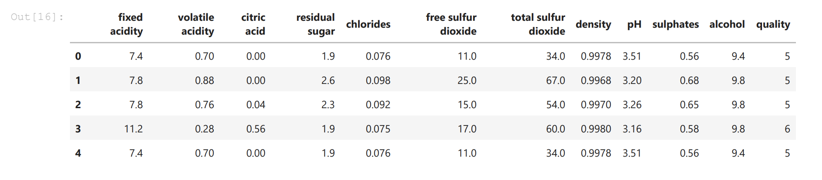
Open dataset from Kaggle and UCI Machine Learning
Task: Classification, Regression
Algorithms use :
Support Vector Machine
Random Forest
K-Nearest Neighbor
Python libraries: Numpy, Pandas, Sklearn, Seaborn, Matplotlib.pyplot
Jupyter Notebook
Notes:
Write note here for speakers

Slide 5
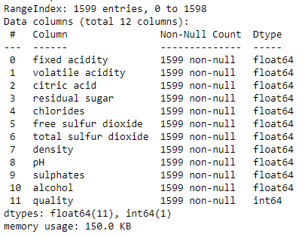
Data Exploration - Info
Data_red.shape # Returns rows and columns
(1599, 12)
data_red.info() # Returns data types and null value count
Contains 0 missing values.
Notes:
The dataset contains 11 independent variables and 1 dependent variable called Quality which is the target feature.
Using the shape function on the data frame, we can see that the dataset contains 1599 rows and 12 columns of data.
Using the info() function on the data frame, we can see that the dataset contains no null values and that every dependent variable has a continuous data type and the dependent variable has a discrete data type.

Slide 6
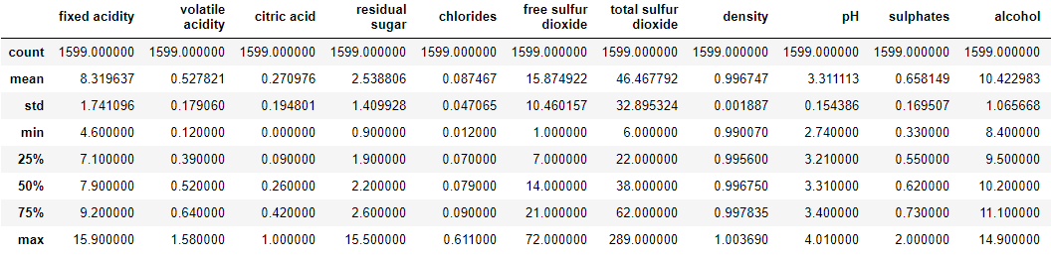
Data Exploration - Description
data_red.describe() # Data Summary
Notes:
Using the describe() function on the data frame, we can see the descriptive statistics of the dataset. These statistics can best be understood when they are visualized in some of the following slides.

Slide 7
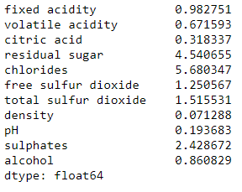
Data Exploration - Skewness
Skewness: Skewness, in statistics, is the degree of distortion from the symmetrical bell curve in a probability distribution. Distributions can exhibit right (positive) skewness or left (negative) skewness to varying degrees. Data lean to the left is positive vs. lean to the right is negative
data_red.drop(columns='quality').skew(axis = 0) # Returns skewness of each independent feature
Notes:
Skewness is the degree of distortion from the bell curve.
Using the skew() function, we can see that all the independent variables in the dataset have a positive skew. This can best be visualized in the next slide.

Slide 8
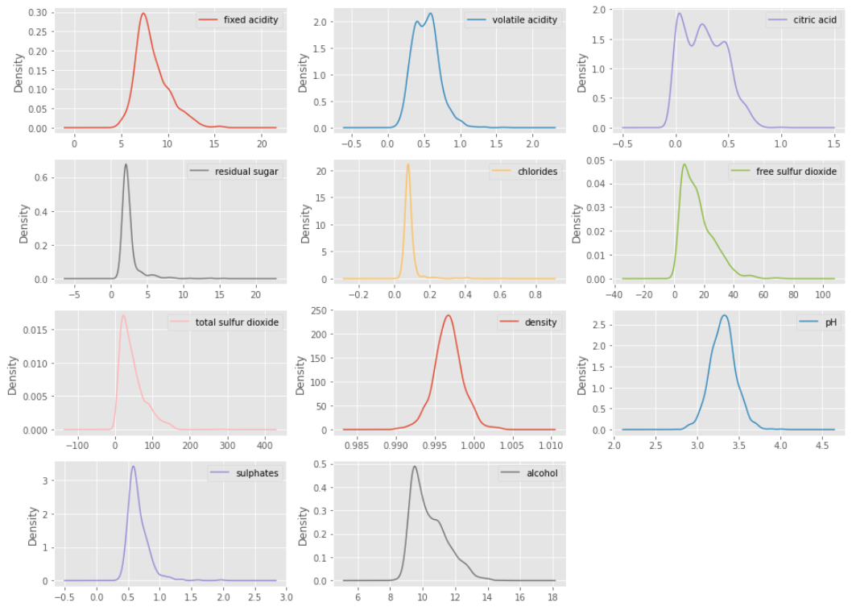
Skewness
data_red.drop(columns='quality').plot(kind='density', subplots=True, layout=(4,3),figsize=(16, 12), sharex= plt.show()
# Returns a density plot
Notes:
A density plot of each independent variable is used to visualize the skewness of each independent variable.
This means that all independent variables have a mean that is closer to the minimum that the maximum value.

Slide 9
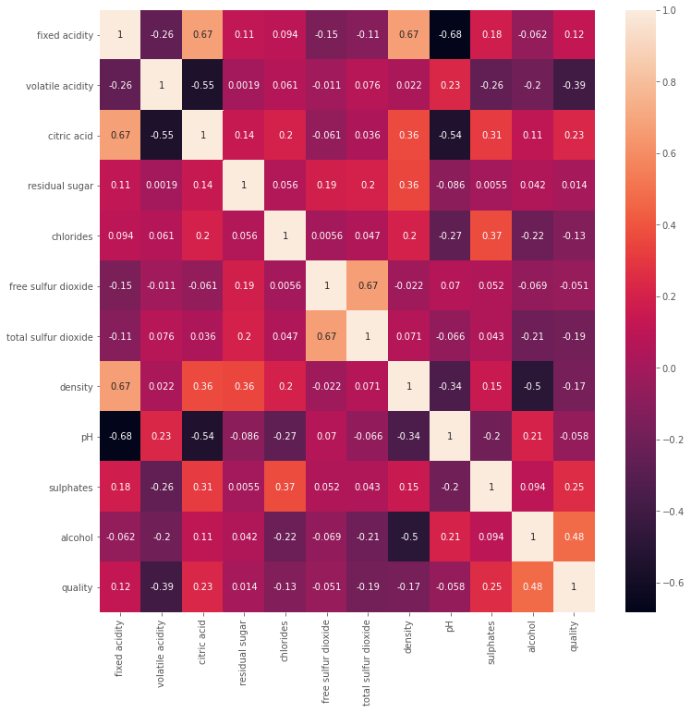
Data Exploration
- Correlation
plt.figure(figsize=(12, 12))
corr = data_red.corr()
sns.heatmap(corr, annot=True) plt.show()
# Returns a heatmap correlation matrix
Notes:
A heatmap is used to visualize the correlation of between every variable.
Correlation is important for feature selection and it has a big impact on the prediction result of the models.
The last row and the last column show the correlation between each independent variable and the target feature variable which is the quality.
The larger the absolute value of the correlation, the larger the effect that variable has on the quality of the wine.
It can be seen that the independent variables with the largest correlation coefficients in relation to the quality are in ascending order: Alcohol, density, chlorides, total sulfur dioxide, volatile acidity & fixed acidity.

Slide 10
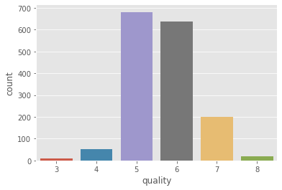
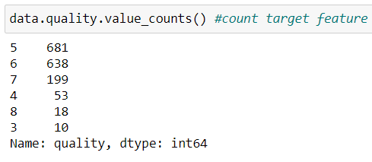
Data Exploration - Count Target Feature
sns.countplot(x='quality', data = data_red) plt.show()
# Returns a count plot of the target feature
Notes:
Target feature is imbalanced for this dataset and this could affect the accuracy score of the models.

Slide 11
Data Exploration - Boxplots
colum_names = ['fixed acidity', 'volatile acidity', 'citric acid', 'residual sugar', 'chlorides', 'free sulfur dioxide’, ‘total sulphur dioxide’, ‘density’, ‘pH’, ‘sulphates’, ‘alcohol’]
train = data_red[colum_names]
plt.style.use('ggplot')
for i in colum_names:
plt.figure(figsize=(13, 7))
plt.title(str(i) + " with " + str('quality'))
sns.boxplot(x=data_red.quality, y=train[i])
plt.show()
Notes:
This code creates multiple boxplots for each independent variable with each wine quality value.

Slide 12
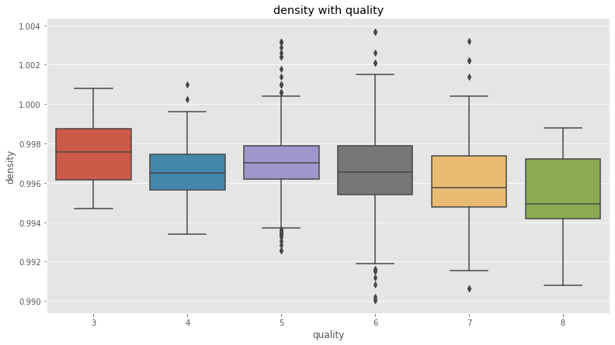
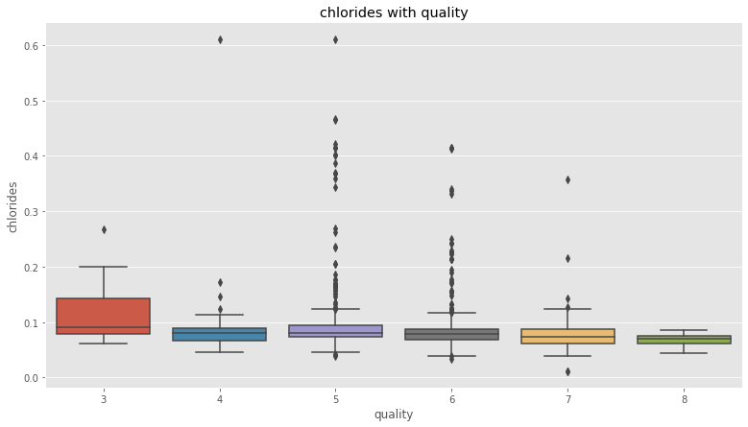
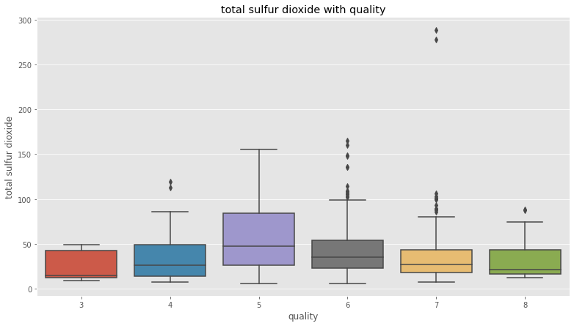
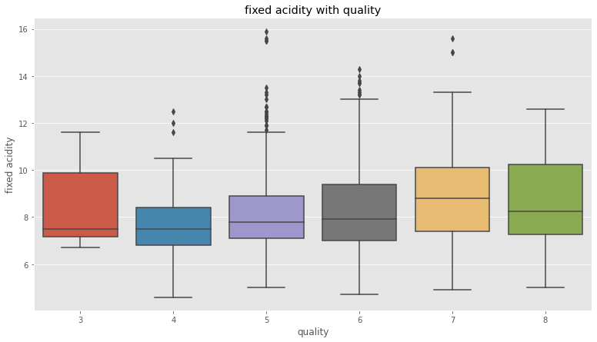

Slide 13
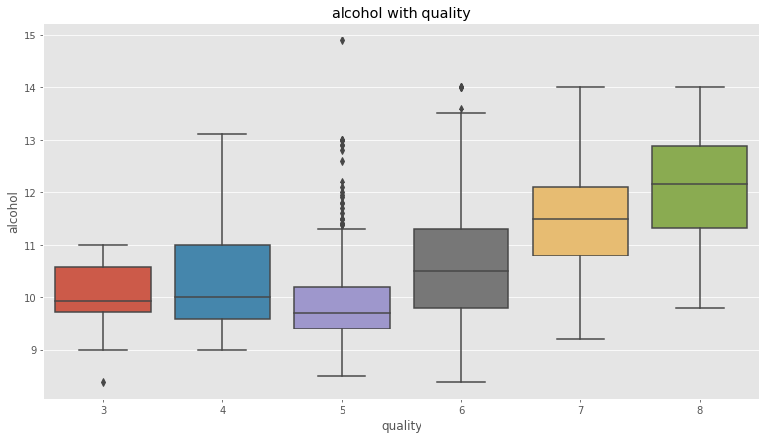

Slide 14
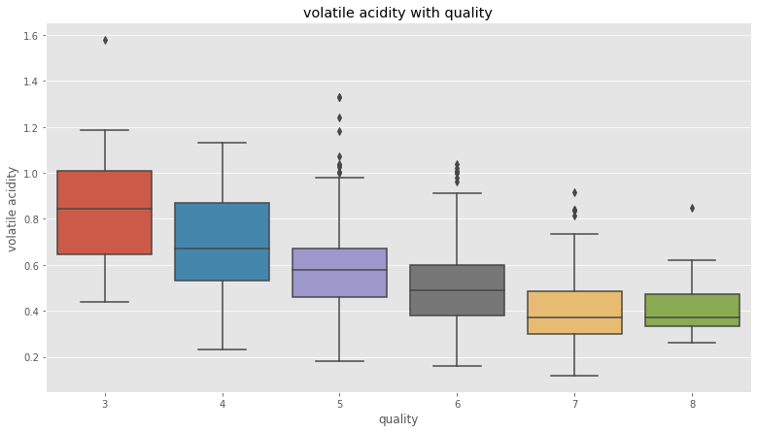

Slide 15

Data Preprocessing
Remove Outliers
Data Normalization
Features Selection

Slide 16
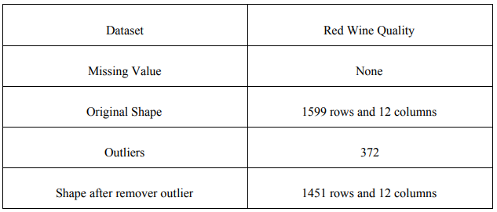

Slide 17
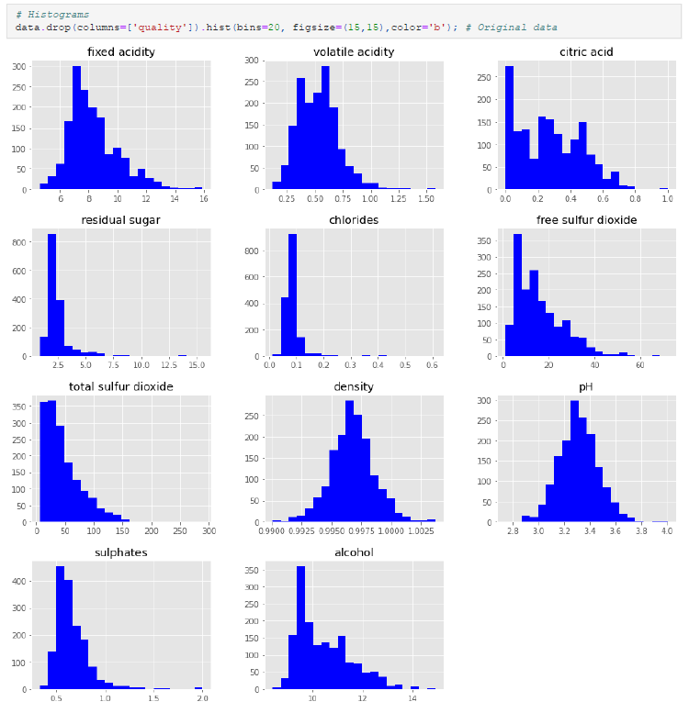

Slide 18
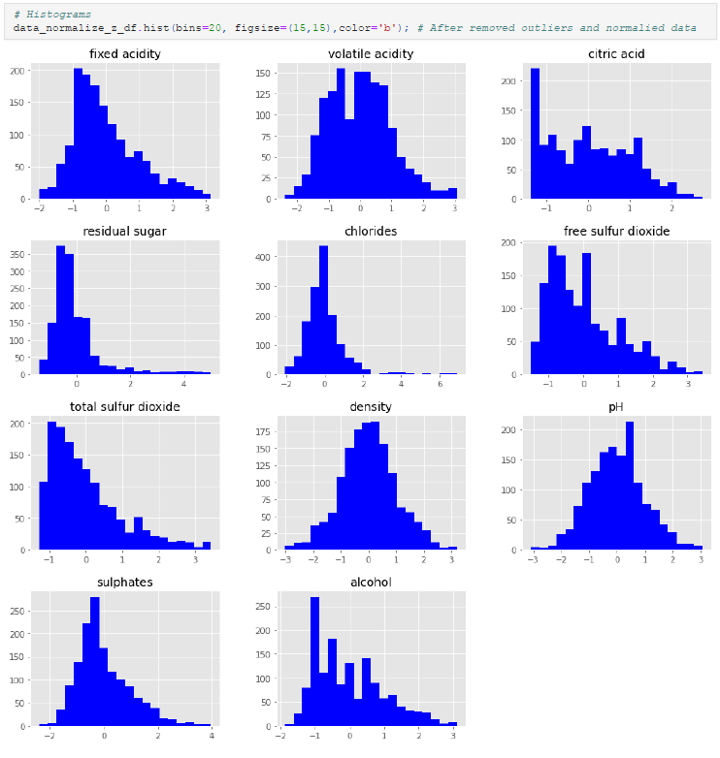

Slide 19
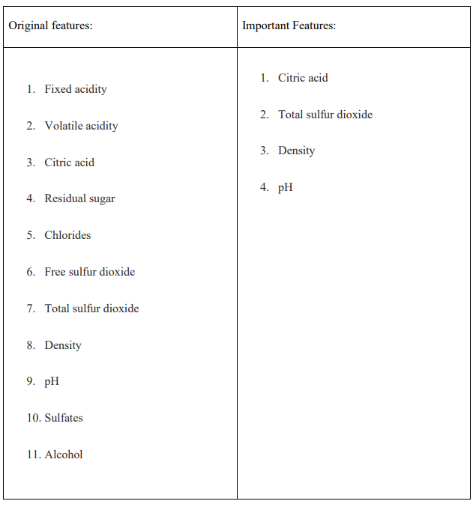
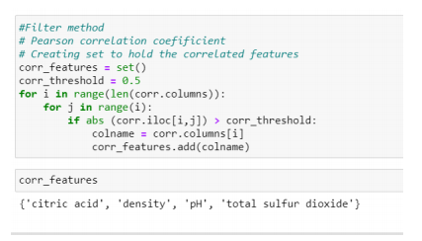
Feature Selection

Slide 20
Data Processing
Split data: 80% Training and 20% Testing
Using Holdout and K-fold Cross-Validation methods
Three models:
Random Forest (RF)
Support Vector Machine (SVM)
K-Nearest Neighbor (KNN)

Slide 21
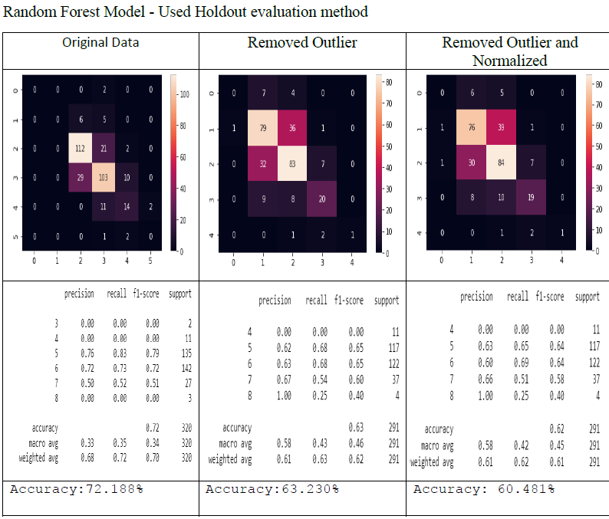

Slide 22
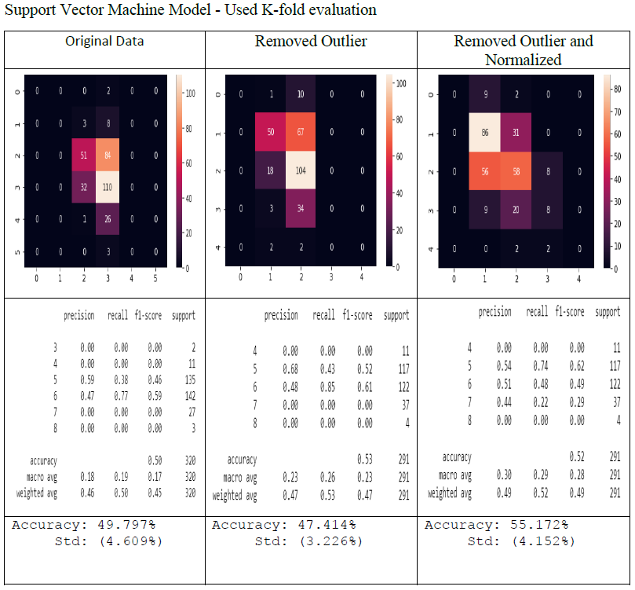

Slide 23
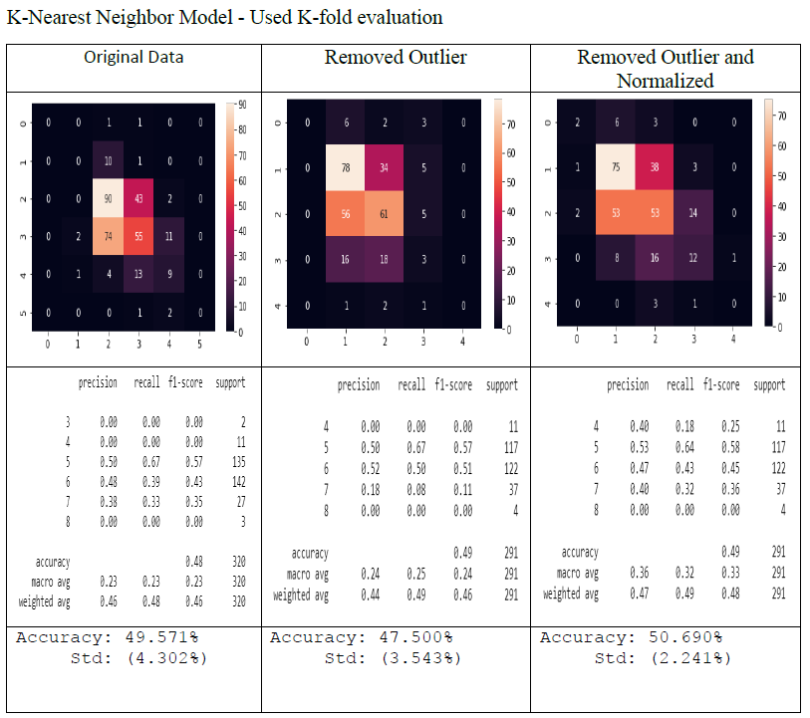

Slide 24
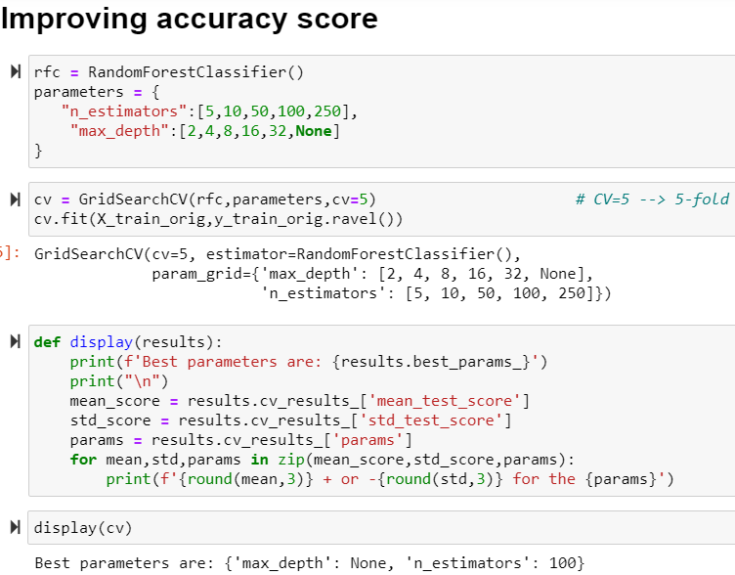
Improvement
Hyper Parameters Tuning
GridSearchCV

Slide 25
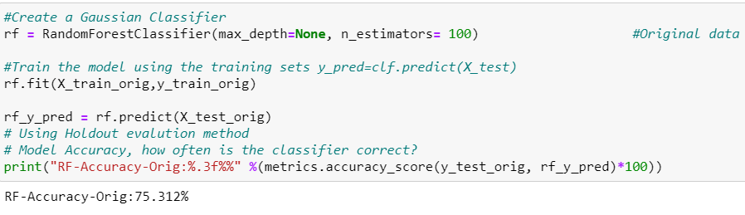
Result
Random Forest is the best model
Accuracy score: 75.312%
Original dataset

Slide 26
THANKS!
Any questions?

