Slide 1
Customer Segmentation using RFM Analysis
Ecommerce Domain

Slide 2
Problem Statement
E-commerce platforms collect large volumes of customer and transaction data every day. However, much of this data isn’t fully used to understand customer behavior or guide marketing actions. Without proper segmentation, it becomes difficult to identify loyal customers, inactive buyers, or potential high spenders. This limits the company’s ability to build strong relationships, improve retention, and increase overall revenue.

Slide 3
Problem Objective
This analysis aims to:
Apply the RFM (Recency, Frequency, Monetary) model to group customers based on their purchase behavior.
Use decile analysis to rank customers from most to least valuable.
Identify loyal, potential, and dormant customer segments.
Suggest data-driven strategies for retention, re-engagement, and upselling.

Slide 4
Dataset Overview
Size: (541909, 8)
Key Variables:
InvoiceNo: Unique transaction ID
StockCode: Unique product identifier
Description: Product description
Quantity: Number of items purchased
InvoiceDate: Timestamp of purchase
UnitPrice: Price per unit in GBP
CustomerID: Unique customer identifier
Country: Location of the customer

Slide 5
Data Cleaning & Preparation
Removed duplicate records.
Dropped rows with missing (null) values.
Eliminated negative or zero values.

Slide 6
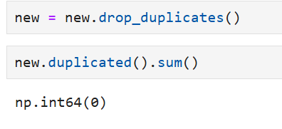
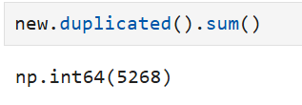
Removed Duplicate Records
Duplicate records were checked using duplicated().sum() and removed with drop_duplicates().
This ensured that each customer transaction appeared only once for accurate analysis.

Slide 7
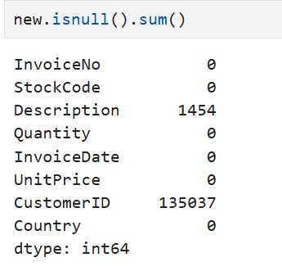
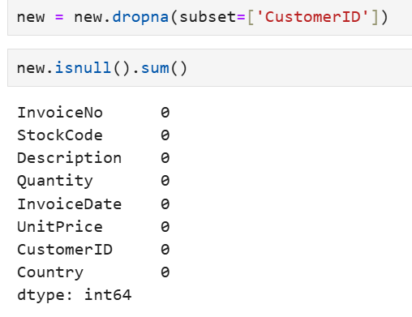
Dropped Rows with missing(null) values
About 24.9% of values were missing in the CustomerID column.
Since the analysis focuses on customer behavior, these records were removed
using isnull().sum() to check and dropna() to delete missing values.

Slide 8
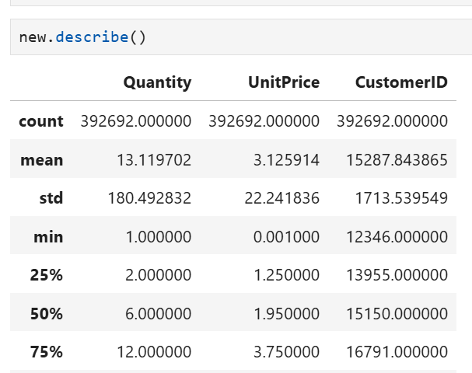
Eliminated negative or zero values
To ensure data accuracy, rows with negative or zero values in Quantity or UnitPrice were identified using conditional filters and summary statistics- new.describe().
All such invalid records were then removed using:
new = new[new['Quantity'] > 0] and new = new['UnitPrice'] > 0].

Slide 9
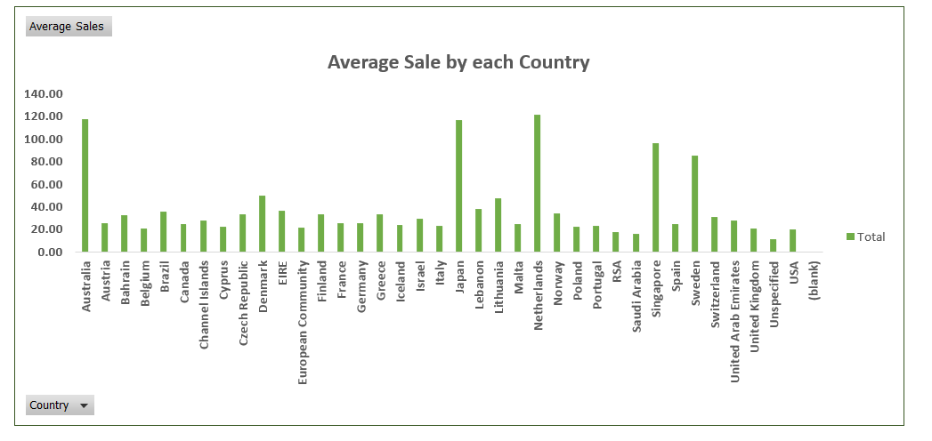
Average Sale by each Country

Slide 10
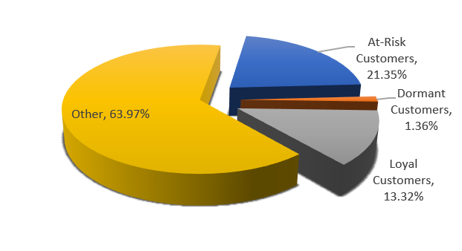
RFM Analysis & Customer Segmentation
RFM stands for Recency, Frequency, and Monetary — used to evaluate customer value.
Recency: How recently a customer purchased
Frequency: How often they purchase
Monetary: How much they spend
Customers are divided into five groups for each metric — typically from 1 to 5. Each customer’s R, F, and M scores are then combined to form a single RFM Score, which helps identify: Top customers, Loyal customer, At- risk customer, etc.

Slide 11
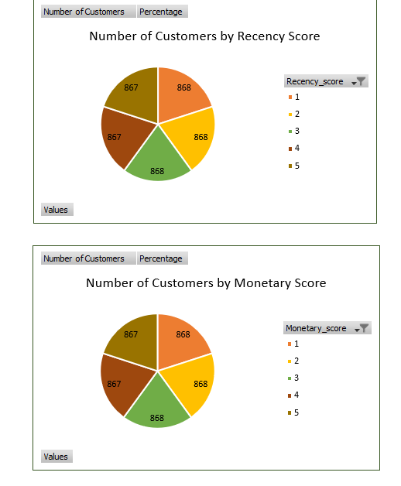
Number of Customers by Recency Score &
Monetary Score

Slide 12
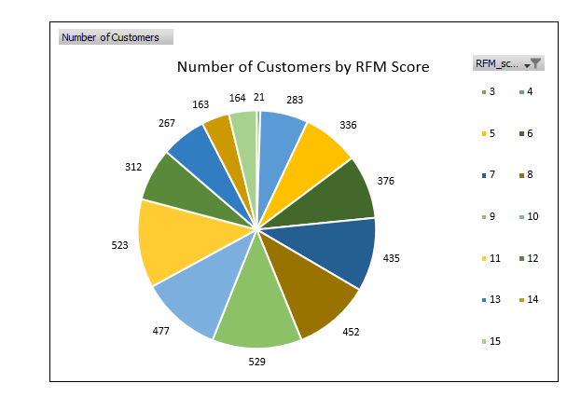
Number of Customers by RFM Score

Slide 13
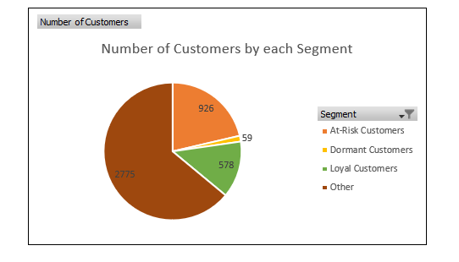
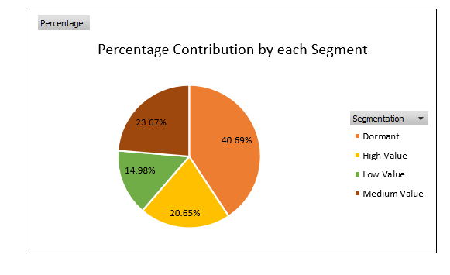
Number of Customers & Percentage Contribution by Segment

Slide 14
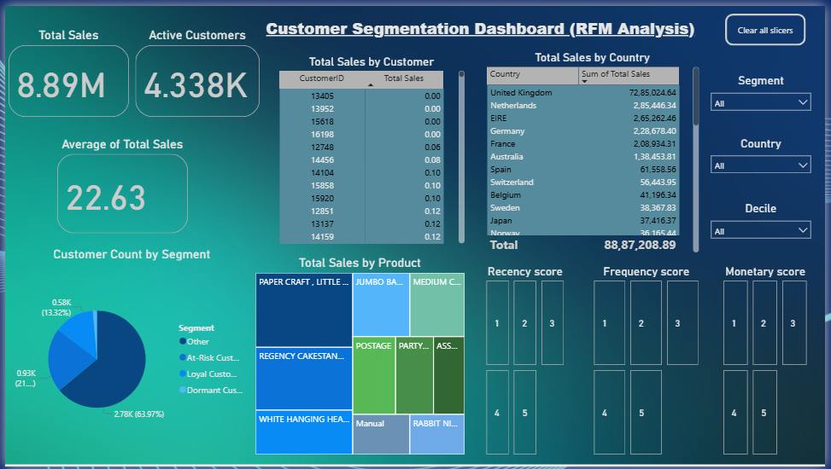
Dashboard

Slide 15
Recommendations for Top-Tier / Loyal Customers
Goal: Keep best customers happy and loyal.
Suggestions:
Offer loyalty programs or early access to sales
Send personalized Top-Tier / Loyal Customers thank-you or anniversary messages
Provide priority support or free shipping
Introduce referral bonuses

Slide 16
Recommendations for Mid-Tier Customers
Goal: Encourage moderate buyers to spend more.
Suggestions:
Recommend complementary or higher-value products
Offer discounts or bundled deals
Send personalized product suggestions

Slide 17
Recommendations for Low-Tier / Dormant Customers
Goal: Bring back inactive or low-value customers.
Suggestions:
Send reactivation emails with special discounts
Offer time-limited coupons for urgency
Request feedback or reasons for inactivity
Use targeted ads to remind them of past interests

Slide 18
Thank You!

