Slide 1
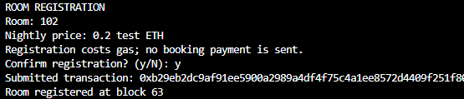
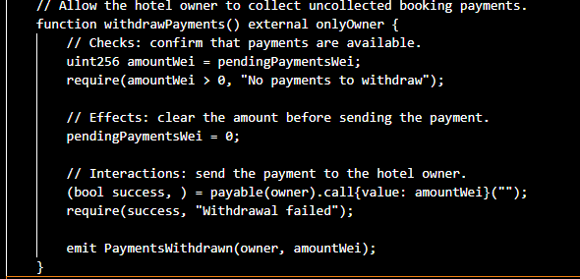
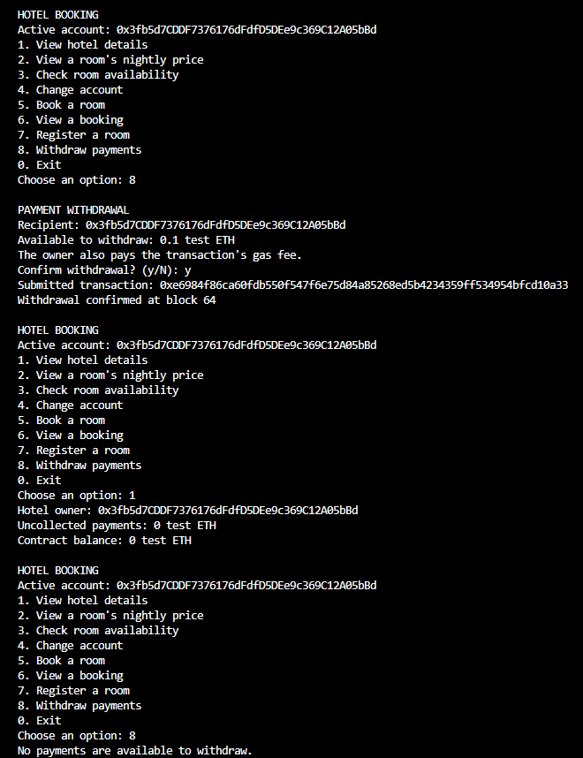
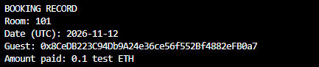
HOTEL BOOKING DAPP
CCT COLLEGE DUBLIN
DISTRIBUTED DIGITAL TRANSACTIONS
CA1 | NOVEMBER 2026
Smart-contract reservations and payments
Student: Kayo Nunes Rocha Student number:2024556
LOCAL PROTOTYPE • TEST ETH
01 / PROPOSAL & DESIGN
02 / CONTRACT & SECURITY
03 / TESTING & RESULTS
04 / EVALUATION
Business model and purpose
Implementation and deployment
Procedure: compile → deploy with zero value →
register → book → inspect → withdraw →
recheck. Screenshots show local runs,
supported by transaction receipts and state
checks.
Benefits and challenges
This DApp project runs booking rules in a
blockchain smart contract. Booking agencies can
Stay in between hotel and guest agreements.
Propose using blockchain as the intermediary.
This project investigates that model for one hotel: the
owner registers rooms and prices; guests reserve
one future UTC night and pay the exact price.
The owner then exchange the payments. No
agency commission is coded; network gas still
applies. Lower costs are a chance, not a
measured result.
Python and Solidity were developed in VS Code.
Remix compiles and deploys to Ganache. Bash
starts the menu; web3.py uses the ABI and
JSON-RPC to read state and submit transactions.
Receipt status is checked before reporting success.
Automatic rules and logs make payments easy to
track. But public data has less privacy;
fees, key management and contract defects add
risks. Muharam, Tussyadiah and Kimbu (2024)
identify tensions between transparency, privacy
and decentralisation. Ganache is one local test
chain; production decentralisation is not
showed. Refunds, reservation cancellation
integration are absent.
BOOKING CONFIRMED
Room 101 • 12 Nov 2026 • 0.1 test ETH
Block 62 • receipt status 1
Solidity 0.8.37 | EVM Paris
Optimisation OFF | Chain ID 1337
Deployment: block 58 | Receipt status: 1
Contract: 0xC4e7B3F1B2856c989D93424566192453470767C5
Recent advance: proposed extension
Architecture and payment flow
E2. Room 102 registered at block 63; nightly price 0.2 test ETH.
Fusaka activated PeerDAS in December 2025,
Expanding capacity for Ethereum rollups.
Proposed design: deploy on an EVM-compatible
layer 2 and connect Python to its RPC.
Compare fees and sequencer trust
before migration. This extension is not
implemented; no fee savings are counted.
GUEST
HOTEL OWNER
Sender • books and pays
Receiver • withdraws
PYTHON CLI + web3.py
E3. Owner exchanged 0.1 test ETH; confirmed at block 64.
Shared menu • Bash launcher
JSON-RPC + ABI
E1. Actual VS Code withdrawal implementation (excerpt).
Conclusion
LOCAL GANACHE BLOCKCHAIN • 1337
Cryptographic method
E4. After withdrawal: pending payments and contract balance =
0.
The prototype demonstrates booking, payment
and withdrawal with preserved records.
Production use needs privacy design, refund
rules, independent security review and network
testing.
HotelBooking smart contract
ECDSA signatures on secp256k1 suit transaction
authentication because Ethereum verifies them.
Signing the Keccak-256 transaction
hash protects authorisation and integrity; hashing
alone cannot authenticate the sender (Wood,
2025, Appendix F). Ganache signs with local test
accounts. Solidity checks msg.sender for actions.
Signatures prove key control, not personal identity,
and do not encrypt bookings.
Rooms • room/day bookings • pending funds
Payment: guest → contract → owner
E5. The booking record stays after payment withdrawal.
References
Figure 1. Implemented roles, communication and payment flow.
Rejection and launch checks
Dong, N., Bai, G., Huang, L.-C., Lim, E.K.H. and Dong, J.S. (2020) ‘A
blockchain-based decentralized booking system’, The Knowledge
Engineering Review, 35, e17. Published 4 May.
https://doi.org/10.1017/S0269888920000260
Why these design choices?
Duplicate registration, guest withdrawal and
empty withdrawals were rejected. Read-only calls
also rejected wrong payments. Duplicate booking was
checked at historical block 62. Python input
validation and Bash launches were checked. A
separate folder run past using the existing
environment; installation remains without check.
Room mappings prevent double booking from
happening. Records store wallet addresses and
payments, without names or contact details.
If we share rules, it could reduce reliance on a
booking agency, but cannot guarantee hotel service
or synchronise other sales channels. A database
may suit a single operator better; blockchain is
most useful when independent parties need
shared rules.
ethereum.org (2026) Fusaka. Updated 16 October. Available at:
https://ethereum.org/roadmap/fusaka/ (Accessed: 10 November 2026).
Contract safeguards
Muharam, I.N., Tussyadiah, I. and Kimbu, A. (2024) ‘Unlocking the
potential of blockchain-based sharing economy in hospitality and
tourism: A systematic review’, International Journal of Hospitality
Management, 122, 103863. September.
https://doi.org/10.1016/j.ijhm.2024.103863
Checks reject rooms that it does not know, invalid
dates, duplicate bookings and incorrect payments.
Withdrawal clears pending funds before
transferring them: Records remain public; no
independent security audit was performed.
Solidity team (n.d.) Security considerations, v0.8.37. Available at:
https://docs.soliditylang.org/en/v0.8.37/security-considerations.html
(Accessed: 6 November 2026).
Wood, G. (2025) Ethereum: A Secure Decentralised Generalised
Transaction Ledger. Shanghai version efc5f9a, 4 February, Appendix
F. Available at: https://ethereum.github.io/yellowpaper/paper.pdf
(Accessed: 8 November 2026).
Research scope: the Muharam et al. claim uses the accessible abstract.
Figures: own project evidence; full screenshots in the repository. Figure 1:
own design.
CODE & FULL EVIDENCE | github.com/Kayo-Creator/CA1-Distributed-Digital-Transactions

