Slide 1
Paired tumour-vs-normal T cells from 43 patients: which genes does a foundation model read as T-cell state?
Kaisar Dauyey · Shinji Nakaoka
Laboratory of Mathematical Biology, Faculty of Advanced Life Science, Hokkaido University
43 donors, both tissues,
100 cells each
Delete AND overexpress,
donor's own normal as goal
Registered before any number;
all 54 rows reported
Geneformer V2-316M (bf16) · in silico perturbation is a hypothesis generator, not a knockout screen

Slide 2
THE QUESTION
Two registered questions, one cleaner design
Panel A — do the July hits replicate?
Panel B — does the model read T-cell genes?
The 15 LUAD→normal top genes of the July screen.
July compared LUAD with normal tissue from other studies (study-confounded).
The lab's 39 curated T-cell genes (36 perturbable).
July never ranked them in its top 120.
What 'a hit' means here
Per donor: shift of tumour T cells toward the SAME donor's normal T cells, minus the median of 20 matched control genes.
Exact Wilcoxon over donors, Holm per panel, for deletion and overexpression separately.
A signal needs BOTH arms significant with opposite signs (dose concordance).
Question
2

Slide 3
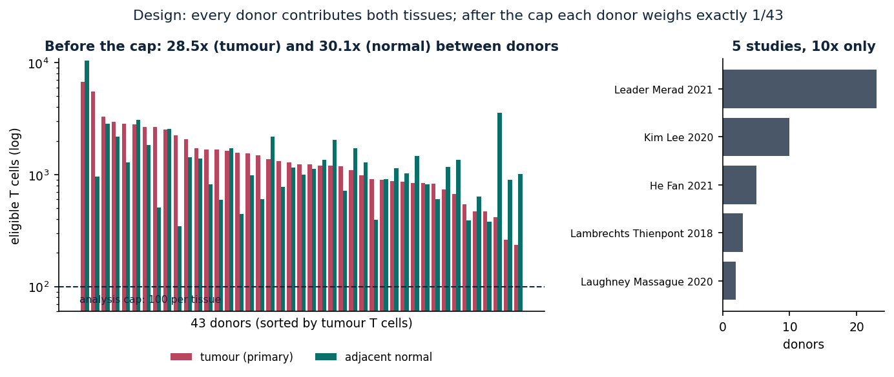
DESIGN
Pairing within a donor cancels study, chemistry and person — not ambient RNA
What pairing cannot fix
Tumour and normal tissue differ in ambient contamination within each donor. 20 of 43 donors overlap July's LUAD pool. Selection favours T-cell-rich samples; 17 unpaired donors excluded.
Balanced paired design
3

Slide 4
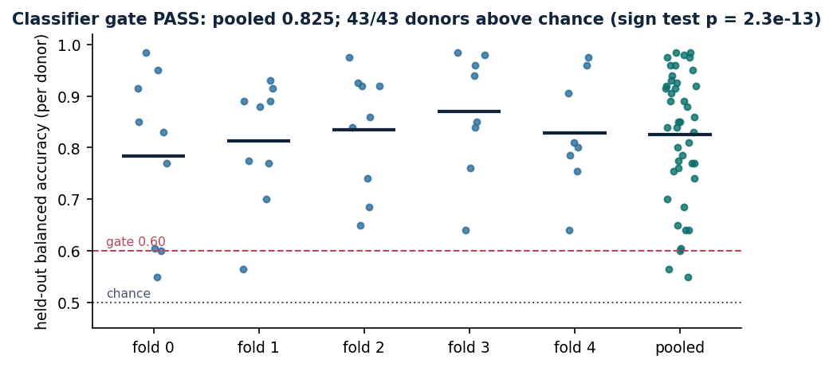
CLASSIFIER GATE
The model tells a donor's tumour from normal T cells: 43/43 donors above chance
Gate: PASS
Pooled balanced accuracy 0.825 (gate 0.60).
Sign test p = 2.3e-13.
Every donor scored by a model that never saw it.
Fine-tune not bit-reproducible (band 0.045 per donor); cannot flip the gate.
Held-out, 5-fold donor cross-fitting
4

Slide 5
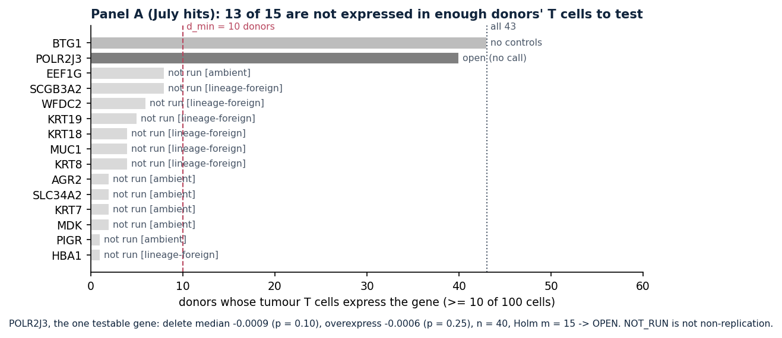
PANEL A — JULY HITS
13 of 15 July hits are not expressed in T cells — not testable, not refuted
Reading
Keratins, mucin, a secretoglobin, a haemoglobin chain: epithelial and blood markers, present in ≤ 8 of 43 donors' T cells.
The one testable gene, POLR2J3, is OPEN (p = 0.10 / 0.25).
The design did not refute the July panel; it showed the panel is mostly not T-cell biology.
Confound: 316M replaced 104M (no 104M arm), so a non-replication could not be attributed — moot, none occurred.
NOT_RUN is not non-replication
5

Slide 6
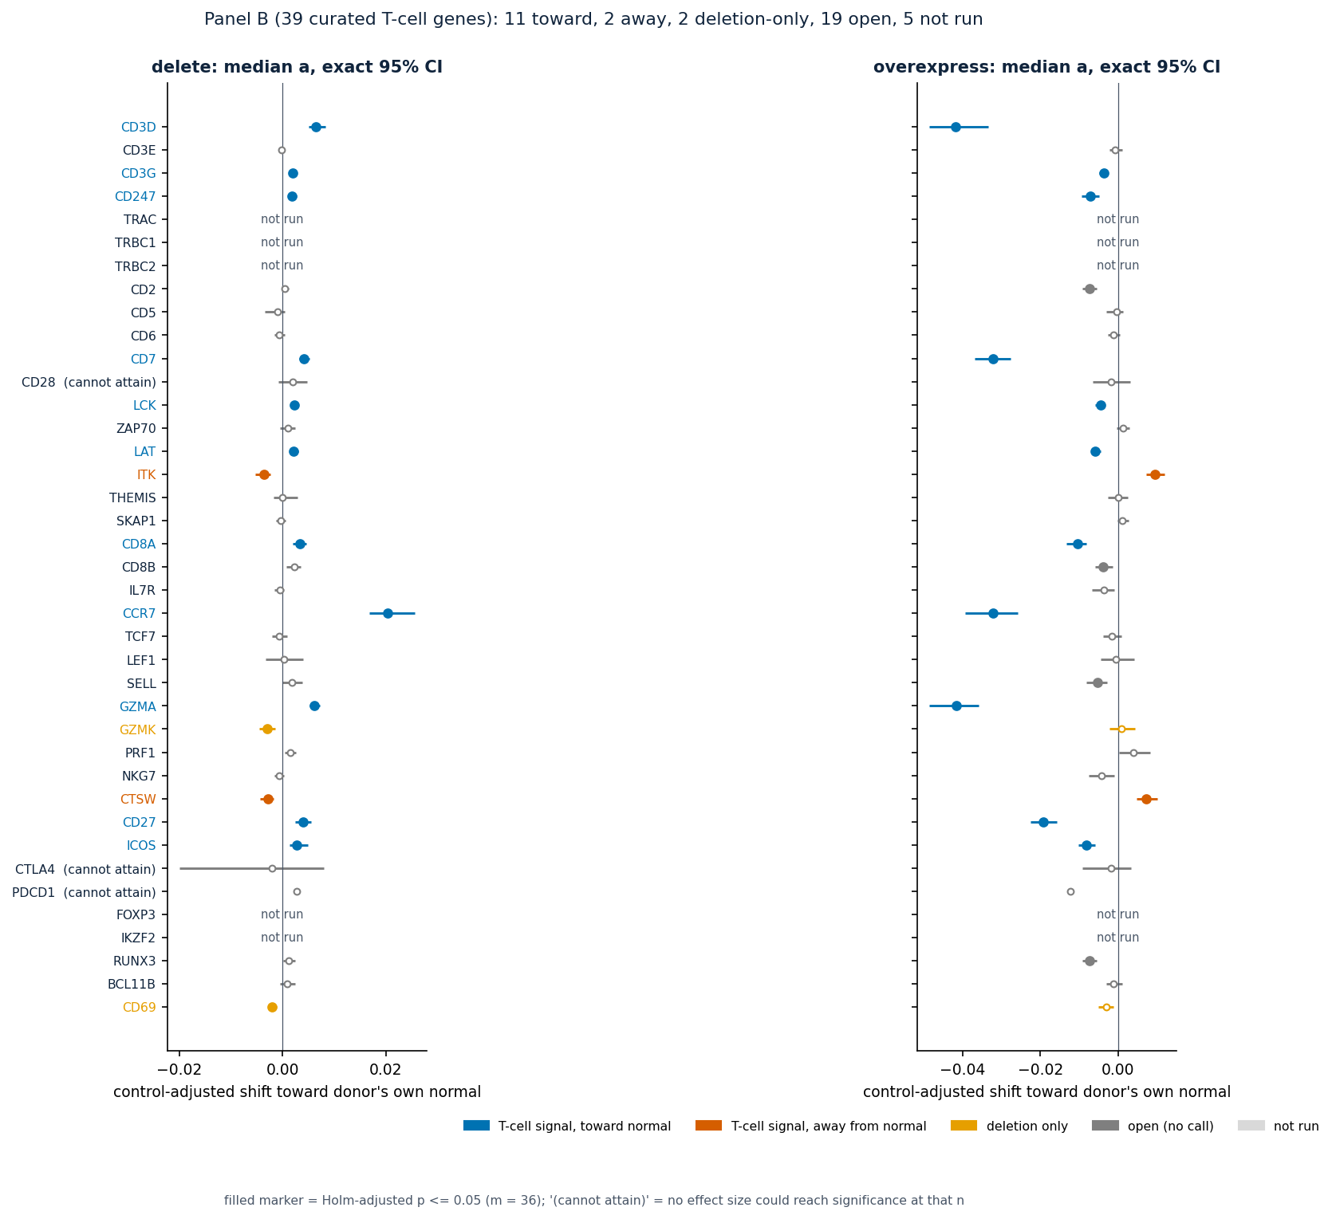
PANEL B — T-CELL GENES
13 of 34 tested T-cell genes give a dose-concordant signal
Toward normal (11)
CD3D, CD3G, CD247, CD7, LCK, LAT, CD8A, CCR7, GZMA, CD27, ICOS
Away from normal (2)
ITK, CTSW
Stable — and what cannot be judged
None of the 13 moves under any registered sensitivity.
Cannot attain significance at any effect size: CD28, CTLA4, PDCD1 (n = 9, 6, 5) — no evidence either way.
TRAC/TRBC1/TRBC2: not in the model's vocabulary.
Curated T-cell genes
6

Slide 7
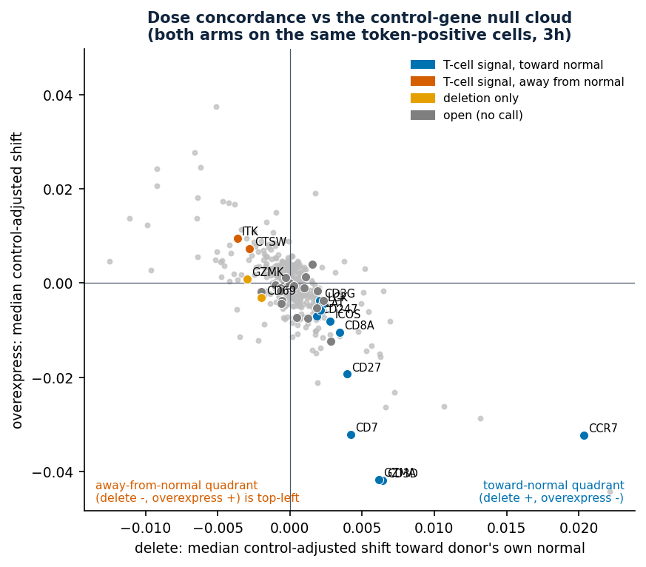
DOSE CONCORDANCE
Opposite-signed arms are common even for control genes — effect size separates few
Confound
360 matched control entries are anti-correlated too (ρ = −0.62); 35% sit in the toward-normal quadrant.
Post hoc, descriptive: only CCR7, CD3D, GZMA, CD7 (and CD27 on overexpression) lie beyond ~95% of controls.
Measured on the same cells (Amendment 3h)
Geneformer overexpresses into all cells; the token-positive subset was reconstructed and checked.
15,142 / 15,142 count checks; 8 / 8 GPU identity pairs bit-identical.
Both arms on the same token-positive cells
7

Slide 8
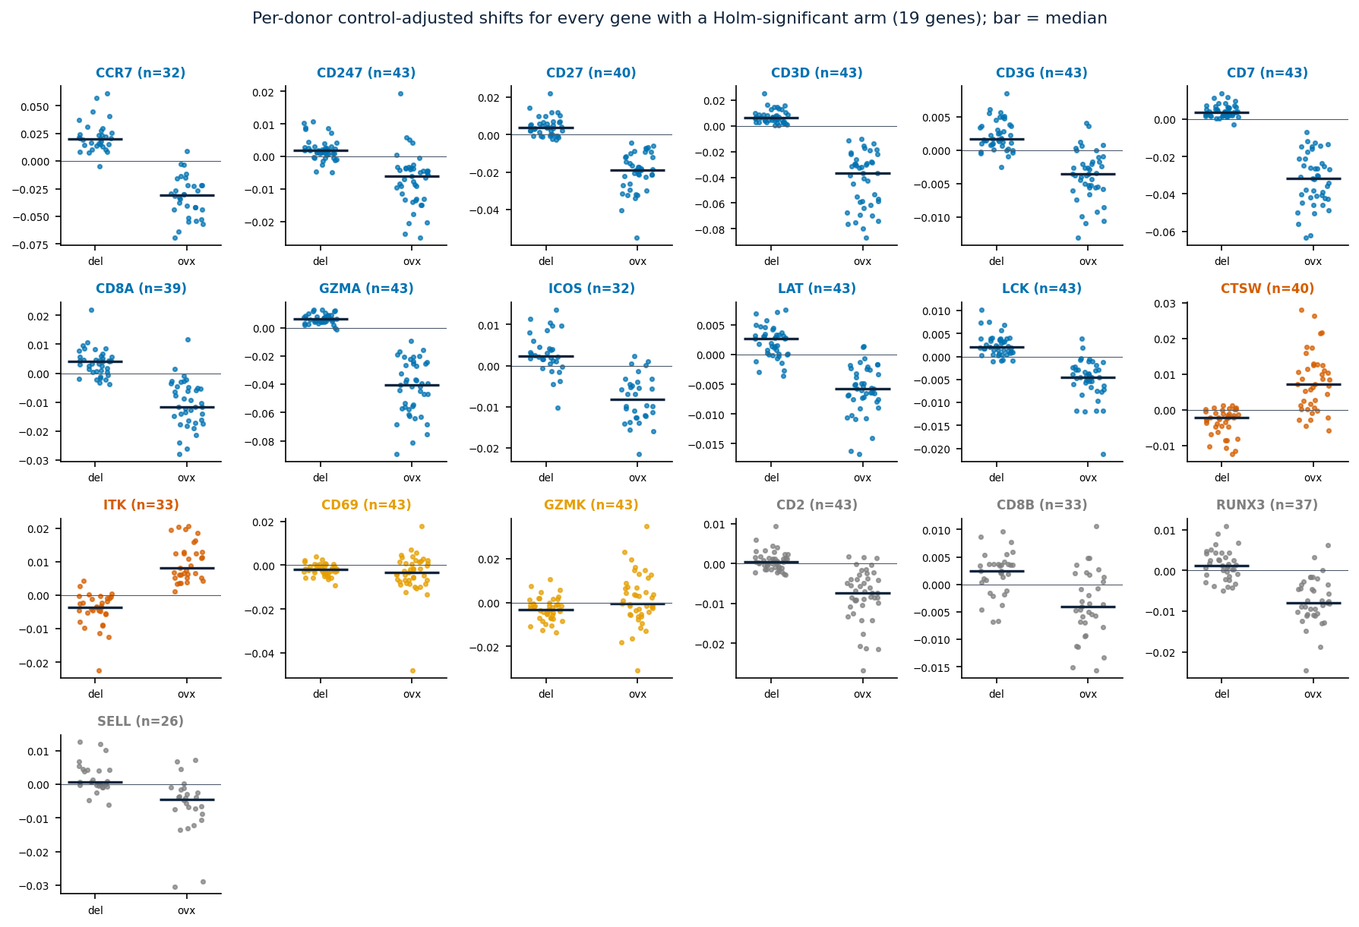
PER DONOR
The medians are not carried by a few donors
Per-donor control-adjusted shifts
8

Slide 9
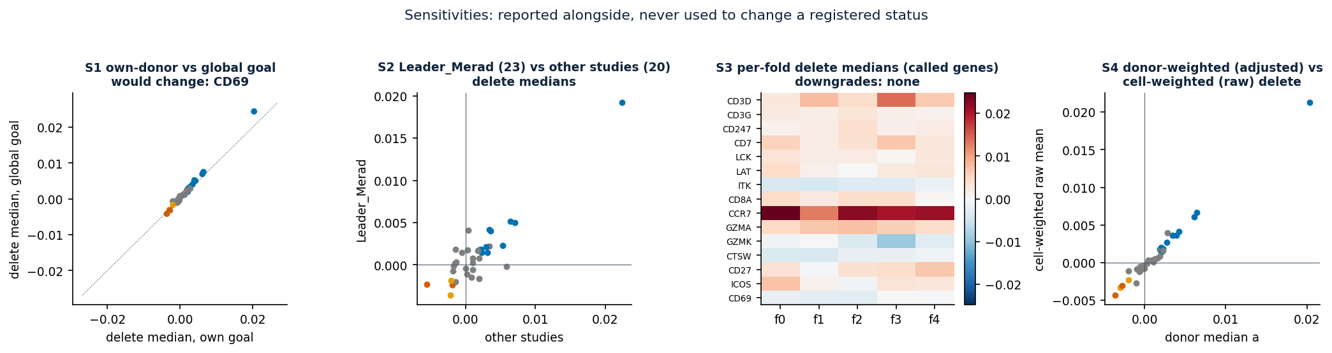
SENSITIVITIES
The coherent set does not move under any registered sensitivity
Three fragile rows, outside the coherent set
GZMK: deletion-only → away under all-cells overexpress. PRF1: open → deletion-only if any control counts. CD69: deletion-only → dose-incoherent under Holm-over-tested and under the global goal.
Panel-level: 21 toward vs 13 away, sign test p = 0.23 — genes share controls, so signs are not independent.
Reported alongside; never used to change a status
9

Slide 10
INTERPRETATION
What each status licenses — and what it does not
T-cell signal (13)
Deletion only (2)
Open (20)
Not run (18) · no controls (1)
Licenses: Model-internal, donor-consistent, dose-concordant response beyond matched controls.
Does not: Not a causal driver; mostly not unusual among genes.
Licenses: A consistent deletion effect.
Does not: No direction; no signal claim.
Licenses: The registered test did not call it.
Does not: Not 'no effect'; for CD28/CTLA4/PDCD1 no evidence either way.
Licenses: Not expressed in enough donors' T cells, or not in the vocabulary.
Does not: Not non-replication; not no effect.
Interpretation breakdown
10

Slide 11
LIMITATIONS
What this design still cannot rule out
Ambient RNA
Model change
Not independent
Tumour vs normal tissue differ in contamination within a donor; pairing cannot remove it.
316M bf16 replaced July's 104M fp32; no 104M arm.
20 of 43 donors overlap July's LUAD pool.
Selection
Nondeterminism
Process
T-cell-rich samples only; 17 unpaired donors excluded.
Fine-tuning is not bit-reproducible; the ISP inherits these fold models.
No-op and wrapper checks ran after Phase 6 started; the overexpress cell set was fixed by Amendment 3h after Phase 6.
Limitations
11

Slide 12
SO WHAT
For the July screen: its LUAD→normal list was mostly not T-cell biology
What this changes
Next
13 of 15 July hits cannot be tested in T cells under a paired, balanced design.
The model does read canonical T-cell genes (CD3 complex, LCK, LAT, CD8A, CCR7, GZMA) in a donor-consistent, dose-concordant way.
Effect size, not significance, separates a handful from arbitrary genes.
Genome-wide control distribution, to rank effect size formally (registered first).
Checkpoint genes (CTLA4, PDCD1, CD28) need more token-positive donors: a larger cohort or a looser cap.
A 104M arm, if attribution to model vs design is wanted.
Independent tissue validation for the top four (CCR7, CD3D, GZMA, CD7).
Implications and next steps
12

