Slide 1

24JSDP · ABSTRACT P25
A foundation model points to antigen presentation in SCLC T-cell dysfunction — and independent tissue agrees
Kaisar Dauyey · Shinji Nakaoka
Laboratory of Mathematical Biology, Faculty of Advanced Life Science, Hokkaido University
Model-derived dysfunction
candidates in SCLC
→
Antigen-presentation
programme
→
Associated with T-cell abundance
in independent tumour tissue
Hypothesis generator, tissue-validated — not a knockout screen
github.com/Kays3/geneformer-lung-tcell
Notes:
Open with the clinical stake: SCLC is the most aggressive thoracic malignancy and barely responds to checkpoint blockade, despite a high mutational burden that should make it visible to the immune system. State the result up front: a foundation model, perturbed in silico, nominates dysfunction candidates in SCLC T cells; the programme it points to is associated with T-cell abundance in independent tumour tissue. Name the honest framing now — this is a hypothesis generator validated against tissue, not a knockout experiment. Saying it early buys credibility for everything that follows.

Slide 2
METHOD
What is an in silico perturbation?
Geneformer reads a cell as an ordered list of its genes, most-expressed first. Deleting or inserting one gene in that list and re-reading the cell asks a counterfactual question: if this gene changed, would the cell look more like a different disease state?
1
One T cell
2
Rank its genes
3
Edit one gene
4
Measure the move
most expressed
DELETE — drop it out
CD3D
CD3D
model's map of cell states
Normal
IL7R
IL7R
nucleus
TIGIT
TIGIT
✕
GZMB
GZMB
▲
SCLC
TOX
TOX
▲
least expressed
the rest move up a rank
shift toward Normal
OVEREXPRESS — move it to the top
Nothing is edited in a laboratory here. The edit is made to the model's input and the result is the model's predicted change in cell state, averaged over thousands of real cells — a hypothesis generator, not a knockout experiment.
Reading a cell as a ranked gene list
2
Notes:
Walk the four stages in plain language, pausing on stage 2 — the key mental model is that Geneformer reads a cell as an ordered list of its genes, most-expressed first. It is a rank order, not expression values. Deleting a gene drops it out of the list and everything below moves up a rank; overexpressing moves it to the top. Re-reading the modified cell gives a predicted change in cell state, averaged over thousands of real cells. Stage 4 is the measurement: the model places cells on a map of disease states, and the perturbation shifts a cell along that map — here, toward the normal T-cell state. Say the caveat out loud: nothing is edited in a laboratory here. This is the conceptual keystone for a non-modelling audience, so do not rush it.

Slide 3
HOW A HIT IS CALLED
A gene counts only when deleting and overexpressing disagree
Every number in the next four slides is a perturbation shift. Two rules decide which ones are allowed to count.
CONCORDANT — counts as a hit
What the numbers are
Delete the gene
toward Normal
A change in similarity
How much closer the perturbed cell sits to a target disease state, on the model's own scale.
Overexpress it
away from Normal
NOT CONCORDANT — discarded
Small by construction
Both edits move the cell the same way — the model is not responding to the direction of the change, so the gene is not treated as a candidate.
Shifts run ~0.001–0.01. Size is not significance — slide 7 shows why.
Averaged over cells
And it must replicate. The four headline edits hold the same sign in all three SCLC donors, at FDR < 0.05 in both arms, in genes detected in at least 100 source cells.
Each value pools thousands of real T cells, not one simulated cell.
Bidirectional concordance
3
Notes:
This slide is the bridge between the method and every number that follows. Two rules decide what counts. Rule one is bidirectional concordance: a gene only counts when deleting it and overexpressing it move cells in OPPOSITE directions. If both edits push the cell the same way, the model is not responding to the direction of the change, and the gene is discarded. This is the internal consistency check, and it is stricter than a significance threshold. Rule two is replication: the four headline edits hold the same sign in all three SCLC donors, at FDR < 0.05 in both arms, with at least 100 detected source cells. On the right, be explicit about what a 'shift' is: a change in similarity on the model's own scale, running about 0.001 to 0.01, pooled over thousands of real cells. Small numbers are expected — and slide 7 explains why the big ones are the suspicious ones.

Slide 4
DATA PROVENANCE
42 individuals, zero donor leakage — so accuracy is measured on people the model never saw
Disease | Train | Eval | Test | Donors
SCLC | 7,037 | 2,330 | 2,424 | 19
LUAD | 17,831 | 5,611 | 6,387 | 22
Normal | 2,334 | 1,620 | 566 | 4
Donor-disjoint splits
Train — 27 donors
Eval — 7 donors
Test — 8 donors
45 donor×disease groups = 42 people + 3 paired tumour–normal donors
A donor contributing both tumour and normal tissue appears twice. The three extra rows are exactly RU675, RU682 and RU684.
No individual appears in two splits. Paired tumour–normal donors are confined to one split by a cross-disease guard.
46,140 cells · 24,540 features · median 390–1,172 cells per donor
Held-out test set: 9,377 cells from 8 donors
Leakage audit: PASS · 0 / 42 donors
Cohort architecture
4
Notes:
Provenance first: HTAN MSK collection via the CELLxGENE 'T cells' dataset — 46,140 CD4+CD8 T cells x 24,540 features from 42 individuals. Explain the 45-vs-42 arithmetic before anyone asks: the split table has one row per donor x disease, so a donor contributing both tumour and normal tissue appears twice. The three-row difference is exactly the three paired tumour-normal donors, RU675, RU682, RU684. The credibility point: splits are donor-disjoint and audited — zero leakage across all 42 individuals, with a cross-disease guard for the paired donors. Every performance number downstream is measured on people the model never saw. This is checked by assertion at build time, not by trusting a stored PASS string.

Slide 5
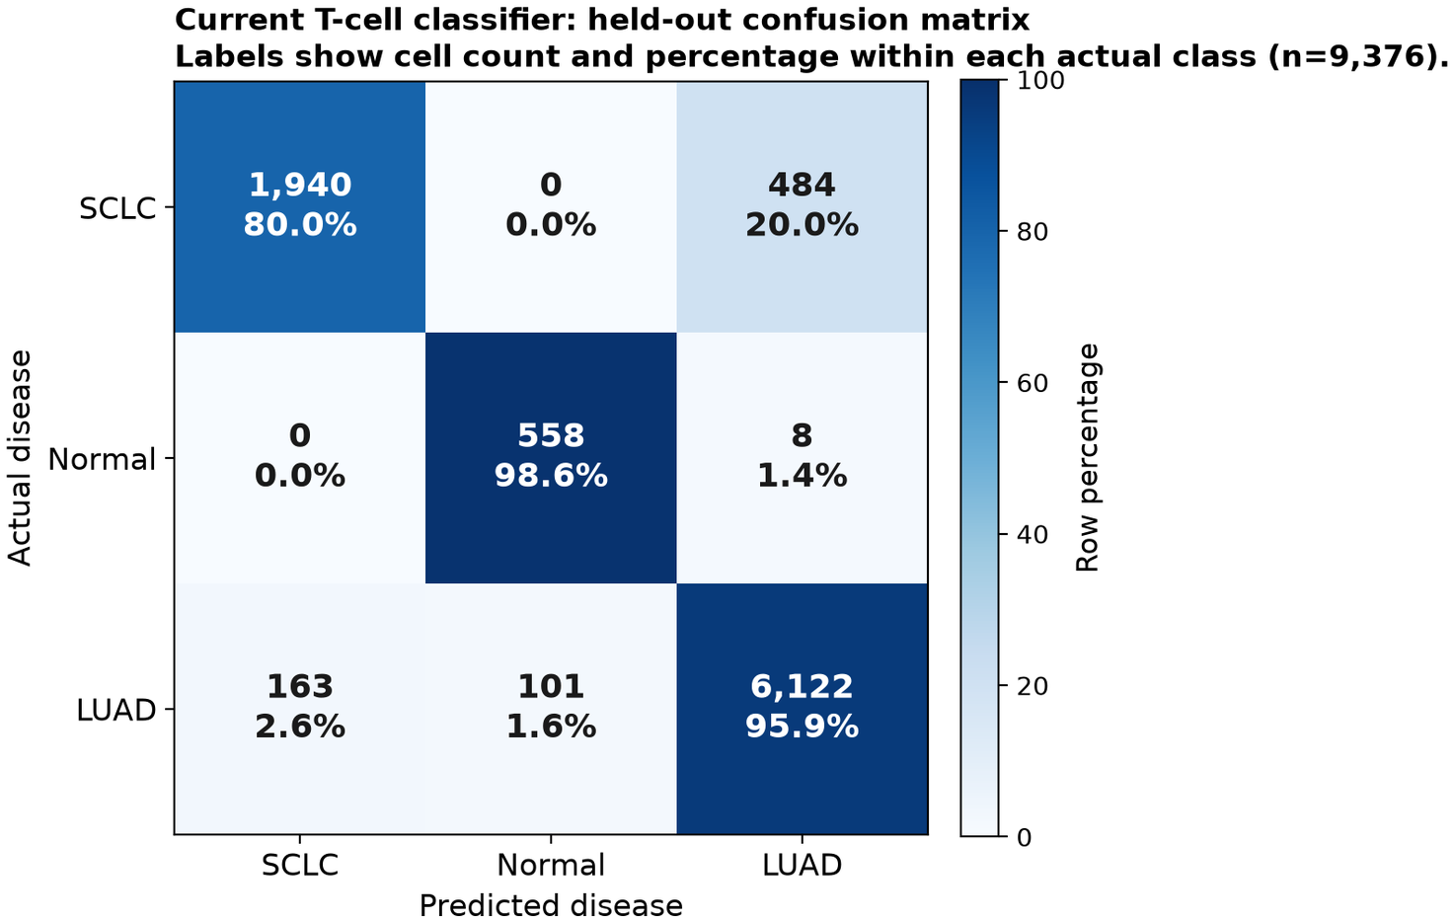
MODEL
91.9% accuracy on held-out donors — with an SCLC→LUAD confusion worth noticing
91.9%
0.903
9,377
8
Test accuracy
Macro F1
Held-out cells
Test donors
Look at the diagonal
Normal 98.6% · LUAD 95.9%
SCLC 80.0% — 484 missed cells go to LUAD
Same axis as the open question on slide 7
Fine-tuning setup
Geneformer-V2-104M
1 epoch · LR 5e-5 · 6 frozen layers
NVIDIA GB10, 119 GiB unified memory
~48 h GPU · ~5.88M cell-gene perturbations
Held-out test confusion matrix, row-normalised.
Fine-tuning & performance
5
Notes:
Headline the metrics: 91.9% accuracy, macro F1 0.903 on 9,377 held-out cells from 8 donors. Donor-held-out performance separates SCLC, Normal and LUAD well enough to support the downstream perturbation screen. Do not skip the diagonal. Normal recall is 98.6% and LUAD 95.9%, but SCLC is 80.0% — and the 20% that is missed goes almost entirely to LUAD, 484 cells. Flag it yourself before a reviewer does. Preview the tension: that SCLC-to-LUAD confusion reappears on slide 7 as a directional result the model produces, and it is the one thing you have not reconciled. Planting it here makes slide 7 land as rigour rather than as a hole.

Slide 6
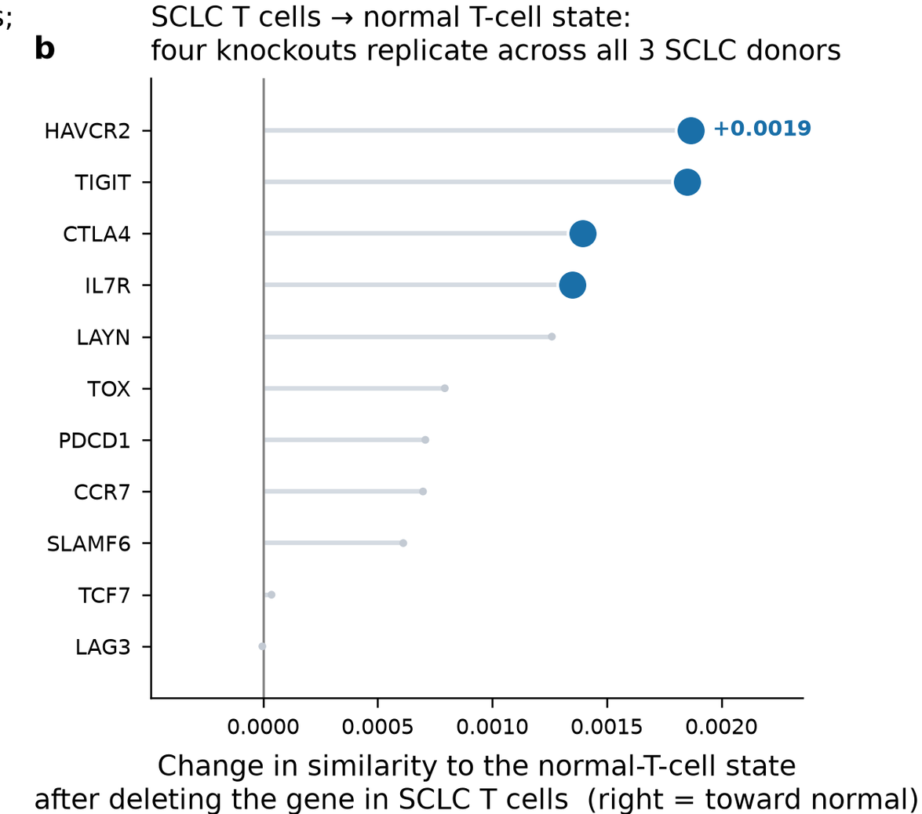
SCREEN
Four edits replicate across every donor: TIM-3, TIGIT, CTLA-4, IL7R
50
4
3/3
8
Genes screened
Replicated edits
Donors agree
No deletion result
Gene | Delete → Normal | Overexpress | Detected
HAVCR2 (TIM-3) | +0.0019 | −0.0060 | 202
TIGIT | +0.0018 | −0.0082 | 438
CTLA-4 | +0.0014 | −0.0014 | 282
IL7R (persistence) | +0.0013 | −0.0054 | 1,131
All four: same sign in all 3 SCLC donors, FDR < 0.05 in both arms, ≥100 source cells detected.
50 genes
›
concordant
both arms
›
FDR < 0.05
both arms
›
all 3
donors
›
≥100
detected
›
4
SCLC → normal: four knockouts replicate across all 3 donors.
Applied checkpoint screen
6
Notes:
Scope the screen: 50 checkpoint and T-cell engineering genes, tested on the SCLC to Normal transition. Of 123 concordant hits genome-wide, 43 are fully donor-consistent; within this targeted panel, four edits survive every filter. State the conjunction, because it is stricter than 'biggest effect': concordant in both perturbation arms, FDR < 0.05 in both, same sign in all three SCLC donors, and detected in at least 100 source cells. These rows are selected in code by that conjunction, so the table cannot drift from the criteria printed beside it. Read the biology plainly: deleting TIM-3, TIGIT, CTLA-4 or IL7R moves SCLC T cells toward a normal T-cell state; overexpressing moves them away. Then set up slide 7 — before you believe the ranking, one control changes how you read these numbers.

Slide 7
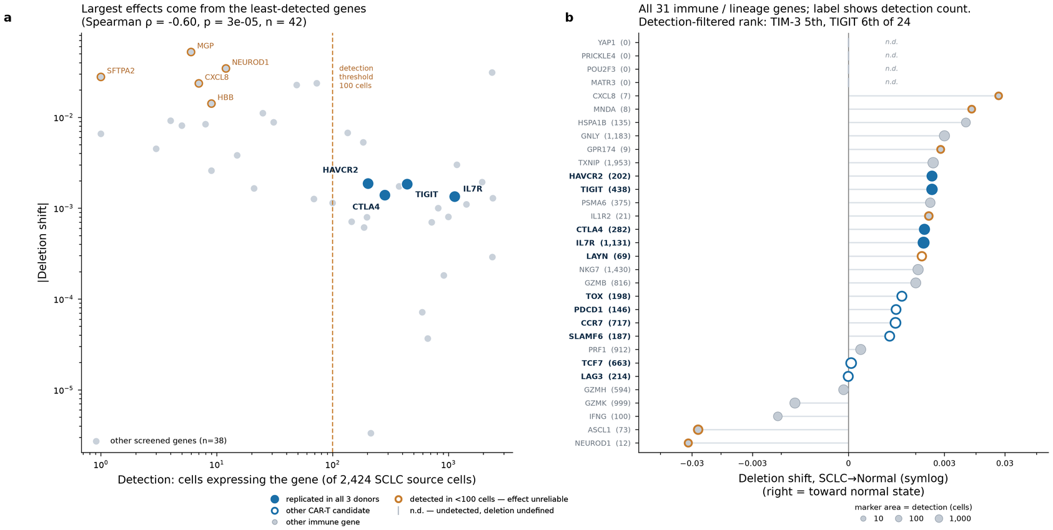
QUALITY CONTROL
Sparse genes fake big effects (ρ = −0.60) — and one model result still contradicts the clinic
OPEN QUESTION
The model orders the exhaustion axis
Normal
SCLC
LUAD
TIGIT overexpression moves SCLC cells away from Normal (−0.0082) but toward LUAD (+0.0256).
Model axis: T-cell intrinsic
Detection vs absolute deletion effect across the full 50-gene panel.
Detection vs effect size: Spearman ρ = −0.60 (p = 2.7×10⁻⁵, n = 42)
8 of 50 genes have no deletion result — undetected, so undefined, not zero
18 of 50 fall below 100 detected SCLC source cells
Effect size alone is not evidence — which is why slide 6 ranked on replication
Clinic: tumour level — SCLC cold, ICI-resistant
Not the same measurement. Presented as an open question, not a reconciled result.
Detection confound & the open axis
7
Notes:
The control that reframes the screen: across the 50-gene panel, detection count and nominal effect size are strongly anti-correlated, Spearman rho = -0.60 (p = 2.7e-5, n = 42). The fewer cells a gene is detected in, the larger its apparent shift. Effect magnitude alone is therefore not a ranking criterion — which is exactly why slide 6 ranked on replication and detection instead. Reinforce with the gaps: 8 of 50 genes have no deletion result at all — undetected in SCLC source cells, so deletion is undefined, not zero — and 18 fall below 100 detected cells. Then the honest part, and give it real time: on the exhaustion axis the model orders states Normal < SCLC < LUAD. TIGIT overexpression moves SCLC cells away from Normal but toward LUAD. That runs opposite to the clinical picture of SCLC as a cold, ICI-resistant tumour. Present it as an open question — a tumour-level clinical phenotype and a T-cell-intrinsic model axis are not the same measurement.

Slide 8
TRANSLATIONAL SCOPE
Two of the four hits are live CAR-T engineering targets — the tumour antigens are out of reach here
How interpretable is each hit?
TIGIT
Exhaustion checkpoint
This design CAN test
Strongest external CAR-T support
T-cell-intrinsic checkpoint edits
Persistence receptors (IL7R)
Exhaustion-programme shifts in SCLC T cells
TIM-3 (HAVCR2)
Exhaustion checkpoint
Direct KO precedent in solid tumours
CTLA-4
Exhaustion checkpoint
This design CANNOT test
Real signal, less CAR-T-specific evidence
CAR-T tumour antigens: DLL3, SEZ6, NCAM1, CD276, CEACAM5
PD-L1 (CD274) — absent from the T-cell atlas
IL7R
Persistence target
Persistence / fitness — not a checkpoint
Not expressed by T cells — this is scope, not failure. No PD-L1 claim is made.
CAR-T relevance and design scope
8
Notes:
Separate the four hits by how interpretable they are, because they are not equivalent: TIGIT has the strongest external CAR-T support; TIM-3 has direct knockout precedent in solid-tumour models; CTLA-4 is a real signal with less CAR-T-specific evidence; IL7R is a persistence/fitness target, not an exhaustion checkpoint at all. Grouping them as 'four checkpoints' would be wrong. The structural limit, stated as design not apology: this is a T-cell atlas, so it can only test T-cell-intrinsic edits. The CAR-T tumour antigens — DLL3, SEZ6, NCAM1, CD276, CEACAM5 — are not perturbable here because they are not expressed by T cells. Likewise PD-L1 is absent from the atlas, so this screen cannot speak to PD-L1 biology. Land the translational read: the actionable axis is checkpoint knockout in the T-cell product (TIGIT, HAVCR2) plus persistence engineering (IL7R) — which is precisely the CRISPR experiment on slide 12.

Slide 9
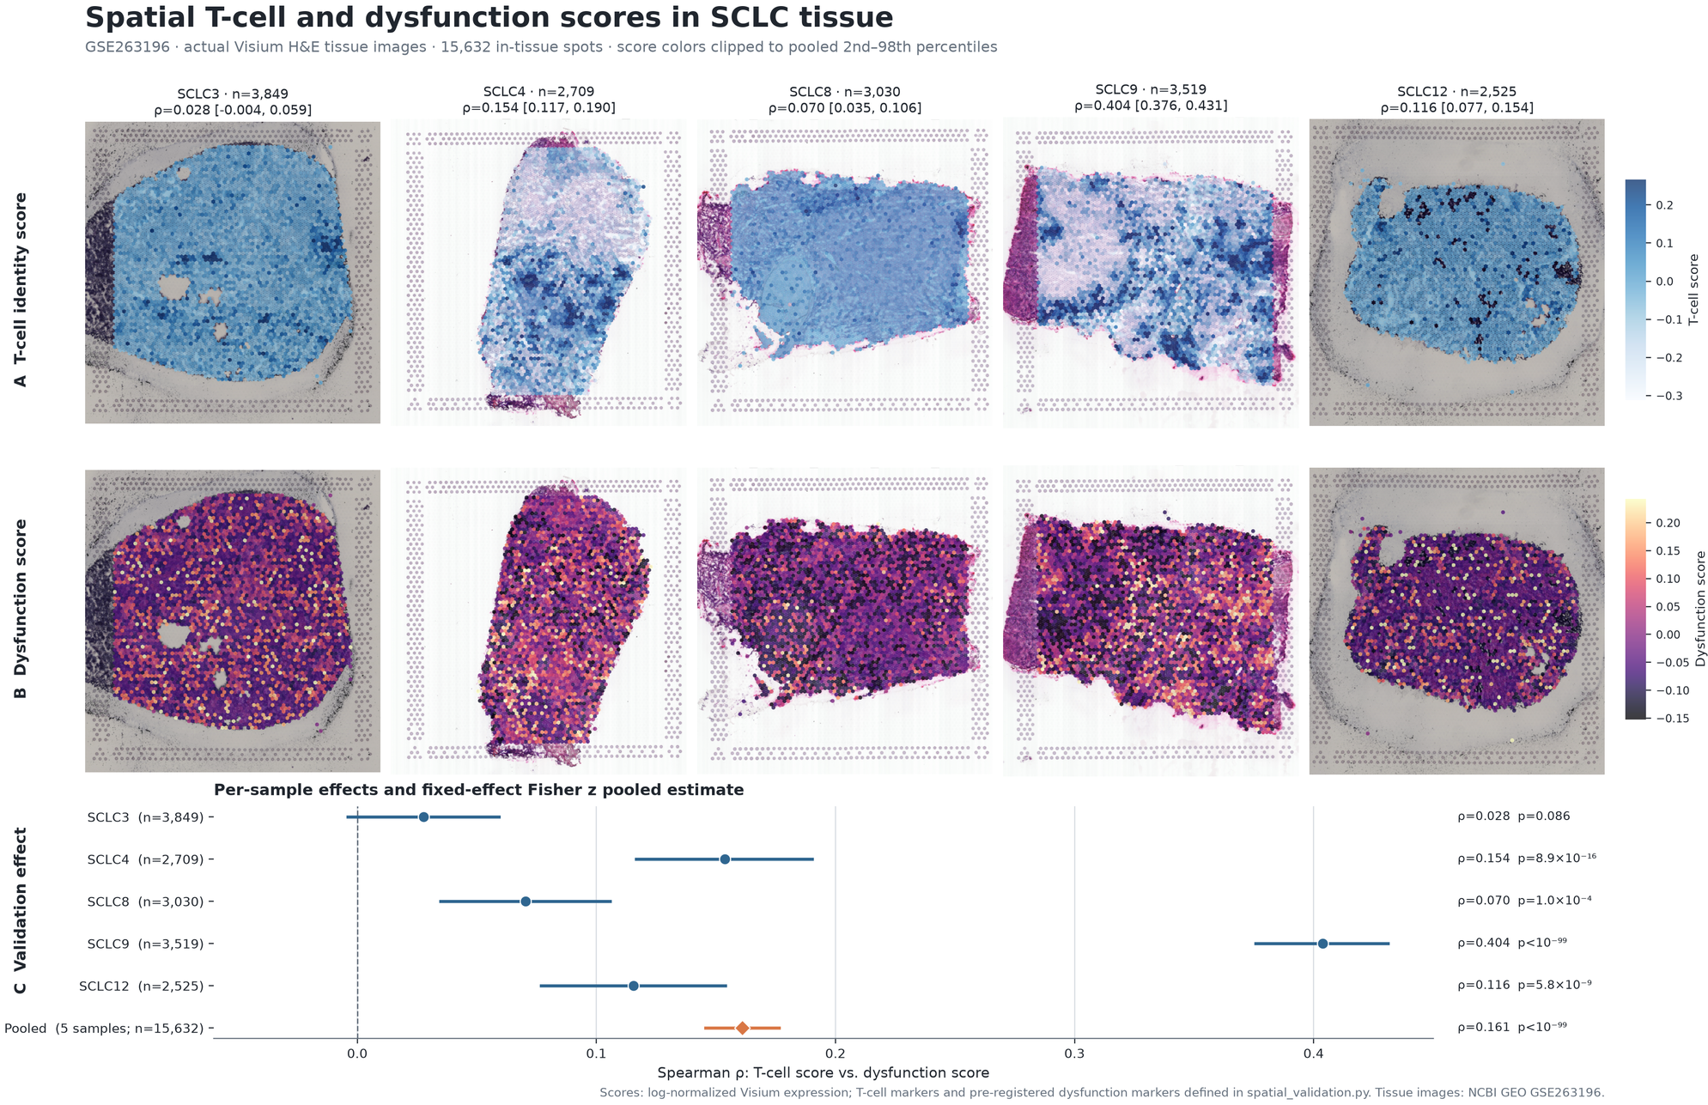
TISSUE VALIDATION
In intact tumour tissue, dysfunction tracks T-cell abundance — and antigen presentation tracks it hardest
GSE263196 · 10x Visium · 5 specimens · 15,632 spots
ρ = 0.161
7-gene dysfunction benchmark · [0.146, 0.176] · 4 of 5 specimens p < 0.001
ρ = 0.361 → 0.384
13-gene antigen-presentation programme · depth-controlled · 7.95 σ above null
A: T-cell identity. B: dysfunction. C: per-specimen and pooled ρ.
Why this is independent
Different cohort, assay and lab
15,632 / 15,774 in-tissue spots kept (99.1%)
Marker panels share no genes — not a self-correlation
Modest effects, high between-specimen heterogeneity (I² ≈ 99%) — real differences in microenvironment composition, not measurement noise.
GSE263196 Visium validation
9
Notes:
Set up the independence: GSE263196 is a different cohort, a different assay and a different lab — five fresh-frozen SCLC sections, 15,632 of 15,774 in-tissue spots retained (99.1%), all 21 marker genes present in every specimen. No donor, cell or read is shared with the discovery atlas. Explain the measurement in one breath: at every spatially indexed spot you score two disjoint marker panels — T-cell abundance and T-cell dysfunction — then correlate them within each specimen. The panels share no genes, so the correlation cannot be a self-correlation. Walk the figure top to bottom: row A is the T-cell identity score, row B the dysfunction score, row C the per-specimen effects with the pooled estimate. Give both numbers, correctly attributed. The benchmark 7-gene dysfunction panel gives pooled rho = 0.161 [0.146, 0.176], significant in 4 of 5 specimens. The 13-gene antigen-presentation programme is stronger at rho = 0.361, rising to 0.384 controlling for sequencing depth, and sits 7.95 sigma above an expression-matched random null. Depth control RAISING the estimate is the opposite of what a technical artifact does. Be straight about effect size: modest correlations with high between-specimen heterogeneity, I-squared about 99%, consistent with real differences in tumour microenvironment composition rather than measurement noise.

Slide 10
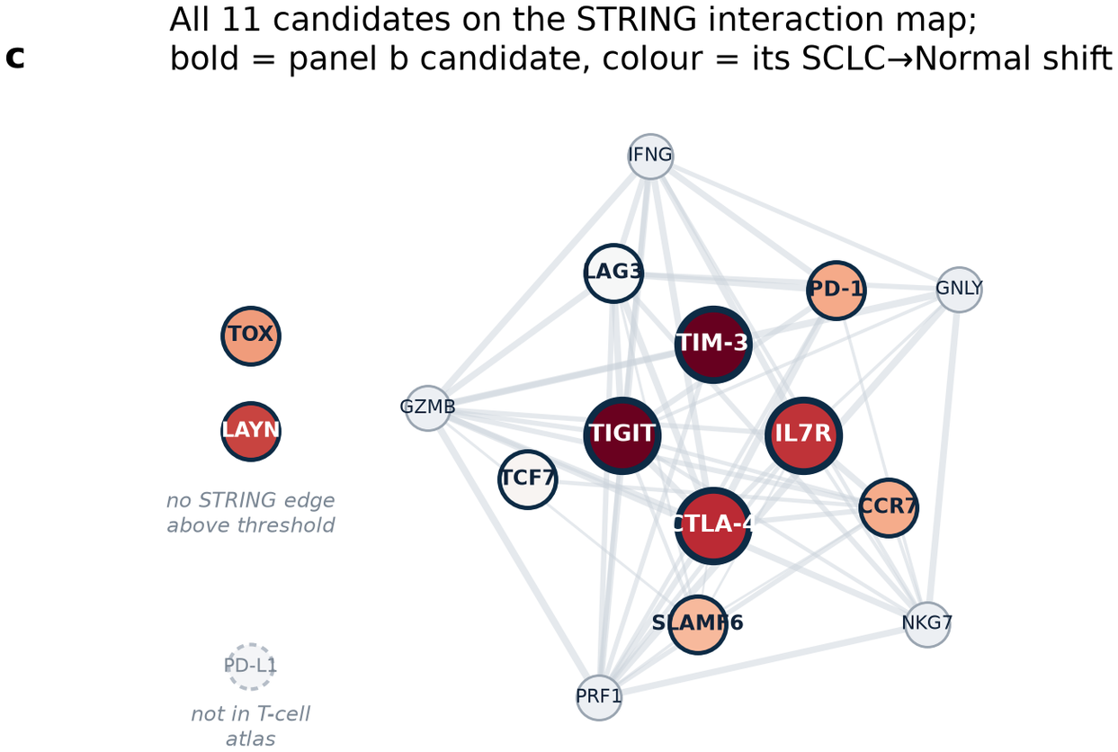
MECHANISM
The hits sit in one connected interaction neighbourhood — from prior knowledge, not inferred here
Evidence behind each hit
TIGIT
CAR-T support
TIM-3
Solid-tumour KO precedent
CTLA-4
Real signal, less CAR-T-specific
IL7R
Persistence, not exhaustion
54 STRING edges among 16 context genes
TOX, LAYN: no edge above threshold
PD-L1 absent from the T-cell atlas
All 11 ICI/CAR-T candidates on the STRING map; colour = SCLC→Normal deletion shift.
Prior interaction evidence — not a network inferred from these cells.
STRING literature overlay
10
Notes:
Show that the four replicated edits are not scattered: all 11 ICI/CAR-T candidates map onto a connected STRING neighbourhood, 54 filtered edges among 16 context genes, with TIM-3, TIGIT, CTLA-4 and IL7R sitting close to the cytotoxic and interferon machinery. State the epistemics without hedging: this map is a literature overlay, prior interaction evidence — it is NOT a gene-to-gene network inferred from these cells. It provides context for the hits; it is not independent evidence for them. Point out the informative absences: TOX and LAYN carry no STRING edge above threshold, and PD-L1 is not in the T-cell atlas at all. TIM-3 is the strongest individual hit but has no supported non-text-mining edge to another checkpoint here — an explicit asymmetry, not a plotting omission.

Slide 11
SCOPE
What this study does not claim
Model-derived predictions, not experimental knockouts
Perturbation shifts are interventions on a rank-value encoding. Everything upstream is a prioritised hypothesis.
Marker-score proxy, not deconvolution
Spot scores reflect panel expression, not inferred cell-type composition.
SCLC-specificity untested
The validation cohort has no Normal or LUAD sections to serve as controls.
Correlational, in archival tissue
Detection is source-state specific — absence of a result is not evidence of absence.
Stating these plainly is what makes everything on the previous ten slides usable.
Limits
11
Notes:
Deliver these as deliberate scope, briskly and without apology — a clean limits slide pre-empts the hostile version of every Q&A question, and this audience will respect it. The one that matters most: perturbation shifts are model-derived interventions on a rank-value encoding, not experimental knockouts. Everything upstream is a prioritised hypothesis. Say this sentence verbatim. The measurement caveats, quickly: detection is source-state specific, so absence of a result is not evidence of absence; the spatial work uses marker-score proxies rather than formal deconvolution; there are no Normal or LUAD sections, so SCLC-specificity of the spatial association is untested; and the design is correlational, in archival tissue. This is a spoken slide. Hold it briefly — the audience should be listening, not reading ahead.

Slide 12
A tissue-validated hypothesis, and the CRISPR experiment that would test it
✓
Donor-clean model
91.9% · F1 0.903
→
✓
Four replicated edits
TIM-3 · TIGIT · CTLA-4 · IL7R
→
✓
Tissue-validated programme
ρ 0.361 · 7.95 σ
EXPERIMENTAL
COMPUTATIONAL
CRISPR knockout of TIGIT and HAVCR2 in SCLC co-culture
Perturb-seq in primary T cells vs in silico predictions
Clinical outcome correlation once metadata is available
cell2location deconvolution in place of marker scores
Normal / LUAD sections as specificity controls
scGPT cross-model replication
Still open: why does the model order Normal < SCLC < LUAD on the exhaustion axis?
github.com/Kays3/geneformer-lung-tcell · snakaoka@sci.hokudai.ac.jp
Kaisar Dauyey & Shinji Nakaoka · Hokkaido University · 24JSDP P25
Notes:
Close the loop in three beats: a donor-clean fine-tuned model (91.9%, F1 0.903) leads to four replicated, detection-adequate candidate edits, which lead to an antigen-presentation programme that tracks T-cell abundance in independent tumour tissue (rho 0.361, 7.95 sigma). Name the falsifying experiment concretely: CRISPR knockout of TIGIT and HAVCR2 in an SCLC co-culture, and Perturb-seq in primary T cells read directly against these in silico predictions. That is what turns predicted shifts into measured ones. Leave the open question open — the Normal < SCLC < LUAD axis. Inviting the room to argue about it is a better close than a tidy conclusion, and it is the honest state of the work.

