Slide 1

A Foundation-Model T-cell Dysfunction Screen:
Translational Candidates, Then a Full Audit
GENEFORMER · SCLC/LUAD/NORMAL T-CELL DYSFUNCTION
Four checkpoint/persistence hits, tissue-validated -- and what a full concordance, ambient, and donor-level audit does and does not change about them.
Kaisar Dauyey · Shinji Nakaoka
Laboratory of Mathematical Biology, Faculty of Advanced Life Science, Hokkaido University
Contact: k.dauyey.bio.nu@gmail.com
Slides, report and build package: github.com/Kays3/talks
1 / 26
Notes:
[0:30] Timing budget for this slide; cumulative 0:30 of 23:45 speaking (30-min slot = ~25 min talk + ~5 min questions).
Slide 1 of 26 (main talk); slide 1 of the 25 Sep deck, content unchanged.
Sources note (docs/lung_tcell_talk_imrad_sources_20260925.md, row for original slide 1): Title: —. Source: —
Commits cited are in geneformer-lung-tcell; the files themselves are in this package under data/git/<commit>/ (see data/MANIFEST.tsv).

Slide 2
T cells in lung cancer: why they matter, and what was already known
RESEARCH BACKGROUND · FOR GENETICISTS
The disease
Lung cancer comes in distinct types. Small cell lung cancer (SCLC) is the most aggressive thoracic malignancy; lung adenocarcinoma (LUAD) is a non-small-cell type.
SCLC itself splits into subtypes defined by master transcription factors (ASCL1, NEUROD1, POU2F3) (Rudin 2019).
The immune angle
T cells can kill tumour cells. Under chronic stimulation they can become dysfunctional ("exhausted"), marked by inhibitory receptors such as PD-1, TIM-3 and CTLA-4 (Wherry 2015).
Immune checkpoint inhibitors release these brakes, but add only a modest survival benefit in extensive-stage SCLC (Horn 2018), despite its high tumour mutational burden.
The open question
Whether SCLC T cells are dysfunctional, and through which genes, was poorly characterised at single-cell resolution when this work began.
SCLC subtypes differ in immune activation; an inflamed subtype benefits most from immunotherapy (Gay 2021). This talk asks what a model trained on T cells themselves can say.
In plain words: we study the immune cells inside lung tumours, because drugs that re-activate them help SCLC patients less than hoped, and nobody knows exactly why.
2 / 26
Rudin 2019; Wherry 2015; Horn 2018; Gay 2021; poster_final (Why this matters)
Notes:
[1:30] Timing budget for this slide; cumulative 2:00 of 23:45 speaking (30-min slot = ~25 min talk + ~5 min questions).
Slide 2 of 26 (main talk). ADDED 2026-09-28 (not in the 25 Sep deck).
SCLC 'most aggressive thoracic malignancy', 'responds poorly to immune checkpoint blockade despite a high tumour mutational burden', 'transcriptional basis poorly characterised at single-cell resolution': JSDP poster, section A 'Why this matters' - data/sources/poster_final.pdf (our 24JSDP poster, P25; geneformer-lung-tcell poster/poster_final.pdf, untracked; sha256 94638dba...)
SCLC transcription-factor subtypes: Rudin CM, Poirier JT, Byers LA, et al. Molecular subtypes of small cell lung cancer: a synthesis of human and mouse model data. Nat Rev Cancer 2019. doi:10.1038/s41568-019-0133-9
T-cell exhaustion and inhibitory receptors: Wherry EJ, Kurachi M. Molecular and cellular insights into T cell exhaustion. Nat Rev Immunol 2015. doi:10.1038/nri3862
Modest benefit of adding atezolizumab to chemotherapy in extensive-stage SCLC: Horn L, Mansfield AS, Szczęsna A, et al. First-line atezolizumab plus chemotherapy in extensive-stage small-cell lung cancer. N Engl J Med 2018. doi:10.1056/NEJMoa1809064
Inflamed SCLC subtype and immunotherapy benefit: Gay CM, Stewart CA, Park EM, et al. Patterns of transcription factor programs and immune pathway activation define four major subtypes of SCLC with distinct therapeutic vulnerabilities. Cancer Cell 2021. doi:10.1016/j.ccell.2020.12.014

Slide 3
Three tools, one analogy each
METHODS IN PLAIN WORDS · READ THIS FIRST
Single-cell RNA sequencing
Reads which genes are switched on in each individual cell, not in a ground-up tissue sample.
Analogy: a list of every fruit in the bowl, instead of the smoothie.
Here: 46,140 T cells from 42 people (HTAN MSK collection, CELLxGENE).
Geneformer, a foundation model
A neural network pre-trained on a large corpus of single-cell profiles (Theodoris 2023). It reads a cell as its genes ranked by expression, most-expressed first, and turns it into a list of numbers (an embedding) that puts similar cells near each other.
Analogy: a map coordinate for every cell. We fine-tuned it to tell SCLC, LUAD and normal-tissue T cells apart.
In silico perturbation
Delete one gene from a cell's ranked list, or move it to the top ("overexpress"), re-read the cell, and measure how far the model's picture of it moves toward another disease state.
Analogy: a Perturb-seq screen run on the computer. Nothing is edited in a lab: it generates hypotheses, it is not a knockout.
In plain words: we taught a model what SCLC, LUAD and normal T cells look like, then asked it "what if this gene were missing, or boosted?" for thousands of real cells.
3 / 26
METHODS.md @ dd7366c; Theodoris 2023; poster_final Fig. 1, Fig. 5
Notes:
[1:30] Timing budget for this slide; cumulative 3:30 of 23:45 speaking (30-min slot = ~25 min talk + ~5 min questions).
Slide 3 of 26 (main talk). ADDED 2026-09-28 (not in the 25 Sep deck).
46,140 cells, 42 individuals, HTAN MSK / CELLxGENE dataset 6fde3ad9: data/git/dd7366c/sclc_validation/perturbation_workflow/METHODS.md (geneformer-lung-tcell @ dd7366c) (lines 5-10) and the poster's cohort panel.
Geneformer: Theodoris CV, Xiao L, Chopra A, et al. Transfer learning enables predictions in network biology. Nature 2023. doi:10.1038/s41586-023-06139-9
'Reads a cell as an ordered list of its genes, most-expressed first'; 'nothing is edited in a laboratory'; 'a hypothesis generator, not a knockout experiment'; 'a Perturb-seq screen run in silico': JSDP poster Fig. 1 and Fig. 5 captions - data/sources/poster_final.pdf (our 24JSDP poster, P25; geneformer-lung-tcell poster/poster_final.pdf, untracked; sha256 94638dba...)
Delete = token removed from the rank-value encoding; overexpress = moved to the front: data/git/dd7366c/sclc_validation/perturbation_workflow/METHODS.md (geneformer-lung-tcell @ dd7366c) (lines 180-187).

Slide 4
Our 24JSDP poster (P25) and what the audit changed
WHERE THIS STARTED · OUR EARLIER POSTER
Our 24JSDP poster (P25) reported a donor-held-out classifier (91.9% accuracy), four replicated edits (TIM-3, TIGIT, CTLA-4, IL7R) and tissue validation in 5 Visium SCLC sections (15,632 spots).
Poster statement | Status after the audit (this talk)
Four edits concordant, FDR < 0.05 in both arms, same sign in all 3 SCLC donors | Deletion replication stands. The concordance half was scored on different cell sets per arm (overexpress 2,424 cells, delete 202-1,131) and has not been rerun.
"The model implies Normal < SCLC < LUAD on the checkpoint axis ... an open question" | Closed as null: donor-level SCLC vs LUAD, p = 0.216.
Detection vs effect size, rho = -0.60: sparse genes fake big effects | Unchanged; the original talk's own QC slide, shown here as Results R2.
Tissue: dysfunction tracks T-cell abundance (rho 0.161); talk: antigen presentation rho 0.361 | Unchanged; not re-analysed here.
In plain words: the poster's main hits survive; one of its claims (an ordering of the three disease states) did not hold up once each person was counted once.
4 / 26
poster_final; JSDP_P25_talk; this deck, slides R1 and R3
Notes:
[1:15] Timing budget for this slide; cumulative 4:45 of 23:45 speaking (30-min slot = ~25 min talk + ~5 min questions).
Slide 4 of 26 (main talk). ADDED 2026-09-28 (not in the 25 Sep deck).
Poster title, number, authors, sections and all poster quotes: data/sources/poster_final.pdf (our 24JSDP poster, P25; geneformer-lung-tcell poster/poster_final.pdf, untracked; sha256 94638dba...)
rho 0.361 / 7.95 sigma: data/sources/JSDP_P25_talk.pdf (the talk that accompanied the poster; geneformer-lung-tcell talk/JSDP_P25_talk.pdf, untracked; sha256 3f013a5d...) (slide 9).
Status column restates this deck's own slides: Results R1 (cell-set caveat; targeted_panel_delete_overexpress_merged.csv @ 6882627, runner fix 66d235b) and R3 (t6_permutation_tests.csv @ 9ec518c).
Held-out cell count: poster 9,377 vs confusion matrix 9,376 is a known one-cell truncation with no effect at any reported precision (METHODS.md lines 125-166) - not an audit change.
Per the human's ruling (2026-09-28), the poster is named only as 'our 24JSDP poster (P25)': no venue, date or meeting details.

Slide 5
A perturbation screen can look statistically overwhelming and still be wrong
BACKGROUND
Foundation models fine-tuned on single-cell transcriptomes can be probed for candidate disease-state drivers: delete or overexpress a gene's simulated expression in a held-out cell, and read the shift in a fine-tuned classifier's predicted state. A dose-responsive driver should move the model toward its target when overexpressed and away from it when deleted.
A classifier trained on real tissue also learns whatever else correlates with its labels -- ambient RNA from other cell types, detection-rate differences, cohort composition, tissue of origin. None of that is cell-intrinsic biology, and a screen does not tell you on its own which one it found.
This talk presents a set of translational candidates identified this way, then applies the audit a screen like this needs: a concordance test, a screen-level ambient-contamination check, and a donor-level reanalysis of a cross-cohort ordering claim.
5 / 26
Notes:
[1:00] Timing budget for this slide; cumulative 5:45 of 23:45 speaking (30-min slot = ~25 min talk + ~5 min questions).
Slide 5 of 26 (main talk); slide 2 of the 25 Sep deck, content unchanged.
Sources note (docs/lung_tcell_talk_imrad_sources_20260925.md, row for original slide 2): Background: (framing only). Source: —
Commits cited are in geneformer-lung-tcell; the files themselves are in this package under data/git/<commit>/ (see data/MANIFEST.tsv).

Slide 6
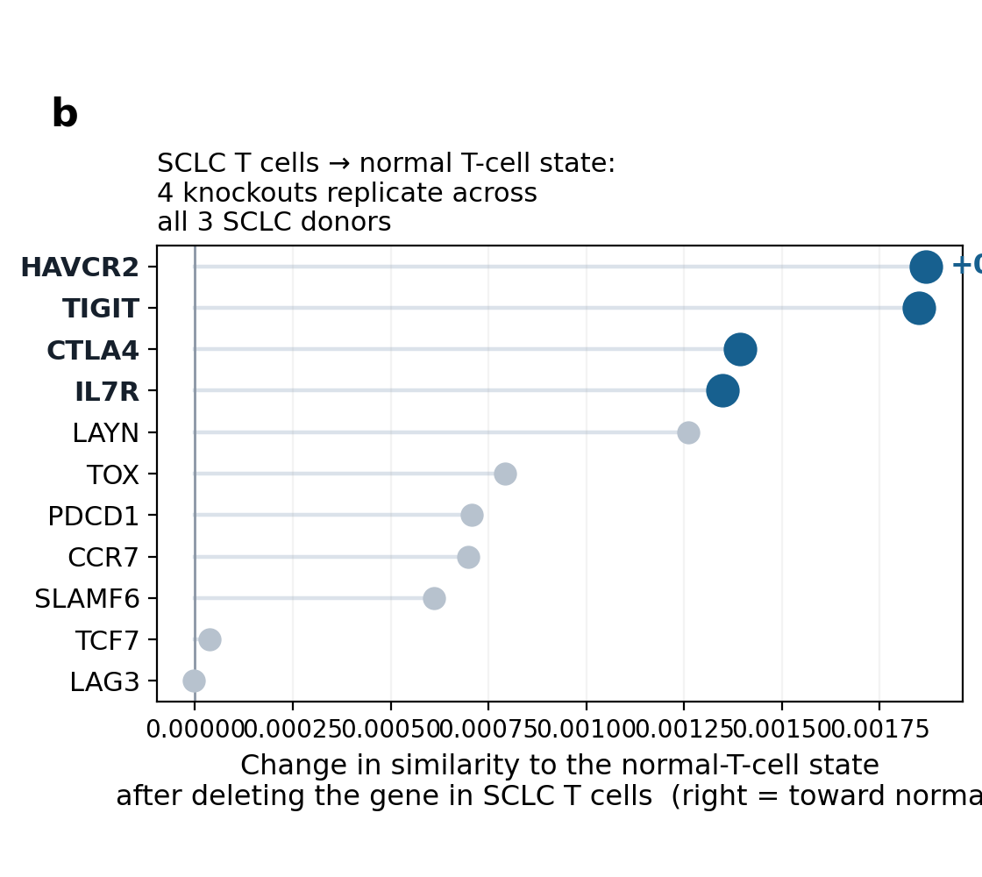
Four replicated checkpoint/persistence hits, tissue-validated
INTRODUCTION · THE ORIGINAL STUDY
A donor-disjoint SCLC/LUAD/normal T-cell classifier supported an applied in-silico perturbation screen for candidate CAR-T/ICI-relevant drivers. Four hits replicated across the screen: TIGIT, TIM-3 (HAVCR2), CTLA-4, IL7R.
Independent Visium spatial validation (GSE263196, 5 SCLC specimens, 15,632 in-tissue spots) supported a tissue-validated antigen-presentation programme.
Presented at JSDP, 2026-08-17. No caveat attached here -- none of these four hits is implicated in anything that follows.
6 / 26
talk/JSDP_P25_talk.pptx; poster/poster_final.html
Notes:
[1:00] Timing budget for this slide; cumulative 6:45 of 23:45 speaking (30-min slot = ~25 min talk + ~5 min questions).
Slide 6 of 26 (main talk); slide 3 of the 25 Sep deck, content unchanged.
Cited on the slide: talk/JSDP_P25_talk.pptx; poster/poster_final.html
Sources note (docs/lung_tcell_talk_imrad_sources_20260925.md, row for original slide 3): Intro I1: 4 original hits, tissue validation. Source: `talk/JSDP_P25_talk.pptx/pdf`
Commits cited are in geneformer-lung-tcell; the files themselves are in this package under data/git/<commit>/ (see data/MANIFEST.tsv).

Slide 7
One test was already flagged as pending; one new screen needed the same scrutiny
INTRODUCTION · WHAT WAS ALREADY OPEN, AND WHAT THIS TALK ADDS
The poster's own hedge
“The model implies Normal < SCLC < LUAD on the checkpoint axis. This conflicts with the clinical tumour-level picture of SCLC as cold and ICI-resistant, so it remains an open question rather than a reconciled conclusion.”
The talk's own QC slide, “TESTED SINCE THE POSTER”
“The states are not on a line, so there is no ordering to contradict... Test 1 of 4 — sign directions, not centroid geometry. Pending T2 and T3.” The donor-level test was named as open before this work began.
What this talk adds
A later, expanded screen surfaced two new high-FDR candidates needing the same concordance scrutiny the original four received. This talk completes the pending test and applies that scrutiny — it does not reopen a settled claim.
7 / 26
poster/poster_final.html; talk/JSDP_P25_talk.pdf ("TESTED SINCE THE POSTER", p.7)
Notes:
[1:00] Timing budget for this slide; cumulative 7:45 of 23:45 speaking (30-min slot = ~25 min talk + ~5 min questions).
Slide 7 of 26 (main talk); slide 4 of the 25 Sep deck, content unchanged.
Cited on the slide: poster/poster_final.html; talk/JSDP_P25_talk.pdf ("TESTED SINCE THE POSTER", p.7)
Sources note (docs/lung_tcell_talk_imrad_sources_20260925.md, row for original slide 4): Intro I2: Poster/talk hedges, quoted. Source: `poster/poster_final.html`; `talk/JSDP_P25_talk.pdf` p.7
Commits cited are in geneformer-lung-tcell; the files themselves are in this package under data/git/<commit>/ (see data/MANIFEST.tsv).

Slide 8
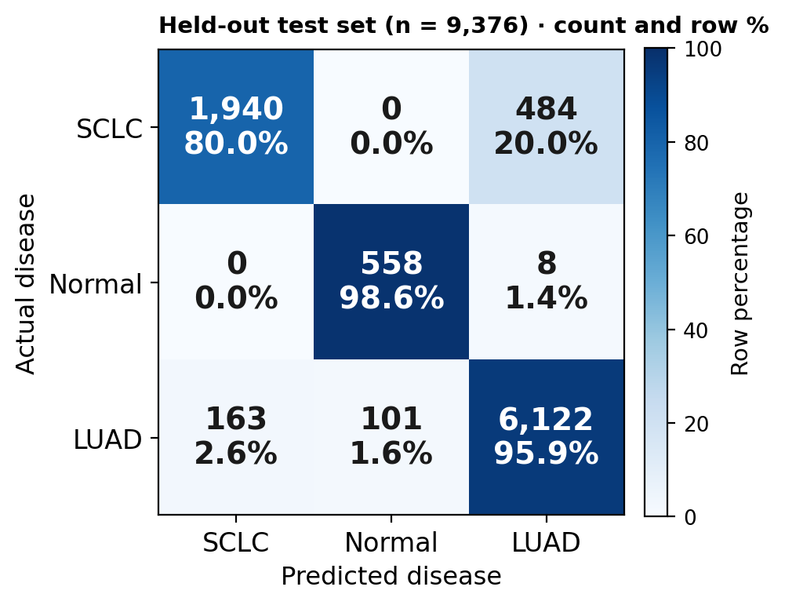
46,140 T cells, 42 donors, one fine-tuned classifier
METHODS · COHORT, CLASSIFIER
Held-out test performance
91.9% accuracy, macro F1 0.903, donor-disjoint split. Geneformer V2 104M fine-tune.
Normal-class test performance rests on 1 held-out donor (566 cells)
A third of this macro-F1. Already flagged in the repo's own methods (perturbation_workflow/METHODS.md, lines 57-67 the split table, line 112: “Normal-class metrics are flagged explicitly given 1 test donor”).
19 SCLC + 22 LUAD + 4 normal = 45, but 42 unique donors: three donor_ids (RU675, RU682, RU684) each carry two biospecimens from the same clinical patient, one LUAD tumour and one normal-tissue sample (METHODS.md, lines 33-39).
In plain words: shown T cells from 8 people it had never seen, the model named the right disease state for about 92 of every 100 cells; the normal-tissue part of that score rests on one person.
8 / 26
README.md; perturbation_workflow/METHODS.md
Notes:
[1:15] Timing budget for this slide; cumulative 9:00 of 23:45 speaking (30-min slot = ~25 min talk + ~5 min questions).
Slide 8 of 26 (main talk); slide 5 of the 25 Sep deck, content unchanged apart from the added 'In plain words' line.
Cited on the slide: README.md; perturbation_workflow/METHODS.md
Sources note (docs/lung_tcell_talk_imrad_sources_20260925.md, row for original slide 5): Methods M1: 91.9%/F1 0.903 + 1-donor caveat; 42-vs-45. Source: `README.md`; `perturbation_workflow/METHODS.md` lines 57–67, 111–112, 33–39
Commits cited are in geneformer-lung-tcell; the files themselves are in this package under data/git/<commit>/ (see data/MANIFEST.tsv).

Slide 9
Delete or overexpress, in held-out cells, across six comparisons
METHODS · IN-SILICO PERTURBATION
Each gene is deleted (its token removed from a cell's rank-ordered input) or overexpressed (promoted to the front of the rank) in held-out cells, and the shift in the classifier's predicted disease-state probability is read for both operations.
Six source→goal disease-state comparisons: SCLC→LUAD, SCLC→normal, LUAD→SCLC, LUAD→normal, normal→SCLC, normal→LUAD.
A dose-responsive driver should move the model toward its target under overexpression and away from it under deletion — the two operations are read together, never one alone.
9 / 26
README.md
Notes:
[1:00] Timing budget for this slide; cumulative 10:00 of 23:45 speaking (30-min slot = ~25 min talk + ~5 min questions).
Slide 9 of 26 (main talk); slide 6 of the 25 Sep deck, content unchanged.
Cited on the slide: README.md
Sources note (docs/lung_tcell_talk_imrad_sources_20260925.md, row for original slide 6): Methods M2: ISP mechanics, six comparisons. Source: `README.md`
Commits cited are in geneformer-lung-tcell; the files themselves are in this package under data/git/<commit>/ (see data/MANIFEST.tsv).

Slide 10
A real driver must move opposite ways under deletion and overexpression
METHODS · HOW A HIT EARNS THE NAME
The concordant criterion, used throughout this repo's perturbation work:
delete_fdr < 0.05 AND overexpress_fdr < 0.05 AND delete_shift × overexpress_shift < 0 AND delete_n ≥ 25
Significance in one arm is not enough. A gene must clear both arms and reverse sign between them — the signature a dose-responsive driver actually produces. A gene can be significant in both arms and still fail this test if deletion and overexpression push the classifier the same direction — the model reacting to the gene's presence at all, not to a dose-responsive relationship with the labelled state.
In plain words: a gene counts only if removing it and boosting it push the cell in opposite directions, each beyond chance; FDR < 0.05 means at most about 5% of such calls are expected to be false.
10 / 26
primary_test_perturbation/scripts/build_delete_overexpress_shift_report.py @ b99365b
Notes:
[1:15] Timing budget for this slide; cumulative 11:15 of 23:45 speaking (30-min slot = ~25 min talk + ~5 min questions).
Slide 10 of 26 (main talk); slide 7 of the 25 Sep deck, content unchanged apart from the added 'In plain words' line.
Cited on the slide: primary_test_perturbation/scripts/build_delete_overexpress_shift_report.py @ b99365b
Sources note (docs/lung_tcell_talk_imrad_sources_20260925.md, row for original slide 7): Methods M3: Concordance criterion, verbatim. Source: `primary_test_perturbation/scripts/build_delete_overexpress_shift_report.py` @ `b99365b`
Commits cited are in geneformer-lung-tcell; the files themselves are in this package under data/git/<commit>/ (see data/MANIFEST.tsv).

Slide 11
Two further checks, applied after the screen, not instead of it
METHODS · SCREEN-LEVEL AND DONOR-LEVEL AUDITS
Ambient-risk audit
Every top-effect gene is checked against a curated ambient-contamination panel and a curated T-cell-intrinsic anchor panel. The flag threshold is the 25th percentile of the full ambient-anchor population's own risk scores — a within-panel, not an absolute, cutoff.
Donor-weighted reanalysis
Any cross-cohort comparison is recomputed donor-level (mean within donor first, then an unweighted mean of donor means) alongside the original cell-weighted statistic, to separate a real group difference from one donor's cell count dominating the mean.
Why both, not either
A significance test alone cannot distinguish a cell-intrinsic effect from an ambient or cell-count artifact. Both audits are applied to every candidate discussed in Results, not selectively to ones that already look questionable.
11 / 26
ambient_risk_diagnostic.py line 198 @ b99365b; immune_axis_test/donor_robustness.py @ 9ec518c
Notes:
[1:00] Timing budget for this slide; cumulative 12:15 of 23:45 speaking (30-min slot = ~25 min talk + ~5 min questions).
Slide 11 of 26 (main talk); slide 8 of the 25 Sep deck, content unchanged.
Cited on the slide: ambient_risk_diagnostic.py line 198 @ b99365b; immune_axis_test/donor_robustness.py @ 9ec518c
Sources note (docs/lung_tcell_talk_imrad_sources_20260925.md, row for original slide 8): Methods M4: Ambient/donor-weighted methodology. Source: `ambient_risk_diagnostic.py` line 198 @ `b99365b`; `immune_axis_test/donor_robustness.py` @ `9ec518c`
Commits cited are in geneformer-lung-tcell; the files themselves are in this package under data/git/<commit>/ (see data/MANIFEST.tsv).

Slide 12
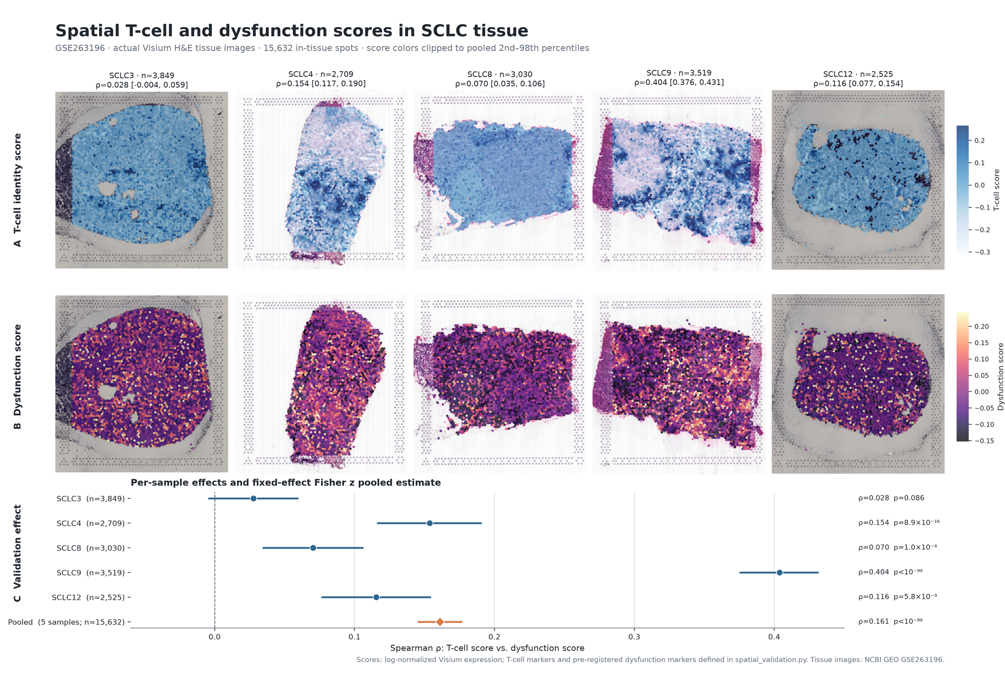
Four hits replicate and validate independently in tissue
RESULTS · THE ORIGINAL SCREEN
TIGIT, TIM-3 (HAVCR2), CTLA-4, IL7R
Four replicated checkpoint/persistence edits from the applied screen (screen_b.png, Introduction). Replication here means: deletion FDR < 0.05 and the same deletion sign in all 3 SCLC donors.
GSE263196 Visium, 5 SCLC specimens, 15,632 in-tissue spots: antigen-presentation programme rho = 0.361, 7.95 sigma above the null.
The concordance half of the original call was made by the pre-2026-09-22 panel runner, which overexpressed into all 2,424 SCLC cells while deleting only in the 202–1,131 cells expressing each gene; it has not been rerun with paired cell sets. Unaffected by S100, ambient or T6 below; the spatial number is untouched. A qualifier, not a retraction.
In plain words: in real tumour slices, spots with more antigen-presentation activity also held more T cells (rho 0.361, where 0 is no relation and 1 is perfect), far beyond chance (7.95 sigma).
12 / 26
talk/JSDP_P25_talk.pptx/pdf (rho, sigma: talk only); targeted_panel_delete_overexpress_merged.csv @ 6882627; runner fix 66d235b
Notes:
[1:30] Timing budget for this slide; cumulative 13:45 of 23:45 speaking (30-min slot = ~25 min talk + ~5 min questions).
Slide 12 of 26 (main talk); slide 9 of the 25 Sep deck, content unchanged apart from the added 'In plain words' line.
Cited on the slide: talk/JSDP_P25_talk.pptx/pdf (rho, sigma: talk only); targeted_panel_delete_overexpress_merged.csv @ 6882627; runner fix 66d235b
Sources note (docs/lung_tcell_talk_imrad_sources_20260925.md, row for original slide 9): Results R1: 4 hits + spatial validation; cell-set caveat on the concordance half (2026-09-25). Source: `talk/JSDP_P25_talk.pptx/pdf`; `targeted_panel_delete_overexpress_merged.csv` @ `6882627` (overexpress_n 2,424 constant; delete_n 202/438/282/1,131); runner fix `66d235b` (2026-09-22); no later commit to the results table
Commits cited are in geneformer-lung-tcell; the files themselves are in this package under data/git/<commit>/ (see data/MANIFEST.tsv).

Slide 13
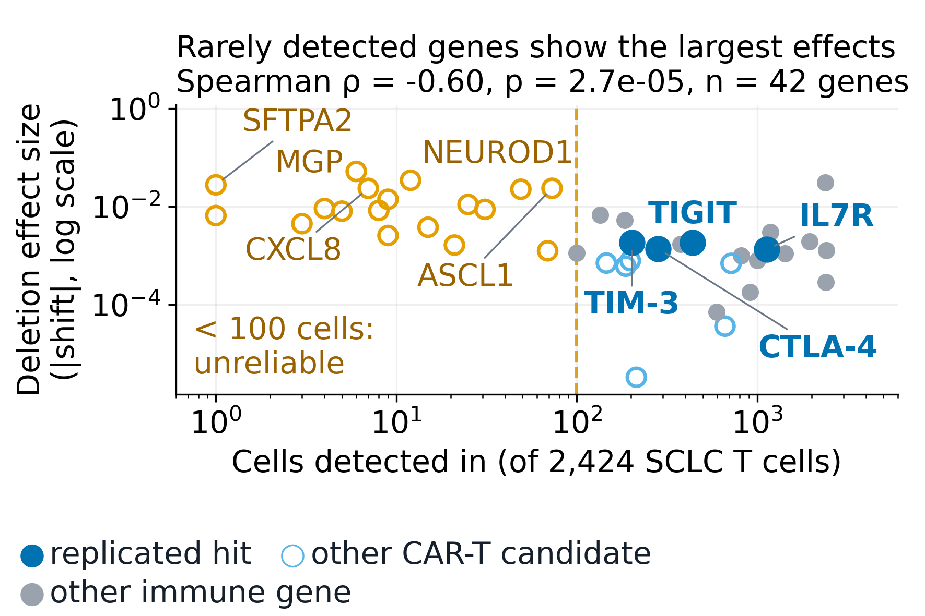
Sparse genes fake big effects, and the poster's own ordering fails its own test
RESULTS · THE ORIGINAL TALK'S OWN QUALITY-CONTROL CHECK
Detection vs. effect size: Spearman rho = -0.60 (p = 2.7e-5, n = 42) across the full 50-gene panel.
“TESTED SINCE THE POSTER” (talk, slide 7): “the states are not on a line, so there is no ordering to contradict... Working reading: a triangle — SCLC ≤ Normal < LUAD... Test 1 of 4 — sign directions, not centroid geometry. Pending T2 and T3.”
This is the original team's own self-correction, dated before this work began — not a finding of ours.
In plain words: the rarer a gene is in the data, the bigger its apparent effect tends to be (rho -0.60), so the size of an effect alone is not evidence.
13 / 26
talk/JSDP_P25_talk.pdf, slide 7
Notes:
[1:30] Timing budget for this slide; cumulative 15:15 of 23:45 speaking (30-min slot = ~25 min talk + ~5 min questions).
Slide 13 of 26 (main talk); slide 10 of the 25 Sep deck, content unchanged apart from the added 'In plain words' line.
Cited on the slide: talk/JSDP_P25_talk.pdf, slide 7
Sources note (docs/lung_tcell_talk_imrad_sources_20260925.md, row for original slide 10): Results R2: JSDP's own QC + pending-test flag. Source: `talk/JSDP_P25_talk.pdf`, slide 7
Commits cited are in geneformer-lung-tcell; the files themselves are in this package under data/git/<commit>/ (see data/MANIFEST.tsv).

Slide 14
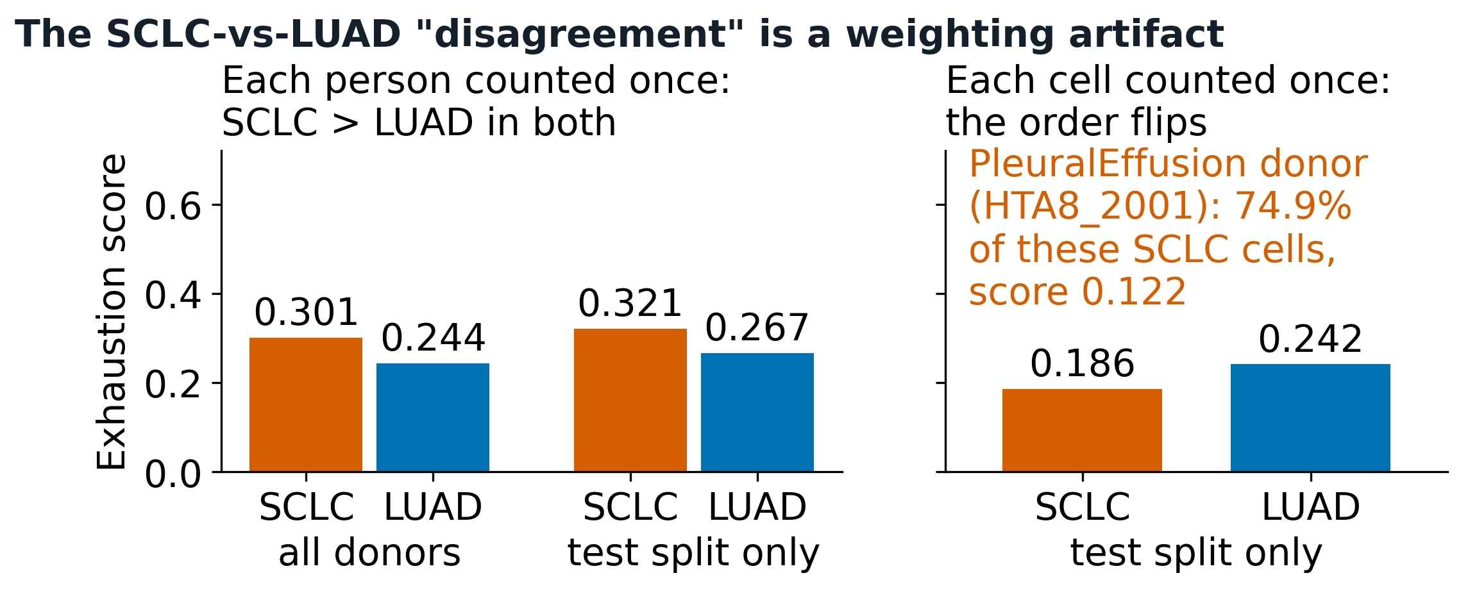
The open question is now closed as null
Donor-level: no reversal
Complete population: SCLC 0.301 > LUAD 0.244. Test-only: SCLC 0.321 > LUAD 0.267. Two-sided Monte Carlo test, 100,000 replicates: p = 0.216, 19 vs. 22 donors. Not significant.
RESULTS · COMPLETING THE PENDING TEST
PleuralEffusion: one genuine donor
Carries 74.9% of test-only SCLC cells. HTAN_Participant_ID confirms exactly one participant (HTA8_2001), not several merged (METHODS.md, lines 29-32).
A separate, exact-enumeration test on the 3-vs-4-donor test-only slice: only 35 label assignments exist; the smallest attainable two-sided p is 0.0571 (2/35) — that design cannot reach significance regardless of the true effect.
In plain words: counting each person once instead of each cell, SCLC and LUAD T cells do not differ significantly on this axis (p = 0.216); one donor had supplied most of the test-only SCLC cells.
14 / 26
t6_weighting_reconciliation.csv, t6_permutation_tests.csv @ 9ec518c
Notes:
[1:00] Timing budget for this slide; cumulative 16:15 of 23:45 speaking (30-min slot = ~25 min talk + ~5 min questions).
Slide 14 of 26 (main talk); slide 11 of the 25 Sep deck, content unchanged apart from the added 'In plain words' line.
Cited on the slide: t6_weighting_reconciliation.csv, t6_permutation_tests.csv @ 9ec518c
Sources note (docs/lung_tcell_talk_imrad_sources_20260925.md, row for original slide 11): Results R3: p=0.216 Monte Carlo (B=100,000); PleuralEffusion/HTA8_2001; 2/35 exact-enumeration floor. Source: `t6_weighting_reconciliation.csv`, `t6_permutation_tests.csv` @ `9ec518c`; `METHODS.md` lines 29–32
Commits cited are in geneformer-lung-tcell; the files themselves are in this package under data/git/<commit>/ (see data/MANIFEST.tsv).

Slide 15
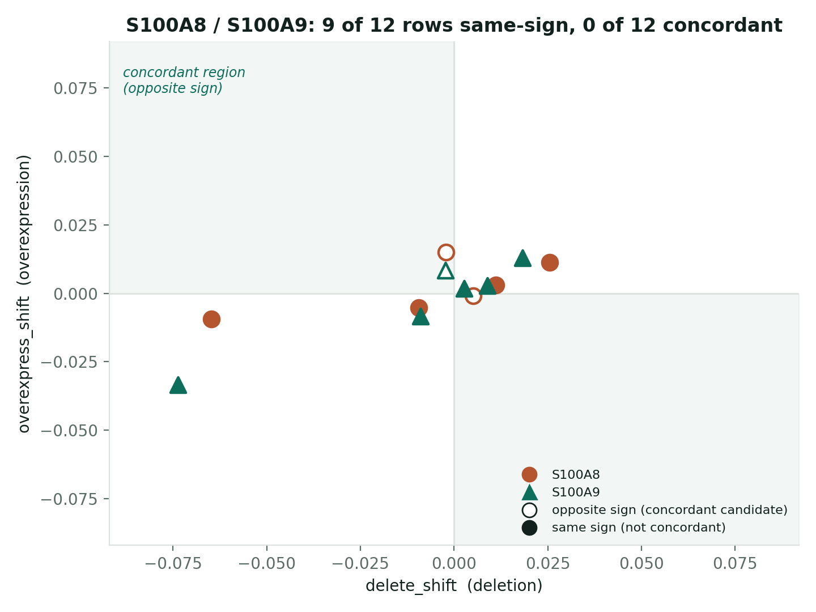
S100A8 and S100A9: an overwhelming FDR, and no concordance at all
RESULTS · A LATER, EXPANDED SCREEN
9 of 12 rows same-sign; 0 of 6 comparisons concordant
Example: S100A8, LUAD→SCLC deletion — FDR = 1.45e-224, N = 713 detections, shift = +0.0255. The FDR is a certainty claim, not a size claim — it says nothing about direction. First appearance of these two genes in this deck: caveated from the start, not a later correction.
What the LUAD-normal and SCLC-normal rows can and cannot lean on
Of 12 rows, 8 touch the normal class (4 comparisons). For luad↔normal, 3 of 4 normal donors are the same patients as 3 LUAD donors — real protection against a separate-cohort confound, though only 3 of 4. No such pairing exists for sclc↔normal.
In plain words: an FDR of 1.45e-224 says the shift is almost certainly not chance, not that it is large or meaningful; S100A8/S100A9 still fail the both-directions test in all 6 comparisons.
15 / 26
isp_plausibility_top_candidates.csv @ b99365b
Notes:
[1:15] Timing budget for this slide; cumulative 17:30 of 23:45 speaking (30-min slot = ~25 min talk + ~5 min questions).
Slide 15 of 26 (main talk); slide 12 of the 25 Sep deck, content unchanged apart from the added 'In plain words' line.
Cited on the slide: isp_plausibility_top_candidates.csv @ b99365b
Sources note (docs/lung_tcell_talk_imrad_sources_20260925.md, row for original slide 12): Results R4: S100A8/S100A9 FDR + concordance failure. Source: `isp_plausibility_top_candidates.csv` @ `b99365b`
Commits cited are in geneformer-lung-tcell; the files themselves are in this package under data/git/<commit>/ (see data/MANIFEST.tsv).

Slide 16
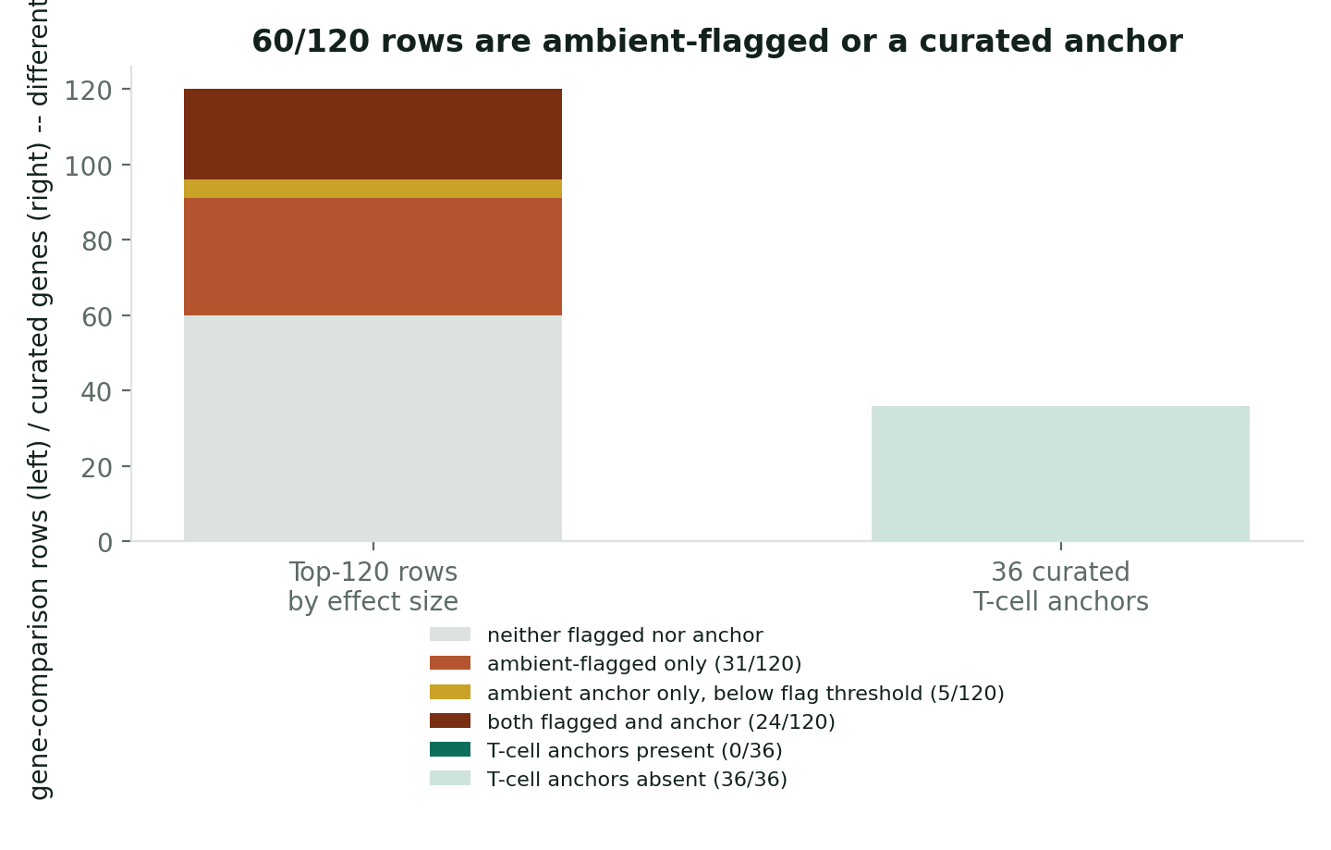
Half the top 120 is ambient-flagged or a curated ambient anchor
RESULTS · SCREEN-LEVEL AMBIENT AUDIT
60/120
rows are ambient-flagged, a curated ambient anchor, or both: 31 flagged-only, 5 anchor-only, 24 both — a real partition of the 120, not two overlapping counts added together
5/120
rows are anchors below the flag threshold — mechanical, not a miss: the threshold is the anchors' own 25th percentile of risk, so some anchors falling under it is built in.
0/36
of the 36 curated T-cell-intrinsic anchor genes (a different denominator: the full curated list, not a row count) appear anywhere in the 120.
In plain words: half of the 120 strongest hits carry a flag for possible contamination by RNA from other cells, or are known contaminant marker genes, so they need caution before being called T-cell biology.
16 / 26
top_n_by_effect rows, ambient_risk_manifest.json @ b99365b
Notes:
[1:15] Timing budget for this slide; cumulative 18:45 of 23:45 speaking (30-min slot = ~25 min talk + ~5 min questions).
Slide 16 of 26 (main talk); slide 13 of the 25 Sep deck, content unchanged apart from the added 'In plain words' line.
Cited on the slide: top_n_by_effect rows, ambient_risk_manifest.json @ b99365b
Sources note (docs/lung_tcell_talk_imrad_sources_20260925.md, row for original slide 13): Results R5: Ambient audit, 60/120 union. Source: same CSV + `ambient_risk_manifest.json` @ `b99365b`
Commits cited are in geneformer-lung-tcell; the files themselves are in this package under data/git/<commit>/ (see data/MANIFEST.tsv).

Slide 17
One candidate survives every check
RESULTS · NOT A NULL STUDY
NBEAL1
5 of 5 comparisons concordant — every one it appears in — detected in 75.0% of cells.
Passes the same concordance test that eliminates S100A8/S100A9, at a detection rate well above the ambient range flagged for those two. Does not make it a validated driver on its own — makes it the one candidate this screen has not been able to eliminate.
Not everything restored from the original screen fails, and the one thing that doesn't fail is more informative for having survived a real test.
In plain words: NBEAL1 passed the both-directions test in all 5 comparisons it appears in and is seen in 3 of every 4 cells, so it is not a rare-gene artefact; it is a candidate, not a proven driver.
17 / 26
isp_plausibility_top_candidates.csv @ b99365b
Notes:
[1:00] Timing budget for this slide; cumulative 19:45 of 23:45 speaking (30-min slot = ~25 min talk + ~5 min questions).
Slide 17 of 26 (main talk); slide 14 of the 25 Sep deck, content unchanged apart from the added 'In plain words' line.
Cited on the slide: isp_plausibility_top_candidates.csv @ b99365b
Sources note (docs/lung_tcell_talk_imrad_sources_20260925.md, row for original slide 14): Results R6: NBEAL1. Source: same CSV @ `b99365b`
Commits cited are in geneformer-lung-tcell; the files themselves are in this package under data/git/<commit>/ (see data/MANIFEST.tsv).

Slide 18
S100 genes did not beat their matched control genes
RESULTS · NEW SINCE 25 SEP · PRE-REGISTERED, RUN 2026-09-28
Question and design
Do simulated deletion and overexpression of S100 genes push LUAD T cells toward normal or SCLC more than matched control genes do, and more so for the 4 S100 genes at high ambient-RNA risk (S100A2, S100B, S100A13, S100PBP) than for 4 at low risk (S100A4, S100A6, S100A10, S100A11)?
Each gene vs its own 20 detection-matched controls; the two groups of 4 compared with an exact Mann-Whitney test; all registered in advance.
Result: negative in both comparisons
LUAD → normal: U = 1.5, p = 6/70 (0.086).
LUAD → SCLC: U = 5.5, p = 34/70 (0.49).
Stability gate not positive (0/160 leave-one-control-out). No-op check passed. S100P and S100A16 not estimable (40 and 48 cells, below the 50-cell gate). S100A8/S100A9 excluded by design (classifier anchors).
How to read it
The test was small: with 4 v 4 the smallest possible p is 2/70 (0.029), reached only by complete separation.
The ambient-high genes did not beat matched controls more than the ambient-low genes. No claim is made from the ambient-low genes' high scores.
This neither confirms nor contradicts the S100A8/S100A9 slides.
In plain words: in a small, pre-registered test, S100 genes flagged for possible contamination did not stand out against look-alike control genes.
18 / 26
RESULT.md, primary_results.json @ 53adee2 (main via PR #37, 4455914)
Notes:
[1:30] Timing budget for this slide; cumulative 21:15 of 23:45 speaking (30-min slot = ~25 min talk + ~5 min questions).
Slide 18 of 26 (main talk). ADDED 2026-09-28 (not in the 25 Sep deck).
NEW since the 25 Sep deck; pre-registered; run 2026-09-28.
Status, U, p, stability gate, no-op PASS, S100P/S100A16 not_estimable, anchors S100A8/A9: data/git/53adee2/.../results_s100_luad_20260928/RESULT.md (geneformer-lung-tcell @ 53adee2; merged to main in PR #37, 4455914); numbers read at build time from data/git/53adee2/.../results_s100_luad_20260928/primary_results.json (@ 53adee2)
Gene groups and ambient risk: data/git/53adee2/.../s100_isp/analyse_s100_luad_20260928.py (@ 53adee2): gene groups, Ensembl IDs, ambient-risk values
Wording rules (never 'no effect'; state the 2/70 floor; no claim from clean genes' high Q): the lab's ISP outcome standard (ISP-STD-1 v1.1, the floor's wording rules; not in this package)
Mann-Whitney test: Mann HB, Whitney DR. On a test of whether one of two random variables is stochastically larger than the other. Ann Math Stat 1947. doi:10.1214/aoms/1177730491

Slide 19
What this establishes, and what it rules out
DISCUSSION · SYNTHESIS
Establishes
Four checkpoint/persistence hits (TIGIT, TIM-3, CTLA-4, IL7R) replicate and validate independently in spatial tissue data. A concordance test and a screen-level ambient audit are necessary companions to significance for any further perturbation-based driver claim. One further candidate (NBEAL1) clears every check applied.
Resolves
The checkpoint-axis ordering the original team flagged as open (“pending T2 and T3”) is closed: donor-level SCLC-vs-LUAD shows no significant difference in either direction, once a single donor's cell-count share is accounted for.
Rules out
S100A8/S100A9 as T-cell-intrinsic dysfunction drivers, at high confidence, independent of model precision. Model precision (bf16) as an explanation for any finding in this deck.
19 / 26
Notes:
[1:00] Timing budget for this slide; cumulative 22:15 of 23:45 speaking (30-min slot = ~25 min talk + ~5 min questions).
Slide 19 of 26 (main talk); slide 17 of the 25 Sep deck, content unchanged.
Sources note (docs/lung_tcell_talk_imrad_sources_20260925.md, row for original slide 17): Discussion D1: Synthesis. Source: (rolls up the above)
Commits cited are in geneformer-lung-tcell; the files themselves are in this package under data/git/<commit>/ (see data/MANIFEST.tsv).

Slide 20
What this study does not establish
DISCUSSION · LIMITATIONS, THEN WHERE THIS LEAVES US
Detection-confound axis is an imperfect proxy
Ambient risk is scored partly against the classifier being audited — evidence of resemblance to known contaminants, not a direct contamination measurement.
Single cohort; curated lists
One HTAN/CELLxGENE cohort; the ambient-anchor and T-cell-anchor gene lists are curated, not ground truth. A different cohort or anchor set could shift specific gene calls.
Thin normal class, both counts
1 held-out test donor AND 4 cohort donors overall — already a named limitation in the repo's own methods (METHODS.md, lines 24-25), carried forward here, not newly flagged.
Tissue-of-origin skew, per contrast
SCLC: 7/19 (37%) lung, 12/19 metastatic. LUAD: 16/22 (73%) lung. Normal: 4/4 (100%) lung. Skews sclc_to_normal/normal_to_sclc, not luad_to_normal/normal_to_luad (which benefits from the 3-of-4 shared-patient pairing above).
Open questions: the original talk's CRISPR TIGIT/HAVCR2 knockout proposal; does NBEAL1 replicate independently; the talk's own still-open question — “if SCLC T cells are not exhausted, what are they, and why does ICI still fail?” A clean negative, honestly obtained, is a contribution.
20 / 26
perturbation_workflow/METHODS.md lines 24-25; talk/JSDP_P25_talk.pdf, slide 11
Notes:
[1:15] Timing budget for this slide; cumulative 23:30 of 23:45 speaking (30-min slot = ~25 min talk + ~5 min questions).
Slide 20 of 26 (main talk); slide 18 of the 25 Sep deck, content unchanged.
Cited on the slide: perturbation_workflow/METHODS.md lines 24-25; talk/JSDP_P25_talk.pdf, slide 11
Sources note (docs/lung_tcell_talk_imrad_sources_20260925.md, row for original slide 18): Discussion D2/D3: Limitations, closing. Source: `perturbation_workflow/METHODS.md` lines 24–25; `talk/JSDP_P25_talk.pdf`, slide 11
Commits cited are in geneformer-lung-tcell; the files themselves are in this package under data/git/<commit>/ (see data/MANIFEST.tsv).

Slide 21
Terms used in this talk
GLOSSARY
Term | Meaning here
Single-cell RNA-seq | Measures which genes are active in each individual cell.
T-cell dysfunction / exhaustion | A worn-out T-cell state after chronic stimulation, with inhibitory receptors (PD-1, TIM-3, CTLA-4) (Wherry 2015).
Immune checkpoint | An inhibitory receptor that brakes T cells; checkpoint-inhibitor drugs block it.
Foundation model (Geneformer) | A model pre-trained on many cells, then fine-tuned for one task (Theodoris 2023).
Embedding | The list of numbers the model uses to place a cell; similar cells sit close together.
In silico perturbation | Deleting or boosting a gene in the model's input and measuring the shift.
Concordant | Deletion and overexpression move the cell in opposite directions, both significant.
FDR | False discovery rate: the expected share of false calls among all calls (Benjamini 1995).
Donor-level analysis | Each person counted once, so one person's many cells cannot dominate.
Ambient RNA | Free-floating RNA from other cells that contaminates a cell's reads (Young 2020).
Matched controls | Non-S100 genes chosen to be detected about as often as the gene tested.
Mann-Whitney U | A rank test of whether one group tends to score higher than another (Mann 1947).
Pre-registration | Fixing the test and its pass/fail rule in writing before seeing the result.
bf16 | A lower-precision number format; used to check that rounding does not drive results.
21 / 26
definitions: this talk; Wherry 2015; Theodoris 2023; Benjamini 1995; Young 2020; Mann 1947
Notes:
[0:15] Timing budget for this slide; cumulative 23:45 of 23:45 speaking (30-min slot = ~25 min talk + ~5 min questions).
Slide 21 of 26 (main talk). ADDED 2026-09-28 (not in the 25 Sep deck).
Glossary definitions are this talk's working definitions. Literature: Wherry EJ, Kurachi M. Molecular and cellular insights into T cell exhaustion. Nat Rev Immunol 2015. doi:10.1038/nri3862; Theodoris CV, Xiao L, Chopra A, et al. Transfer learning enables predictions in network biology. Nature 2023. doi:10.1038/s41586-023-06139-9; Benjamini Y, Hochberg Y. Controlling the false discovery rate: a practical and powerful approach to multiple testing. J R Stat Soc B 1995. doi:10.1111/j.2517-6161.1995.tb02031.x; Young MD, Behjati S. SoupX removes ambient RNA contamination from droplet-based single-cell RNA sequencing data. GigaScience 2020. doi:10.1093/gigascience/giaa151; Mann HB, Whitney DR. On a test of whether one of two random variables is stochastically larger than the other. Ann Math Stat 1947. doi:10.1214/aoms/1177730491

Slide 22
Backup slides
APPENDIX
Deep-dive technical slides, kept for questions:
A1 · Precision control: is any of this a bf16 artefact? (was slide 15 of the 25 Sep deck)
A2 · Mechanism: the four hits in one interaction neighbourhood (was slide 16; the designated cut for a shorter slot)
A3 · S100 ISP per-gene scores (new, 2026-09-28)
A4 · All 31 immune / lineage genes ranked by deletion shift (panel b of the detection figure, moved here so it can be read at 14 pt)
22 / 26
Notes:
[--] Appendix: not in the timed talk; show only if asked.
Slide 22 of 26 (appendix). ADDED 2026-09-28 (not in the 25 Sep deck).
Appendix divider. Slides moved here, not deleted, per the 2026-09-28 request to keep the main talk length sane.

Slide 23
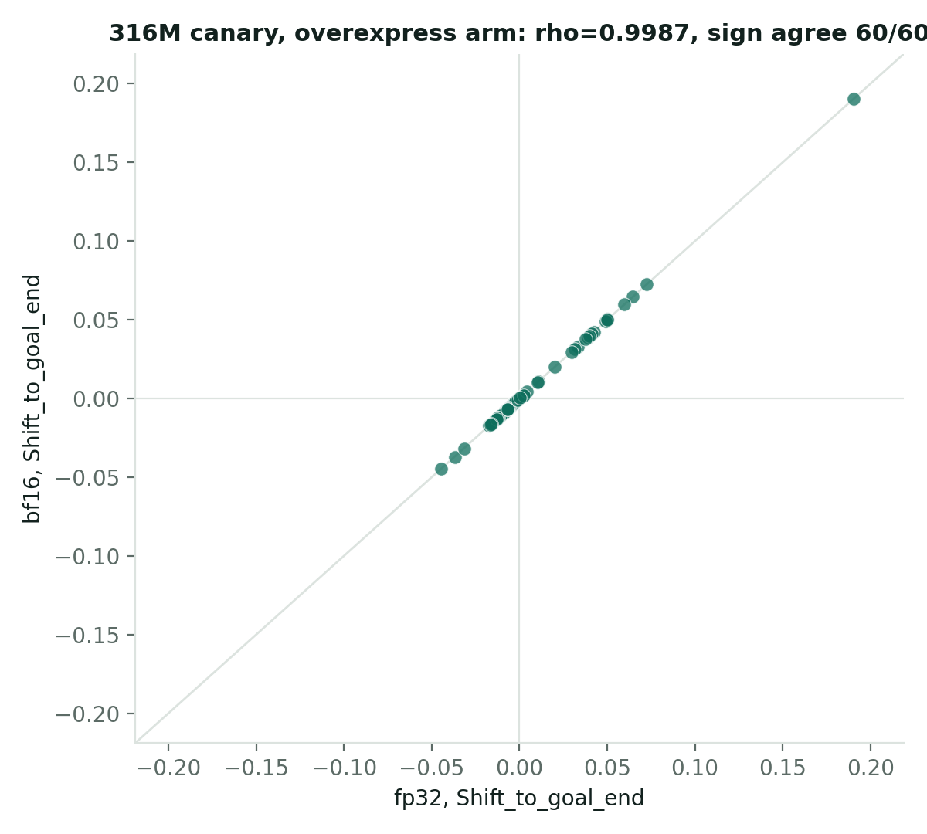
No: precision replicates cleanly; model size is the axis that moves things
RESULTS · CONTROL, IS ANY OF THIS A PRECISION ARTIFACT?
Same model, fp32 vs. bf16 (half precision)
104M panel (300 rows): rho = 0.9998, sign agreement 298/300. 316M canary (60 rows): rho = 0.9987, sign agreement 60/60.
The pre-registered 104M sign-agreement gate is still recorded FAIL — a bitwise-deterministic fp32-vs-fp32 rerun made the noise floor zero, not a usable sign threshold; the domain reviewer's ruling was that the frozen gate stands unamended, not that bf16 disagrees with fp32. Both are true at once.
Same model, changed precision vs. changed size
Precision (104M fp32→bf16): rho = 0.9998. Size (104M→316M, both bf16): rho = 0.489. Using (1−rho) as the divergence measure, size moves results ~2,500x (~3.4 orders of magnitude) more than precision. None of this deck's findings are precision artifacts.
In plain words: rerunning the model at lower numerical precision gave essentially the same answers (rho 0.9998), so rounding does not explain any result in this talk.
23 / 26
committed_run_stats/{bf16,316m_bf16,...} @ origin/main; RESULTS_BF16.md @ afa0564
Notes:
[--] Appendix: not in the timed talk; show only if asked.
Slide 23 of 26 (appendix); slide 15 of the 25 Sep deck, content unchanged apart from the added 'In plain words' line.
Cited on the slide: committed_run_stats/{bf16,316m_bf16,...} @ origin/main; RESULTS_BF16.md @ afa0564
Sources note (docs/lung_tcell_talk_imrad_sources_20260925.md, row for original slide 15): Results R7: bf16 + frozen-FAIL gate. Source: `committed_run_stats/*` @ `origin/main`; `RESULTS_BF16.md` @ `afa0564`
Commits cited are in geneformer-lung-tcell; the files themselves are in this package under data/git/<commit>/ (see data/MANIFEST.tsv).

Slide 24
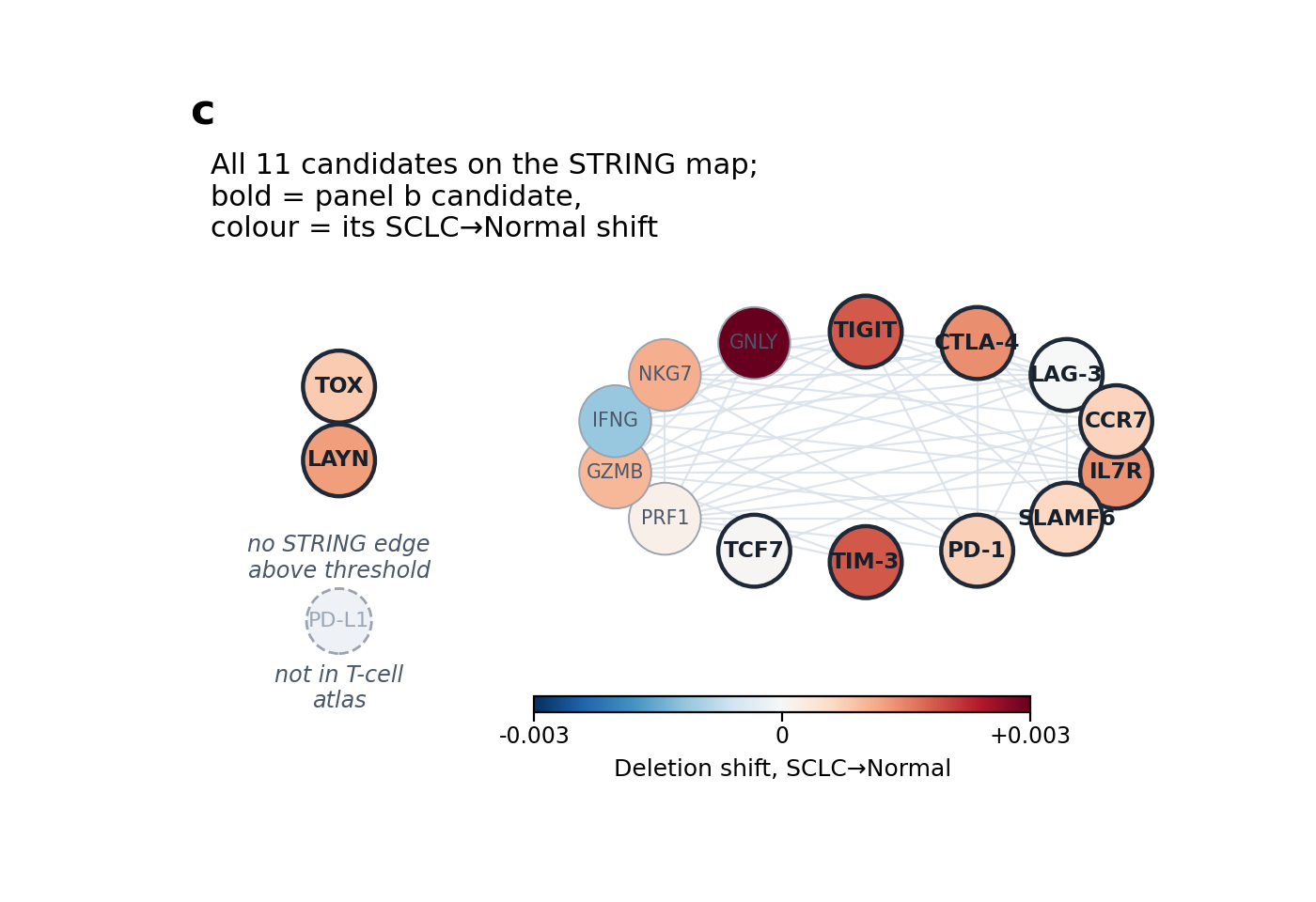
The four original hits sit in one connected interaction neighbourhood
RESULTS · MECHANISM (DESIGNATED CUT FOR A SHORTER SLOT)
From prior literature, not inferred from these cells
TIGIT: CAR-T support. TIM-3: solid-tumour knockout precedent. CTLA-4: real signal, less CAR-T-specific. IL7R: persistence, not exhaustion. 54 STRING edges among 16 context genes; TOX and LAYN have no edge above threshold; PD-L1 is absent from the T-cell atlas.
No caveat — these four hits are unaffected by anything in this deck's audit.
In plain words: the links between these genes come from STRING, a public database of known and predicted protein interactions (Szklarczyk 2023), i.e. from prior literature, not from these cells.
24 / 26
talk/JSDP_P25_talk.pdf, slide 10 (STRING literature overlay)
Notes:
[--] Appendix: not in the timed talk; show only if asked.
Slide 24 of 26 (appendix); slide 16 of the 25 Sep deck, content unchanged apart from the added 'In plain words' line.
Cited on the slide: talk/JSDP_P25_talk.pdf, slide 10 (STRING literature overlay)
Sources note (docs/lung_tcell_talk_imrad_sources_20260925.md, row for original slide 16): Results R8 (designated cut): STRING mechanism. Source: `talk/JSDP_P25_talk.pdf`, slide 10
Commits cited are in geneformer-lung-tcell; the files themselves are in this package under data/git/<commit>/ (see data/MANIFEST.tsv).

Slide 25
Each S100 gene's percentile against its own 20 matched controls (Q)
APPENDIX · S100 ISP PER-GENE SCORES (NEW, 2026-09-28)
Gene | Ensembl ID | Group | Ambient risk | Q, LUAD→normal | Q, LUAD→SCLC
S100A2 | ENSG00000196754 | ambient-high | 0.955 | 88.1 | 97.6
S100B | ENSG00000160307 | ambient-high | 0.859 | 21.4 | 16.7
S100A13 | ENSG00000189171 | ambient-high | 0.796 | 26.2 | 59.5
S100PBP | ENSG00000116497 | ambient-high | 0.744 | 54.8 | 78.6
S100A4 | ENSG00000196154 | ambient-low | 1.1e-06 | 88.1 | 97.6
S100A6 | ENSG00000197956 | ambient-low | 3.4e-05 | 97.6 | 88.1
S100A10 | ENSG00000197747 | ambient-low | 0.000312 | 92.9 | 88.1
S100A11 | ENSG00000163191 | ambient-low | 0.000144 | 64.3 | 50.0
Group test (exact two-sided Mann-Whitney, 4 v 4): LUAD→normal U = 1.5, p = 6/70; LUAD→SCLC U = 5.5, p = 34/70. Negative in both. The ordering seen (ambient-low above) is descriptive only; the ambient-low genes' high Q was not tested and supports no claim.
25 / 26
primary_results.json, analyse_s100_luad_20260928.py @ 53adee2
Notes:
[--] Appendix: not in the timed talk; show only if asked.
Slide 25 of 26 (appendix). ADDED 2026-09-28 (not in the 25 Sep deck).
Q values and group test read at build time from data/git/53adee2/.../results_s100_luad_20260928/primary_results.json (@ 53adee2)
Ensembl IDs, groups and ambient-risk values: data/git/53adee2/.../s100_isp/analyse_s100_luad_20260928.py (@ 53adee2): gene groups, Ensembl IDs, ambient-risk values
Q is the gene's midrank percentile among its 20 matched controls; 8 of 8 genes have 20 valid controls in both contrasts.

Slide 26
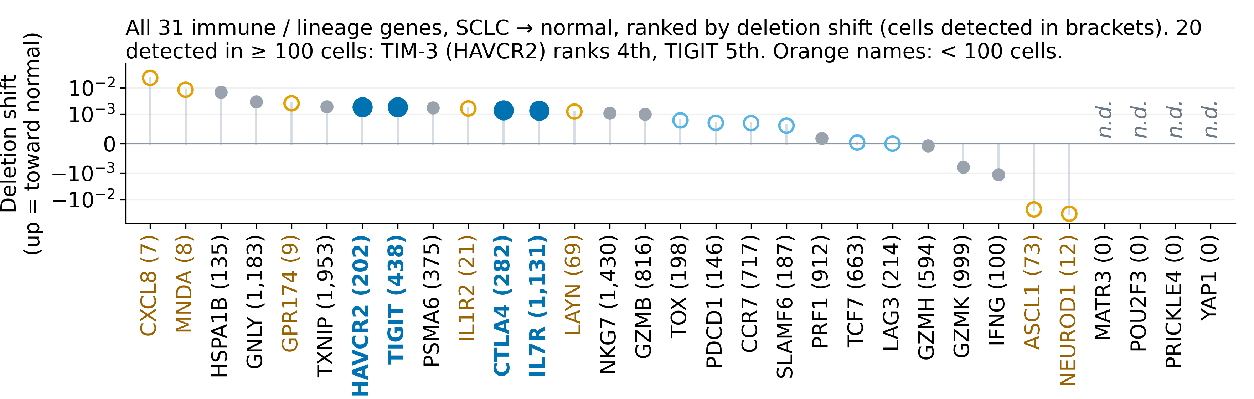
Every immune / lineage gene, ranked by its deletion effect
APPENDIX · DETECTION FIGURE, PANEL B
In plain words: the four replicated hits sit near the top among well-detected genes; the very top is taken by genes seen in fewer than 100 cells, whose effects are unreliable.
26 / 26
cart_overexpression_vs_deletion.csv @ eb533f8 (make_detection_figure.py rule)
Notes:
[--] Appendix: not in the timed talk; show only if asked.
Slide 26 of 26 (appendix). ADDED 2026-09-28 (not in the 25 Sep deck).
Panel b of the original detection figure (poster Fig. 6 / JSDP talk slide 7), redrawn 2026-09-28 by src/make_readable_figures.py so its 31 gene names read at 14 pt; the slide-size slot of the Results slide cannot hold them. Same genes, values, ranks (TIM-3 4th, TIGIT 5th of 20 detected in >= 100 cells) and colour rules as data/git/eb533f8/.../scripts/make_detection_figure.py.
Data: data/git/eb533f8/sclc_validation/checkpoint_cart_perturbation/tables/cart_overexpression_vs_deletion.csv and cart_engineering_perturbation.csv (last changed 37a0211).

