Slide 1
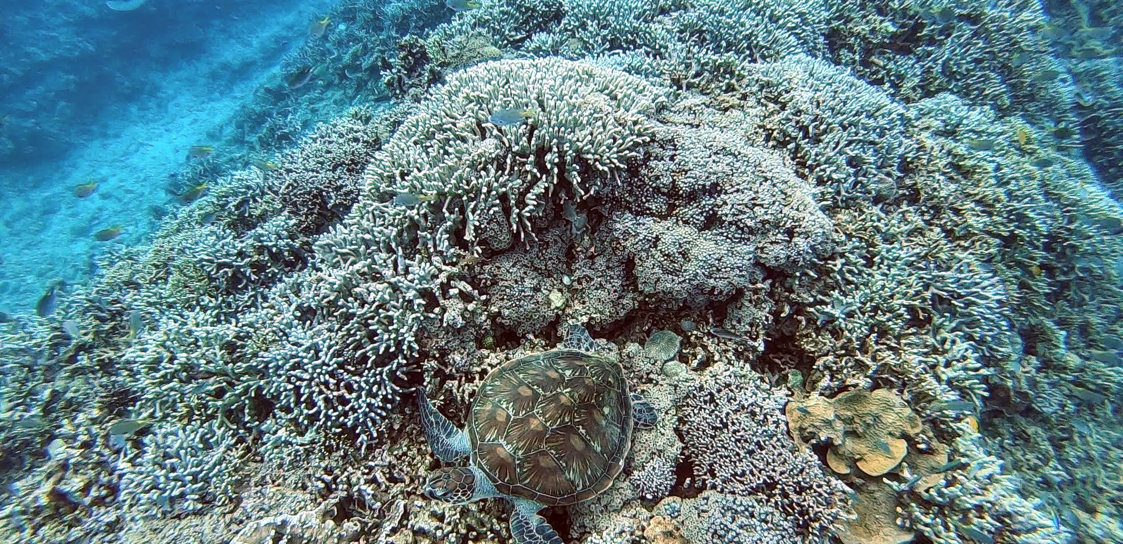
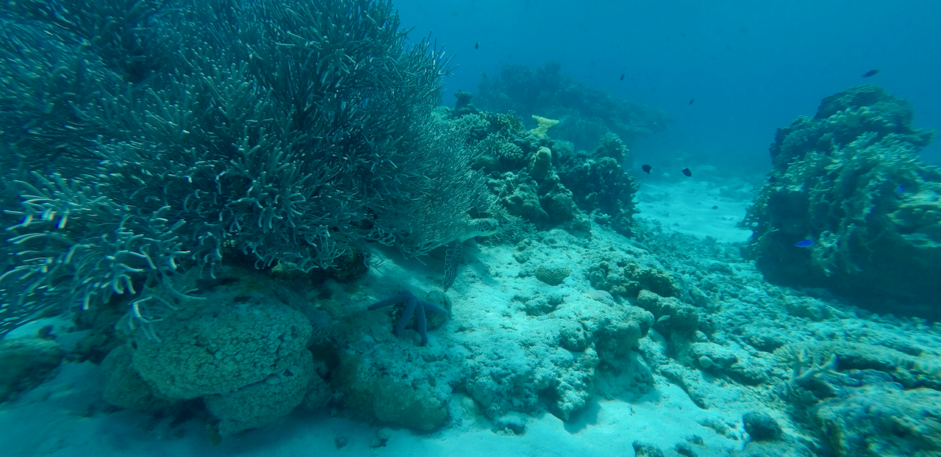
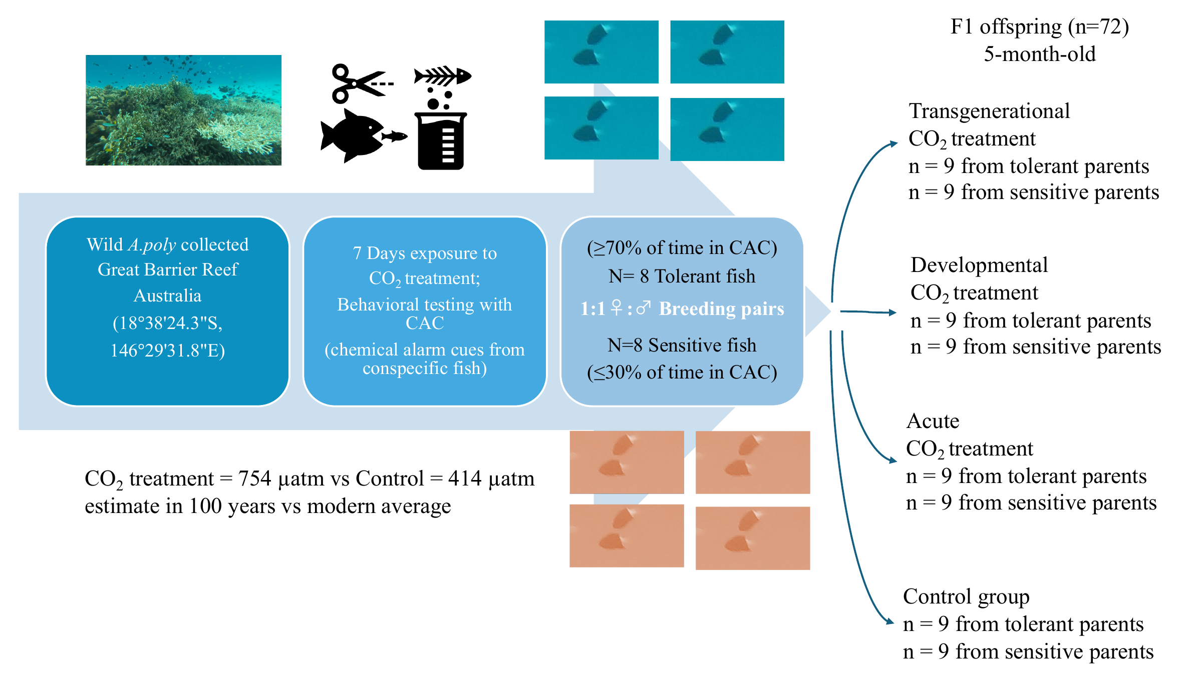
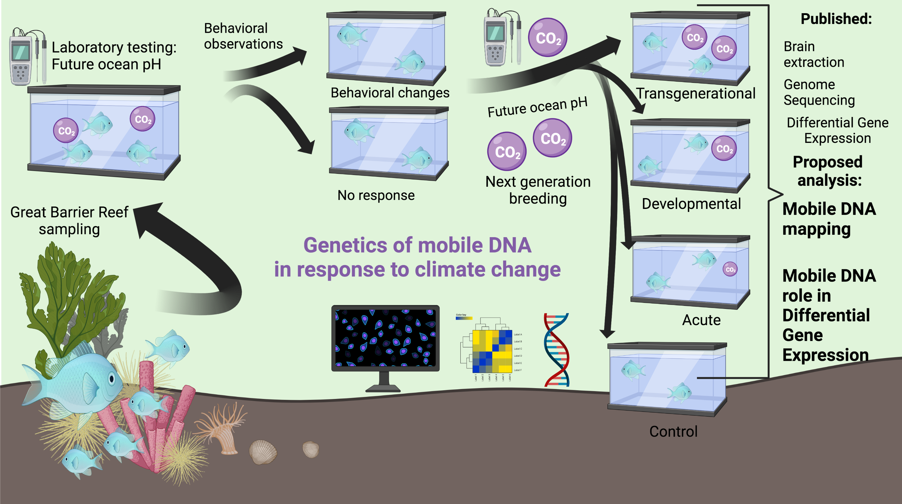
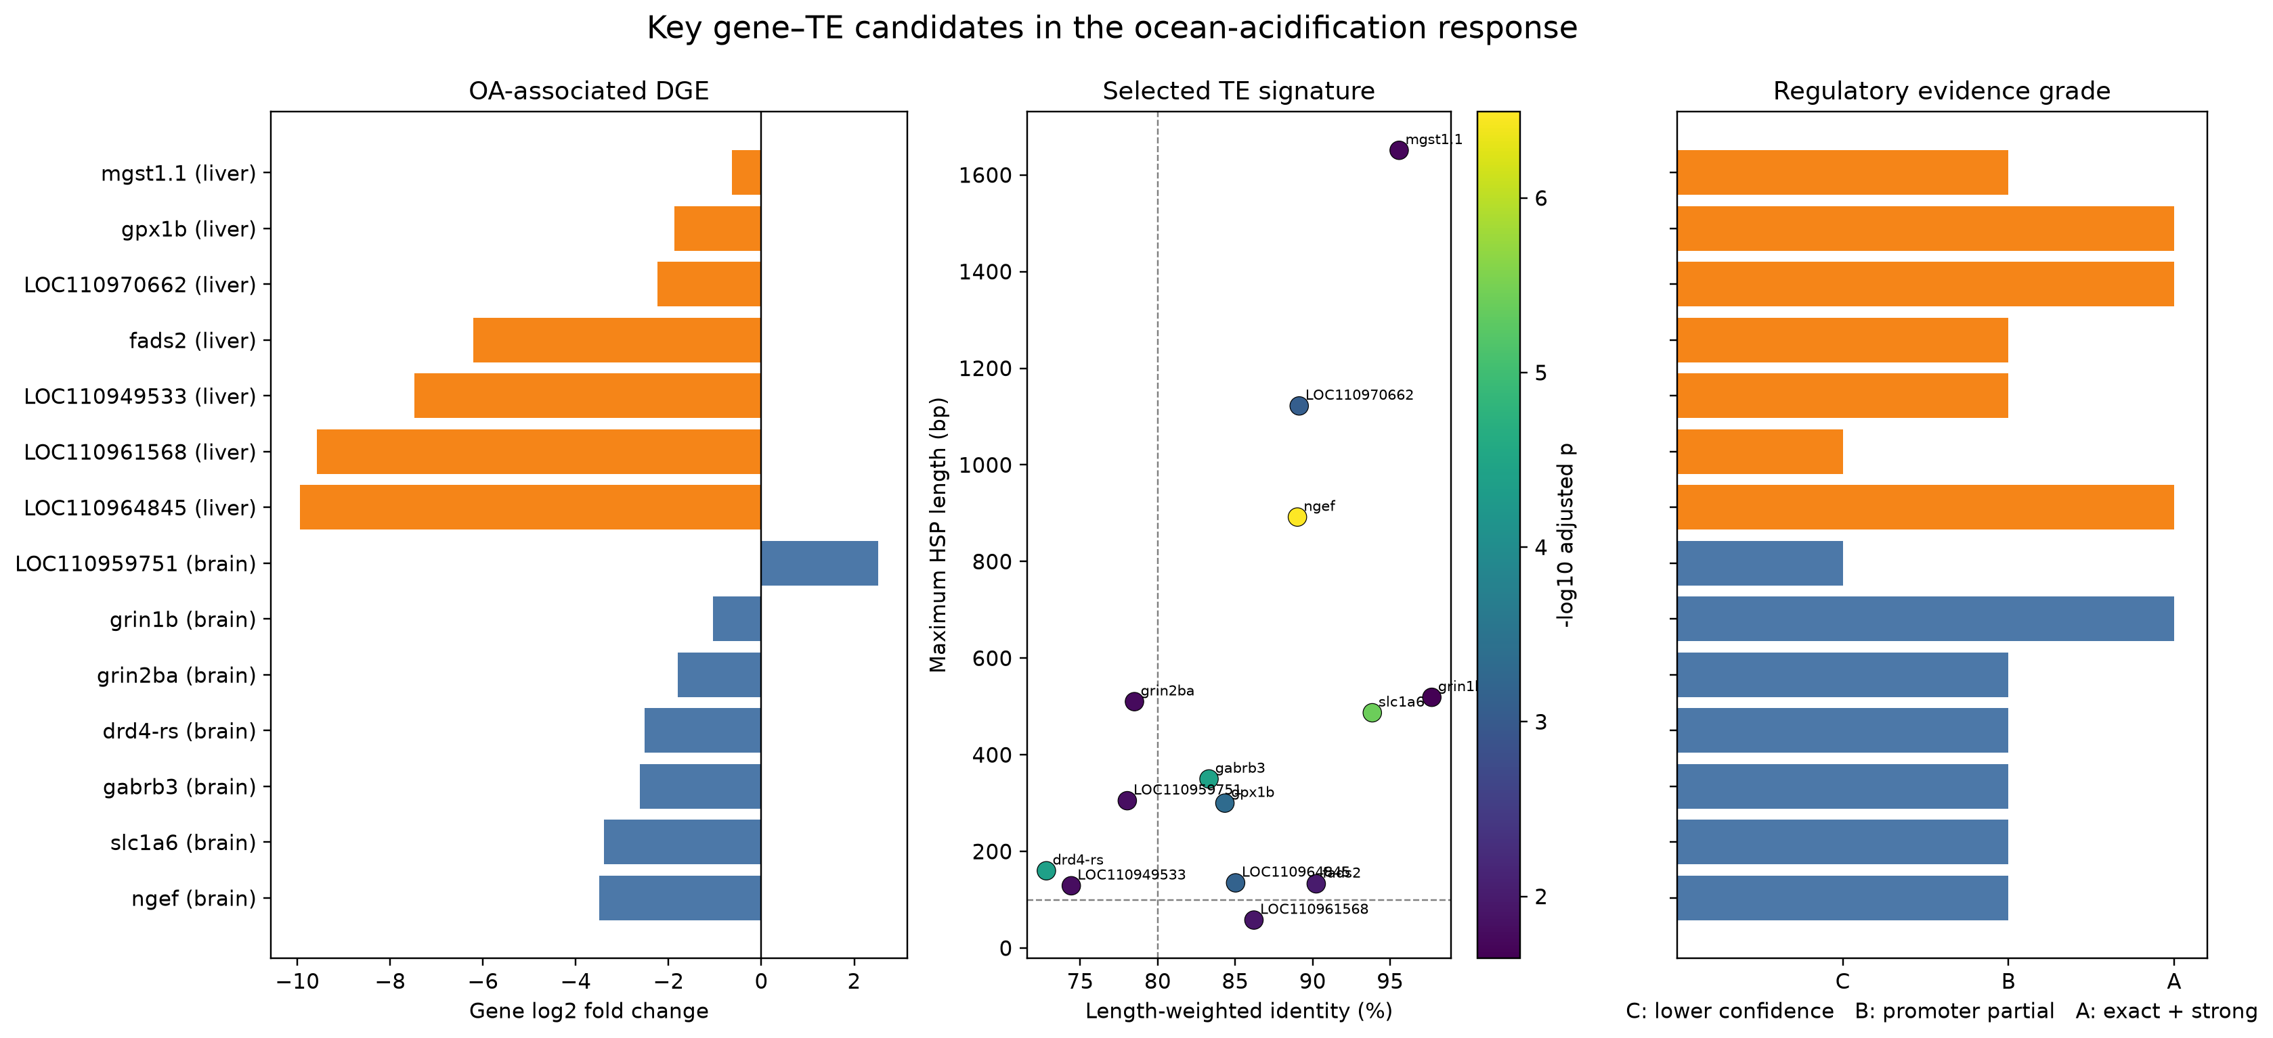
CITIZEN SCIENCE • OCEAN ACIDIFICATION
EXPLORATORY — NOT FINAL
How do reef fish respond to a changing ocean?
A first look at hidden “jumping gene” activity in the brain and liver
Kaisar Dauyey | TE Ocean Acidification Project
Turtle and coral reef • photo supplied by Kaisar Dauyey
Aka Island reef, Japan • photo: Kaisar Dauyey
EXPERIMENTAL DESIGN
FROM REEF TO “JUMPING GENES”
GENE-EXPRESSION SIGNATURES
Wild parents were classified as tolerant or sensitive before offspring entered control, developmental or intergenerational CO₂ histories.
The workflow connects reef sampling and behavior with RNA sequencing, gene expression and transposable-element mapping.
Brain candidates emphasize neural signalling; liver candidates emphasize metabolism, oxidative stress and detoxification.
THE CLEAREST TISSUE PATTERN
SIGNALS TO FOLLOW UP
Significant TE results in the two contrasts with the strongest brain–liver differences • FDR < 0.05
BRAIN
LIVER
gabra5 and gabrb3 point to inhibitory-neural signalling. Other prioritized candidates include ngef, grin genes and slc1a6.
mgst1.1, gpx1b and fads2 highlight oxidative-stress, metabolism and detoxification pathways.
NEXT: VALIDATE IN 162 LIBRARIES
The larger brain–gill–liver cohort will test whether these tissue and gene signatures hold up. Association does not prove regulation.
Pilot results: FDR < 0.05 • 60 samples • association does not prove regulation
Suresh et al. (2023) • TE Ocean Acidification Project
Notes:
[Sources]
- Left hero photograph: GPTempDownload.jpg (supplied by Kaisar Dauyey)
- Right hero photograph: coral-aka-kame.png (Kaisar Dauyey, Aka Island, Japan, 17 April 2024)
- Experimental-design schematic: figure_method1draft.pdf
- Project workflow illustration: Figure2_1.png
- Gene/TE candidate signature figure: key_gene_te_oa_functional_map.png
- matched_tissue_comparison.csv
- aggregate_summary.csv
- gaba_signature_summary.csv
- analysis_summary.csv
- Suresh et al. (2023), Nature Climate Change, https://doi.org/10.1038/s41558-023-01793-1
- Feschotte (2008), Nature Reviews Genetics, https://doi.org/10.1038/nrg2336
- NCBI BioProjects PRJNA694131 and PRJNA801251
Audience note: plain-language citizen-science version. “Jumping genes” refers to transposable elements. Results are exploratory and based on the completed 60-sample pilot; the 162-library validation analysis is pending.

