Slide 1
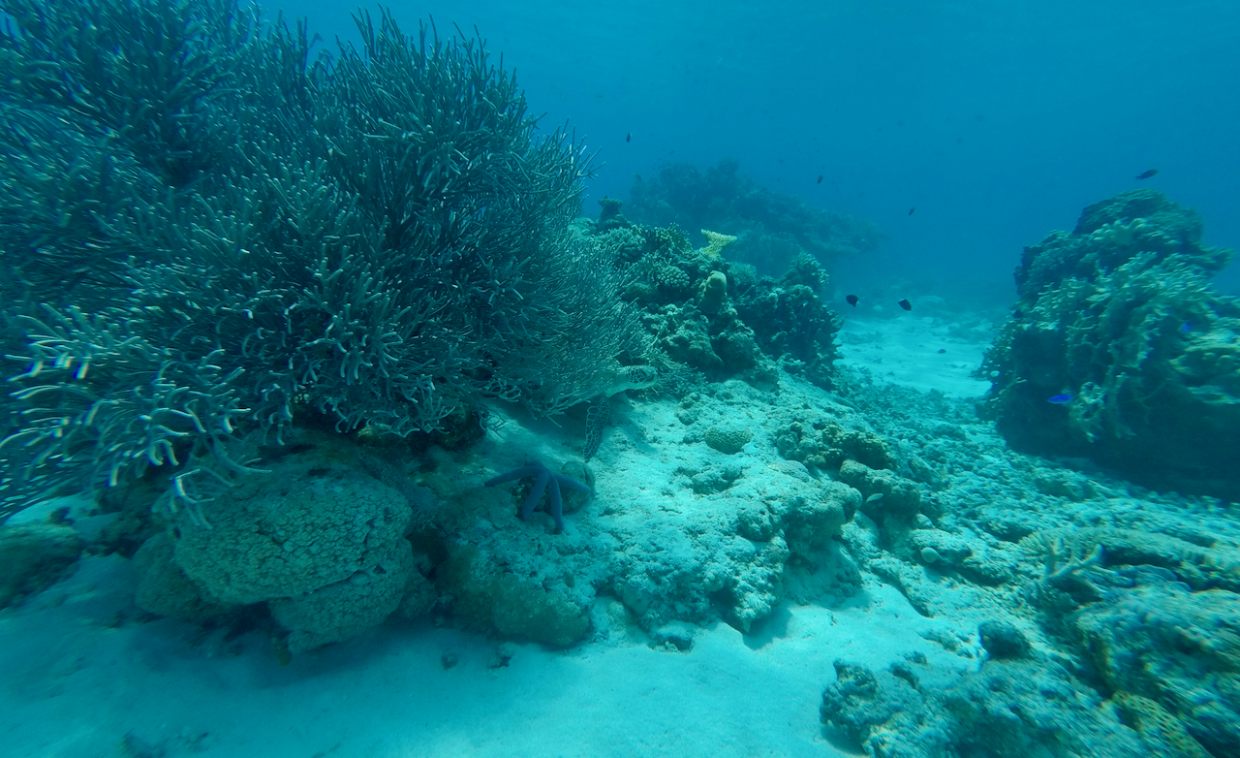
Tissue- and phenotype-dependent transposable-element responses to ocean acidification
EXPLORATORY PILOT
Analysis freeze: 30 July 2026
Exploratory brain–liver RNA-seq reanalysis in the coral reef fish Acanthochromis polyacanthus
60 samples • 30 brain • 30 liver
Kaisar Dauyey | TE Ocean Acidification Project
QUESTION
PRIMARY RESULT
CANDIDATE ASSOCIATIONS
Do developmental and intergenerational CO₂ exposures produce tissue- and parental-phenotype-specific TE responses?
The dominant TE response shifts from sensitive-parent brain after developmental exposure to tolerant-parent liver after intergenerational exposure.
Top TE–gene relationships remained strong after adjustment for family, treatment and phenotype.
Residual Spearman ρ • n = 30 per tissue
STUDY DESIGN
Significant strict-TE results by contrast
FDR < 0.05 • n = 5 per tissue × exposure × phenotype cell
n = 60
2 tissues × 3 exposure groups × 2 parental phenotypes
5 biological samples per cell
D–C developmental vs control
I–C intergenerational vs control
I–D intergenerational vs developmental
ANALYSIS
•
Species-specific de novo TE annotation
Brain candidates
Liver candidates
•
STAR alignment retaining multimappers
•
TEcount multi-mode quantification
NEURAL HYPOTHESIS
•
Family-aware DESeq2 model: ~ family + treatment
•
Adjusted TE–gene and GABA-pathway screens
3
GABA transporter 1-like
gabra5
gabrb3
direct GABA genes
in tolerant brain I–C
gabra5 and gabrb3 were also significant for I–D. These signals motivate targeted tests of inhibitory-neural regulation.
30
51
73 brain
93 liver
WHAT THIS SUPPORTS
Sensitive D–C
brain
contrasts with
Tolerant I–C
liver
unique significant strict-TE features across tested strata
•
Tissue identity is central to TE-response interpretation.
Aka Island reef, Japan • photo: Kaisar Dauyey
•
Parental phenotype changes which exposure contrast dominates.
INTERPRETATION
•
TE–gene correlations prioritize mechanistic candidates; they do not establish regulation.
VALIDATION STATUS
Parental phenotype modifies both the magnitude and tissue localization of TE responses. The pattern is consistent with distinct developmental and intergenerational regulatory states, but requires confirmation in the full cohort.
A 162-library brain–gill–liver cohort is frozen for full validation (54 libraries per tissue; 9 per experimental cell). Results shown here are the completed pilot only.
NEXT STEP
Validate effect direction, tissue specificity and GABA-linked candidates in the frozen 162-library cohort.
Pilot significance: Benjamini–Hochberg FDR < 0.05. Association ≠ causation. Full-cohort validation pending.
Suresh et al. (2023)
Notes:
[Sources]
- matched_tissue_comparison.csv
- aggregate_summary.csv
- brain_top5_candidates.csv
- liver_top5_candidates.csv
- gaba_signature_summary.csv
- coral-aka-kame.png (photo: Kaisar Dauyey, Aka Island, Japan, 17 April 2024)
- Suresh et al. (2023), Nature Climate Change, https://doi.org/10.1038/s41558-023-01793-1
- NCBI BioProjects PRJNA694131 and PRJNA801251
Interpretive note: these are exploratory pilot findings from 60 samples. The 162-library brain–gill–liver cohort is frozen, but its differential-expression and correlation results are not yet available.

