Slide 1
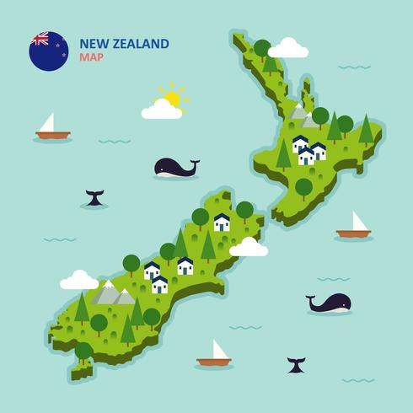
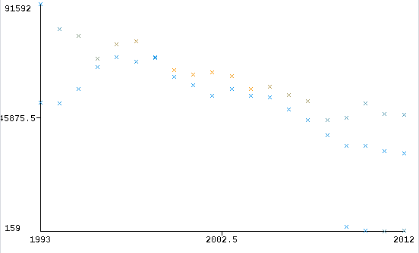
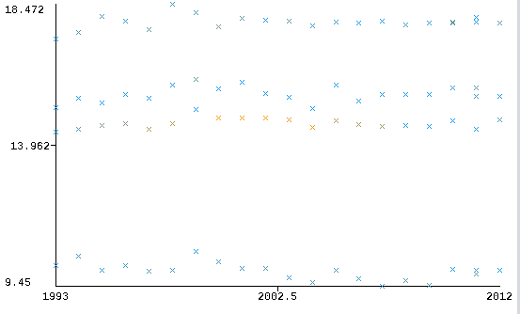
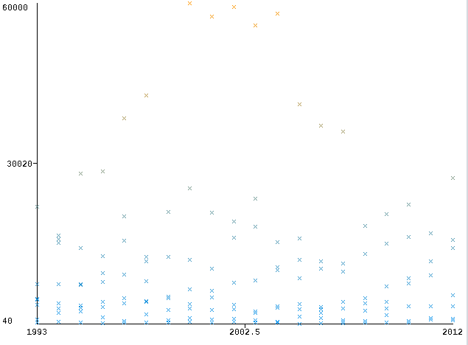
The recent bycatch amount does not affect the fish population in New Zealand!
There is a strong negative correlation with estimated trawling amount in the past 20 years
What we should be concerned for is Global Warming and temperature risings affecting our fish populations!
Because we are trawling significantly less, we are bycatching less amounts of fish!
Data from 4 different water regions around New Zealand, stating their mean temperature each year.
Year vs Trawl Amount
Our bycatch rate has decreased significantly over the past 10 years, across 8 examined fish species
Year vs Temperature
Fluxating curves each year due to pollution and other enviromental impacts are leading to a decrease in fish population!
Year vs Bycatch Amount

