Slide 1
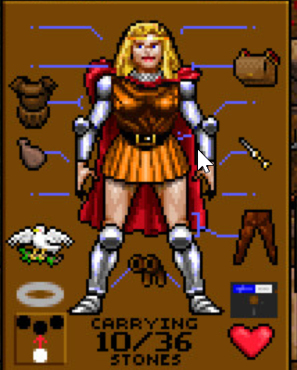
HEAD
NECK
BACKPACK
TORSO
SHIELD
WEAPON
FINGER
LEGS
FEET

