Slide 1

VYNGO TAKE-HOME
Vivi
Voice search for used commercial vehicles
A working agent that keeps every vehicle fact tied to the catalog.
Kayvan Shah
September 2026
Notes:
Open with the product in one sentence: Vivi turns a spoken vehicle need into a shortlist while the application owns every hard constraint and catalog fact. The talk has one goal: prove the demo works, then show exactly why it can be trusted. Design references: https://developer.samsung.com/one-ui/index.html https://developer.apple.com/design/human-interface-guidelines/dark-mode https://support.microsoft.com/en-us/powerpoint/tips-for-creating-and-delivering-an-effective-presentation https://styleguide.dynatrace.com/docs/best-practices/remove-ai-writing-patterns-from-content/ https://www.duarte.com/blog/how-to-develop-the-best-big-idea-for-your-presentation/ Project source: https://github.com/KayvanShah1/conversational-commercial-vehicle-search

Slide 2
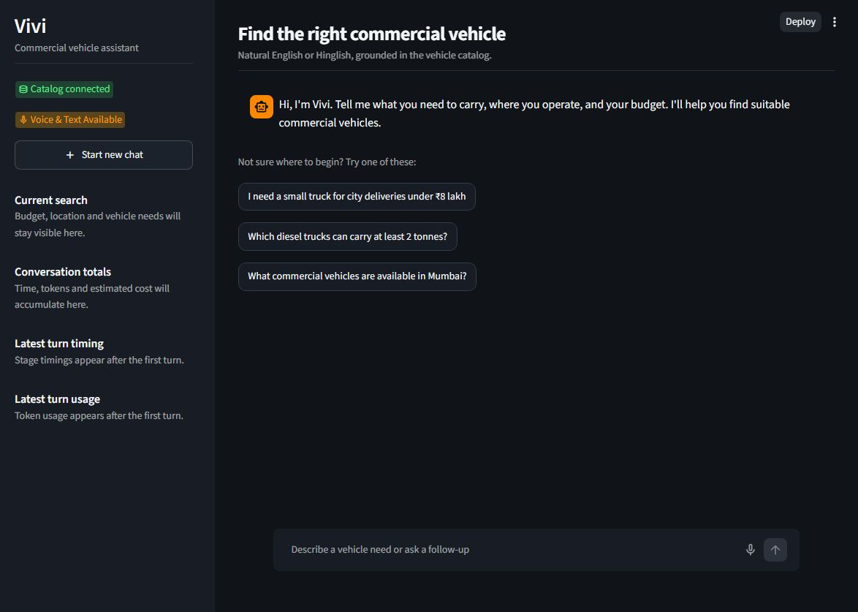
LIVE DEMO
The demo starts easy, then tests memory
1
Find
Chhota truck chahiye, 5 lakh ke andar, city delivery ke liye.
2
Correct
Nahi, diesel nahi, CNG.
3
Ask
Second one ka payload aur GVW kya hai?
4
Push it
Actually, show only CNG tankers under ₹1 lakh in Kolkata.
Actual localhost interface
02
Notes:
Run these four turns in one session. The order matters. The follow-up comes before the deliberate miss so it can reference the returned second vehicle. On the final turn, expect a plain sentence that reports no exact match and names one constraint that could be relaxed. Sources: https://github.com/KayvanShah1/conversational-commercial-vehicle-search#try-the-conversation https://github.com/KayvanShah1/conversational-commercial-vehicle-search/blob/main/docs/assignment/README.md

Slide 3
ARCHITECTURE
Seven seams, one process
The live path stays short. State and evaluation observe it without becoming extra agents.
01
02
03
04
05
Voice interface
Speech to text
Understanding
Catalog search
Response + TTS
Mic + playback
Groq Whisper
One agent
Hard filters
Grounded audio
06
Conversation state
07
Evaluation
Slots + result references
Cases + timings
Every seam has a current implementation and a clean production replacement.
03
Notes:
Walk left to right through the live voice path. Then point to state and evaluation below it. These are seven responsibility boundaries inside one process, not seven agents. Each boundary keeps a production replacement possible without changing the rest of the contract. Sources: https://github.com/KayvanShah1/conversational-commercial-vehicle-search/blob/main/docs/assignment/README.md https://github.com/KayvanShah1/conversational-commercial-vehicle-search/blob/main/docs/TECHNICAL_DECISIONS.md

Slide 4
SEARCH CORRECTNESS
₹5 lakh means ₹5 lakh
Ranking can reorder eligible rows. It cannot rescue a row that breaks a constraint.
Ranking weights
User words
Typed slots
SQL filters
Invariant
Top 3
Purpose fit
30%
natural request
budget, fuel, city
parameters only
recheck every row
rank valid rows
Verified papers
15%
Budget proximity
15%
Lower mileage
15%
Condition
15%
No match? Vivi tests one constraint at a time and names the first relaxation that produces a valid row.
Newer year
10%
Unused signals drop to zero. The remaining weights are normalized.
04
Notes:
This is the search contract. The model provides typed arguments. Application code builds parameterized SQL, applies every hard filter, and rechecks returned rows. Ranking happens only after eligibility. If the result set is empty, the application tests one active constraint at a time and suggests a relaxation that can actually produce a result. Source: https://github.com/KayvanShah1/conversational-commercial-vehicle-search/blob/main/docs/TECHNICAL_DECISIONS.md#ranking

Slide 5
GROUNDING BOUNDARY
Where the model stops
MODEL
APPLICATION
Choose one typed tool
Build SQL and enforce filters
Extract slot changes
Rank eligible vehicles
Validate IDs and numeric facts
Phrase a detail answer when useful
Use deterministic fallback
If a generated answer changes a listing ID or number, Vivi discards it and shows the deterministic answer.
05
Notes:
The model reasons at two narrow seams: tool choice with typed arguments, and optional phrasing over records already returned. The application owns SQL, filters, ranking, catalog facts, and validation. Ordinary searches use deterministic composition. A generated detail or comparison must preserve every required value or the fallback wins. Source: https://github.com/KayvanShah1/conversational-commercial-vehicle-search/blob/main/docs/TECHNICAL_DECISIONS.md#correctness-boundaries

Slide 6
CONVERSATION STATE
Each turn changes only what the buyer changed
TURN
WHAT THE BUYER SAYS
WHAT VIVI DOES
01
Small truck under 5 lakh for city delivery
Sets category, budget and purpose
02
Nahi, diesel nahi, CNG
Changes fuel only
03
Second one ka payload aur GVW kya hai?
Reads two fields from saved result 2
04
CNG tanker under ₹1 lakh in Kolkata
Reports zero results and keeps prior IDs
A failed search changes the answer. The last valid result set remains available for later references.
06
Notes:
Point out the state change after every turn. The correction patches only fuel. The detail question resolves the second saved listing and requests only payload and GVW. The zero-result turn creates no new result IDs, so Vivi preserves the last valid set for a later reference. Sources: https://github.com/KayvanShah1/conversational-commercial-vehicle-search/blob/main/docs/TECHNICAL_DECISIONS.md https://github.com/KayvanShah1/conversational-commercial-vehicle-search/wiki/Agent-Behavior-and-Grounding

Slide 7
EVALUATION
51 of 52 live cases passed
98.1%
Core conversation
28/28
overall across three suites
Vehicle variants
18/18
The failed case stayed in the score.
Recorded voice
5/6
Known miss
STT and extraction produced "Bangalore" while the catalog expects "Bengaluru". The exact filter returned no result.
07
Notes:
These are complete live runs from 6 September 2026. The result clears the assignment's 90 percent target. Keep the miss visible: one Hinglish payload request resolved Bangalore rather than the catalog's canonical Bengaluru value. The strict filter did the safe thing and returned no result. Source: https://github.com/KayvanShah1/conversational-commercial-vehicle-search/blob/main/docs/EVALUATION.md

Slide 8
VOICE LATENCY
The voice loop averages 5.32 seconds
5.32 s
Mean stage timings
STT
0.43 s
recording received to complete audio ready
Understanding
1.06 s
Catalog
1.36 s
₹0.4313
TTS
2.65 s
mean estimated list cost
TTS is the largest mean stage.
The first catalog request also carried a 5.00 s cold connection.
Boundary: completed upload at the server to complete WAV ready. Browser recording and playback sit outside it.
08
Notes:
The repeatable server-side proxy averages 5.32 seconds. TTS is the largest mean stage at 2.65 seconds. The first voice case also paid a five-second MotherDuck cold-connection cost. These stage means should be read independently rather than added as a stacked total. Browser recording, upload time before receipt, and playback are outside this boundary. Source: https://github.com/KayvanShah1/conversational-commercial-vehicle-search/blob/main/docs/EVALUATION.md#voice-latency

Slide 9
TECHNICAL DECISIONS
Four choices I would defend
AREA
CHOSEN
REJECTED
WHY
Search
Typed tools + app SQL
Model-written SQL
Hard filters stay visible and testable
Agent
One agent, three tools
Planner and critic chain
Fewer calls and no routing disagreement
Voice
STT, text agent, TTS
Speech-to-speech
Transcript, slots and timings stay inspectable
Database
Scoped read-only connection
Process-global connection
Safe ownership across Streamlit sessions
09
Notes:
Defend the alternatives, not only the implementation. Typed tools cost a little schema work but keep SQL and constraints under application control. One agent avoids extra round trips. The cascaded voice path exposes every stage. Scoped read-only connections avoid unsafe shared ownership, even though production should pool them. Source: https://github.com/KayvanShah1/conversational-commercial-vehicle-search/blob/main/docs/TECHNICAL_DECISIONS.md#decisions-at-a-glance

Slide 10
SCALE
What breaks first at 100,000 conversations a month?
Provider capacity.
Free-tier quotas and long-tail model latency fail before the 1,000-row catalog.
1
Buy defined capacity and add circuit breakers
2
Stream STT and TTS
3
Move session state to Redis
4
Pool catalog access and cache stable options
5
Pin models in CI and run provider canaries
10
Notes:
Answer the question immediately: provider capacity breaks first. Then give the order of operations. Buy capacity and add circuit breakers, stream speech, move session state to a concurrent store, pool catalog access, and pin evaluation routes. The existing typed seams make each replacement local. Source: https://github.com/KayvanShah1/conversational-commercial-vehicle-search/blob/main/docs/TECHNICAL_DECISIONS.md#production-priorities

Slide 11
APPENDIX
Seven component decisions
COMPONENT | WHY THIS CHOICE | COMPLEXITY HIDDEN | PRODUCTION SEAM
Voice interface | Fast demo surface | Mic capture, upload, playback | Product client with streaming
Speech to text | Fits file input | Codecs, retry, transcription | Streaming STT + confidence
Understanding | Typed tool contracts | Intent, slots, repair, routing | Capacity-backed model
Catalog search | Strict query ownership | Filters, ranking, read access | Indexed service + pool
Response + TTS | Facts remain controlled | Validation and audio batching | Streaming response gateway
State | Simple typed memory | Corrections and result references | Redis or concurrent store
Evaluation | Behavior over prose | Expected filters and telemetry | Pinned CI + production traces
These are seams, not separate services. The current build remains one process.
11
Notes:
Use this slide when an evaluator asks for the seven-component justification. Move row by row: why the current choice fits the assignment, which complexity sits behind the seam, and which production component would replace it. Source: https://github.com/KayvanShah1/conversational-commercial-vehicle-search/blob/main/docs/TECHNICAL_DECISIONS.md#seven-identifiable-components

Slide 12
APPENDIX
What the evaluation actually checks
28
18
6
core
variants
voice
Case
Live pipeline
Behavior checks
Report
utterance + expectations
model + MotherDuck
action, filters, IDs, facts
pass, latency, tokens, cost
A pass does not depend on one exact sentence. It depends on the executed behavior and catalog facts.
12
Notes:
The evaluator drives the real agent and search path. Each case declares expected behavior, not a fixed answer sentence. The report separates routing, arguments, result behavior, factual grounding, latency, token usage, and estimated cost. This prevents a fluent answer from hiding an incorrect tool or filter. Source: https://github.com/KayvanShah1/conversational-commercial-vehicle-search/blob/main/docs/EVALUATION.md#what-is-evaluated

Slide 13
APPENDIX
How the synthetic catalog stays believable
1,000
listings generated with seed 42
Reference specs
Compatible model
Used listing
Validation
MotherDuck
source URLs kept
fuel + weight class
age, km, price, city
Pydantic + taxonomy
read-only search
Vehicle specifications stay attached to compatible models.
Estimated payloads stay labeled.
Age, mileage, price, city, condition and verification remain synthetic demonstration data.
13
Notes:
The generator starts from curated commercial-vehicle references, then creates used listings around compatible model attributes. Mileage depends on age. Price uses an inspectable depreciation formula. Pydantic validates the output before Parquet and CSV are loaded into MotherDuck. Listing values remain synthetic and payload estimates stay labeled. Source: https://github.com/KayvanShah1/conversational-commercial-vehicle-search/blob/main/docs/DATA_GENERATION.md

Slide 14
APPENDIX
The questions I would ask this system
01
STT hears "S" instead of "Ace"
Exact filtering returns no match. Add catalog-aware normalization with a confirmation threshold.
02
Every provider returns 429
The UI shows a recoverable error. Buy capacity and add circuit breakers first.
03
Two hundred sessions arrive together
Move SQLite state to Redis and replace repeated database setup with a bounded pool.
04
Where can 200 ms disappear?
Warm catalog connections. Requested-field follow-ups can also skip natural rephrasing.
05
Why did these three rank first?
Open the numeric score breakdown. Purpose fit carries 30 percent when the query includes it.
The code is ready for each answer.
14
Notes:
Use this page only in Q&A. Each answer points back to code or measured evidence. If the evaluator asks for ranking evidence, open the UI score breakdown. If they ask about failures, show the exact-filter behavior, provider rotation logs, and the production replacement order. Sources: https://github.com/KayvanShah1/conversational-commercial-vehicle-search/blob/main/docs/TECHNICAL_DECISIONS.md#reviewer-quick-answers https://github.com/KayvanShah1/conversational-commercial-vehicle-search/blob/main/docs/assignment/README.md#72-role-bars

