Slide 1

2019/04/25——2019/05/06
Work Conclusion
THE Week WORK SUMMARY REPORT
Reporter：Mengxi Zhang

Slide 2
Work Process
PART 01
PART 02
PART 03
Introduction
Experiment and Foundation
The Next Week
Work

Slide 3
Introduction
PART 01
During this time, I mainly explored two problems: the structural characteristics of TSE journal and the reason for the small number of Pull Request Template. A project with update Pull Request Template time node was found and its data was preliminarily analyzed

Slide 4
TSE Construction
PART 02
I have read some articles in TSE journals about Empirical Study, and have found an article of doing Case Study.(Experiment on just one project)
2018 TSE Coordination Challenges in Large Scale Software Development A Case Study of Planning Misalignment in Hybrid Settings.
2018 TSE Choosing Component Origins for Software Intensive Systems In-House COTS OSS or Outsourcing A Case Survey.

Slide 5
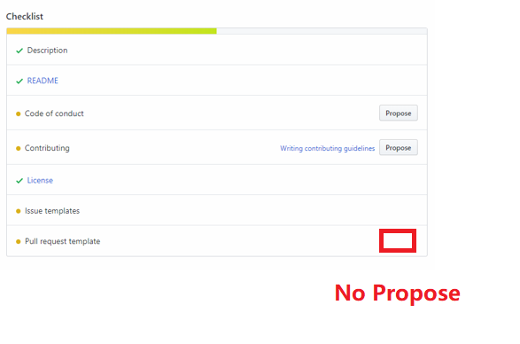
Reasons
PART 02
1、GitHub does not provide a mechanism to automatically create Pull Request templates(no guidance)
2、Multiple Pull Request template exists. (Increase user and developer workloads)

Slide 6
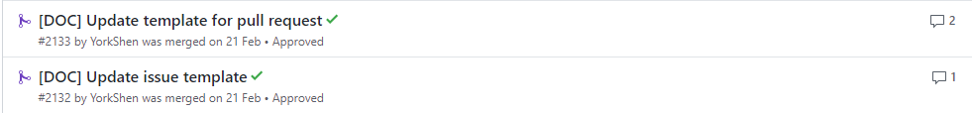
A Repository
PART 02
The project has a time node that updates the Pull Request template.
https://github.com/apache/incubator-weex

Slide 7
Experiment
PART 02
A total of 1924 projects were merged or closed. According to the updated Pull Request template time node, the review speed of reviewers was re-calculated.(After creating template: 87; Before creating template: 1837)

Slide 8
Experiment
PART 02
Mann Whit-net U test(α=0.05, n=4)：
H0: There was no significant difference between the two groups
H1: There were significant differences between the two groups of data
Uα = 10, U1 = 26, U2 = 10, U2 = Uα
P-value = 0.0325 < 0.05
Reject the H0 hypothesis

Slide 9
Next Week Work
PART 03
Set control variables.
Methods required by these Research questions.

