Slide 1

2019/02/20——2019/02/29
Work Conclusion
THE Week WORK SUMMARY REPORT
Reporter：Mengxi Zhang

Slide 2
Work Process
PART 01
PART 02
PART 03
Data Collection
Experiment
The Next Week
Work

Slide 3
Data Collection
PART 01
During that time, I climbed the GitHub repository for the 2017-2018 year. A total of more than 500,000 items were crawled, and there were 13 items with labels after statistics. As a result, the data needed for the experiment have already been obtained.
Therefore, based on these data, I have calculated the frequency distribution of tag in this year and the proportion of tag in description and readme documents.

Slide 4
Experiments
and results
PART 02
First of all, I made statistics on the frequency of tag occurrence of these data, and ranked them from the largest to the smallest, and obtained the chart of tag occurrence frequency last year.

Slide 5
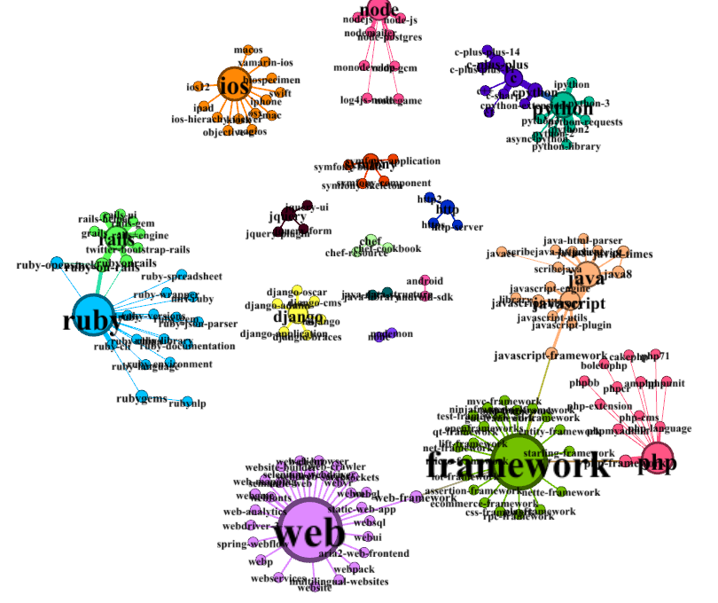
Experiments
and results
PART 02
Besides, for the first time, I used Gephi and reconstructed the edge data table according to the construction rules of the edge data table in the teacher‘s paper, and drew the relationship diagram of each tag. From the Gephi diagram and frequency diagram, it can be seen that from 2017 to 2018, the tag web and framework with high frequency appeared on GitHUb.

Slide 6
Experiments
and results
PART 02
I made statistics on the proportion of all tags appearing in description or readme. Among them, the proportion of all tags appearing in description or readme was 57%, and the proportion of all tags not appearing in description or readme was 43%.In addition, during the experiment, it was found that when the number of tags was greater than 4, it was rare for the readme and description documents to fully contain tag; however, when the number of tags was less than 4, it would occur frequently.
In addition, I also counted the items that did not completely contain all tags, and the average number of tags was included. About 51% of tags will appear in description and readme

Slide 7
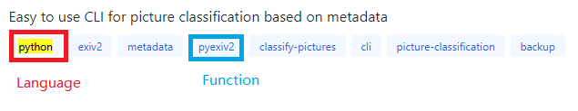
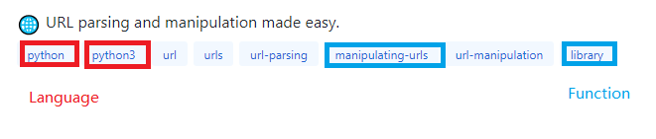
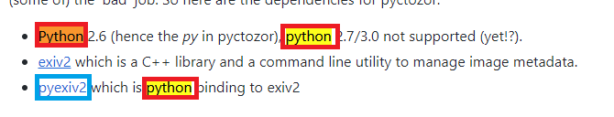
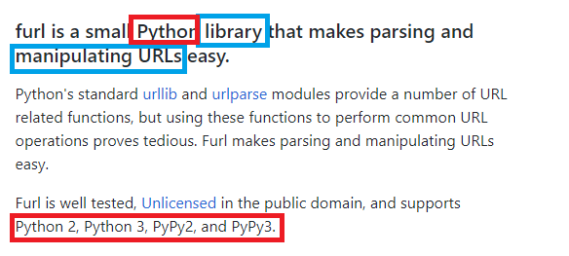
Experiments
and results
PART 02
Finally, when accounting for the percentage of all tags that appear in description and readme, we focused on which tags are more likely to appear in description and readme.
Tags of type Language and Function appear in description and readme 80% of the time.

Slide 8
Next Week Work
PART 03
1、Research more time period of tag, to observe with the number of time, which tag shows a significant increase in the number of times.
2、Similarities and differences between stack overflow and tag on github.

