Slide 1

2019/04/09——2019/04/15
Work Conclusion
THE Week WORK SUMMARY REPORT
Reporter：Mengxi Zhang

Slide 2
Work Process
PART 01
PART 02
PART 03
Introduction
Framework and
Research Questions
The Next Week
Work

Slide 3
Introduction
PART 01
In this week, I have read some Empirical Study articles, which have roughly summarized the framework of the paper, the methods of RQ, etc.
And give the framework I understand and some preliminary RQs.

Slide 4
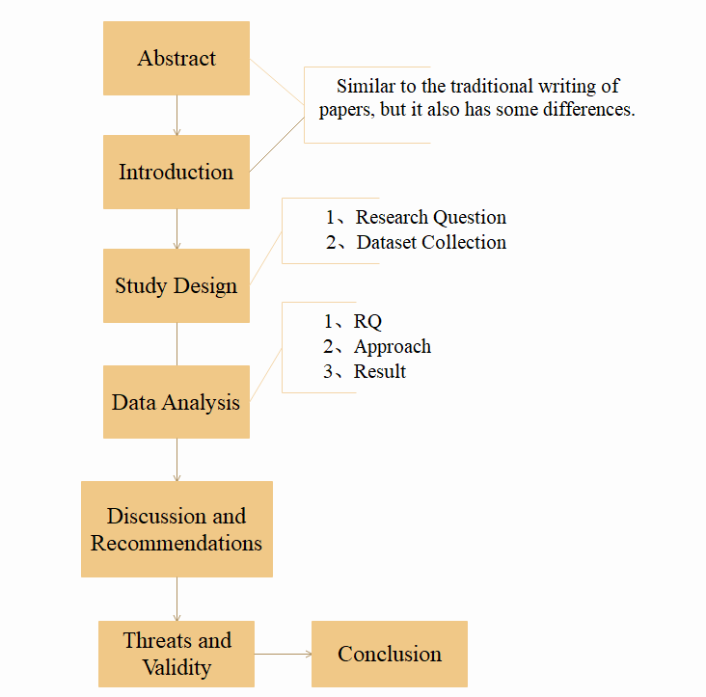
Framework
PART 02
The Empirical Study Framework

Slide 5
Research Questions
PART 02
Main Question: Whether the Pull Request template exists or not will affect the Repository?
RQ1: For the Repository：Will the presence or absence of the Pull Request template affect the popularity of the project itself?
Focus: Comparison of star, Fork, and Pull Request in Repository.

Slide 6
Research Questions
PART 02
RQ2: For the inspector：Whether the presence or absence of the Pull Request template is more conducive to the preliminary screening of Pull Request reviewers?
Focus: The time difference between a Pull Request from Create to Open or from Create to Close.

Slide 7
Research Questions
PART 02
RQ3: For the Users：Whether the presence or absence of the Pull Request template helps users determine whether the Pull Request they want to submit already exists?
Focus: Number of duplicate pull requests in a template that exists and in a template that does not.

Slide 8
Research Questions
PART 02
RQ4: For the Users：Will pull request become more popular among users who often write it as a Template?
Focus: The number of followers in the users homepage is compared to the proportion of the Pull Request submitted by the user that contains the template.

Slide 9
Research Questions
PART 02
RQ5: For the Pull Request：Pull request contains probability statistics for whether the template is merged with it?
Focus: Merge and close conditions for Pull request.

Slide 10
Research Questions
PART 02
RQ6: For the Pull Request：Does the pull request in the Repository milestone prefer a pull request with a template?
Focus: Pull request statistics for the pull request template are contained in the milestone in Repository.

Slide 11
Research Questions
PART 02
RQ7: An uncertain RQ：Does the Pull Request Template have any impact on the code integration?
Focus: How easy it is for developers to merge md documents with different Pull requests.
Different types of Repositories have template-specific tags that help with code integration.

Slide 12
Next Week Work
PART 03
Further improve Research Question.
Methods required by these Research questions.

