Slide 1

2018/12/14 – 2018/12/21
Work Conclusion
THE Week WORK SUMMARY REPORT
Reporter：Mengxi Zhang

Slide 2
Work Process
PART 01
PART 02
PART 03
Download Data
Preliminary Idea
The Next Week
Work

Slide 3
Download Data
PART 01
I downloaded the data of GHTorrent, which has been running since 2013, updates GitHub‘s data monthly and is available as a MySQL package.
Since I downloaded the 2018-11-01 MySQL database about 200 million projects, contains 21 CSV files, and I put the name of each file and its corresponding functionality on GitHub.
About these data, from 2017 to now, there are about 10 million projects. I mainly researched the project_topics.csv file, It contains the topics of all projects which about 30,072 projects have topic, and after removing duplicate data, the number of topic is 2,000.
In addition to the readme documentation and code, other data is available on Github. So I'm using the crawler algorithm to get the readme document for each project through its URL(from Projects.CSV).
Now that the code is complete, I can start crawling the data once import project.csv into the database.
The CSV_File.docx contains the name of each csv file and its corresponding functionality
The schema.sql is data table structure
GHTorrent Download:http://www.ghtorrent.org/downloads.html

Slide 4
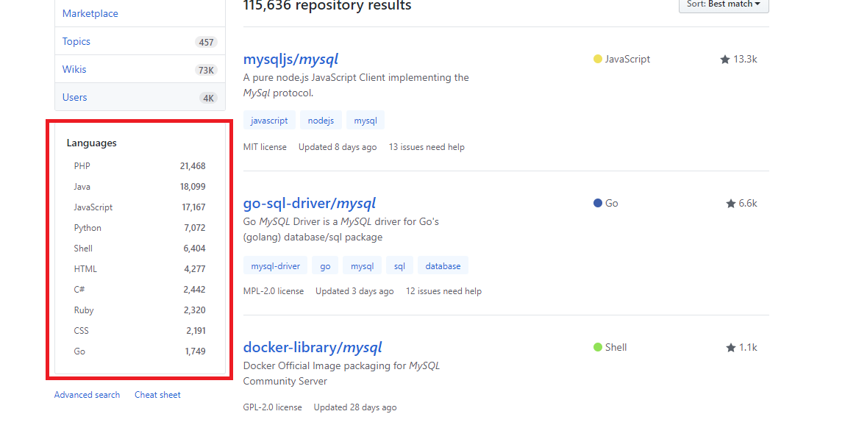
Preliminary Idea
PART 02
There are two preliminary ideas at present. I haven't checked the relevant papers yet. And I'm not sure whether anyone has done it.
1、 When I query or search for a project on github, the left-hand side gives you an index based on project language
But when I looked at the project_topics.csv file, I found that the tags it typed could be categorized into categories such as language(javascript、python), model(machine-learning), system(andriod、ios、linux), framework(bootstrap、tensorflow、Spring) and so on.
The index on GitHub can only be indexed through language, Can other indexing methods are used to locate items more accurately?
So I need to use the projects.csv file 、repo_lable.csv file and project_topics.csv file, projects.csv file have the project name, which contains more comprehensive content; Repo_label.csv file only has the language and model of the project; project_topics.csv contains most of the information, but the number of projects is small.
So I think I need to use the projects.csv file to achieve it.

Slide 5
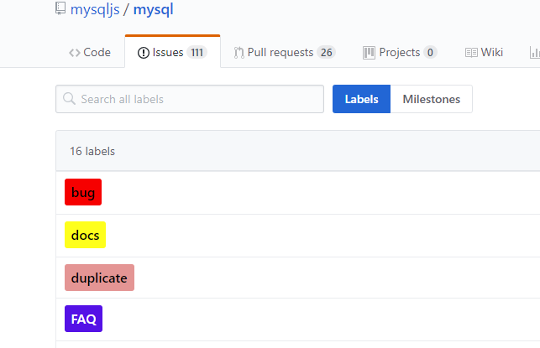
Preliminary Idea
PART 02
2、 When I research the Issues_labels.csv file, and It is found that there is a certain rule for marking. Most of the content of the tag is bug, duplicate, enhancement and so on. But at present, these issues are manually marked by the developer, and there have a lot isuues which not marking. Therefore, I wonder if it is possible to automatically generate the specified label according to the content of issue.

Slide 6
Next Week Work
PART 03
Next week, I'll use the crawler algorithm to crawl down the ReadMe documentation for all projects, And then I will import some CSV files into Pycharm, and use python to do some visualization, and see if there are any patterns in this data.

