Slide 1

2019/06/03——2019/06/10
Work Conclusion
THE Week WORK SUMMARY REPORT
Reporter：Mengxi Zhang

Slide 2
Work Process
PART 01
PART 02
PART 03
Introduction
Experiment
The Next Week
Work

Slide 3
Introduction
PART 01
The main work of this week is to improve the previous experiment, including:
1. Pull requests with review speed of 1-5 days were counted
2. The relative number of repeated Pull requests was counted and the reasons for
their various special points were studied
3. Projects are categorized, and the Merge probability and repeat Pull Request curves for each category appear

Slide 4
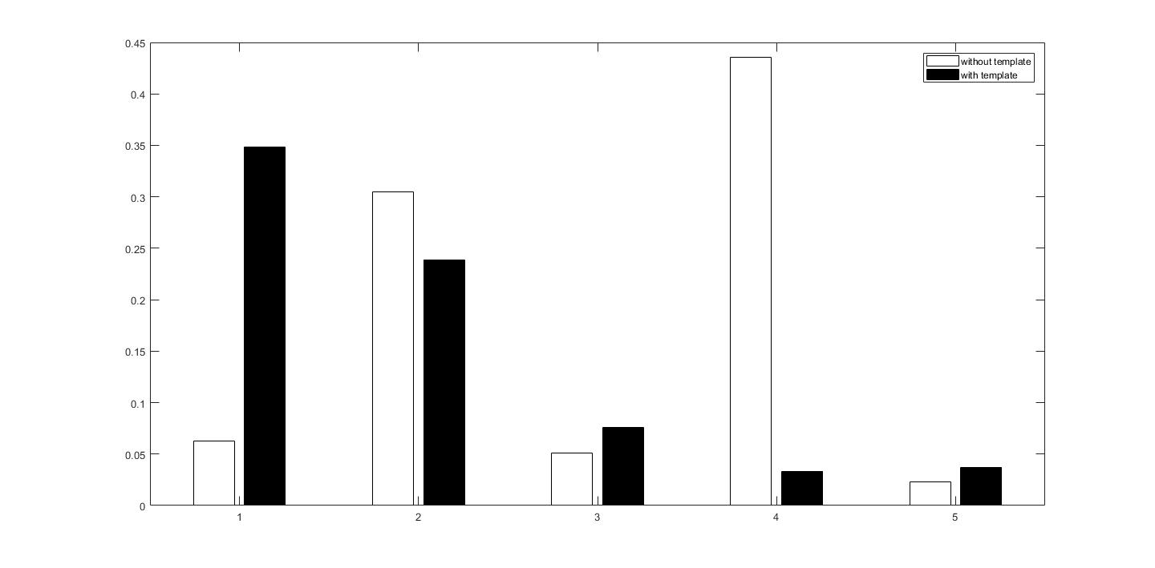
Experiment
PART 02
Review the statistical results at a rate of 1-5 days

Slide 5
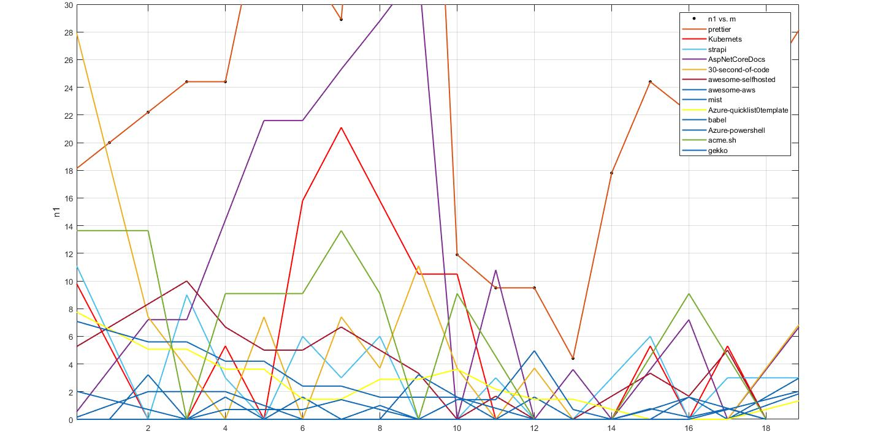
Experiment
PART 02
The relative count results of repeated Pull requests（line chart）

Slide 6
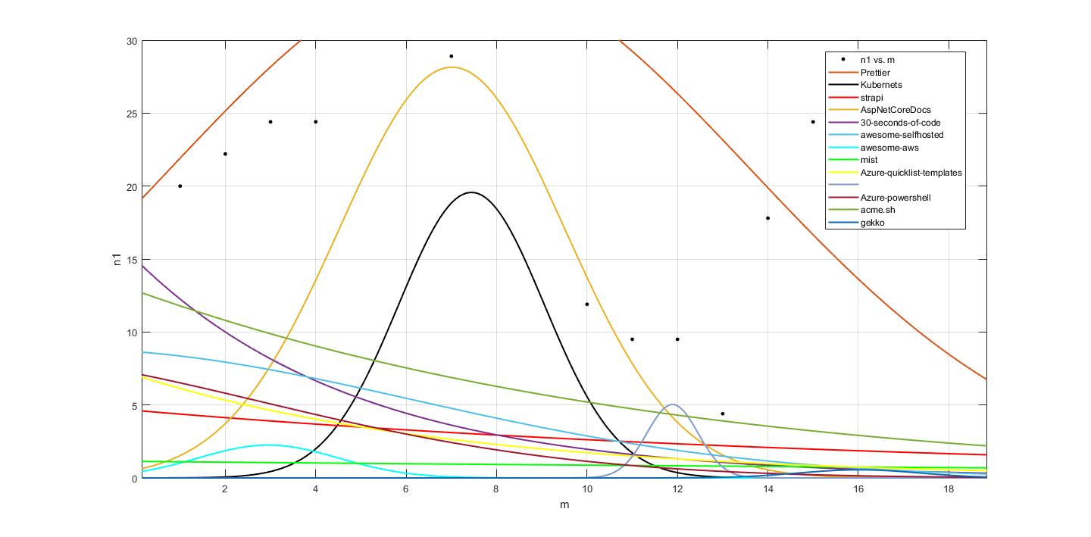
Experiment
PART 02
The relative count results of repeated Pull requests（Fitting curve）
babel

Slide 7
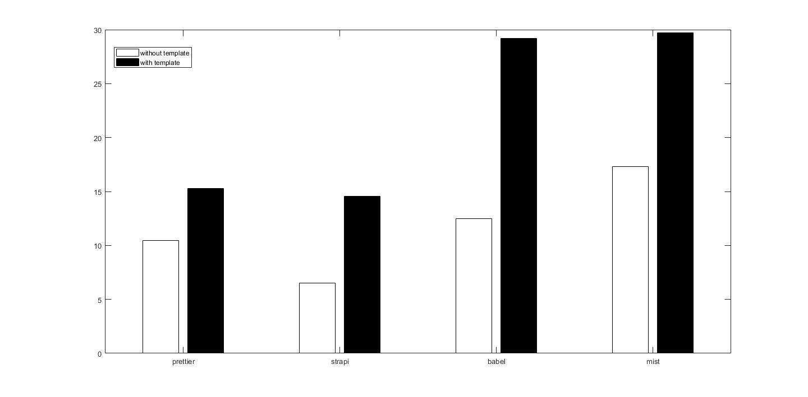
Experiment
PART 02
Merge probability classification graph（Tools）

Slide 8
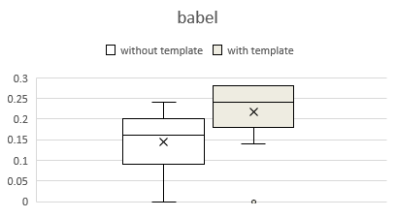
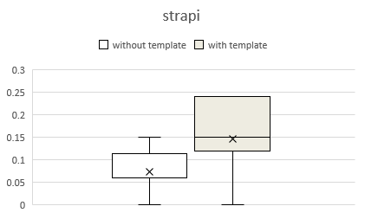
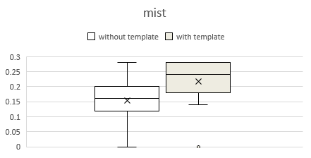
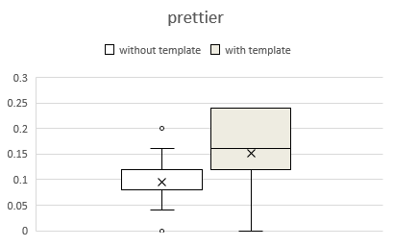
Experiment
PART 02
Merge probability classification graph（Tools）

Slide 9
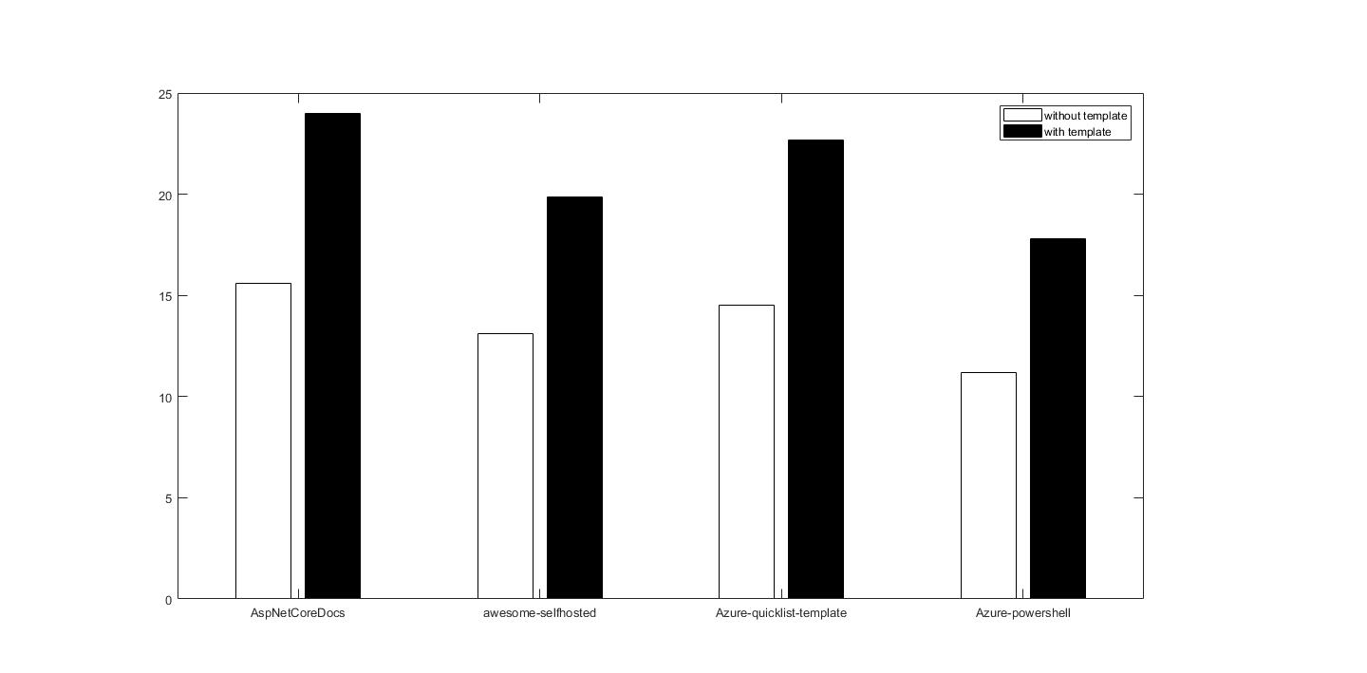
Experiment
PART 02
Merge probability classification graph（Document）

Slide 10
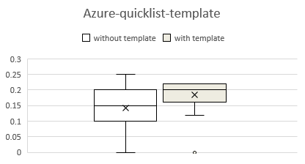
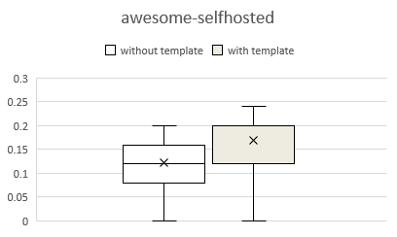
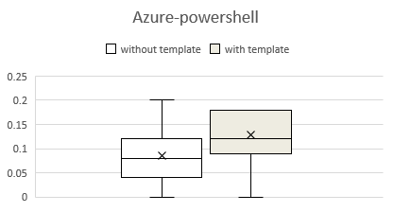
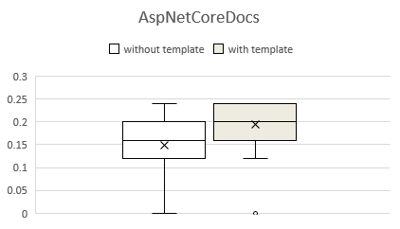
Experiment
PART 02
Merge probability classification graph（Document）

Slide 11
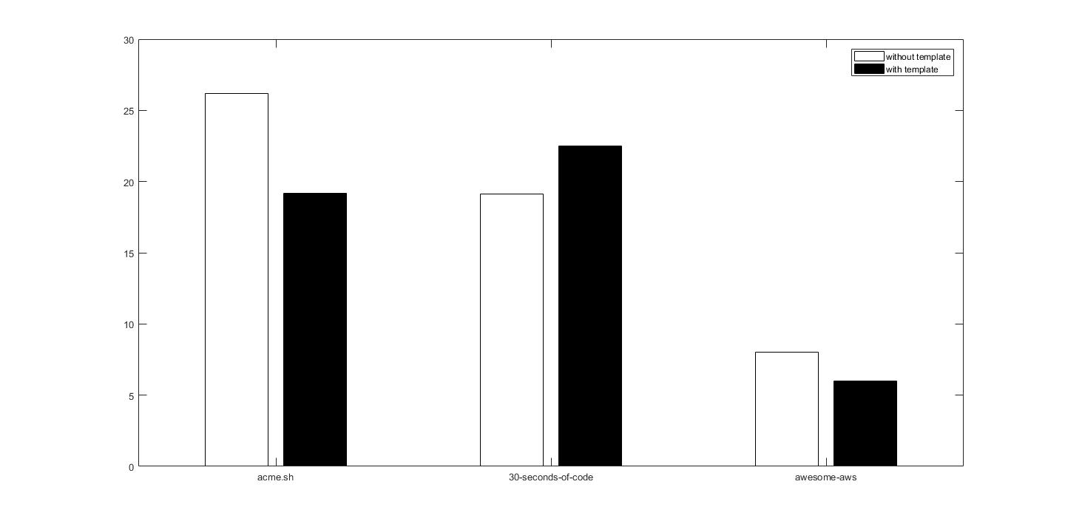
Experiment
PART 02
Merge probability classification graph（code snippets）

Slide 12
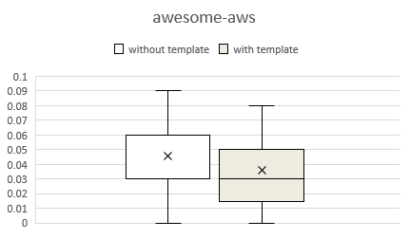
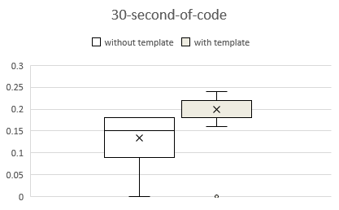
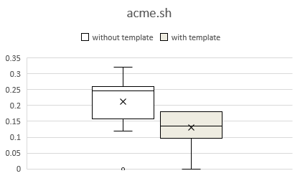
Experiment
PART 02
Merge probability classification graph（code snippets）

Slide 13
Experiment
PART 02
Add word frequency statistics before and after the template

Slide 14
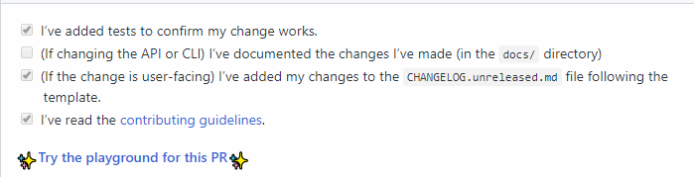
Experiment
PART 02
Sentences that often appear after adding templates

Slide 15
Next Week Work
PART 03
Further improve Research Question.
Methods required by these Research questions.

