Slide 1

2019/03/19——2019/03/25
Work Conclusion
THE Week WORK SUMMARY REPORT
Reporter：Mengxi Zhang

Slide 2
Work Process
PART 01
PART 02
PART 03
Introduction
Experiment and Idea
The Next Week
Work

Slide 3
Introduction
PART 01
This week, we first counted the changes of tag on GitHub and tag on Stack Overflow on a monthly basis. And compared it, found some laws. Secondly, the Issue Template and Pull Request Template on GitHub are further explored, and the templates of Top100 projects containing Issue Template and Pull Request Template are summarized. Six different templates are summarized for future use. For the Top100 project which does not contain the Issue Template and Pull Request Template, I explored its Issue and Pull Request, and found that it has necessary connection with some other documents of the project.

Slide 4
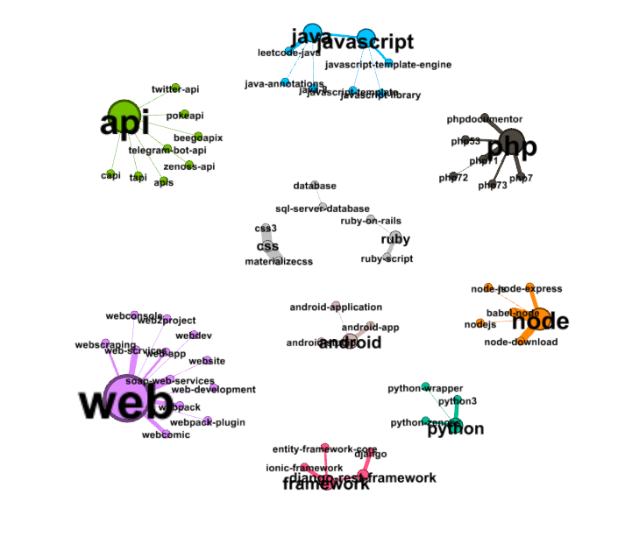
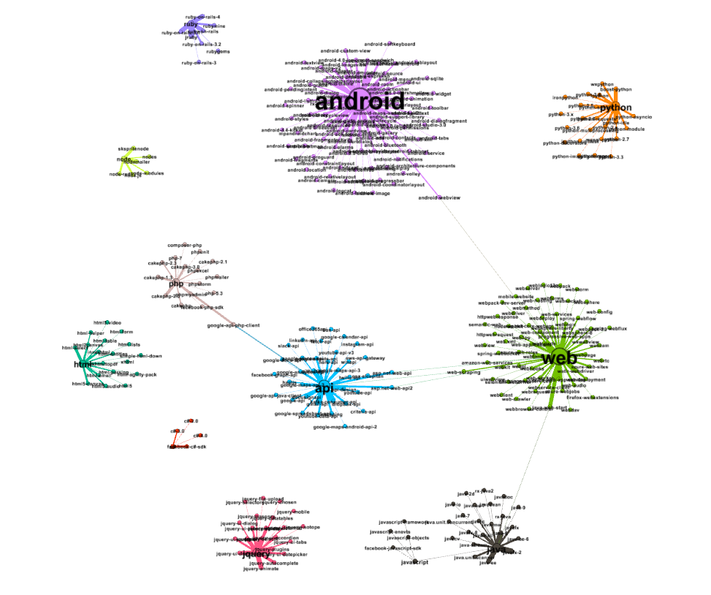
GitHub Tags And Stack Overflow Tags
PART 02
After drawing Gephi graphs on GitHub's tag and Stack Overflow's tag on a monthly basis, I observed some differences.
The number of tags on GitHub is far less than that on Stack Overflow
It is obvious from the figure that there are great differences in the quantity distribution. The reason for this difference may be that every problem on Stack Overflow must have a tag, while GitHub has relatively few.
GitHub
Stack Overflow

Slide 5
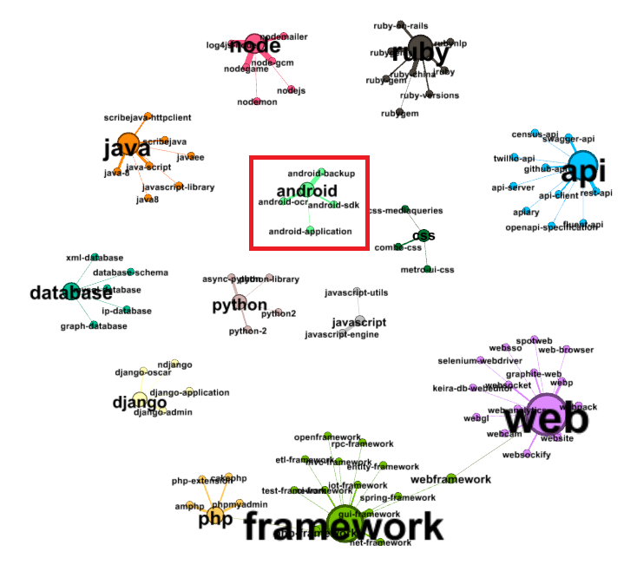
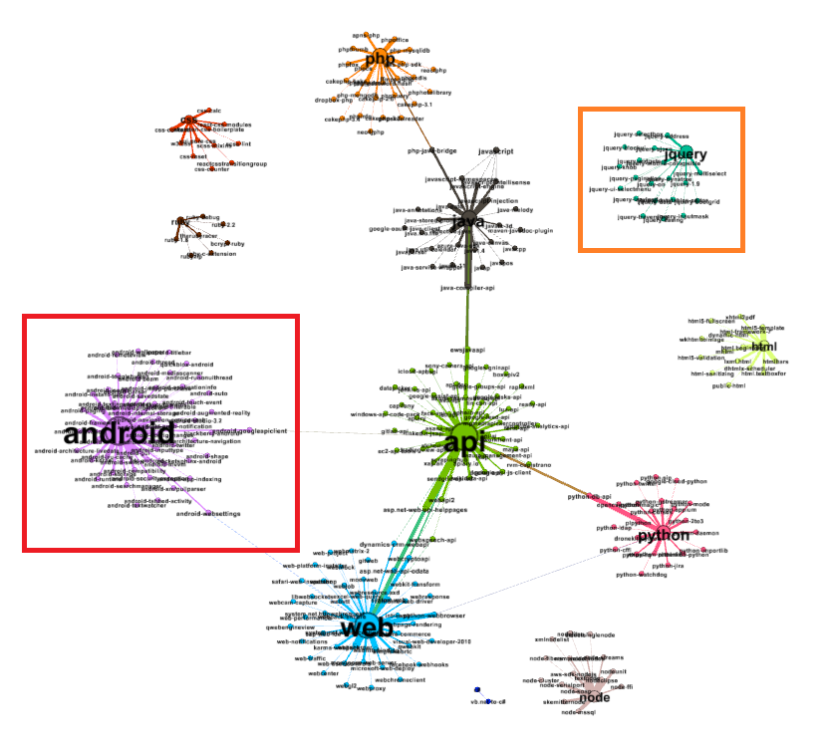
GitHub Tags And Stack Overflow Tags
PART 02
2. There is a certain gap between tag on Stack Overflow and tag on GitHub within the same time. On the one hand, it takes up less tag on GitHub at the same time, but more tag on Stack Overflow. For example: 'Android’; On the other hand, some tags that do not exist in GitHub will appear in the Stack Oveflow. For example: ‘jquery’
GitHub
Stack Overflow

Slide 6
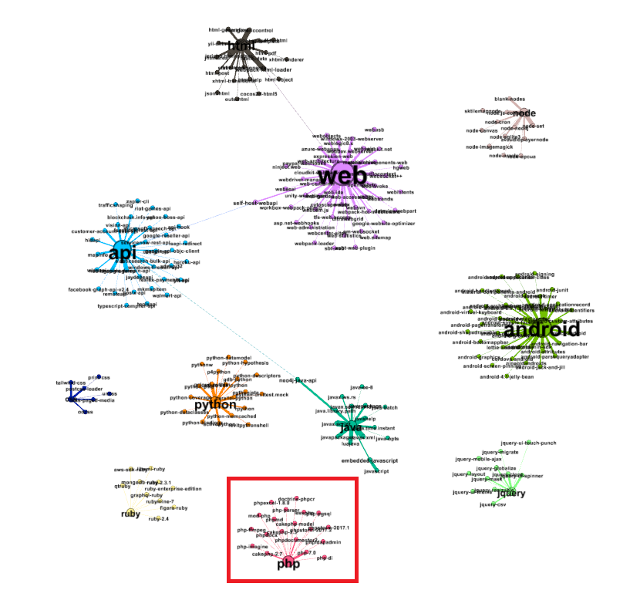
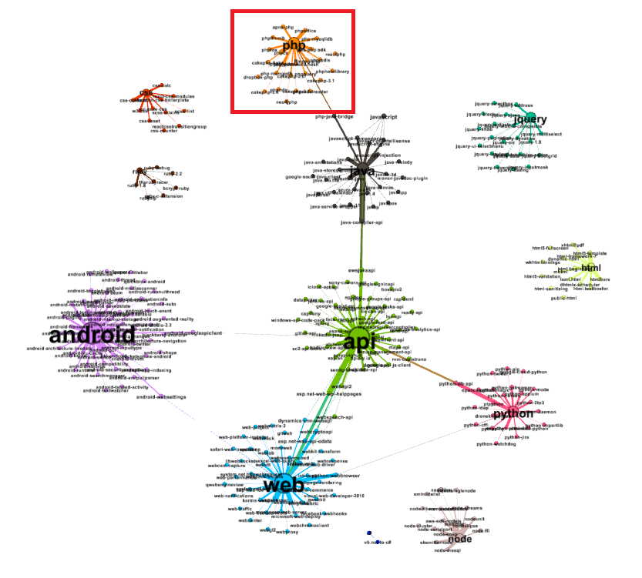
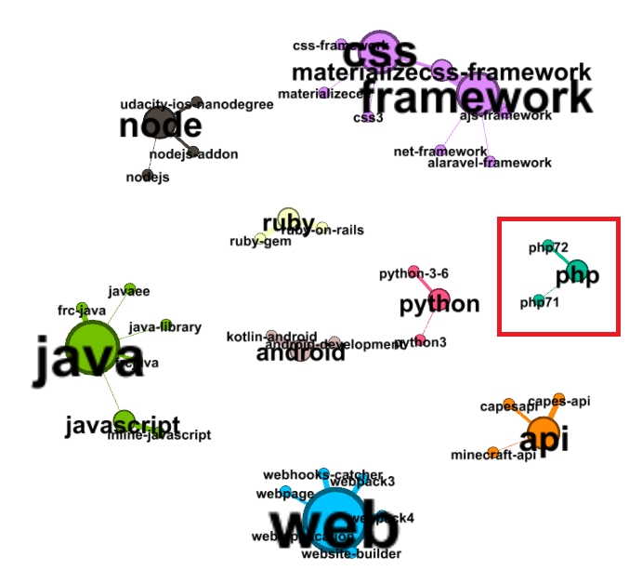
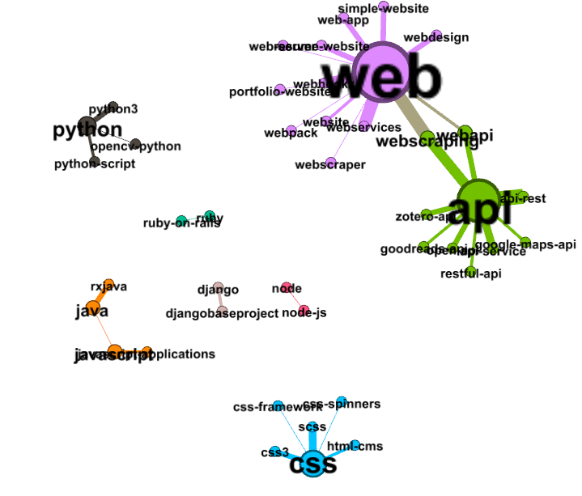
GitHub Tags And Stack Overflow Tags
PART 02
3、As time goes by, some tags on GitHub will gradually decrease, while on the contrary, those on Stack Overflow are always in a relatively stable state. For example: 'PHP', the 'PHP' tag on GitHub has gradually disappeared in the changes from July to August, while 'PHP' on Stack Overflow remains relatively stable.
GitHub
Stack Overflow

Slide 7
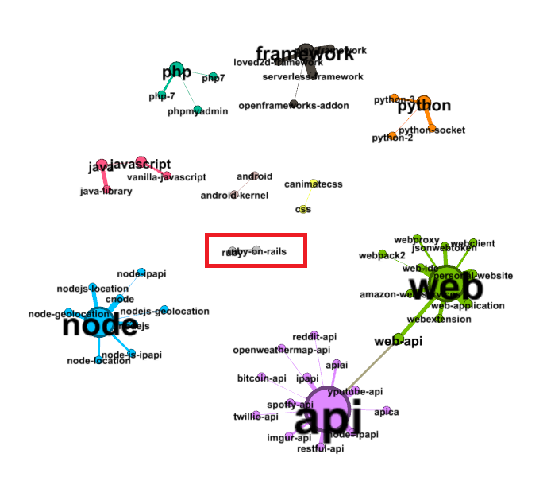
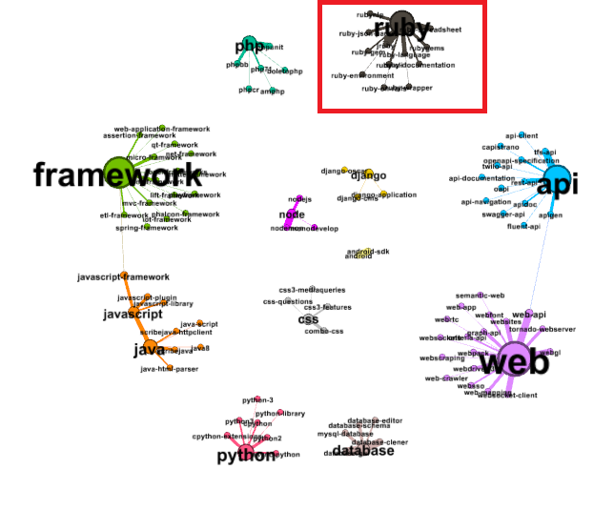
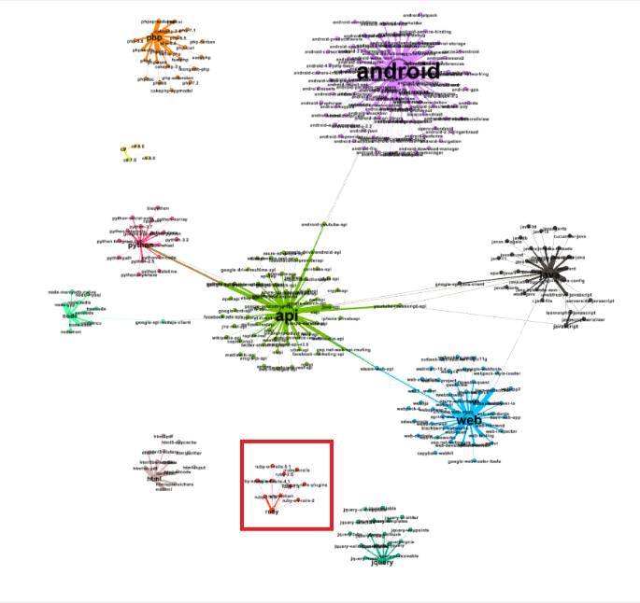
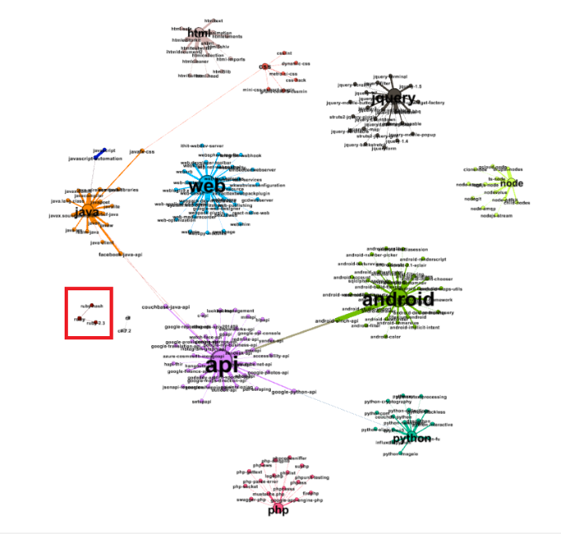
GitHub Tags And Stack Overflow Tags
PART 02
4、How sensitive GitHub and Stack Overflow are to new words, for example, a new tag ‘ruby’ appears, with slightly different word cycles. For GitHub, ruby was relatively small in number when it first appeared, but gradually increased over time. On the other hand, Stack Overflow is different. When “ruby” appears, the number is relatively large, but with the growth of time, the number gradually decreases. The reason for this is that when a new thing appears, it faces many problems, so Stack Overflow, as a question-and-answer platform, will have more problems in a short time. However, as time goes by, the problems of this type are gradually solved, and the corresponding number will naturally decrease. However, as a code hosting platform, GitHub‘s tag changes exactly the opposite.
GitHub
Stack Overflow

Slide 8
GitHub Tags And Stack Overflow Tags
PART 02
Based on these findings, after comparing these two tags, it can be found that the sensitivity of the two platforms to new words can be continued, and one can be used as the mark of the other. Because the processing of tag in Stack Overflow is much stronger than Stack Overflow. Therefore, can we make use of the current situation of tag in Stack Overflow to estimate the development form of tag in GitHub? In Stack Overflow, within a certain period of time, does the large appearance of a tag mean that GitHub has too many warehouses containing this tag in the newly released warehouse in the following period of time? However, the most important point is that it is not easy for tag to think about what impact he can bring to the development of GitHub.

Slide 9
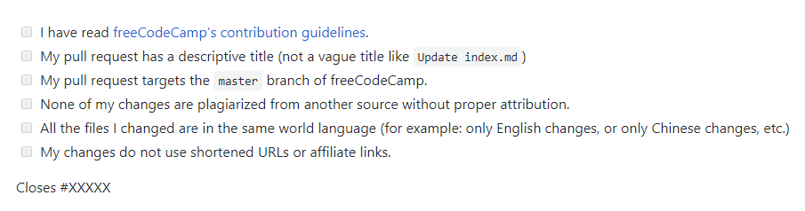
Issue Template And Pull Request Template
PART 02
After further analysis of the number of Star and Fork on GitHub in Top100 projects, it is found that:
1. For projects with these two templates, I have figured out the rules for writing these two templates.
①Several rules required by Pull Request are given. When writing, check and supplement the checked content

Slide 10
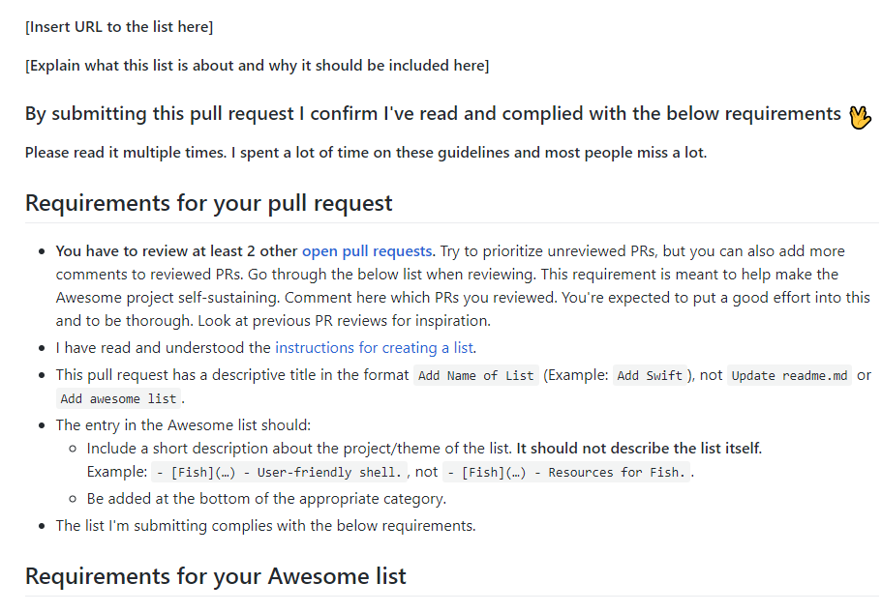
Issue Template And Pull Request Template
PART 02
②The whole Template is more detailed, from URL to requirement analysis, and the Template is given in a way of directory

Slide 11
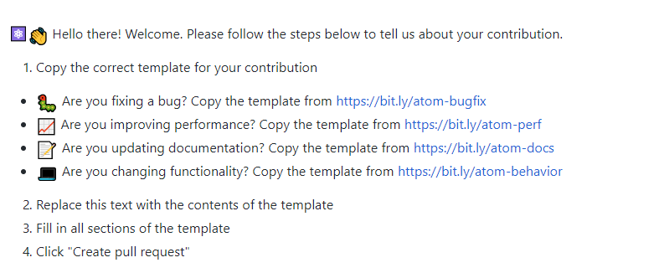
Issue Template And Pull Request Template
PART 02
③Given a template in the form of a question, the user answers these questions when writing a Pull Request.

Slide 12
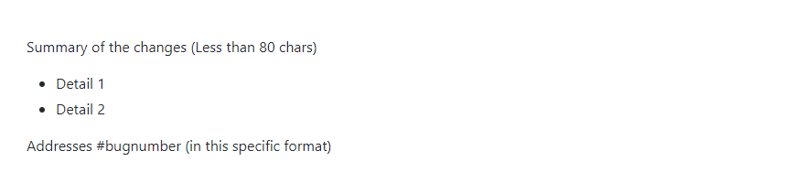
Issue Template And Pull Request Template
PART 02
④The simpler form gives the template

Slide 13
Issue Template And Pull Request Template
PART 02
After further analysis of the number of Star and Fork on GitHub in Top100 projects, it is found that:
2、For projects without templates, I observed from the following perspectives:
1. Do the Pull Request and Issue in the project have generable templates? After statistics, users can be divided into two types when writing: the first one is to directly paste the modified file for convenience, but the probability of Merge is not high. The second is that users who write documents their own way, according to their own habits, have a higher probability of Merge.
2. Observe from the perspective of users. For users involved in this project, if the number of Followers is high, there will be certain rules for them to write the document.
3. From the internal perspective of the project, for the project without these two templates, it may contain a Code of Conduct. In this document, it is possible to write the rules that users should pay attention to when submitting Pull Request and Issue.

Slide 14
Issue Template And Pull Request Template
PART 02
Therefore, for the summary of the template, after observation, the initial idea is to determine which template is more suitable for the project according to various attributes of the project:
the number of users of the Fork project will find those users with higher reputation, and from the documents they write, an automated learning will be carried out. To determine his writing style.
The Code Of Conduct document in the project, and extract the part about the Pull Request Template and Issue Template from it.
For this project, Pull Request and Issue which have been merged or accepted have been extracted, and then filtered and processed, leaving those Pull Request and Issue with rules. It is further analyzed and further summarized by combining the above two extraction schemes.

Slide 15
Next Week Work
PART 03
Observe the Fork user of the project for which Pull Request Template and Issue Template do not exist, and try to summarize the writing rules of the user.
Try to extract the relevant rules of Code of Conduct about Pull request and Issue.

