Slide 1

2019/06/010——2019/06/24
Work Conclusion
THE Week WORK SUMMARY REPORT
Reporter：Mengxi Zhang

Slide 2
Work Process
PART 01
PART 02
PART 03
Introduction
Experiment
The Next Week
Work

Slide 3
Introduction
PART 01
The main work of this week is to redefine the data filtering rules, and to re-experiment the following two RQs:
1. Duplicate Pull Request number and the data representation of whether the Pull Request template is added or not.
2. Merge probability statistics for each category after manually classifying items

Slide 4
Data Collection
PART 01
Reacquire the experimental data set and set the following two rules for filtering
1. The project contains a Pull Request template
2. The number of Pull Request for a project is greater than 100
After these two layers of filtering, 115 available projects were obtained.

Slide 5
Manual Classification
PART 01
Each project is categorized according to its wiki introduction and its Readme documentation.
Divide the acquired data set into five categories: Tools（30）, Framework（27）, Platform（18）, Library（15） and Other（25）.

Slide 6
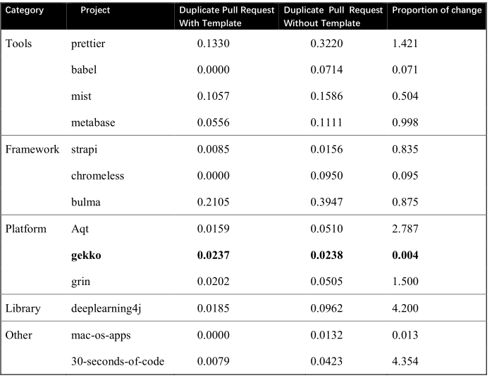
Experiment
PART 02
Duplicate Pull Request statistics(Classification statistics)

Slide 7
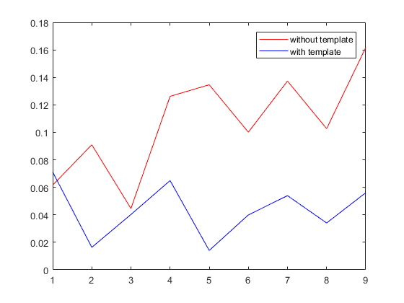
Experiment
PART 02
Duplicate Pull Request statistics(average index)

Slide 8
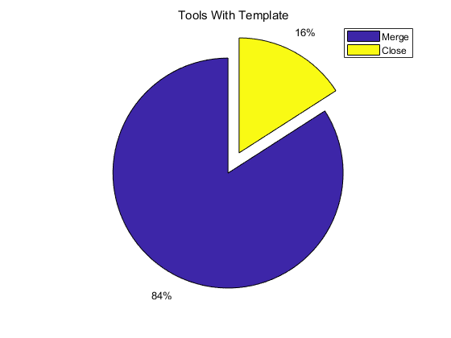
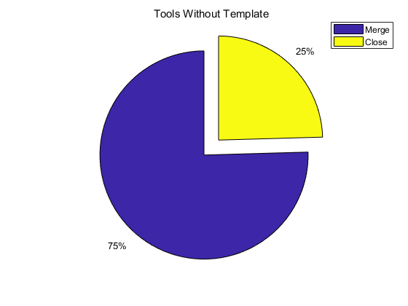
Experiment
PART 02
Merge probability with or without the Pull Request template(Tools)
babel
prettier
mist
metabase(an open source business intelligence tool)
……..

Slide 9
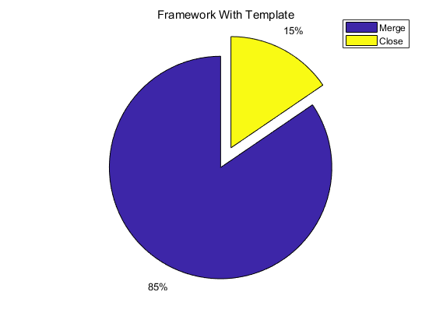
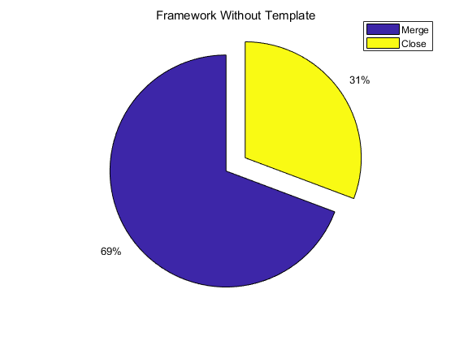
Experiment
PART 02
Merge probability with or without the Pull Request template(Framework)
bulma(css framework)
chromeless
strapi(css framework)
……..

Slide 10
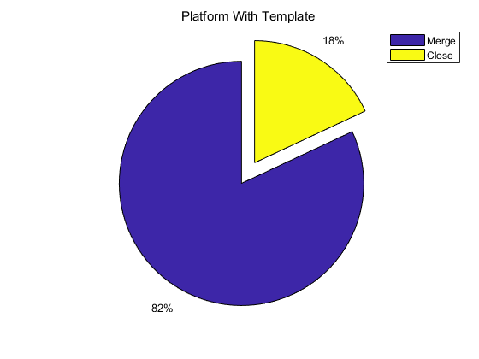
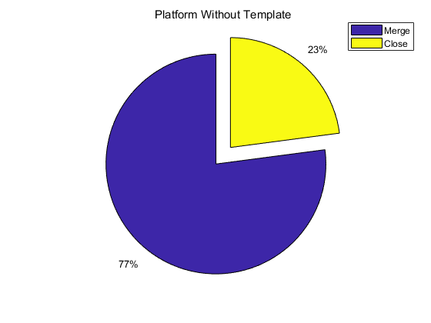
Experiment
PART 02
Merge probability with or without the Pull Request template(Platform)
Grin(electronic transaction platform for all)
gekko（Automated trading platform<bitcoin>）
Azure-quickstart-templates
……..

Slide 11
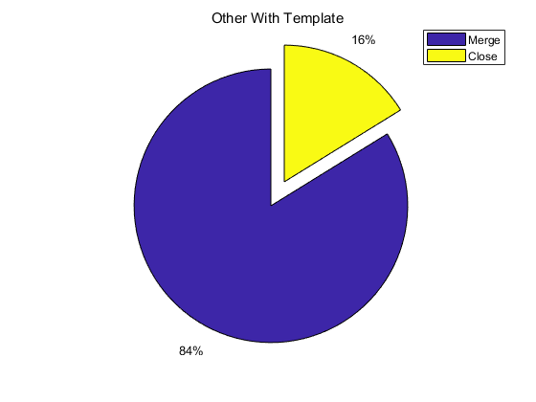

Experiment
PART 02
Merge probability with or without the Pull Request template(Other)
mac-os-apps
30-seconds-of-code
……..

Slide 12
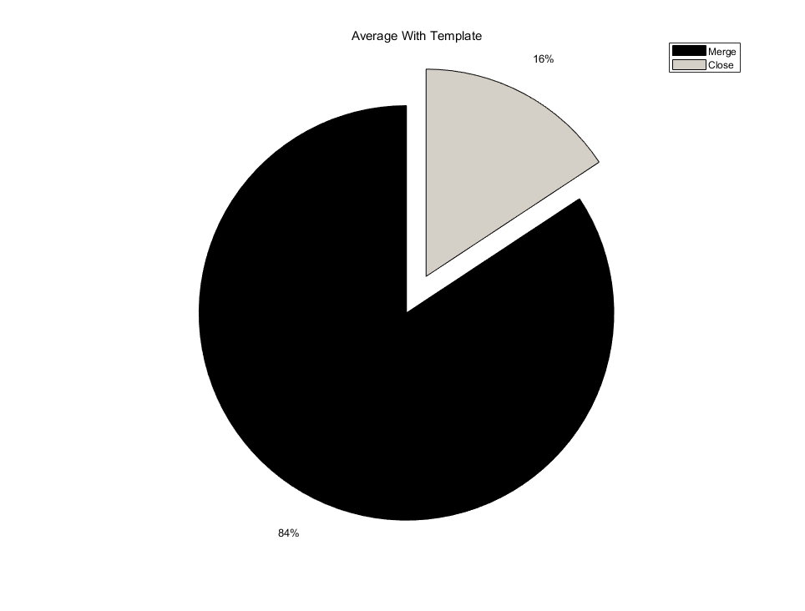
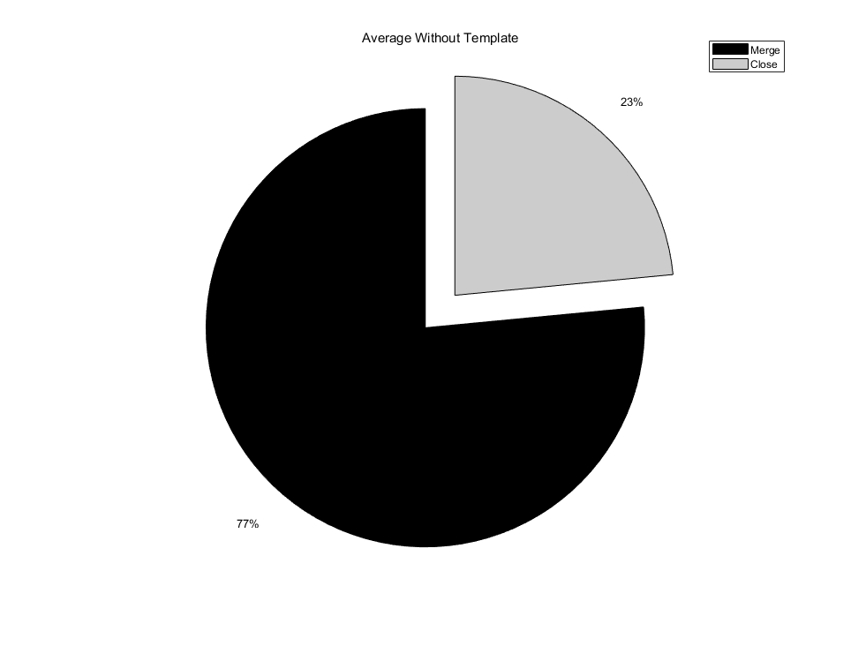
Experiment
PART 02
Merge probability with or without the Pull Request template(average statistics)

Slide 13
Summary
PART 02
A summary of the previous experiments and blog content collected

Slide 14
Next Week Work
PART 03
Further improve Research Question.
Methods required by these Research questions.

