Slide 1

2019/05/20——2019/06/03
Work Conclusion
THE Week WORK SUMMARY REPORT
Reporter：Mengxi Zhang

Slide 2
Work Process
PART 01
PART 02
PART 03
Introduction
Experiment
The Next Week
Work

Slide 3
Introduction
PART 01
The main work of this period is to improve the previous experiment, including:
1. review the speed of the time period reset
2. Timeline control of repeated Pull Request occurrence
3. Compare the Merge probability before and after adding the Pull Request template
4. Analyze the perfection of specific contents of Pull Request.

Slide 4
Experiment
PART 02
Review the speed of impact changes

Slide 5
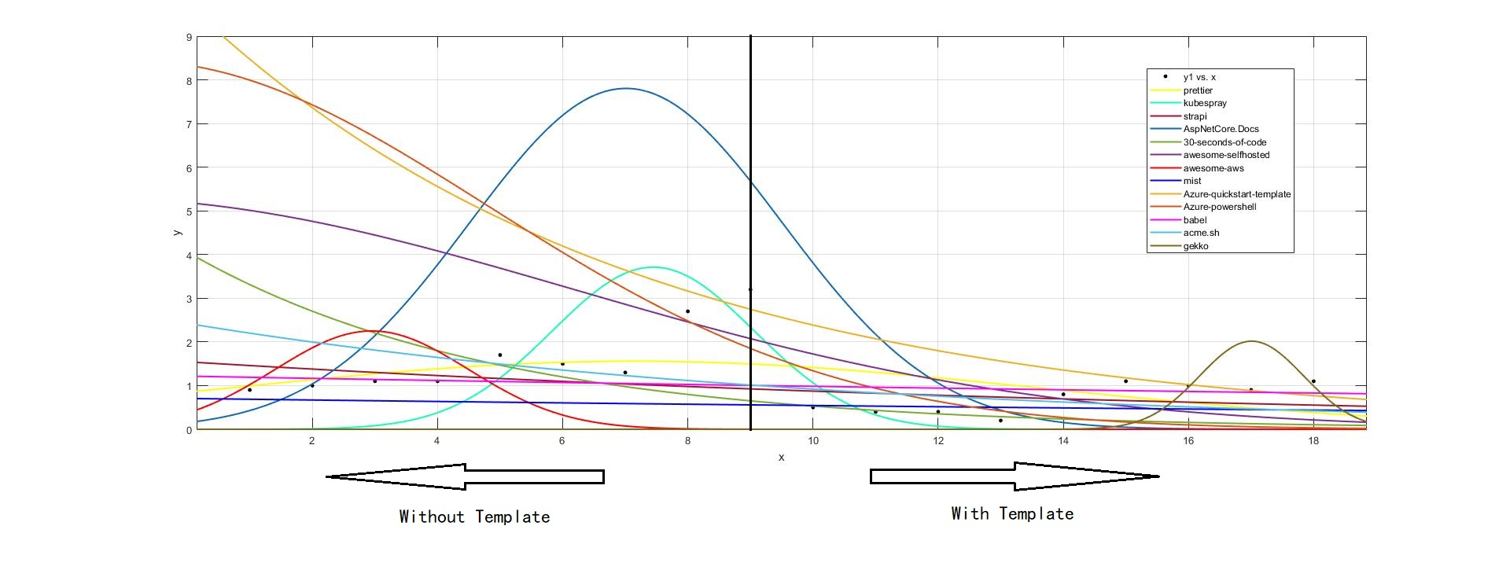
Experiment
PART 02
Repeat the Pull Request to regain control of the timeline

Slide 6
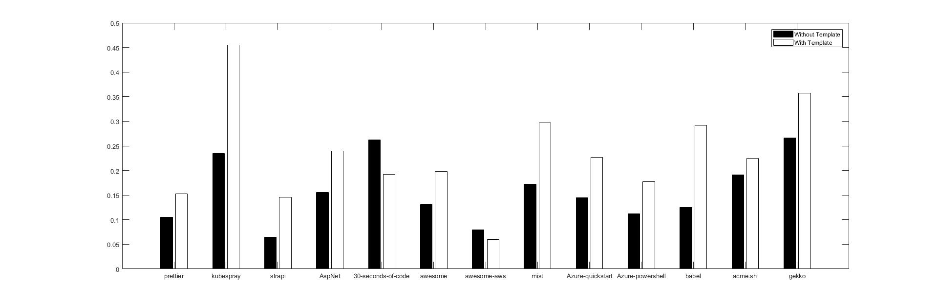
Experiment
PART 02
The Pull Request template has statistics of Merge probability before and after the project

Slide 7
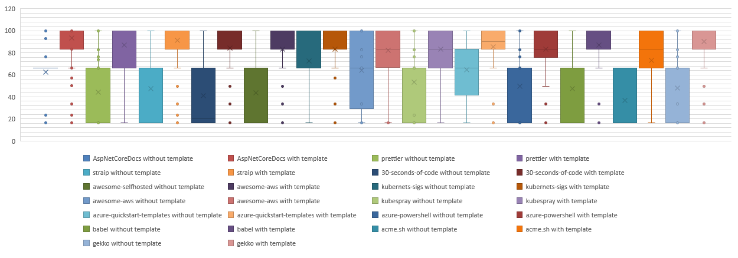
Experiment
Description: 24.36%
Test: 25.4%
PR Type: 9.95%
Check list: 16.59%
Code link: 16.59%
Guide lines: 7.11%
(based on Analytic hierarchy process)
PART 02
Analysis of the completeness of Pull Request content(preliminary)

Slide 8
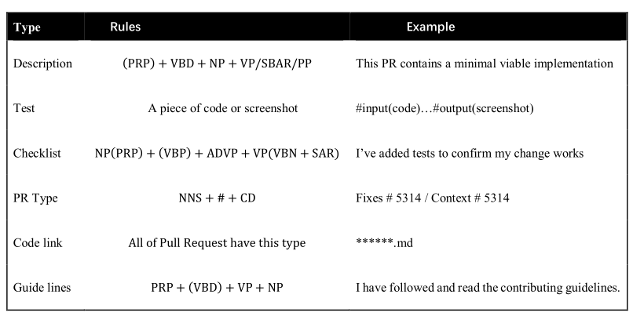
Experiment
PART 02
Some improvements based on the above experiments
1. Rules for each evaluation criterion

Slide 9
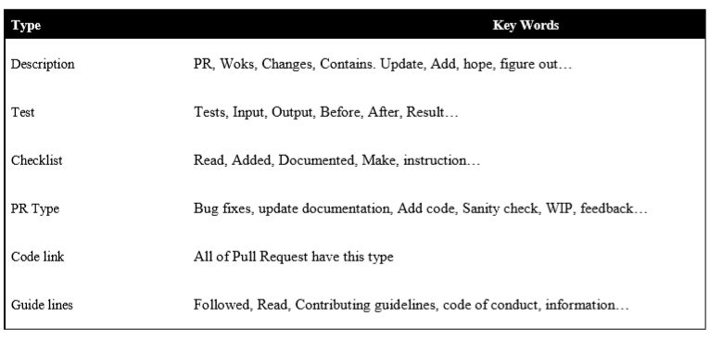
Experiment
PART 02
Some improvements based on the above experiments
2. Key words for each evaluation criterion

Slide 10
Next Week Work
PART 03
Further improve Research Question.
Methods required by these Research questions.

