Slide 1

2019/04/02——2019/04/08
Work Conclusion
THE Week WORK SUMMARY REPORT
Reporter：Mengxi Zhang

Slide 2
Work Process
PART 01
PART 02
PART 03
Introduction
Statistical
The Next Week
Work

Slide 3
Introduction
PART 01
This week, I crawled the data of Community Profile again according to the star number ranking of the project. A total of 53,573 projects were crawled, among which 433 projects included Pull Request Template and 190 projects included Issue Template after statistics. According to these data, further statistics were made on the number distribution of Pull Request and the number of Star.

Slide 4
Statistical
PART 02
Community profile in 53573 projects contains proportion of each document

Slide 5
Statistical
PART 02
1、Which a project with a template
2、Which a project without a template

Slide 6
Causal Relationship
PART 02
The presence or absence of Pull Request is related to the number of Star ranking(Top-1000)

Slide 7
Causal Relationship
PART 02
The presence or absence of Pull Request is related to the number of Star ranking(Top-10000)

Slide 8
Causal Relationship
PART 02
The presence or absence of Pull Request is related to the number of Star ranking(All Data)

Slide 9
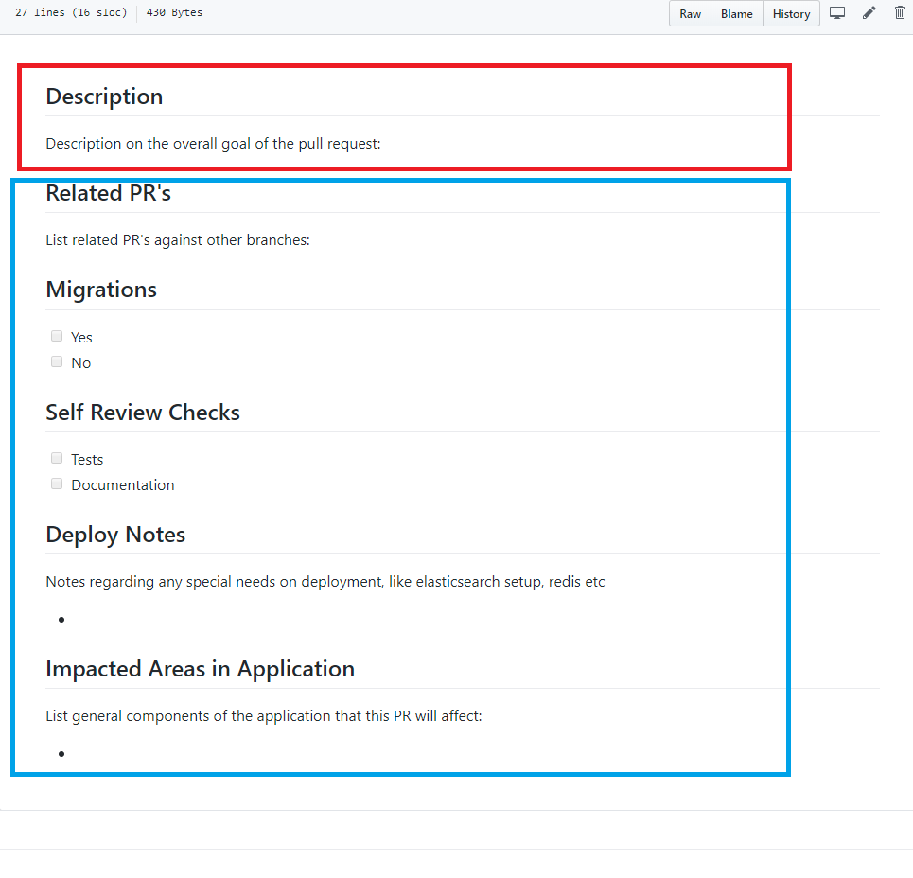
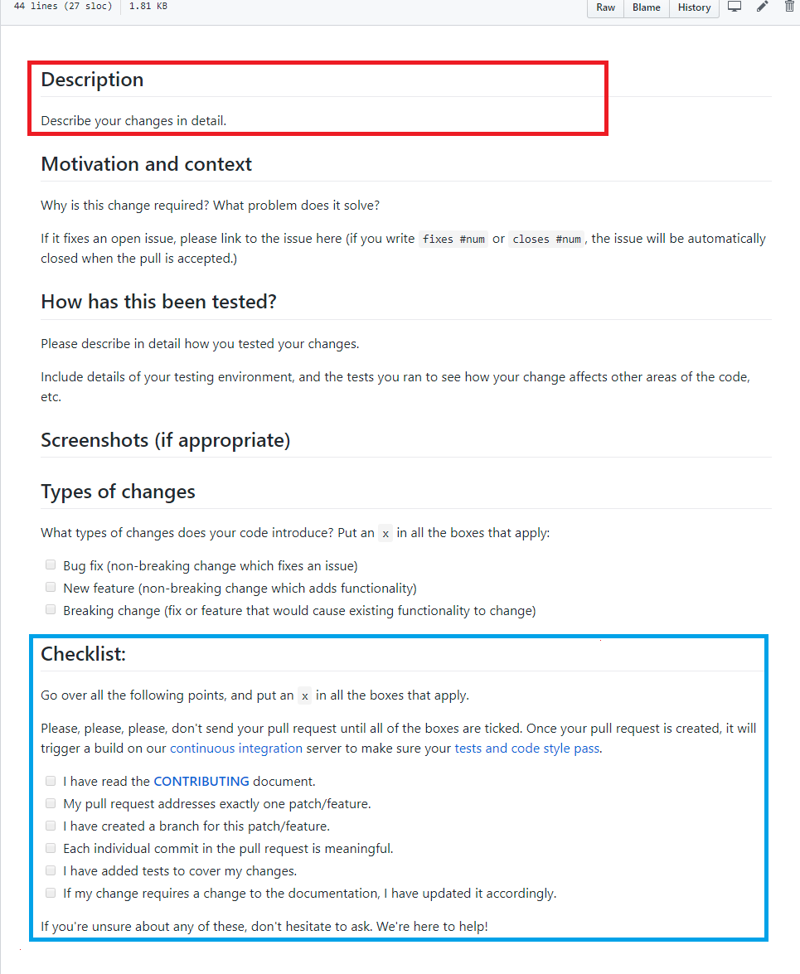
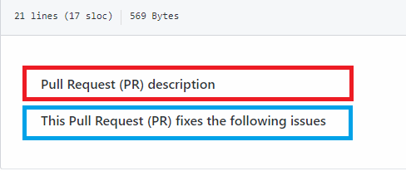
Commons
PART 02
Pull Request commonalities among 433 projects，and 318/433 of them contains the same commonality as last week.

Slide 10
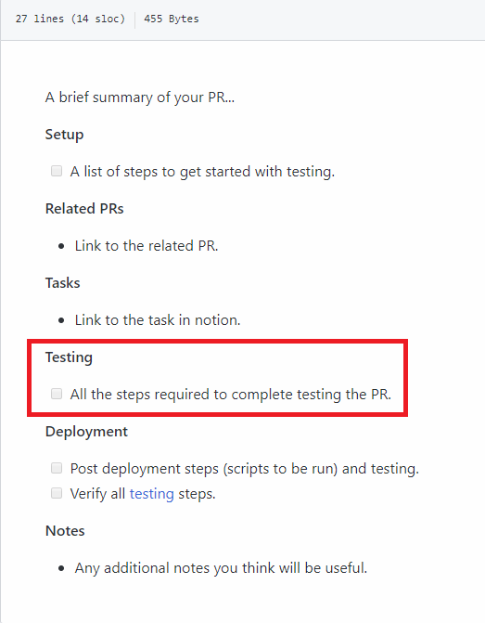
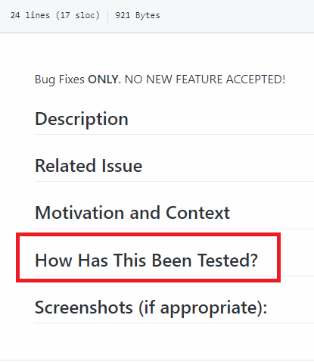
Characteristic
PART 02
After manually classifying the projects that have a Template, observe the characteristics of each category
1、Tools
Test

Slide 11
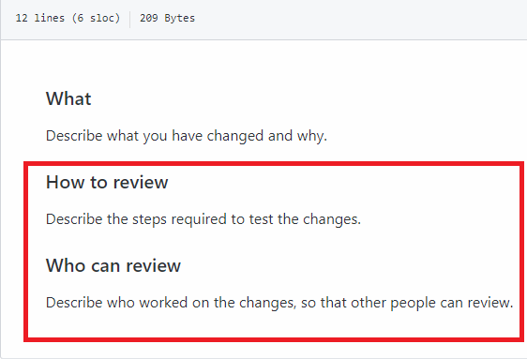
Characteristic
PART 02
After manually classifying the projects that have a Template, observe the characteristics of each category
2、API
Review

Slide 12
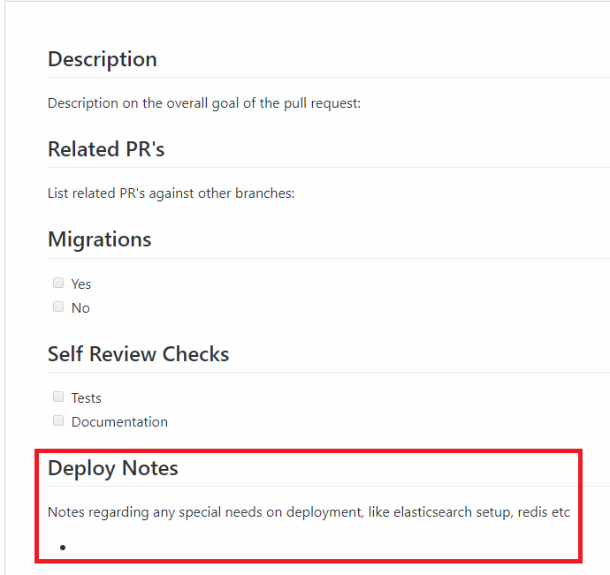
Characteristic
PART 02
After manually classifying the projects that have a Template, observe the characteristics of each category
3、Command
Deploy Notes

Slide 13
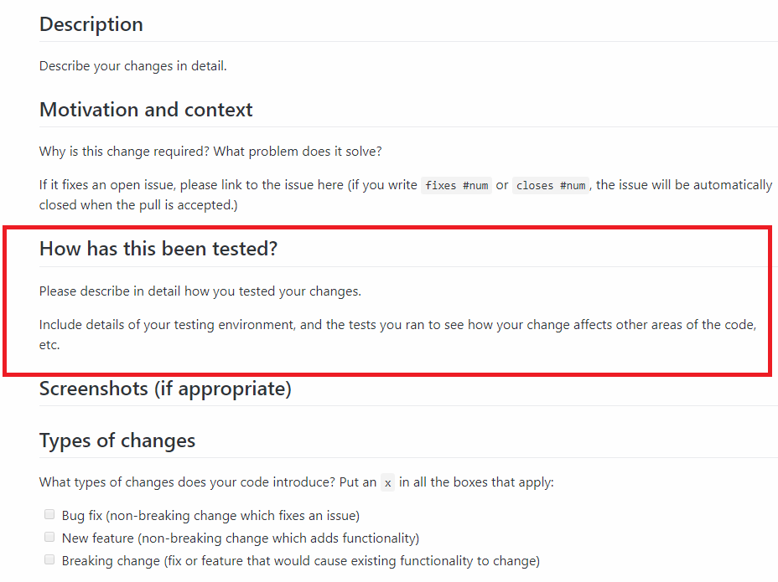
Characteristic
PART 02
After manually classifying the projects that have a Template, observe the characteristics of each category
4、Package
Test

Slide 14
Next Week Work
PART 03
Further crawling data, including: Community profile page data inclusion, pull request of each project, code of conduct.
Automatically determines whether a pull request is a pull request with a template.

