Slide 1

2019/03/10——2019/03/18
Work Conclusion
THE Week WORK SUMMARY REPORT
Reporter：Mengxi Zhang

Slide 2
Work Process
PART 01
PART 02
PART 03
Introduction
Experiment and Idea
The Next Week
Work

Slide 3
Introduction
PART 01
This week, I made further research on relevant contents on GitHub, and paid more attention to the compilation of the given classification of tag on GitHub, and relevant open documents in GitHub Insight Community. And got some ideas.

Slide 4
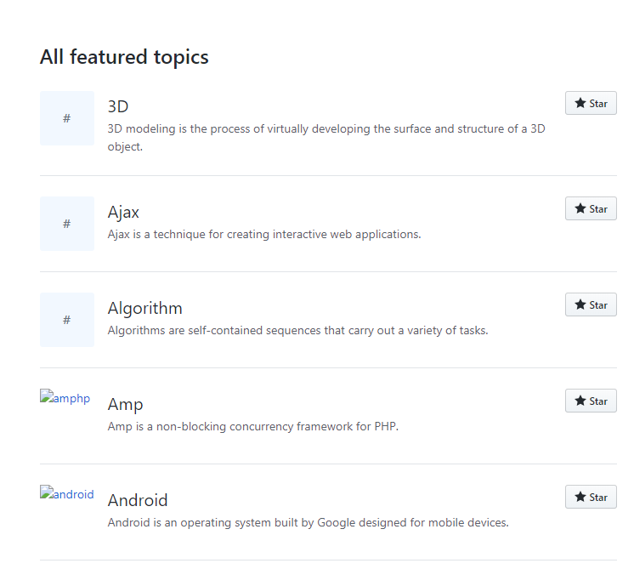
Experiments
and Idea
PART 02
First of all, in the interface of tag classification on GitHub, I counted the official number of tag classification given by it, and there were 183 tags. However, according to the data we got, the types of tags on GitHub were far more than these. After further analysis of these tags, it is found that the tags classified by GitHub include their abbreviations and extensions. However, after all the statistics, only 874 tags appeared in the tag classification. GitHub, though, has categorized the most popular tags. However, it is inevitable that some relatively unpopular tags will be used by someone, and it will be troublesome to retrieve them.
Totally 183 tags

Slide 5
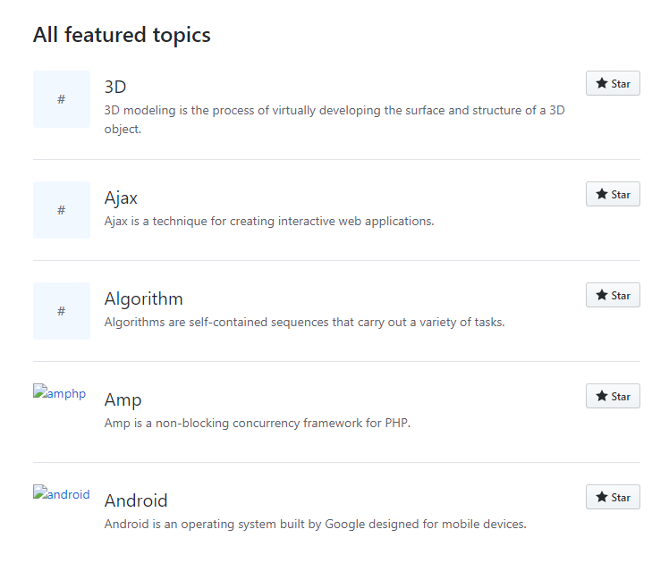
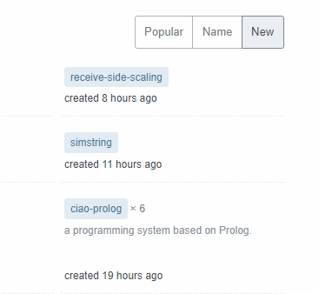
Experiments
and Ideas
PART 02
Secondly, the tag classification order given on GitHub is sorted only by the Name of tag. Different from Stack Overflow, Stack Overflow provides three different sorting methods: "Popular", "Name" and “New". Can the tag classification in GitHub be optimized according to Stack Overflow?
GitHub Tag
Stack Overflow Tag

Slide 6
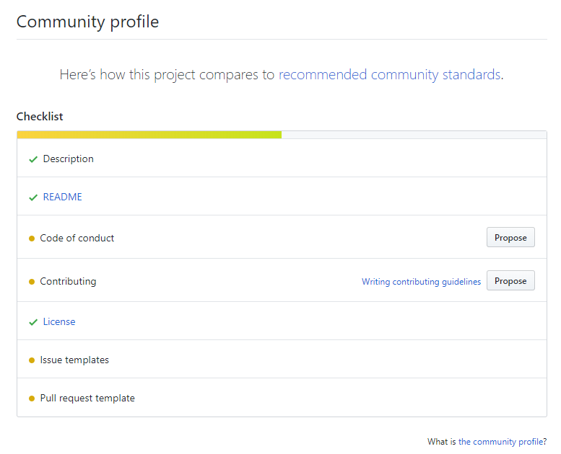
Experiments
and Ideas
PART 02
The other is that there is a Community Profile for each Repository on GitHub. It included: Description, Readme, Code of Conduct, License, Issue Templates, and Pull Request Templates. Distributions represent Repository descriptions, Readme documents, guidelines, contributions, version updates, Issue templates, and pull request templates.

Slide 7
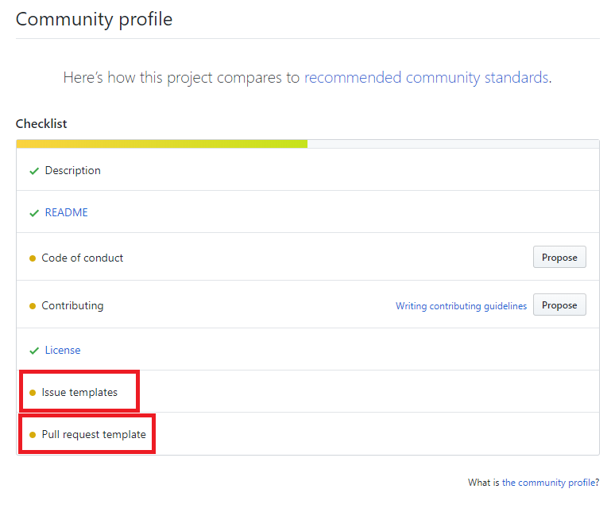
Experiments
and Ideas
PART 02
In which, I observed the first 100 items with Forks quantity and Star quantity in GitHub and found that 87 items had no Issue Template and Pull Request Template. The Issue Template and Pull Request Template make it easier for project developers to manage user Suggestions and requests. Most of these large projects do not have these two templates. Therefore, could you summarize the Issue Template and Pull Request Template from the existing Issue and Pull Request in the project?

Slide 8
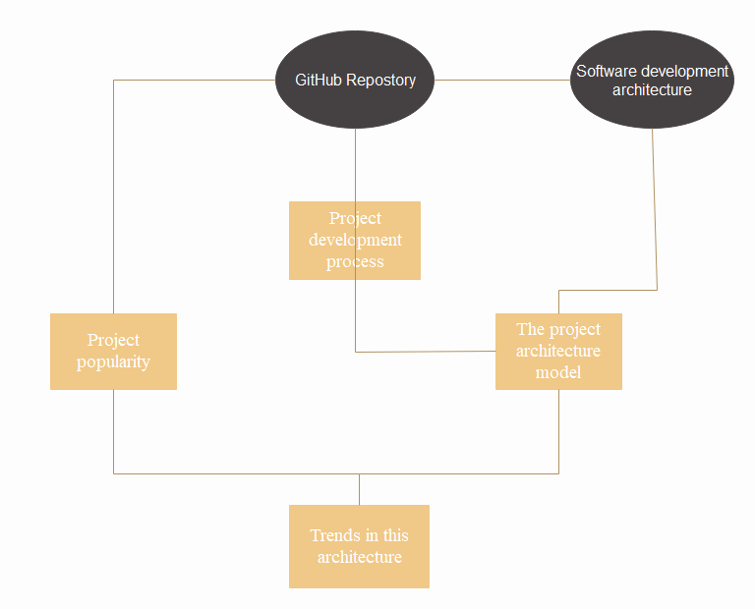
Experiments
and Ideas
PART 02
Finally, after discussing with the teacher, we had an idea: I summarized the relevant software architecture with the project of GitHub, and then predicted the development trend of software architecture. And I made a simple flow chart.

Slide 9
Next Week Work
PART 03
1、If a software architecture project is feasible, I will learn about the relevant models of software architecture.
2、Take a closer look at GitHub to see some of the minor issues on GitHub.
3、Compare Stack Overflow's tag with GitHub's tag in chronological order.

