Slide 1

2019/05/07——2019/05/20
Work Conclusion
THE Week WORK SUMMARY REPORT
Reporter：Mengxi Zhang

Slide 2
Work Process
PART 01
PART 02
PART 03
Introduction
Experiment and Idea
The Next Week
Work

Slide 3
Introduction
PART 01
Some time ago, I mainly completed two parts of the experimental contents, including the influence of the presence of the Pull Request template on the examiner's review speed and the influence of the presence of the Pull Request template on the repeated occurrence of Pull Request in the project

Slide 4
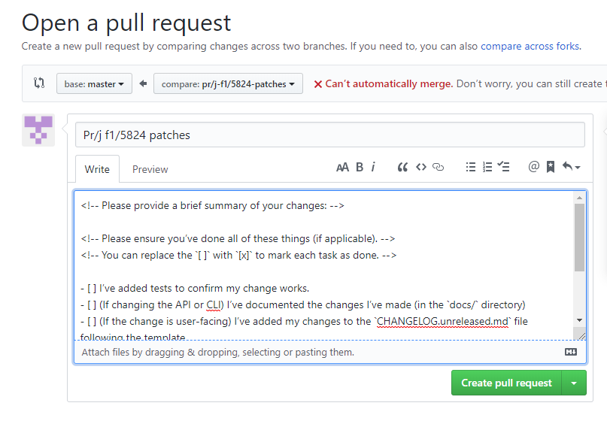
Pull Request Template
PART 02
The user can choose whether to write a Pull Request as per the Pull Request template
However, most users will still write a Pull Request
based on the template given for the project

Slide 5
Experiments
PART 02
The presence of the project Pull Request template affects the speed of review（50 projects）

Slide 6
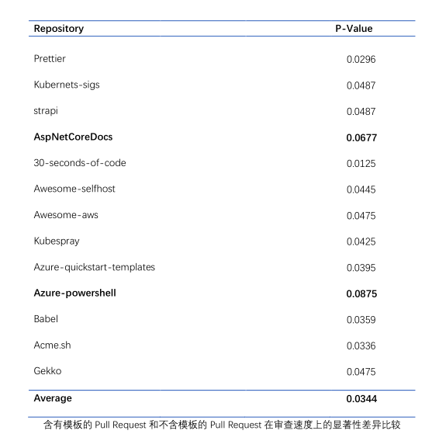
Experiments
PART 02
There is a significant difference in the influence of
Pull Request template on the speed of reviewers
between Pull Request template and no Pull Request
template

Slide 7
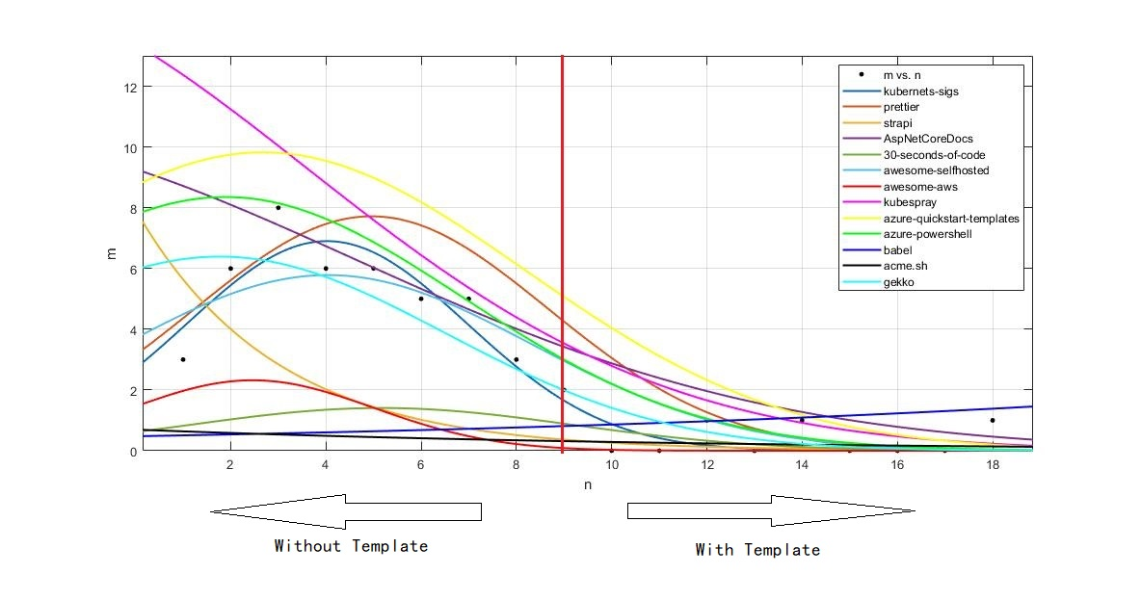
Experiments
PART 02
The effect of the presence of a Pull Request template on the duplicate Pull Request in a project（Gaussian curve fitting）

Slide 8
Experiments
and Ideas
PART 02
A study on the merge probability shows that the Pull Request with and without templates for the same Pull Request does not exist in a project.
Change in the popularity of Pull Request users who often write Pull Request as per the Pull Request template. The number of followers on GitHub does not change with time. I need to set up a tracking tool to track users for a long time.(count per 3 days)

Slide 9
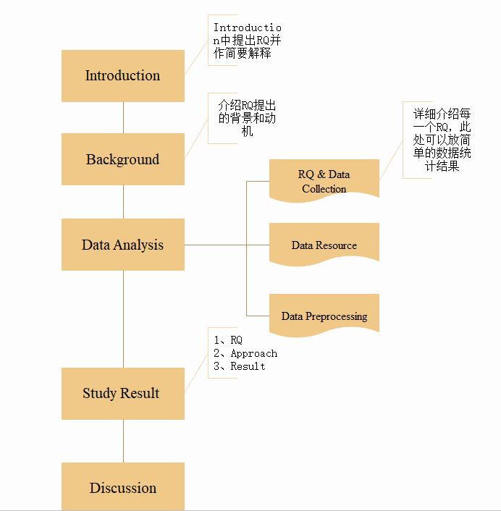
Paper Structure
PART 02
TSE 2018 How Do Users Revise Answers On Technical Q&A Websites A Case Study On Stack Overflow

Slide 10
Next Week Work
PART 03
1、If a software architecture project is feasible, I will learn about the relevant models of software architecture.
2、Take a closer look at GitHub to see some of the minor issues on GitHub.
3、Compare Stack Overflow's tag with GitHub's tag in chronological order.

