Slide 1

2018/12/25——2019/01/04
Work Conclusion
THE Week WORK SUMMARY REPORT
Reporter：Mengxi Zhang

Slide 2
Work Process
PART 01
PART 02
PART 03
The Overall Mission
Experiments
and results
The Next Week
Work

Slide 3
The Overall Mission
PART 01
After I downloaded and crawled the data, I experimented and explored the problem of tagging untagged projects on GitHub. And I think to solve this problem, I need to solve three sub-problems:
RQ1: How many labels should a project have?
RQ2: What should be the order of labeling?
RQ3: What types of projects should be labeled as appropriate?
Then in order to solve these problems, I did subsequent experiments to find a suitable solution for these problems.

Slide 4
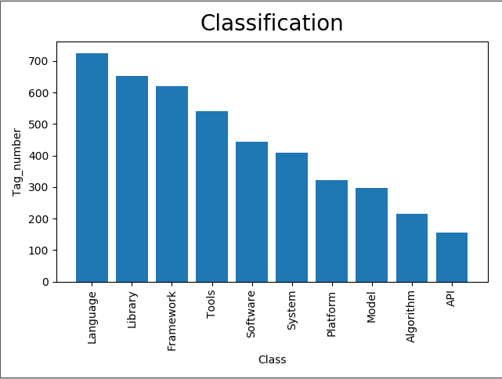
Experiments
and results
PART 02
First of all, After preprocessing the tags (removing duplicate tags), there are still 39,213 tags left. Then I clustered these tags and took the number of top-10 classes for further analysis. Which include Language(Python、java、Lua…);Library(BeautifulSoup4、numpy、Scripejava…);Framework(Bootstrap、php…);Tools(structuremap、census…);Software(twitter、facebook…) and so on.
However, the clustering effect is not very good, because word2vec requires context to calculate the vector, the single word input will lead to insufficient training. Therefore, whether other corpora(like description) can be used for training.

Slide 5
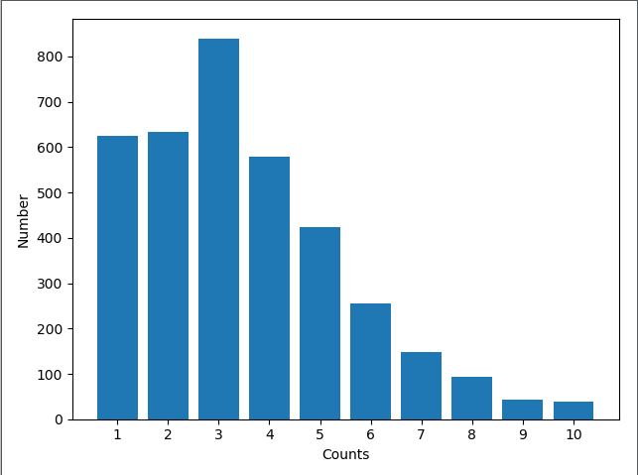
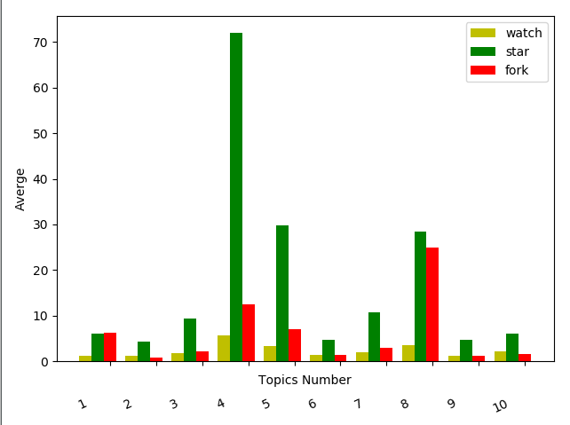
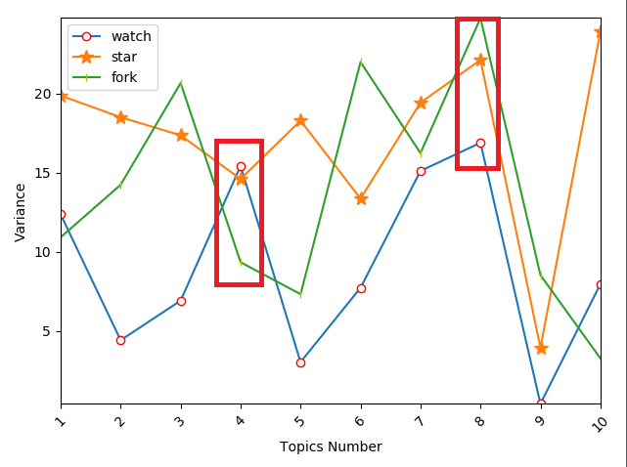
Experiments
and results
PART 02
In order to solve the first problem, I need to count the number of tags for each project. I selected 5,000 projects and counted their number of tags. Found that the number of tags in 5 or less of the project is too much. And three of these tags appear most often. But just in this way it's difficult to determine what impact the number of tags will have on the project? Therefore, I further compared the number of tags with the number of watch, star and fork of the project. And when the number of tags is 4 or 8, the number is higher. Then I calculated their variance to further confirm the experimental results, and found that when the number was 8, his variance was large and his data fluctuated greatly. Therefore, when the number of labels is 4, it is more appropriate.

Slide 6
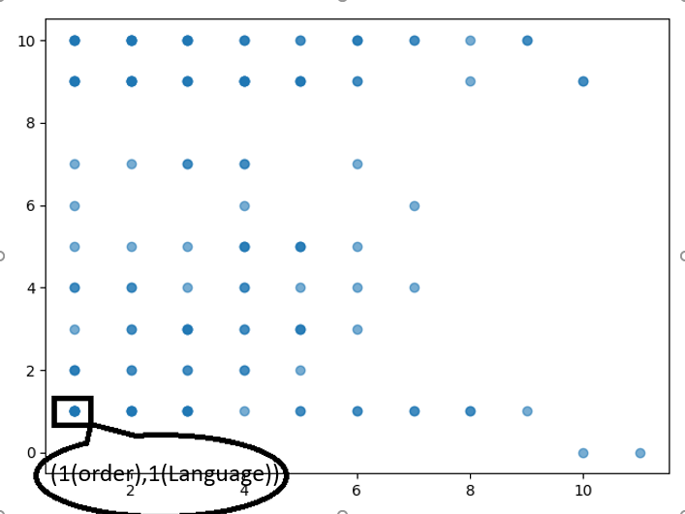
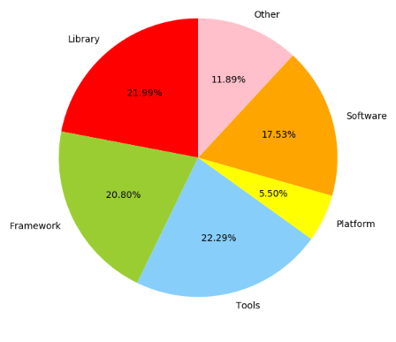
Experiments
and results
PART 02
In order to solve the second problem, Based on the clustering results and the sequence of engineering labels, I drew a scatter diagram, in which the color depth of the points represented the number of times this situation occurred. Each point can be represented as (order, category).But if you look at it, the order of tags is not very intuitive. Therefore, I manually analyzed the labels of 1000 projects. First, these projects are divided into five categories according to the project description: Library, Framework, Tools, Platform , Software and Other. Each category is then analyzed separately.

Slide 7
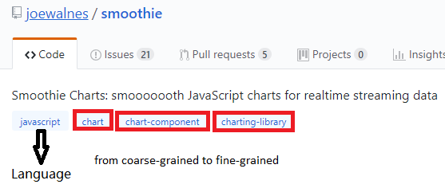
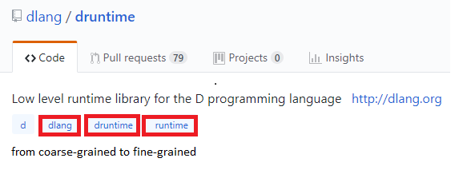
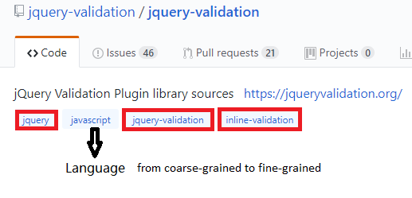
Experiments
and results
PART 02
For the Library, the tag order follows these rules(80%):
1、Most of the project have the language tags;
2、Language tags usually appear first or second;
3、Some tags are expanded from coarse-grained to fine-grained

Slide 8
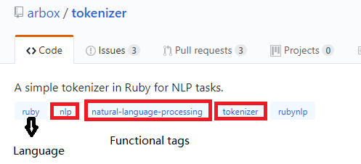
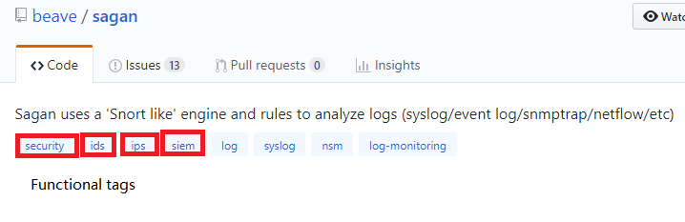
Experiments
and results
PART 02
For the Tools, the tag order follows this rule(70%):
The functional tag is placed at the front;

Slide 9
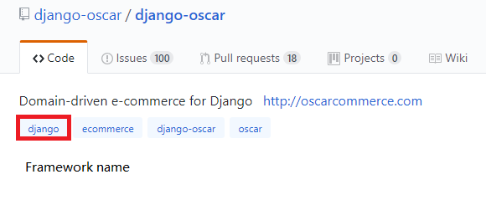
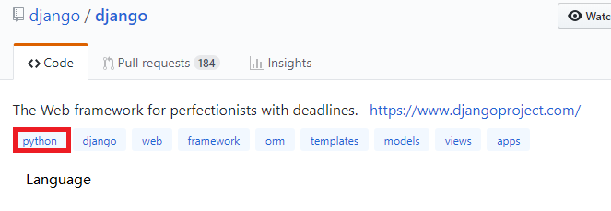
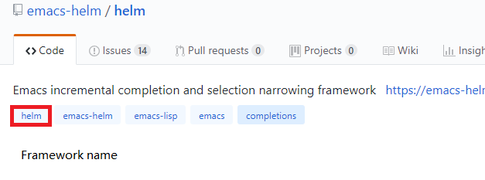
Experiments
and results
PART 02
For the Framework, the tag order follows this rule(70%):
1、It usually starts with the name of the framework or the language used by the framework;

Slide 10
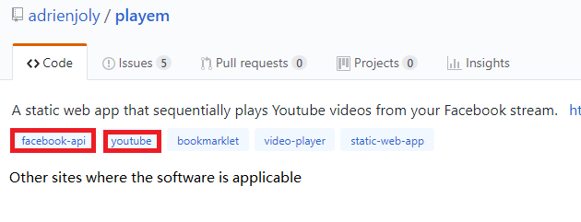
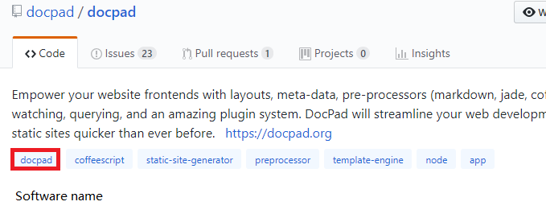
Experiments
and results
PART 02
For the Software, the tag order follows this rule(80%):
1、It usually starts with the name of the Software or other sites where the software is applicable;

Slide 11
Experiments
and results
PART 02
As for Platform, the label order cannot be specified according to some rules. However, there are significant differences in the categories of projects. It's hard to find a rule that most projects will satisfy. Moreover, the order of GitHub's tags is not officially restricted. The order varies from person to person, and there are many different situations. So, when adding tags to projects that are not tagged on GitHub, can they be recommended in the same order that other sites tag them (such as Stack Overflow)? But the question is, what are the benefits of labeling this way? What are the criteria? No suitable explanation has been found yet.

Slide 12
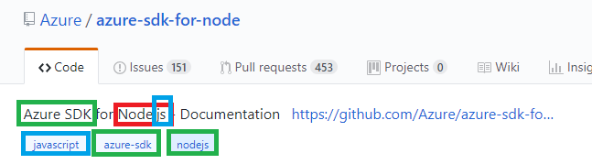
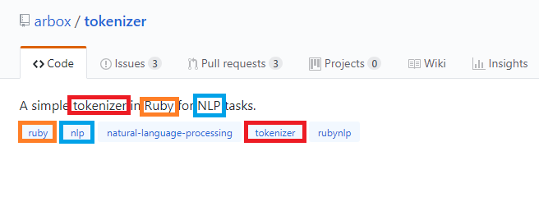
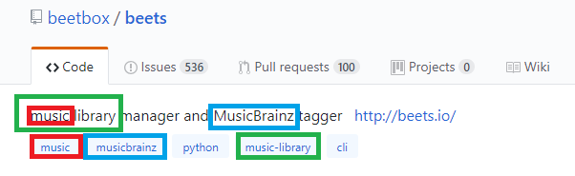
Experiments
and results
PART 02
In order to solve the third problem, the first thing that comes to mind is to determine which types of tags the project should have based on the readme document, but keyword extraction of the readme document can be cumbersome (with code or commands).Later, I found description on most projects on GitHub (85%), then analyzed some descriptions and found that I could extract from them the types of tags I needed.

Slide 13
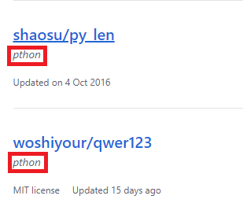
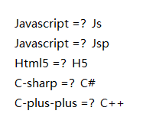
Experiments
and results
PART 02
Another two small discoveries:
1、Tag misspellings (still searchable on GitHub), such as python being written as ‘pthon’ when tagging, are not provided on GitHub. So is it possible to automatically check for spelling errors when entering labels?
2、When labeling, engineers like to use abbreviations, such as javascript can be written as js or JSP;Html5 will be written as h5, etc. But this inevitably produces ambiguities. Moreover, the correlation between javascript and js calculated by word2vec is not high. Therefore, can tags of these abbreviations be restored according to existing common abbreviation rules to achieve more accurate retrieval?

Slide 14
Next Week Work
PART 03
1、Because there are many categories of projects, it is not realistic to manually analyze all of them. Therefore, the next step is to consider whether the automation rules for each category can be automated
2、Visualize the scatter plot by category.
3、To improve the clustering effect, text information with context is selected during model training.
4、Description text may not contain all tags. Can those tags that are not included be extracted from other text.

