Slide 1

2019/03/04——2019/03/10
Work Conclusion
THE Week WORK SUMMARY REPORT
Reporter：Mengxi Zhang

Slide 2
Work Process
PART 01
PART 02
PART 03
Introduction
Experiment and Idea
The Next Week
Work

Slide 3
Introduction
PART 01
After the discussion last time, I classified the collected data by time, and first counted the data for two months (divided by week). Gephi graph analysis is carried out for the same kind of vocabulary. And then, through the discussion with the teacher last week, we had a new research idea, which broke my previously blocked idea.

Slide 4
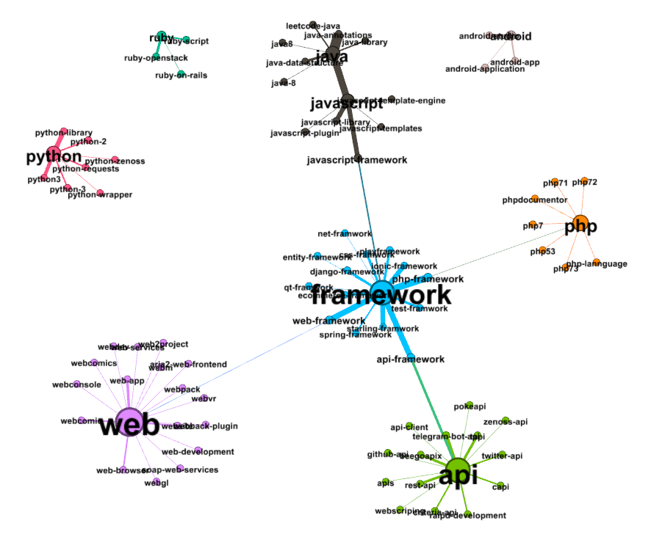
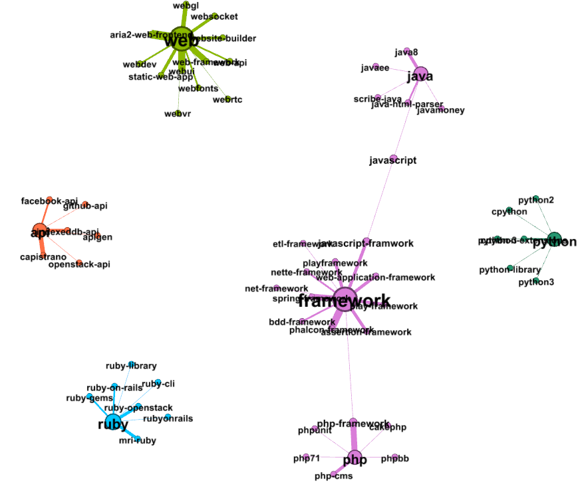
Experiments
and Idea
PART 02
The following is the Gephi graph analysis on the data of 2017/01/01-2017/02/18, in which the statistics of time nodes are recorded according to the creation time of their projects.
2017/01/01——2017/01/08
2017/01/09——2017/01/15

Slide 5
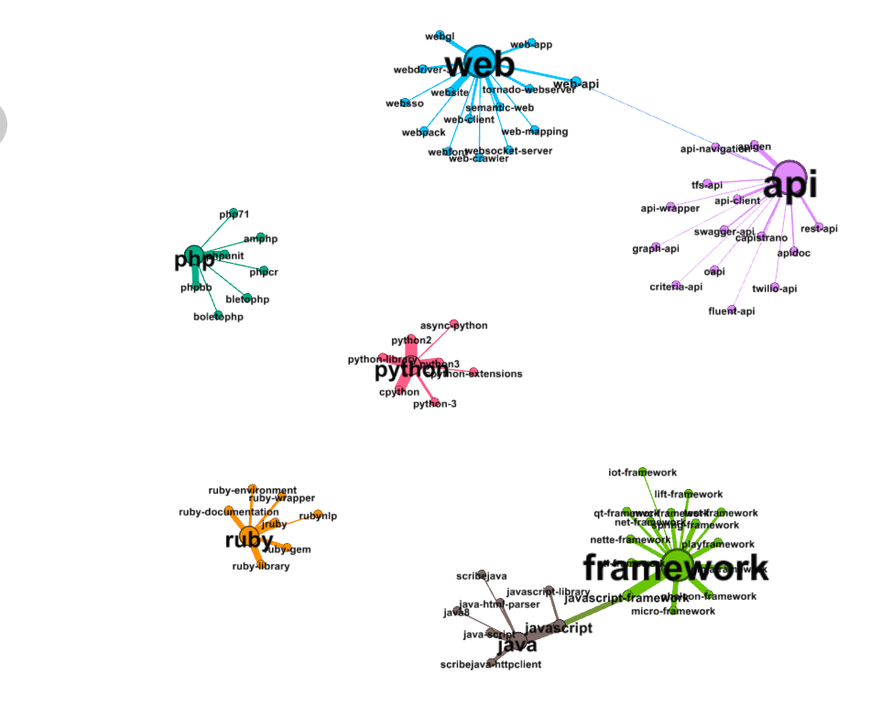
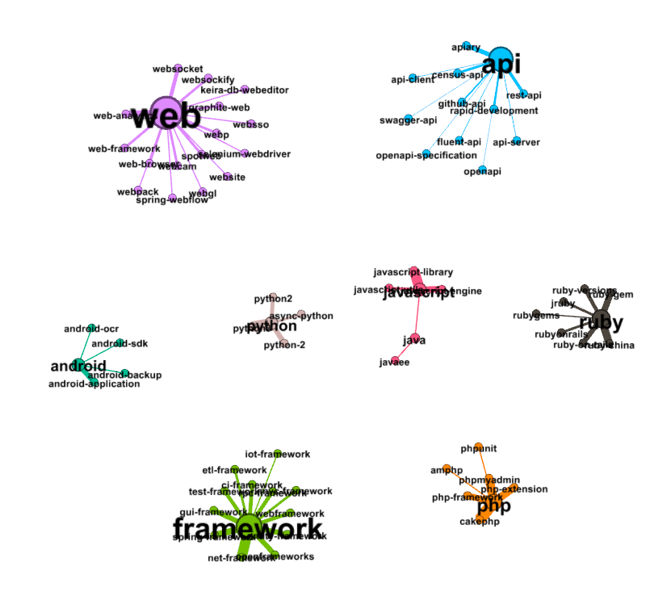
Experiments
and Ideas
PART 02
2017/01/16——2017/01/22
2017/01/23——2017/01/29

Slide 6
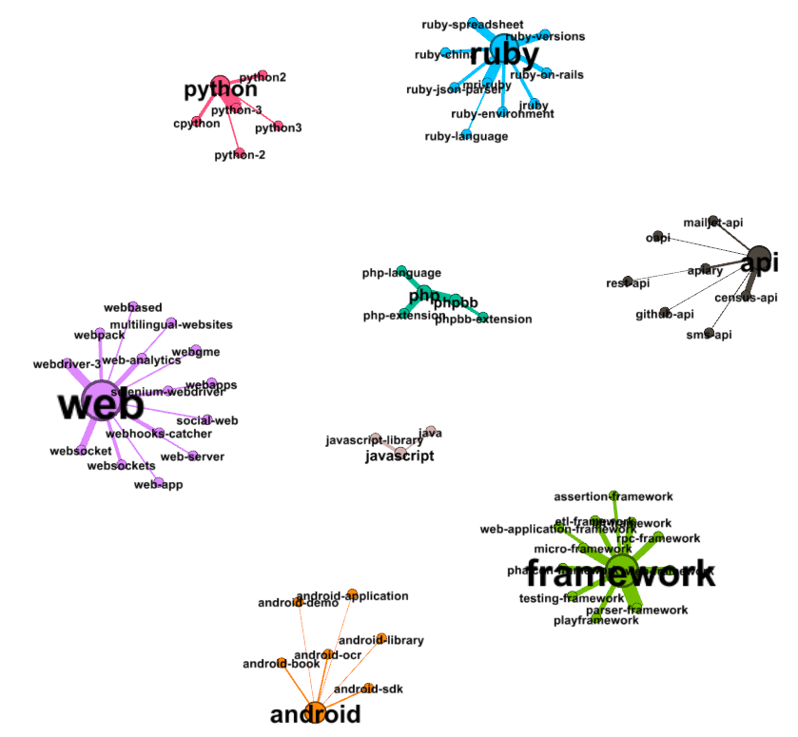
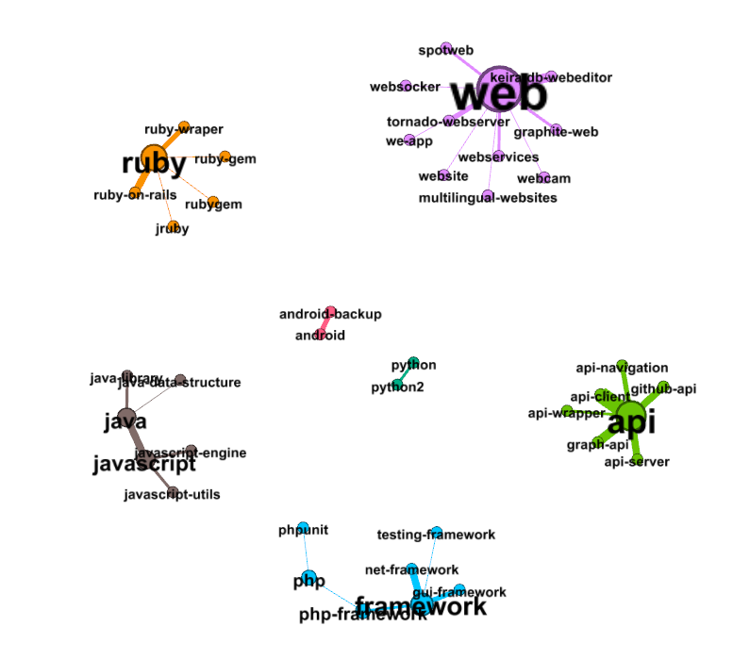
Experiments
and Ideas
PART 02
2017/01/30——2017/02/05
2017/02/06——2017/02/12

Slide 7
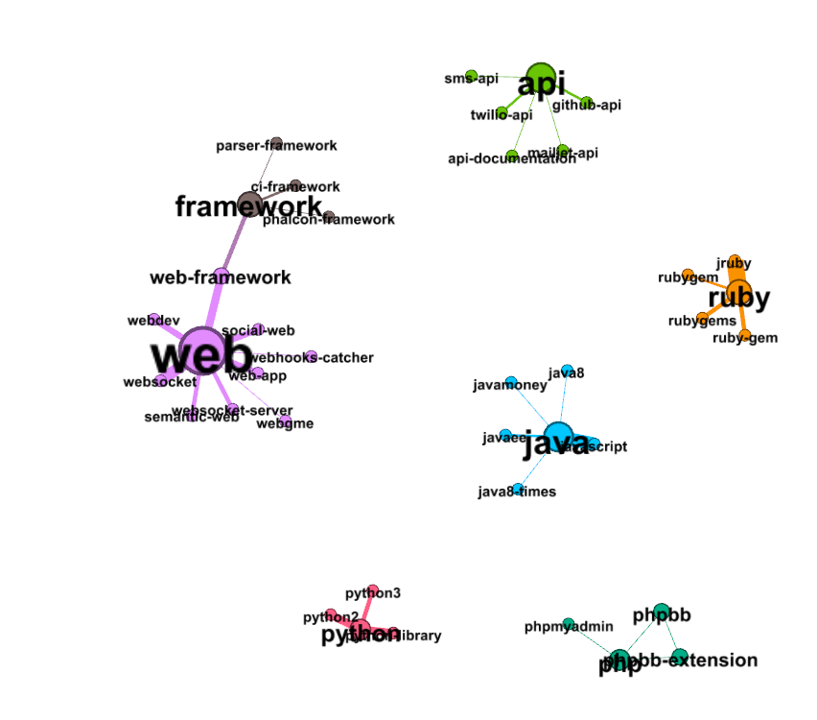
Experiments
and Ideas
PART 02
Through the analysis of these graphs, it is found that at the beginning, if a tag maintains a relatively high correlation degree, it is sufficient for the ‘framework’ and ‘web’, then these tags still maintain a leading trend in a short period of time, but after two months, as shown in fig.6-7, the correlation degree of the framework gradually decreases. Some of the other tags are starting to become more relevant, like ‘ruby’ and ‘apis’. Does this mean that the heat of a tag has a certain duration? Whether those tags with increasing correlation could predict the trend of the research boom in the next two months.
2017/02/13——2017/02/19

Slide 8
Experiments
and Ideas
PART 02
Another finding is that during the two weeks from January 1, 2017/01/01 to January 15, 2017/01/15, there were a lot of tag moments disappeared, like "Android". In the statistics of the following weeks, the tag of "Android" never appeared again. Therefore, can it be said that there is no research value for those fleeting tags? The answer, of course, is no, just as the 'Android' tag is incredibly important, so why is it so fleeting? Therefore, one of my ideas is to dig out the reasons for the sudden disappearance of those fleeting tags, so as to predict whether this tag will reappear in people's eyes in a short period of time.

Slide 9
Experiments
and Ideas
PART 02
In addition, after discussion with the teacher last week, we found that we should not limit our eyes to what benefits these tags can provide to GitHub when exploring the data, but should open our eyes to find out whether the study on these tags or the study on GitHub data can solve the known problems in the society. Just like the 2018 ICSE Competence Confidence Gap A Threat to Female Developers' Contribution on GitHub, the study of GitHub is taken as A data set, which illustrates A very practical problem: Gender discrimination against women in society. Female engineers on GitHub are used as a medium to reflect this very realistic problem and alert people.
After this inspiration, we wonder whether the sensitivity analysis of Stack Overflow and GitHub to the new tag can tell us more about social issues to some extent. For example, if a tag appears frequently on Stack Overflow but rarely on GitHub within the same time, does it mean that the current problem encountered for this tag is greater than the solution? Therefore, for this tag, can we find some solutions from other platforms or report the situation to the top 5,000 users on GitHub to speed up the resolution of this problem?

Slide 10
Next Week Work
PART 03
1、 I should pay more attention to the news and current social phenomena to consider whether what we have studied can reflect or solve this social phenomenon.
2、Take a closer look at a change on GitHub tag
3、A statistical comparison of Stack Overflow and GitHub tag in the same time period.

