Slide 1

2019/03/26——2019/04/01
Work Conclusion
THE Week WORK SUMMARY REPORT
Reporter：Mengxi Zhang

Slide 2
Work Process
PART 01
PART 02
PART 03
Introduction
Statistical
The Next Week
Work

Slide 3
Introduction
PART 01
This week, I crawled all documents in the Community profile. If the project contains Pull request template and Issue template, I crawled the text and made further statistical analysis. And then for projects that have a template, I've summarized some of the commonalities of their templates. Secondly, the Pull request of part of the project was crawled, and a simple method of template extraction was implemented automatically

Slide 4
Statistical
PART 02
Community profile in 19382 projects contains proportion of each document

Slide 5
Statistical
PART 02
1、Which a project with a template
2、Which a project without a template

Slide 6
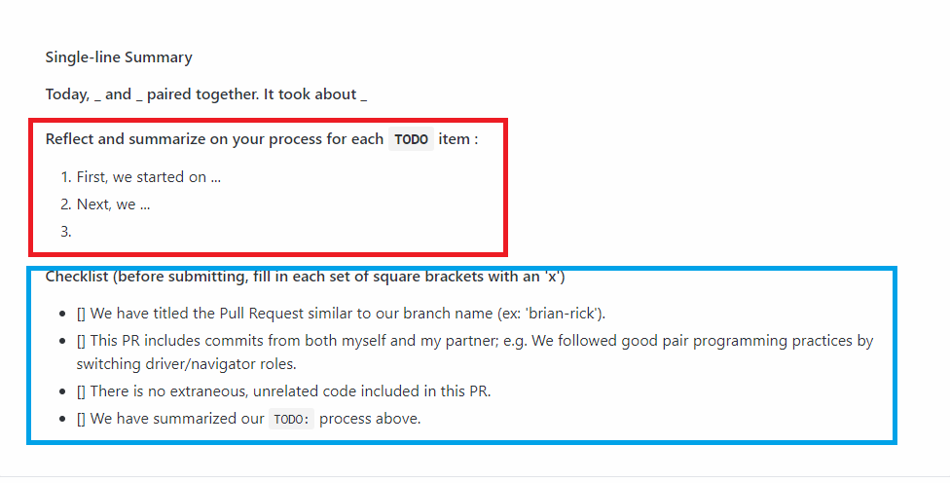
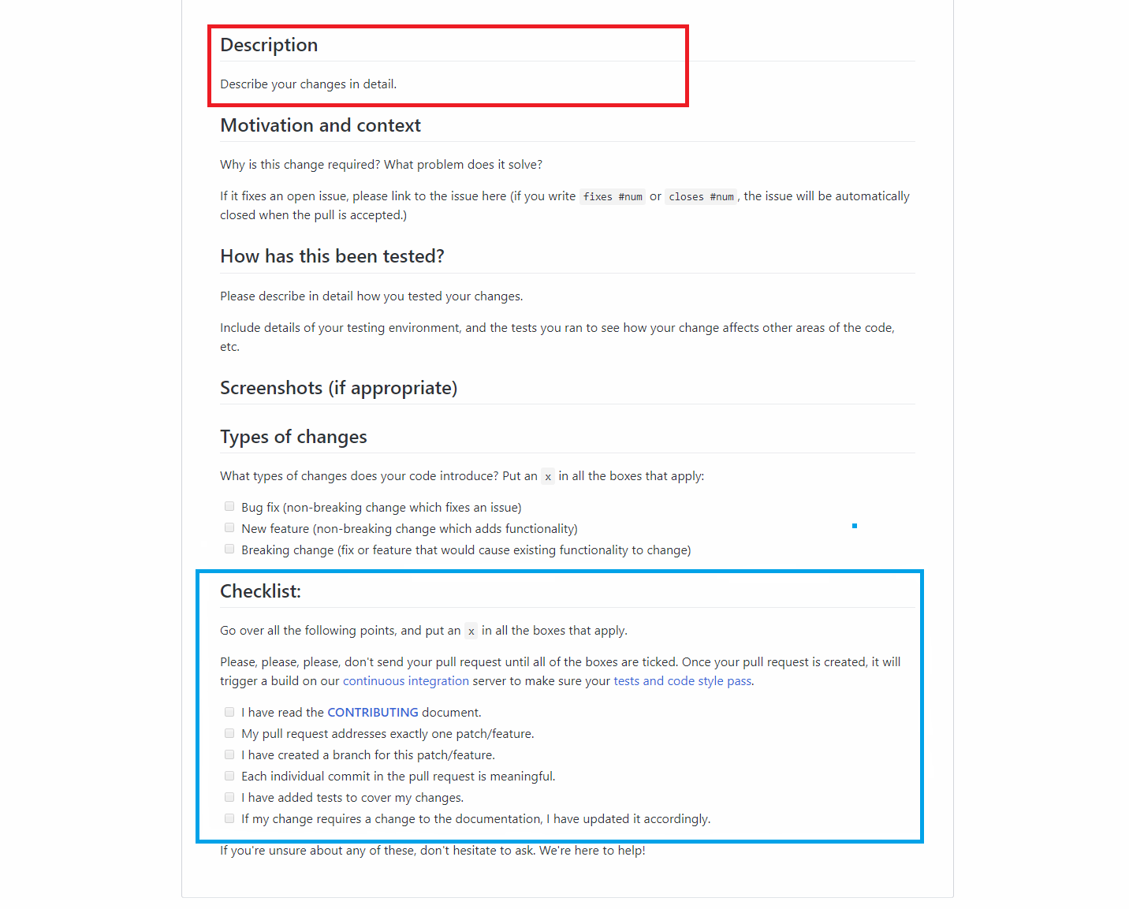
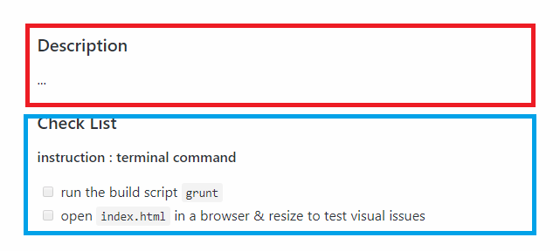
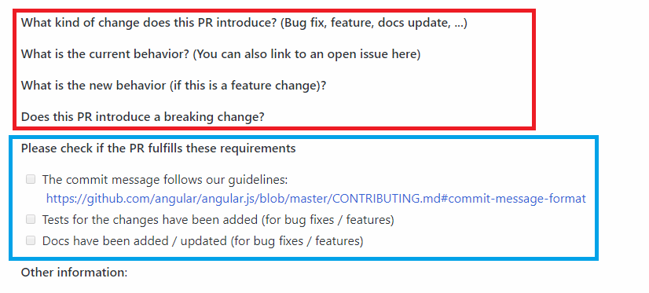
Commons
PART 02
The commons of pull request template

Slide 7
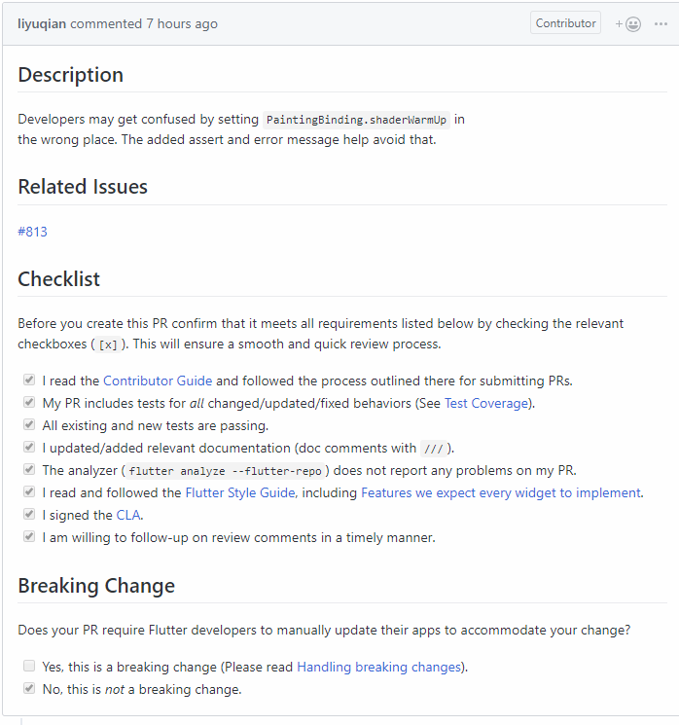
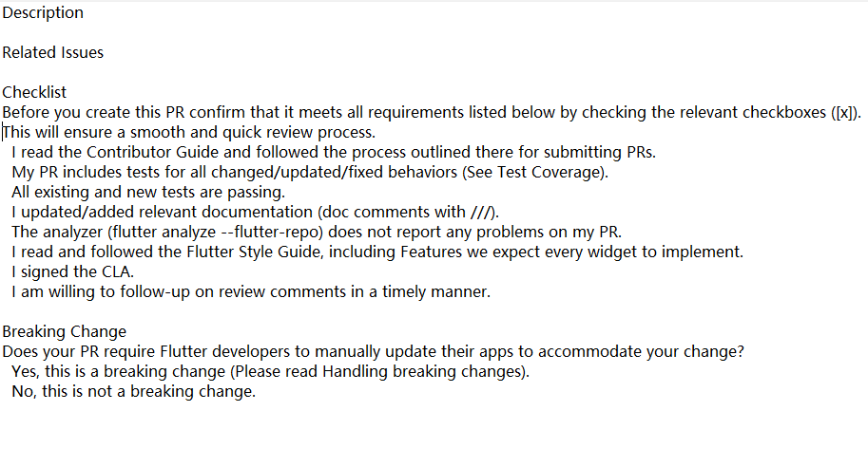
Pull Request Example
PART 02
Extract templates automatically based on Pull request (extract based on the unique name/class of each div in the web page)

Slide 8
Next Week Work
PART 03
Further crawling data, including: Community profile page data inclusion, pull request of each project, code of conduct.
Automatically determines whether a pull request is a pull request with a template.

