Slide 1
Customer Churn Prediction: A Data-Driven Approach
KAZEEM E. BELLO

Slide 2

Introduction
Brief Overview of Customer Churn
Customer churn refers to the rate at which customers stop using a company's service or product over a given period.
In the telecommunications industry, churn directly impacts recurring revenue, and business sustainability.
Why Does This Matters?
To identify patterns and behaviors that lead to customer attrition using historical data.
To shift from reactive churn management to a predictive, preventative approach powered by data.
To enable leadership to take strategic actions that directly impact revenue, customer satisfaction, and long-term value.

Slide 3
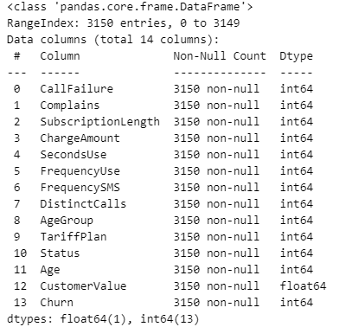
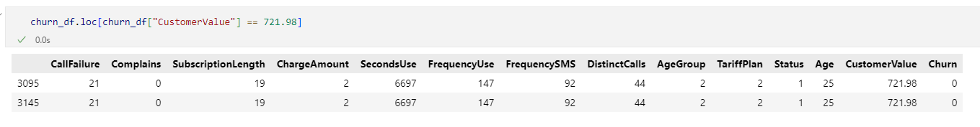
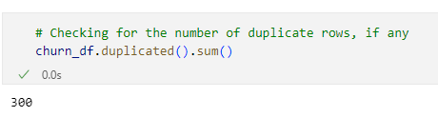
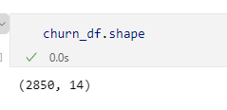
Data Preprocessing
Dataset Overview
3,150 customer records, 14 Columns
Customer Info: Age, TariffPlan
Usage Patterns: SecondsUse, FrequencyUse
Financials: CustomerValue (monetary)
Target Variable: Churn (1 = churned, 0 = not churned)
Data Cleaning
The data is clean, no missing values
Categorical columns that have been converted to numerical
There are duplicate rows in the data

Slide 4
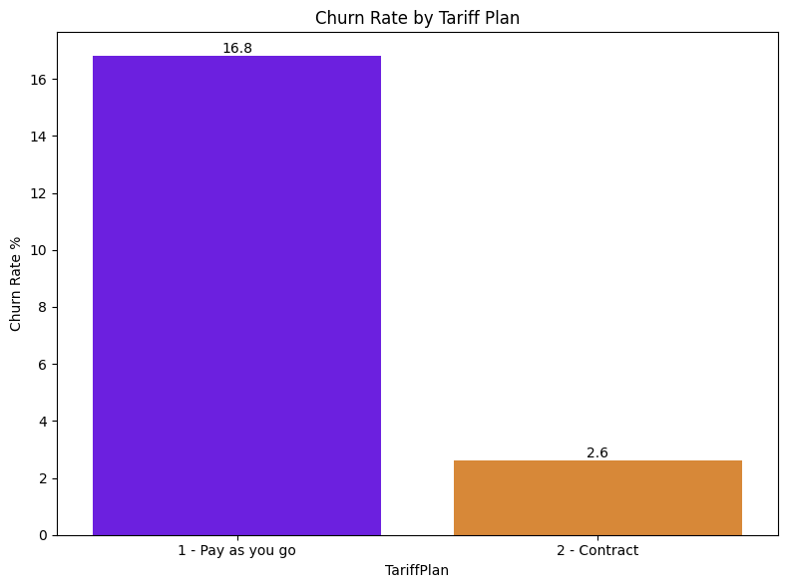
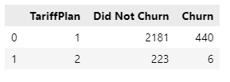
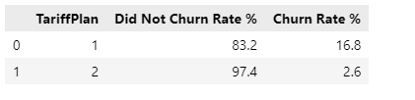
Key Insights
How does TariffPlan affect the rate of Churn

Slide 5
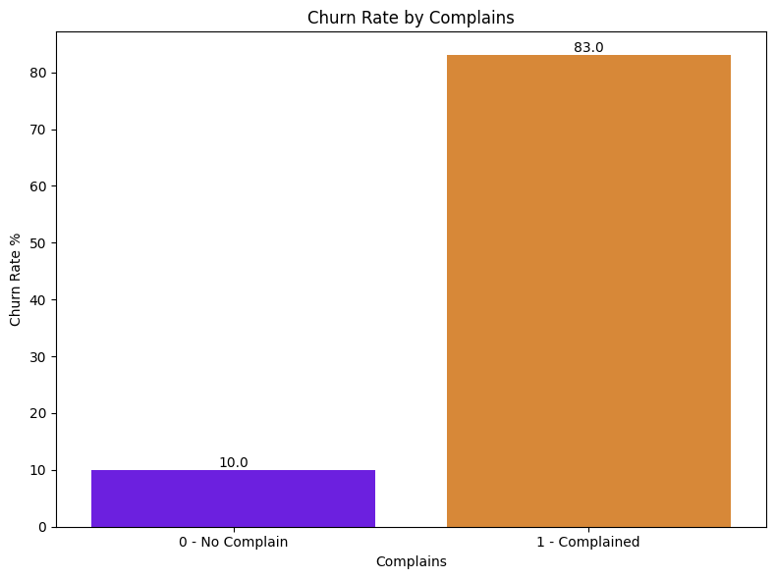
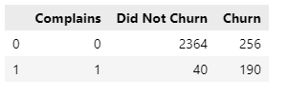
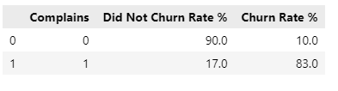
Key Insights
How does Complains affect the rate of Churn

Slide 6
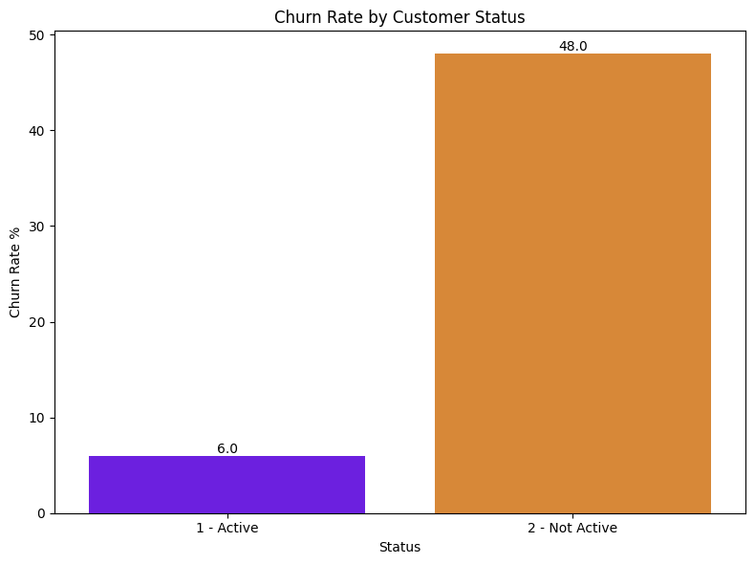
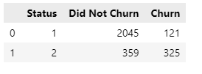
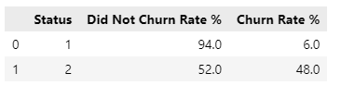
Key Insights
How does Status affect the rate of Churn

Slide 7
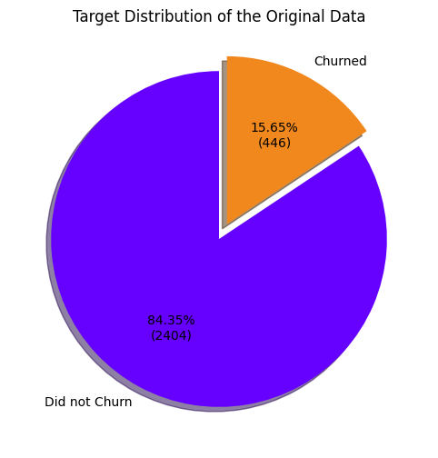
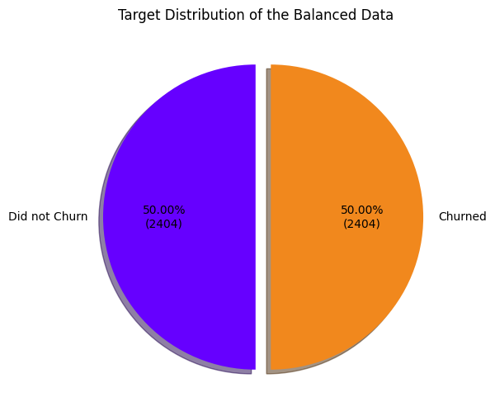
Imbalanced Data
Does imbalanced data affect model accuracy?
A big challenge is the distribution of the target variable- (Churn)
Imbalance can lead to model bias towards the majority class
Synthetic Minority Over-sampling Technique (SMOTE) was used to balance the class distribution by generating synthetic samples for the minority class

Slide 8
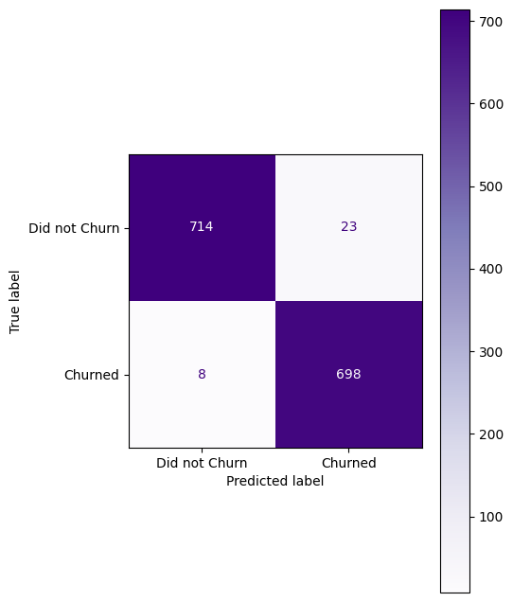
Model Implementation
Evaluation metrics of the base models
Evaluation metrics of the Tuned models
Confusion Matrix of the Best Model (XGB)
Data Standardization
Model Name | Accuracy (%)
XGBoost | 97.9
CatBoost | 97.9
RandomForest | 97.5
KN | 96.1
Decision Tree | 96.0
SVM | 93.2
LR | 84.8
Model Name | Accuracy (%)
XGBoost | 97.9
CatBoost | 97.7
RandomForest | 97.6
Train-Test Split
Model Training
Model Evaluation
Hyperparameter Tuning

Slide 9
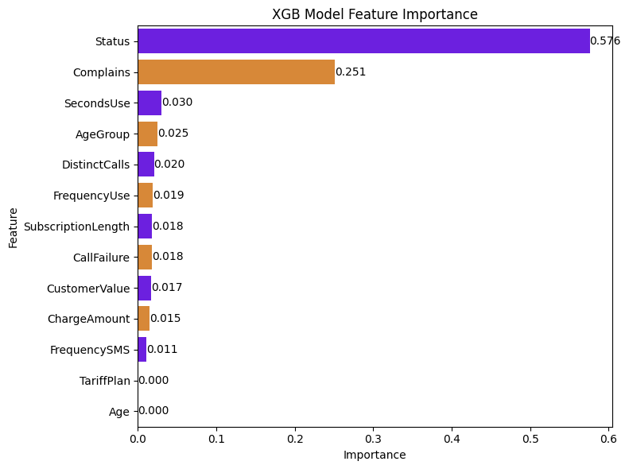
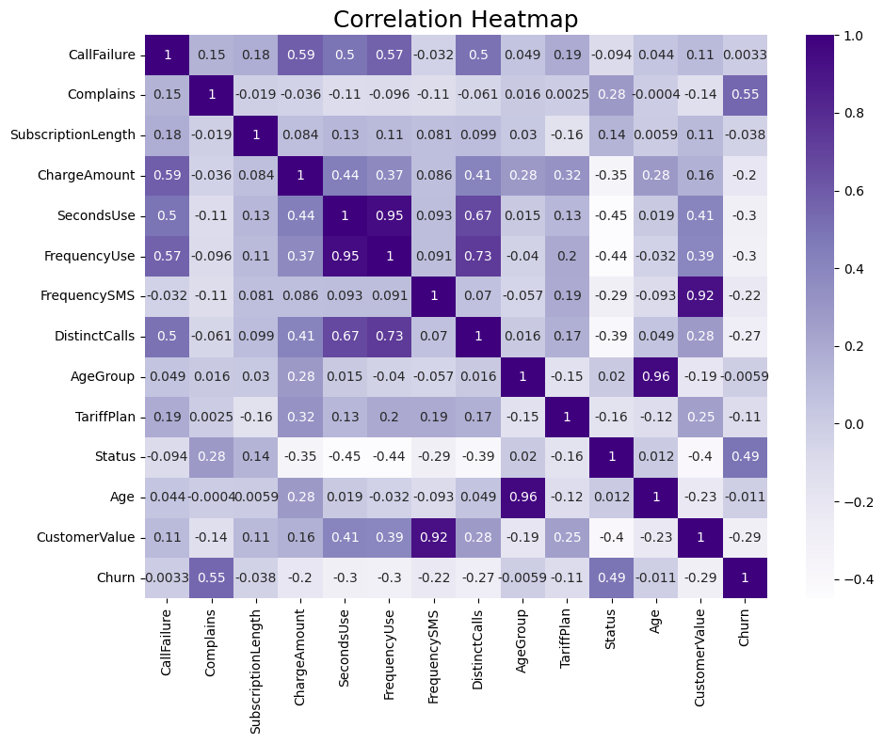
Feature Importance
TP, age, FU, FS

Slide 10
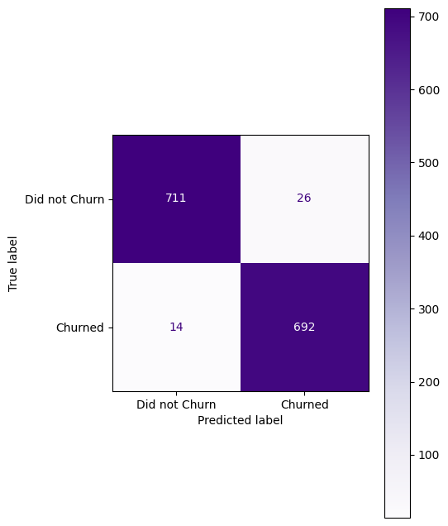
Model Comparison
Evaluation metrics of the Tuned models
Confusion Matrix of the Best Model (XGB) After Feature Selection
Confusion Matrix of the Best Model (XGB)
Model Name | Accuracy (%)
XGBoost | 97.9
CatBoost | 97.7
RandomForest | 97.6
Evaluation metrics of the Tuned models After Feature Selection
Model Name | Accuracy (%)
XGBoost | 97.1
CatBoost | 97.1
RandomForest | 96.6

Slide 11
Business Recommendation
Improve service quality to reduce complaints and failures
Offer incentives to new/short-term users
Personalize retention for high-value customers
Promote usage through targeted engagement
Offer a reduced monthly plan for contract customers
Detect early customer inactivity and implement targeted advertising strategies to re-engage them

Slide 12

Business Recommendation
Project Code and Slide:
https://github.com/Kazeem-Bello/customer_chun/
Thank You

