Slide 1
Combine Facility Management
Customer Churn Prediction: A Data-Driven Approach
KAZEEM E. BELLO

Slide 2

Introduction
Brief Overview of Customer Churn
Customer churn refers to the rate at which customers stop using a company's service or product over a given period.
In the telecommunications industry, churn directly impacts recurring revenue, and business sustainability.
Why Does This Matters?
To identify patterns and behaviors that lead to customer attrition using historical data.
To shift from reactive churn management to a predictive, preventative approach powered by data.
To enable leadership to take strategic actions that directly impact revenue, customer satisfaction, and long-term value.

Slide 3
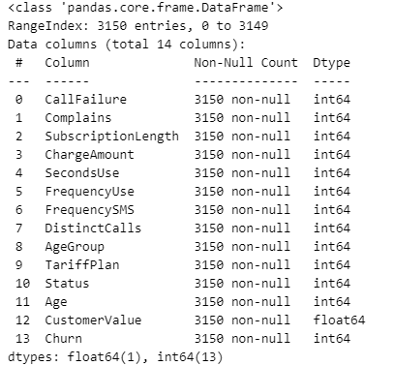
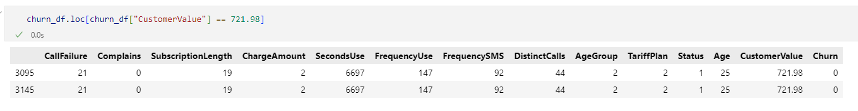
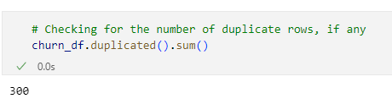
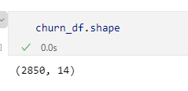
Data Preprocessing
Dataset Overview
3,150 customer records, 14 Columns
Customer Info: Age, TariffPlan
Usage Patterns: SecondsUse, FrequencyUse
Financials: CustomerValue (monetary)
Target Variable: Churn (1 = churned, 0 = not churned)
Data Cleaning
The data is clean, no missing values
Categorical columns that have been converted to numerical
There are duplicate rows in the data

Slide 4
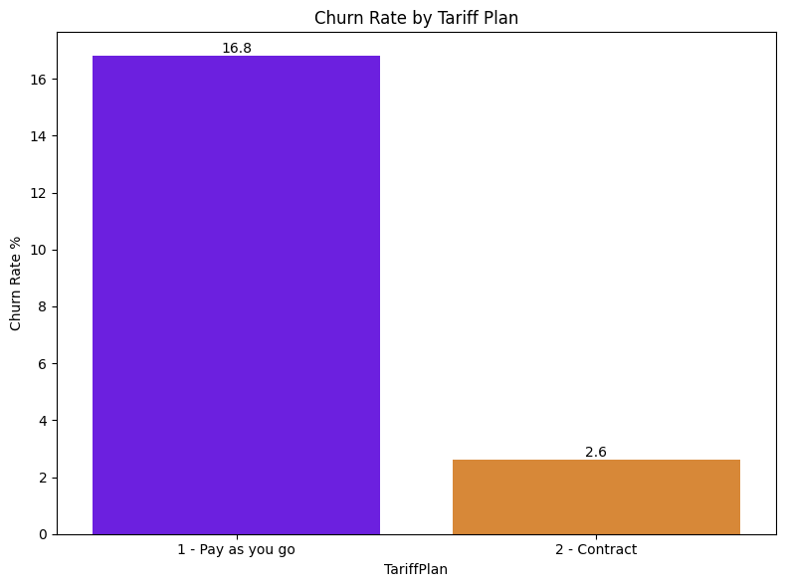
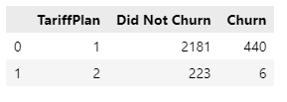
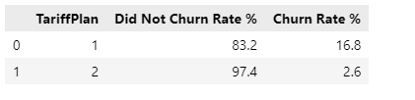
Key Insights
How does TariffPlan affect the rate of Churn

Slide 5
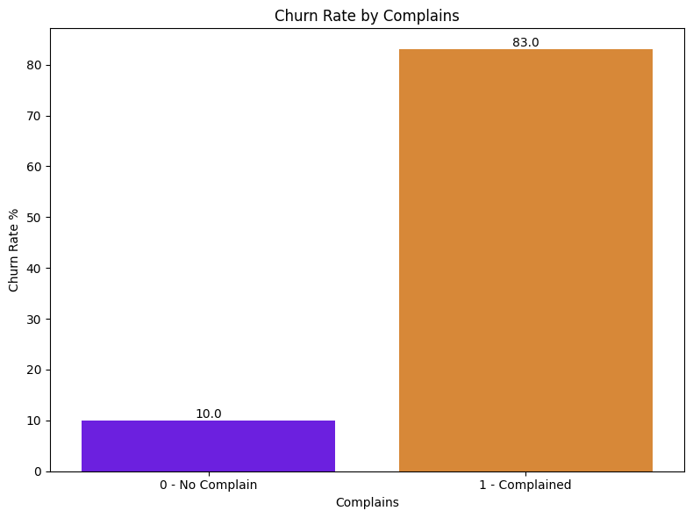
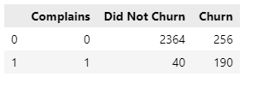
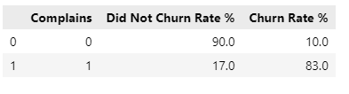
Key Insights
How does Complains affect the rate of Churn

Slide 6
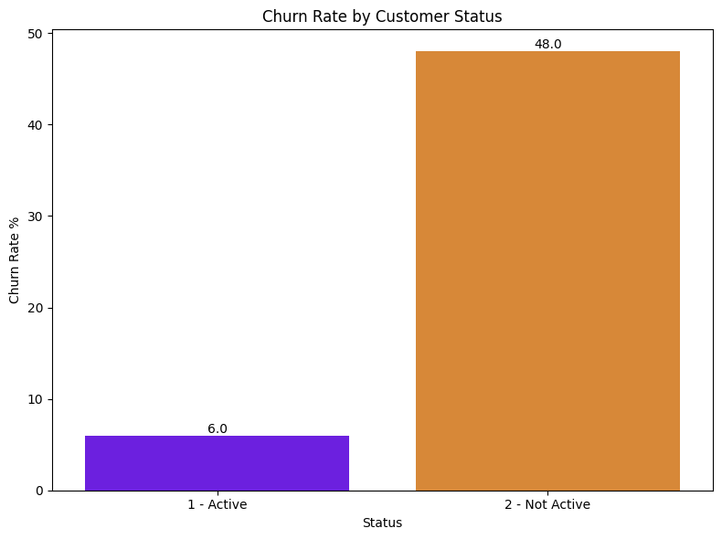
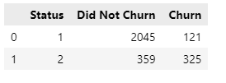
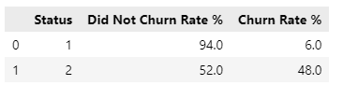
Key Insights
How does Status affect the rate of Churn

Slide 7
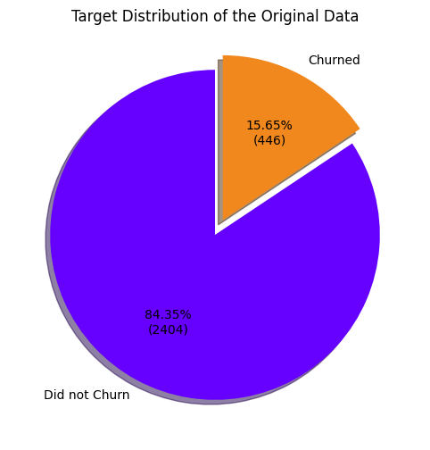
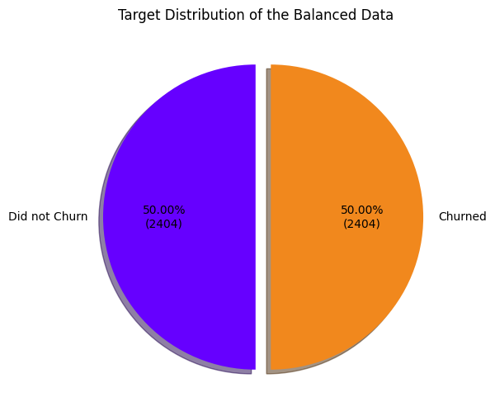
Imbalanced Data
Does imbalanced data affect model accuracy?
A big challenge is the distribution of the target variable- (Churn)
Imbalance can lead to model bias towards the majority class
Synthetic Minority Over-sampling Technique (SMOTE) was used to balance the class distribution by generating synthetic samples for the minority class

Slide 8
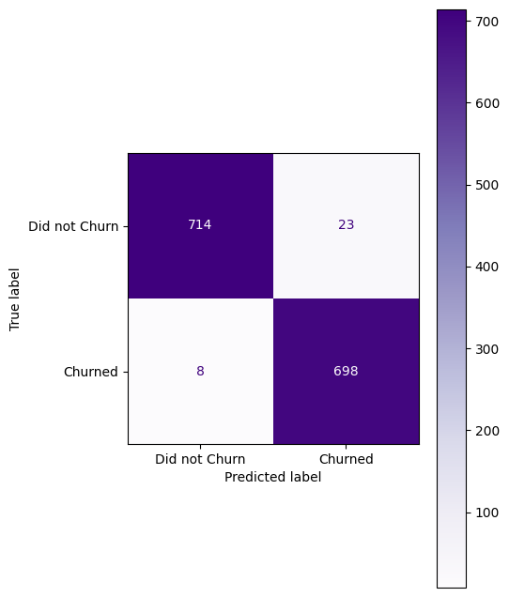
Model Implementation
Evaluation metrics of the base models
Evaluation metrics of the Tuned models
Confusion Matrix of the Best Model (XGB)
Data Standardization
Model Name | Accuracy (%)
XGBoost | 97.9
CatBoost | 97.9
RandomForest | 97.5
KN | 96.1
Decision Tree | 96.0
SVM | 93.2
LR | 84.8
Model Name | Accuracy (%)
XGBoost | 97.9
CatBoost | 97.7
RandomForest | 97.6
Train-Test Split
Model Training
Model Evaluation
Hyperparameter Tuning

Slide 9
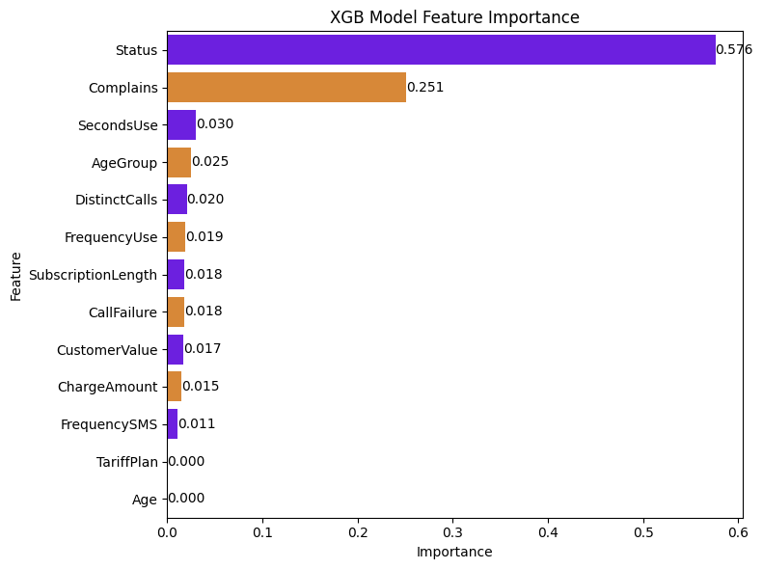
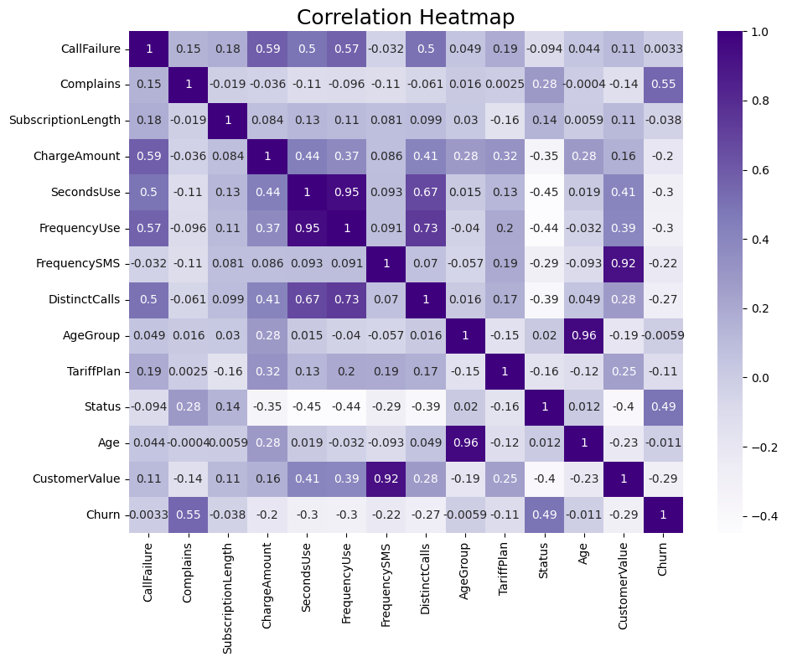
Feature Importance
TP, age, FU, FS

Slide 10
Feature Importance
TP, age, FU, FS

Slide 11
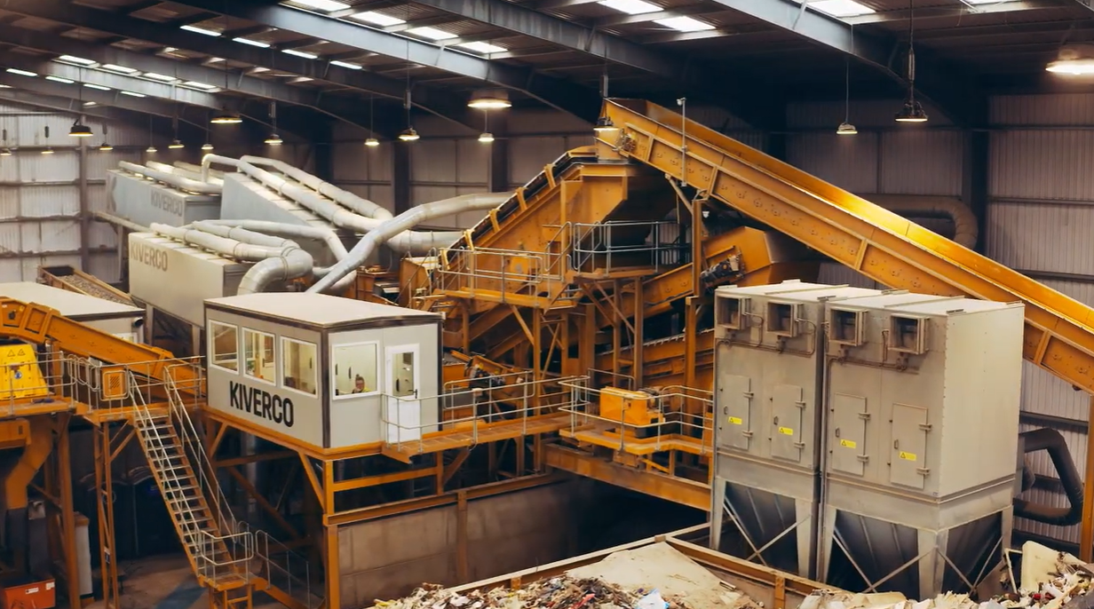
Why Digital Twin for Kiverco ?
Performance Monitoring
Predictive Maintenance
Process Optimisation
Case Study- Construction and Demolition Waste Recycling Plant

Slide 12
Implementation Challenges
Integration with existing system
Custom-built machinery and third-party equipment are heterogenous system
Integrating into heterogenous system is complex
Different data format
Data Collection and Quality
DT relies on high quality real-time data
Dust. Vibration and temperature affect sensor reliability

Slide 13
Addressing the Challenges using AI and Data Science
Integration with existing system
extract, transform, and load data into a unified format suitable for the digital twin model
Data Collection and Quality
Use advanced analytics and AI to clean and structure data

