Slide 1
CV Maker
Using HTML,JS and CSS
Name Lastname
Contact: xxx@redi-school.org

Slide 2
Why I chose this project? Personally for me it is a very challenging project and also making a CV Maker App or a Website that makes CV is useful. Personally I always needed such program or website to make an updated form CV and maybe there be some person like me who need this App. On the other hand, I think the most of lessons and lectures that we learned in ReDI School some how is included in this project.
Name Lastname
Contact: xxx@redi-school.org

Slide 3

Project Process

Slide 4
Actually this is a very simple project that just gets inputs and makes a designated output.
All inputs that users give to application, it invokes to JavaScript, JavaScript takes the forms’ values and makes it a text without forms to not showing up the forms in print view, and then that text will be designed automatically with CSS.

Slide 5
HTML, CSS and JavaScript
This App has the following pages to execute.
“Index.html” for making containers of project.
“script.js” for assigning functions
“styles.css” for designing contents
“print.css” for designing the print page

Slide 6

CSS Pages
It has two CSS pages named “styles.css” and “print.css”, that styles.css works at screen media and print.css works at print media.

Slide 7
JavaScript Page:
At all just two function are used in this Application:
Function for adding more and more forms in Education field.
A listener to the inputs that coverts the forms values to single text and prints the whole page.

Slide 8
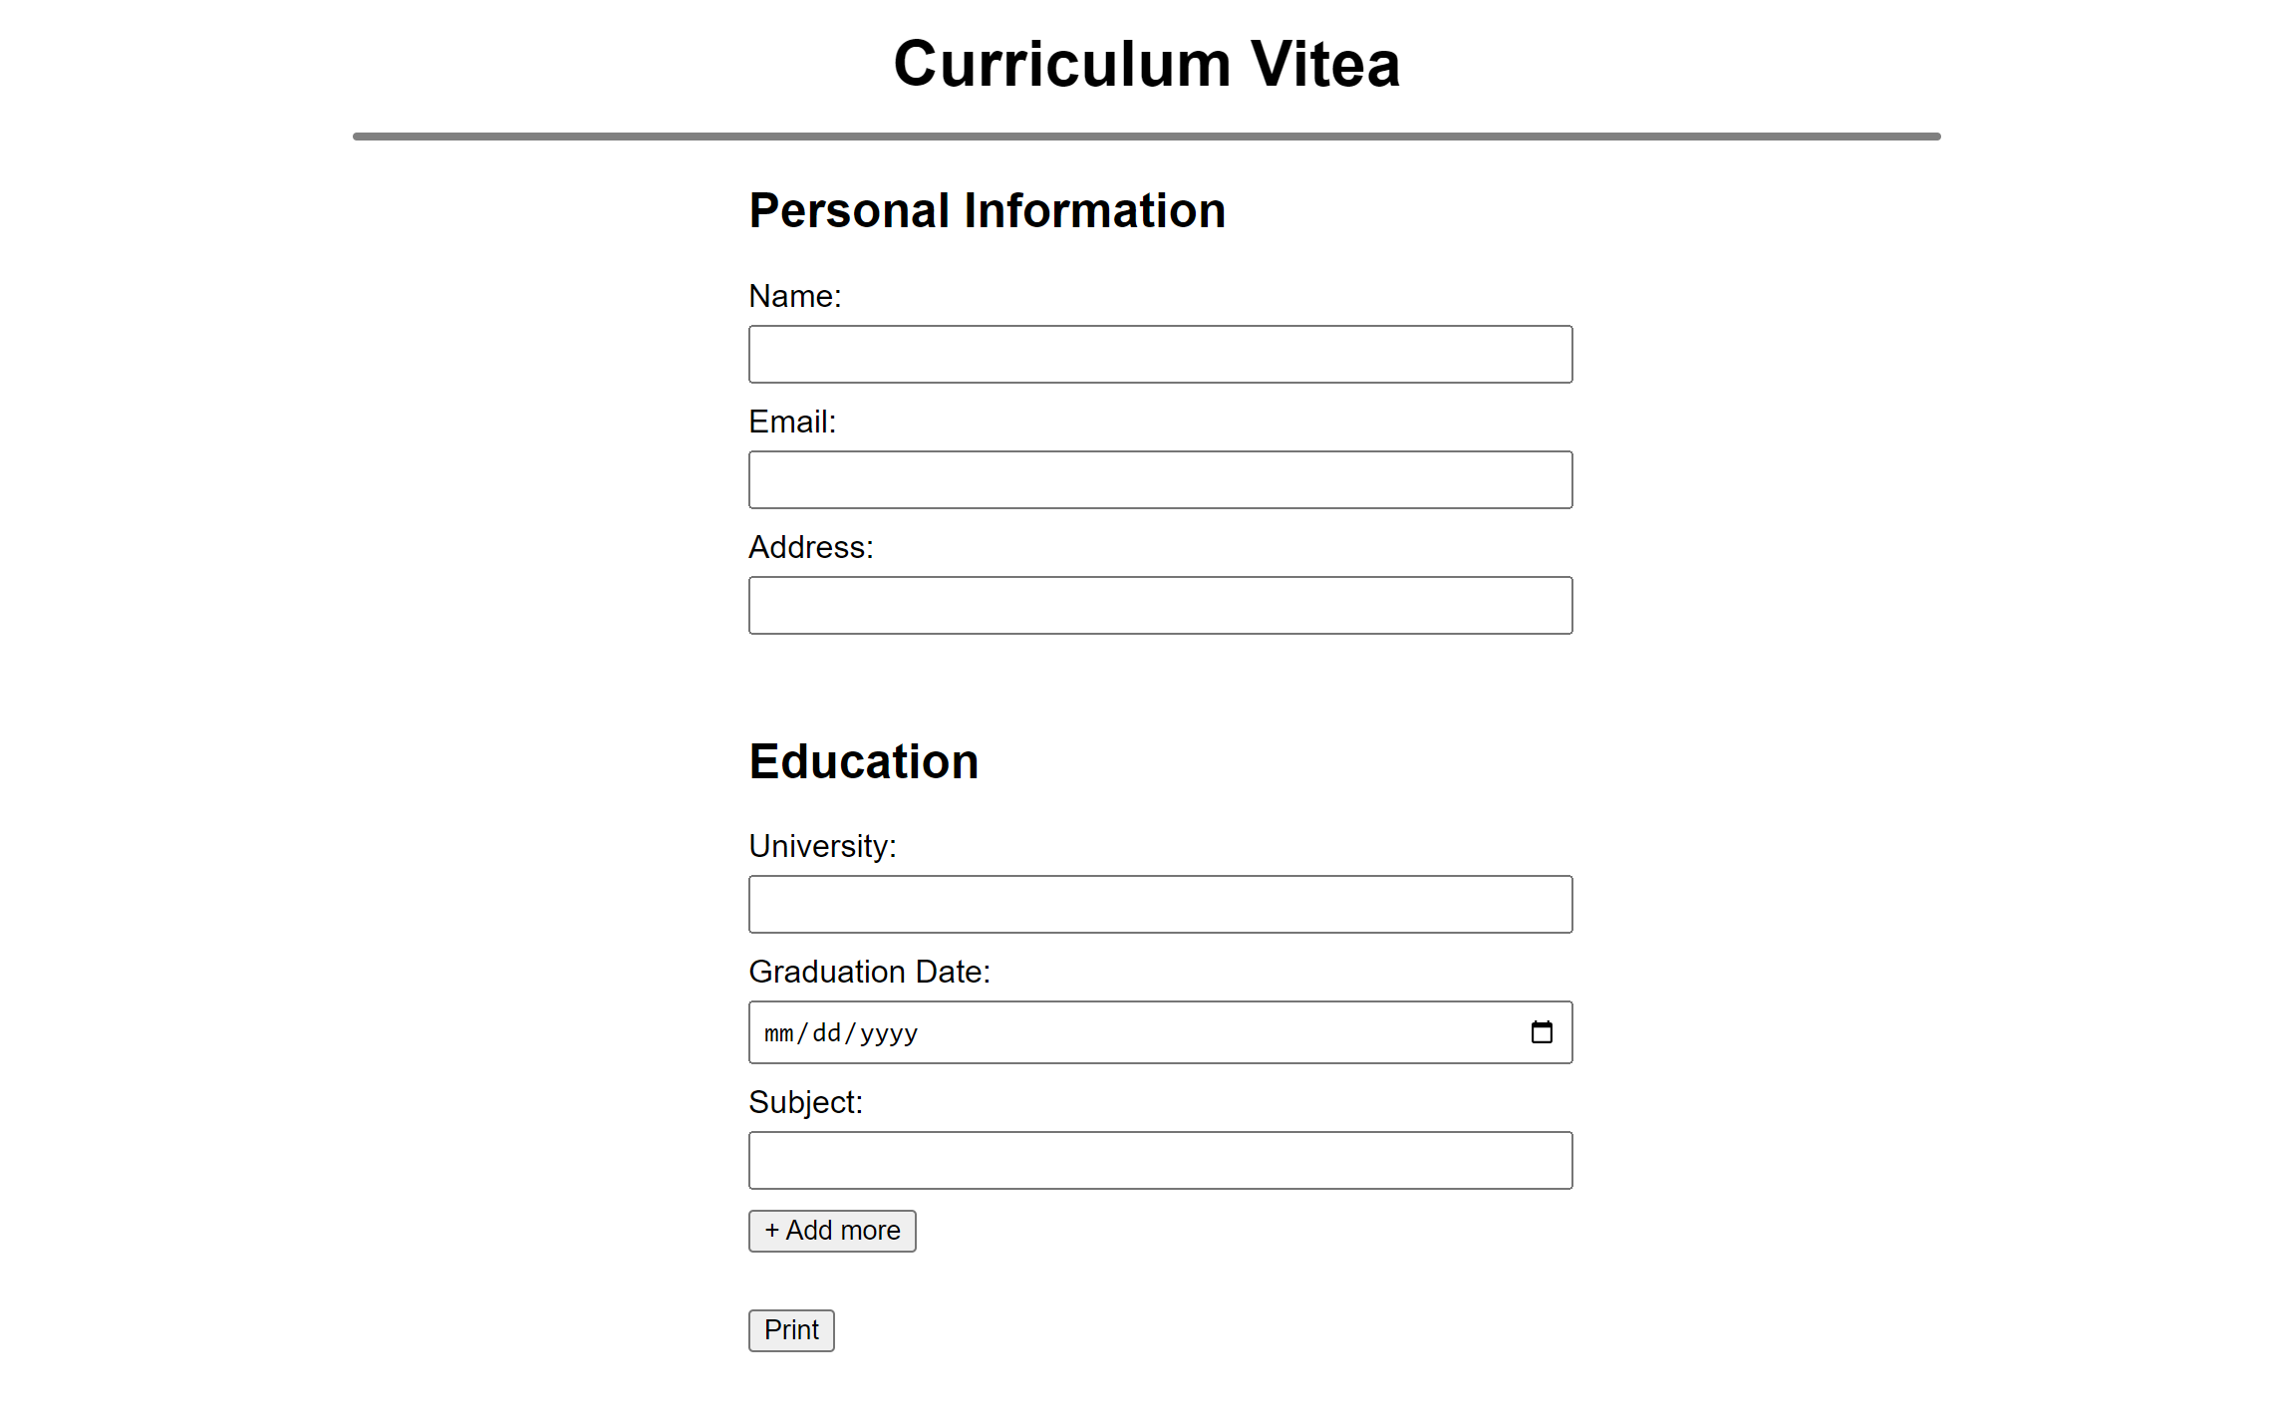
Screen shot of Application:

Slide 9
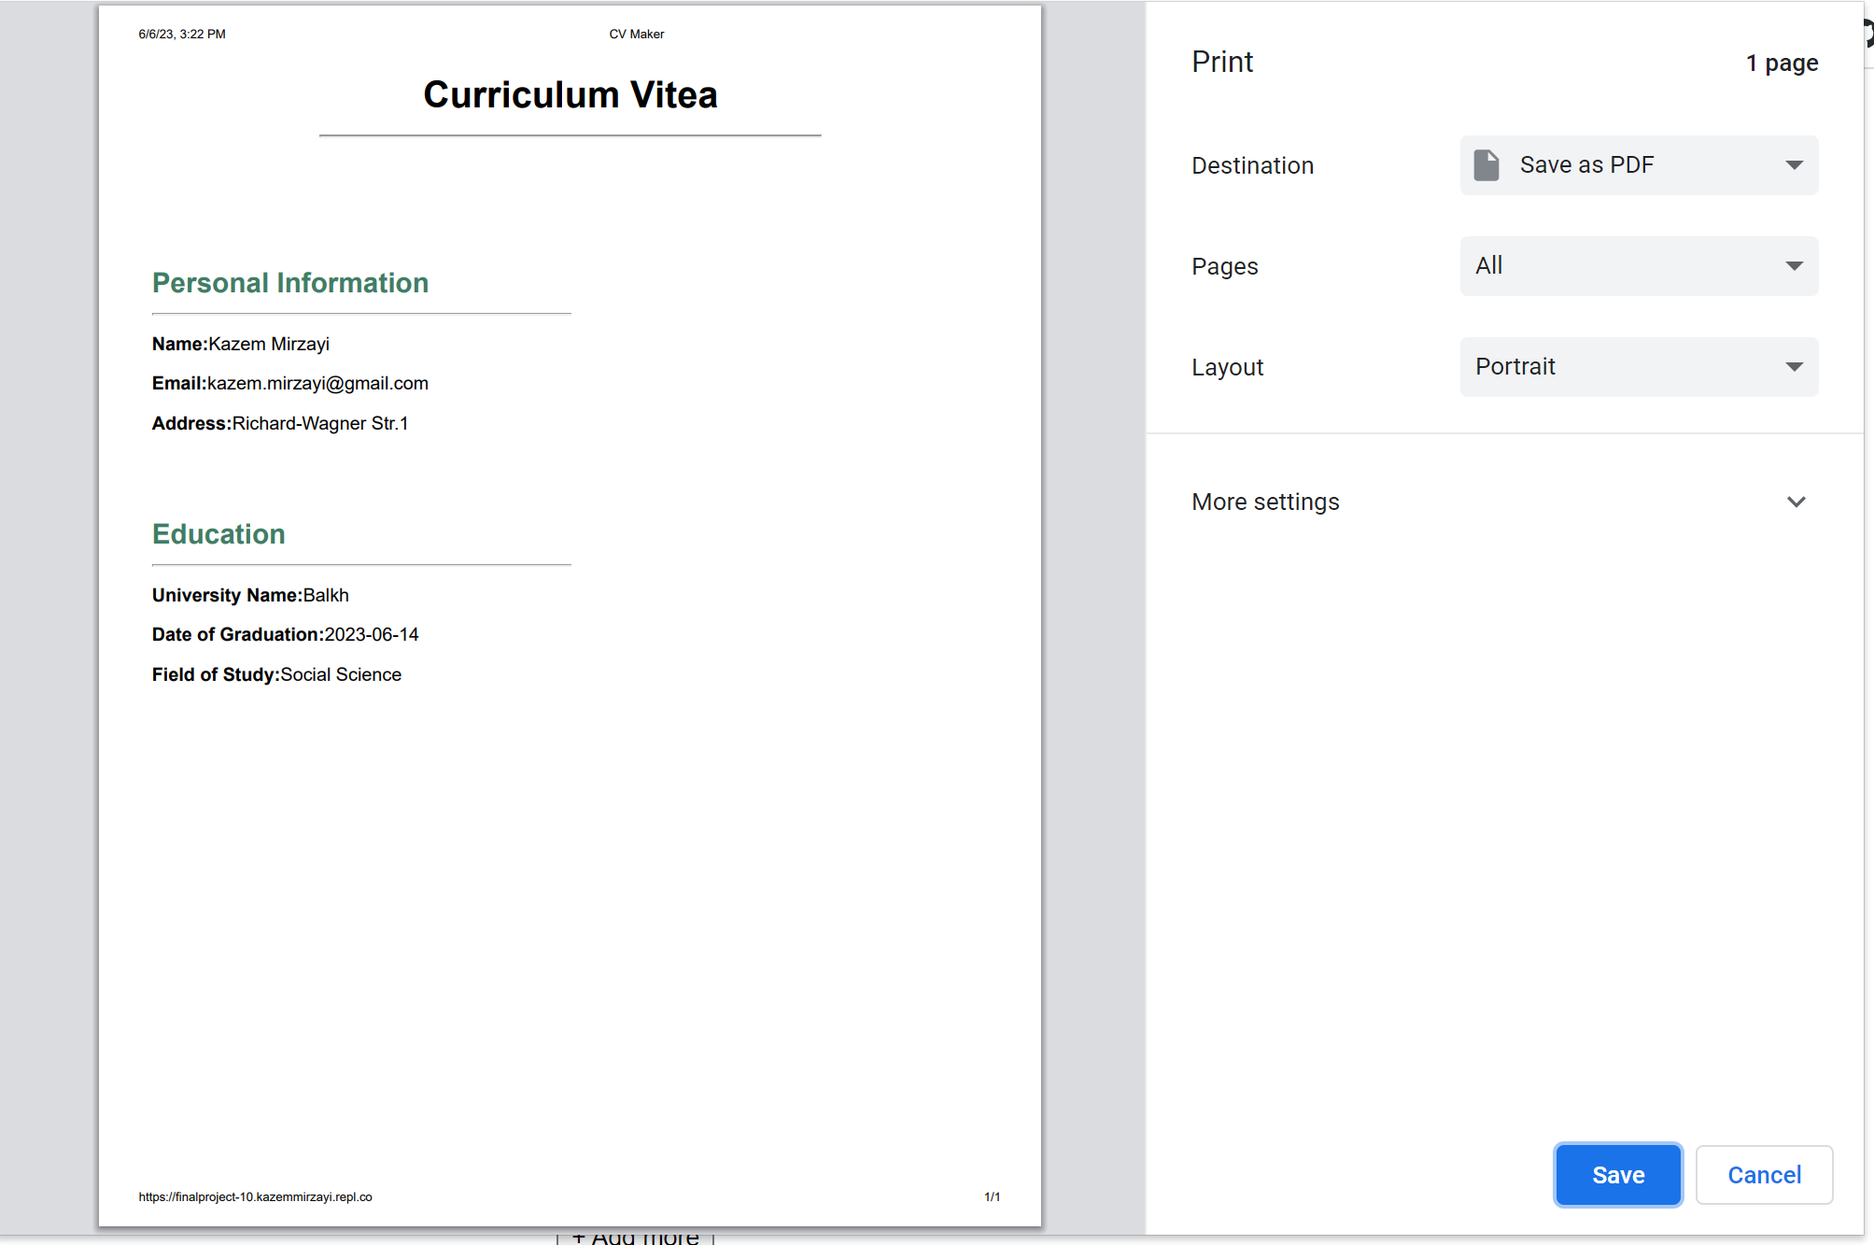
Screen shot of Print Preview:

Slide 10
Future Steps
I want to improve the app with different selectable languages, different selectable themes.

Slide 11
Thanks a lot!

