Slide 1
生態模擬: 以C語言為例
Class 11
2018/06/07
How to solve algebraic equation and how to reduce numerical errors
11.1 How to use complex number
11.2 Numerical errors (0): IEEE 754
11.3 Numerical errors (1): what is the loss of significant digits?
11.4 Numerical errors (2): what happens in logistic map?
11.5 Numerical errors (3): how to solve quadratic equation
11.6 Further information
Takeshi Miki
三木 健 (海洋研究所)
Notes:
<number>

Slide 2
11.1 Numerical errors (0): How to use complex number
You can use complex number including the library <complex.h>
Just try to compile and execute ‘complex_test0.c’
#include <stdio.h>
#include <math.h>
#include <stdlib.h>
#include <time.h>
#include <complex.h>
int main(void){
double complex x;
x = 3.0 + I*4.0;
printf("real=%lf\timg=%lf\tabsolute value = %lf\n", creal(x), cimag(x), cabs(x));
return 0;
}
Functions in real sqrt(x), exp(x), fabs(x)… ←→ csqrt(x), cexp(x), cabs(x)…
Notes:
<number>

Slide 3
11.2 Numerical errors (0): IEEE 754
IEEE 754: Standard for Binary Floating-Point Arithmetic, which is organized the Institute of Electrical and Electronics Engineers, Inc.) (I triple E).
We need many roles for arithmetic calculations in computer for keeping the quality of calculation with controlling errors.
IEEE 754 is adopted as default specification in some language (e.g. C#, Java) but not in C language. However, it is recommended to follow IEEE754 even in C language.
For example, IEEE 754 determines the specification of float and double.
→Topic 1
Also, it determines the roles of rounding algorithms (c.f. 四舍五入)
→Topic 2
Notes:
<number>

Slide 4
11.2 Numerical errors (0): IEEE 754, floating point number
What is floating point number?
In the decimal system (十進位)
exponent
fraction
-10.34 = - 1.034 x 10¹
*significant digit = 4
base
sign
In the binary system (二進位)
-2.5= -(1x2¹ + 0x2⁰ +1x2⁻¹) = -10.1
-10.1 = - 1.01 x 2¹
Notes:
<number>

Slide 5
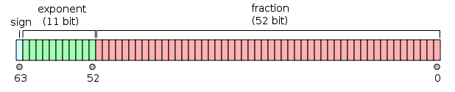
11.2 Numerical errors (0): IEEE 754, floating point number
“double” is defined in IEEE 754
In the binary system (二進位)
-2.5= -(1x2¹ + 0x2⁰ +1x2⁻¹) = -10.1
-10.1 = - 1.01 x 2¹
Type Double (64bit)
http://ja.wikipedia.org/wiki/
Notes:
<number>

Slide 6
11.2 Numerical errors (0): IEEE 754, rounding algorithms
What is the source of rounding ‘error’??
Consider converting 0.1 (in decimal system) to a binary number and to floating point number. We need one digit for 0.1 in decimal system, but in the binary system we need infinite number of digits: 0.1 = 0.0001100110011・・・. However, we can use only 52 bit of memory to stock the fraction part of this number.
0.1
0.0001100110011・・・(binary number)
+1.100110011・・・x 2⁻⁴ (binary floating point number)
We omit the fist digit because it’s always 1.
-4 + 1023 = 1019
0
01111111011
100110011001100110011001100110011001100110011001100110011…
No Space!!
Notes:
<number>

Slide 7
11.2 Numerical errors (0): IEEE 754, rounding algorithms
We need common rules on how to round numbers.
One of common rules in IEEE 754 is ‘Roundings to nearest, ties to even’
Consider a simple hypothetical trial to round two digits of binary for understanding the difference bet. the roundings to nearest and simple 0舍1入
0舍1入
‘Roundings to nearest, ties to even’
計
0.10
0.11
1.00
1.01
1.10
1.11
0 (ties to even)
Before
After
1
計
<
Before
After
1
=
11.1
110
11
11
計
10 (ties to even)
Before
After
計
<
10
10.00
10.01
10.10
Before
After
10
=
111.1
1000
1010
1010
11
10 (ties to even)
0.00
0.10
1.00
exactly middle
Notes:
<number>

Slide 8
11.2 Numerical errors (0): IEEE 754, rounding algorithms
Common rules in IEEE 754 is not included
in mathematical library <math.h>.
One of alternative libraries is:
CRlibm Correctly Rounded mathematical library
http://lipforge.ens-lyon.fr/www/crlibm/
However, I would not say Crlibm is always better than libm…
cf) intel C compiler (icc) also includes specific math library
Notes:
<number>

Slide 9
11.2 Numerical errors (0): IEEE 754, rounding algorithms
Do you think this type of error is critical?
Notes:
<number>

Slide 10
11.3 Numerical errors (1): what is the loss of significant digits?
Let’s consider a simple example, trying to calculate the following when the significant digit number = 8 (let’s think only in the decimal system).
Round-off errors occur in the final digit.
(error: 1.2 x 10⁻⁷ %)
(error: 8.2 x 10⁻⁷ %)
← should be 3.1622781e-2
error: 6.9 x 10⁻⁴ %!!
Round-off error
in the final digit.
Round-off error jumps up to 5th digit!!
→ loss of significant digits!!
Notes:
<number>

Slide 11
11.4 Numerical errors (2): what happens in logistic map?
Let’s consider a simulation of logistic map, using x as float or y as double (see logistic_error.c).
float x = 0.1;
double y = 0.1;
Loss of significant digits occurs
In this subtraction.
Notes:
<number>

Slide 12
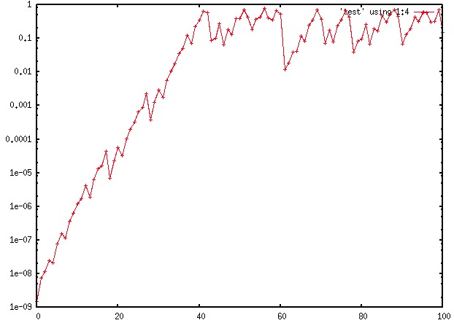
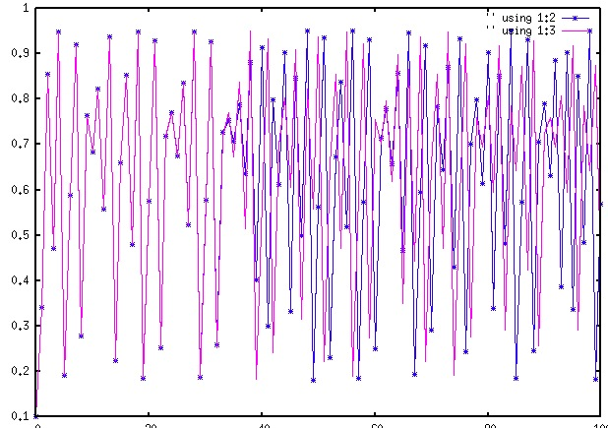
11.4 Numerical errors (2): what happens in logistic map?
float x = 0.1;
double y = 0.1;
|x – y|
x, y
Time Step
Time Step
Notes:
<number>

Slide 13
11.4 Numerical errors (2): what happens in logistic map?
Suggestions from logistic map:
The source of the cancellation of significant digit is the rounding error.
Therefore, we can suppress this error by using double instead of float.
→In some computer systems, you can further increase the memory size for floating point numbers.
Is this unique solution?
→NO!!
Notes:
<number>

Slide 14
11.5 Numerical errors (3): how to solve quadratic equation
First , we need to go back to…
← should be 3.16227805e-2
error: 6.9 x 10⁻⁴ %!!
We can reduce the error by avoiding the subtraction between similar size of number!!
error: 1.8 x 10⁻⁶ %!!
Notes:
<number>

Slide 15
11.5 Numerical errors (3): how to solve quadratic equation
Then, try to think about the good algorithm for solving quadratic equation.
We have an formula for exact solution !!
But, when b² >> 4ac
…leading to loss of significant digits
Notes:
<number>

Slide 16
11.5 Numerical errors (3): how to solve quadratic equation
Let’s assume
A better formula is:
Notes:
<number>

Slide 17
11.5 Numerical errors (3): how to solve quadratic equation
Compare the performance of quadratic_solver and quadratic_bad_solver in solver_test0.c for following equations.
Notes:
<number>

Slide 18
11.6 Further information
Generally, there are gaps between analytical formula and numerical algorithm.
In calculations of floating point number, the following ‘associative law’ does NOT hold.
‘Numerical Verification method’ to control the worst error size and thus ensure the quality of simulations is a growing field in applied math. With this method, we are able to prove mathematical theorems using computer!! e.g. existence or uniqueness of solution or attractor in ODE/PDE
http://www.econ.hit-u.ac.jp/~finmodel/events/pdf/Kobayashi07-24-10.pdf
Notes:
<number>

