Slide 1




Paper on :
ENHANCING ROBUST FRAUD DETECTION FOR GCC FINANCIAL SYSTEMS
Presented by : Group G
Kazi Namira Meyheg Sanam (ID:C231450)
Umme Benin Yeasmin Meem (ID: C231452)
PRESENTATION

Slide 2





ABSTRACT
Fraud Challenges in GCC
Proposed Framework
  Class imbalance
A hybrid ML framework is proposed:
  Adaptive k-neighbor SMOTE
  Hybrid resampling
  Regularized XGBoost
  Adversarial threats
  Concept drift
Performance Metrics
Proposed Framework
  85.81% recall
  28.22% precision
  42.47% F1-score
  96.94% AUC
  Reduces operational false alarms by 1,192 per 10,000 daily transactions

Slide 3




INTRODUCTION
Enhancing Robust Fraud Detection for GCC Financial Systems
A Hybrid Framework for Imbalance, Drift, and Adversarial Threats
Topic
Significnce
Purpose
Fraud detection in GCC financial systems
Rising digital payments → high financial losses (~$32B globally)
Create an accurate, efficient, robust fraud detection method

Slide 4






PROBLEM STATEMENT
  01
  02
  03
Class Imbalance
Concept Drift
Adversarial Attempts
Fraud <0.2% of
transactions,
making detection difficult.
Fraud patterns change over time
Aim to bypass detection

Slide 5


OBJECTIVE / HYPOTHESIS
Objective
  01
Maximize recall while improving precision
Hypothesis
  02
Hybrid ML (resampling + XGBoost) improves precision without losing recall

Slide 6


LITERATURE REVIEW
SMOTE & XGBoost
  01
  SMOTE & XGBoost are widely used,
  But result in high recall, low precision.
  Oversampling leads to noise;
  Cost-sensitive methods are parameter sensitive;
  Ensemble methods are computationally expensive.
Limitations
  02
  03
  No GCC-specific, balanced, deployable framework exists,
  highlighting the need for a tailored solution.
Research Gap

Slide 7
SOLUTION
Hybrid Approach
  01
  02
  03
Adaptive k-Neighbor SMOTE
Hybrid Resampling Methodology
Regularized XGBoost Implementation
The framework integrates adaptive k-neighbor SMOTE with k=3 to generate synthetic samples closer to real fraud patterns.
Utilizing hybrid resampling, combining SMOTE and random undersampling, helps balance the dataset to prevent overfitting.
Implementation of L1/L2 regularized XGBoost to generalize unseen patterns and improve model robustness is also a factor.

Slide 8
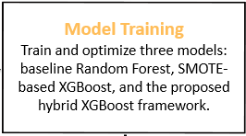
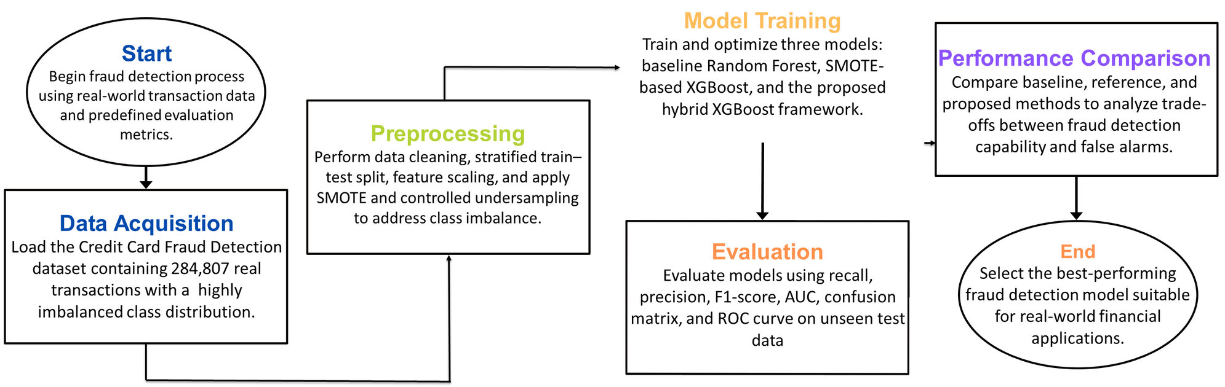
METHODOLOGY

Slide 9



DATA COLLECTION
Dataset Overview
  01
European Credit Card dataset ( 284,807 transactions) as a test dataset.
Class Distribution
  03
  Legitimate 99.827%,
  Fraud 0.173%,
Features
  02
V1–V28 (PCA), Time, Amount, used for training and testing the model.

Slide 10


RESULTS & DISCUSSION
Recall
Original F1-score Enhancement
Achieved 85.81% on fraud detection, ensuring comprehensive coverage.
  01
  03
Enhanced to 42.47% ↑ (31.87%) indicating a better balance between recall and precision.
Result
Precision Improvement
AUC
Improved to 28.22% ↑ (19.57%), reducing false positives significantly.
  02
  04
AUC of 96.94%, demonstrating high capability to distinguish fraud vs legitimate transactions.

Slide 11




RESULTS & DISCUSSION
Daily Transaction Analysis
Benefits
  01
10,000 daily transactions example to illustrate real-world impact.
  04
Reduced analyst fatigue, faster response, cost savings from fewer false alarms.
Reduction in False Alarms
Recall Maintenance
  02
  05
Reduction in false alarms compared to baseline paper, which is a key improvement.
Framework preserves 85.81% recall, ensuring customer protection is intact.

Slide 12


WHY IT WORKS
Conservative Synthesis
Regularization Effectiveness
Conservative k=3 synthesis
samples closer to real fraud patterns
L1/L2 regularization
generalizes to unseen patterns
1
2
3
Balanced Sampling
Balanced sampling
prevents overfitting

Slide 13

LIMITATIONS
Dataset Specificity
Dataset specificity may affect generalization to other datasets.
1
3
2
Precision Ceiling
Static Evaluation
Precision ceiling indicates potential for further improvement.
Static evaluation may not fully capture concept drift, for better real-time usefulness.

Slide 14
FUTURE WORK
GCC-Specific Adaptation
  01
GCC-specific data integration for enhanced regional accuracy for the model.
Drift Adaptation
  02
Drift adaptation strategies to maintain performance over time with changing patterns.
Explainable AI
  03
Explainable ML (SHAP/LIME) will be adopted for better interpretability.

Slide 15
CONCLUSION
  01
  02
  03
  04
Precision Improvement
Quantitative Results
False Alert Reduction
Deployability
Hybrid framework improves precision without losing recall.
Maintains 85.81% recall, 28.22% precision for effective fraud detection.
Modular, deployable for GCC financial systems for widespread implementation.
1,192 fewer daily false alerts for better efficiency.

Slide 16
REFERENCES
[1] K. I. Al-Daoud and I. A. Abu-AlSondos, "Robust AI for Financial Fraud Detection in the GCC: A Hybrid Framework for Imbalance, Drift, and Adversarial Threats," J. Theor. Appl. Electron. Commer. Res., vol. 20, no. 2, p. 121, 2025.
[2] N. V. Chawla et al., "SMOTE: Synthetic Minority Over-sampling Technique," J. Artif. Intell. Res., vol. 16, pp. 321–357, 2002.
[3] A. Dal Pozzolo et al., "Learned lessons in credit card fraud detection from a practitioner perspective," Expert Syst. Appl., vol. 41, no. 10, pp. 4915–4928, 2014.
[4] T. Chen and C. Guestrin, "XGBoost: A scalable tree boosting system," in Proc. ACM SIGKDD, 2016, pp. 785–794.
[5] H. He and E. A. Garcia, "Learning from imbalanced data," IEEE Trans. Knowl. Data Eng., vol. 21, no. 9, pp. 1263–1284, 2009.

Slide 17



THANK YOU

