Slide 1


PROJECT PRESENTATION
Campus Resource
Hub
A centralized web platform for academic resource sharing with AI-powered moderation
Department of Computer Science & Engineering
Northern University Bangladesh • August 2026
Notes:
Presenter cue: Introduce the project title, university context, and the main idea in one sentence.
[Sources]
- /Users/bayshorecommunication/Desktop/Office/crh/campus-resource-hub-frontend/project-documentation/report/main.tex
- /Users/bayshorecommunication/Desktop/Office/crh/campus-resource-hub-frontend/project-documentation/report/main.pdf
- /Users/bayshorecommunication/Desktop/Office/crh/campus-resource-hub-frontend/project-documentation/report/figures/university-logo.png
- /Users/bayshorecommunication/Desktop/Office/crh/campus-resource-hub-frontend/public/favicon.svg
- https://slidesgo.com/theme/cellular-respiration-and-its-impact-on-health-research-thesis-defense
[/Sources]
[Sources] - Project report and implementation evidence: /Users/bayshorecommunication/Desktop/Office/crh/campus-resource-hub-frontend/project-documentation/report/main.pdf - NUB logo asset: /Users/bayshorecommunication/Desktop/Office/crh/campus-resource-hub-frontend/project-documentation/report/figures/university-logo.png - NUB official brand reference: https://www.nub.ac.bd/ [/Sources]

Slide 2
CAMPUS RESOURCE HUB
02
Problems in existing campus systems
4 GAPS
“Information is scattered, hard to verify and easy to lose.”
across resources, campus updates, lost items and shared content
01
02
03
04
Scattered files
→
Limited reach
→
Unsafe claims
→
Weak controls
Files disappear in chat groups
Updates reach only part of campus
Lost-item claims expose contact details
No moderation or reliable search
Existing tools do not provide one searchable, role-aware campus workflow.
Notes:
Presenter cue: Give a simple example of semantic search, then explain the four-stage retrieval flow and the visibility check that prevents unpublished content from leaking.
[Sources]
- /Users/bayshorecommunication/Desktop/Office/crh/campus-resource-hub-frontend/project-documentation/report/main.tex
- https://slidesgo.com/theme/cellular-respiration-and-its-impact-on-health-research-thesis-defense
[/Sources]
[Sources] - Project report and implementation evidence: /Users/bayshorecommunication/Desktop/Office/crh/campus-resource-hub-frontend/project-documentation/report/main.pdf - NUB logo asset: /Users/bayshorecommunication/Desktop/Office/crh/campus-resource-hub-frontend/project-documentation/report/figures/university-logo.png - NUB official brand reference: https://www.nub.ac.bd/ - Supervisor review screenshots: /var/folders/_y/1bg_zrxs0bb1r1652v_trcbc0000gn/T/codex-clipboard-62fc83a1-a95c-4cbc-9f99-5a5b58233f95.png; /var/folders/_y/1bg_zrxs0bb1r1652v_trcbc0000gn/T/codex-clipboard-46ebd2d0-32c1-47e8-bd2f-2a43eeaff988.png [/Sources]

Slide 3
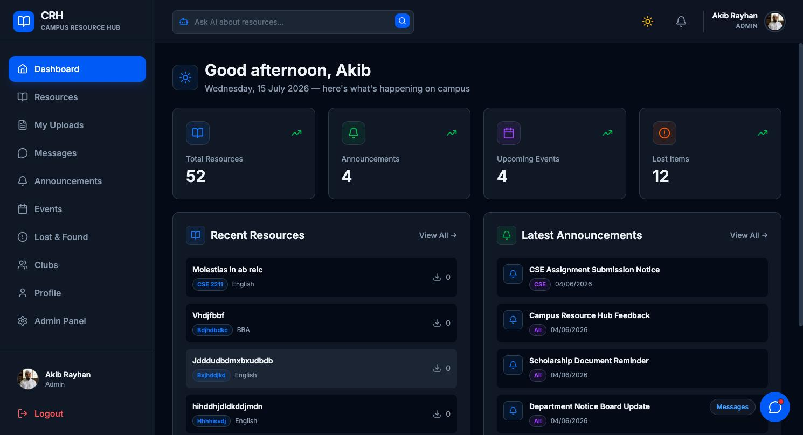
CAMPUS RESOURCE HUB
03
Proposed solution: one verified campus hub
Reviewed resources stay organized and searchable.
Announcements, events and clubs share one live feed.
Private claims protect lost-and-found contact details.
Chat, semantic search and notifications connect every workflow.
CRH brings these workflows into one verified campus hub.
Prototype dashboard captured during project testing
One secure place to discover, communicate and act through role-aware workflows.
Notes:
Presenter cue: Explain the everyday campus problem first, then point to the role-aware dashboard as the proposed answer. Treat the screenshot as a prototype, not adoption data.
[Sources]
- /Users/bayshorecommunication/Desktop/Office/crh/campus-resource-hub-frontend/project-documentation/report/main.tex
- /Users/bayshorecommunication/Desktop/Office/crh/campus-resource-hub-frontend/project-documentation/report/figures/dashboard.png
- https://slidesgo.com/theme/cellular-respiration-and-its-impact-on-health-research-thesis-defense
[/Sources]
[Sources] - Project report and implementation evidence: /Users/bayshorecommunication/Desktop/Office/crh/campus-resource-hub-frontend/project-documentation/report/main.pdf - NUB logo asset: /Users/bayshorecommunication/Desktop/Office/crh/campus-resource-hub-frontend/project-documentation/report/figures/university-logo.png - NUB official brand reference: https://www.nub.ac.bd/ [/Sources]

Slide 4
CAMPUS RESOURCE HUB
04
Meet the project team
PROJECT GOAL
Build one secure, searchable and real-time platform for academic resources and daily campus coordination.
01
02
03
Akib Rayhan
Rakibul Hasan
Mahdi Hasan
ID 42230200858
ID 42230200859
ID 42230200717
Supervisor
Department of Computer Science & Engineering
Tanmoy Mazumder, Lecturer
Notes:
Presenter cue: Introduce all three team members and the supervisor, then state the shared project goal.
[Sources]
- /Users/bayshorecommunication/Desktop/Office/crh/campus-resource-hub-frontend/project-documentation/report/main.tex
- /Users/bayshorecommunication/Desktop/Office/crh/campus-resource-hub-frontend/project-documentation/report/main.pdf
- https://slidesgo.com/theme/cellular-respiration-and-its-impact-on-health-research-thesis-defense
[/Sources]
[Sources] - Project report and implementation evidence: /Users/bayshorecommunication/Desktop/Office/crh/campus-resource-hub-frontend/project-documentation/report/main.pdf - NUB logo asset: /Users/bayshorecommunication/Desktop/Office/crh/campus-resource-hub-frontend/project-documentation/report/figures/university-logo.png - NUB official brand reference: https://www.nub.ac.bd/ [/Sources]

Slide 5
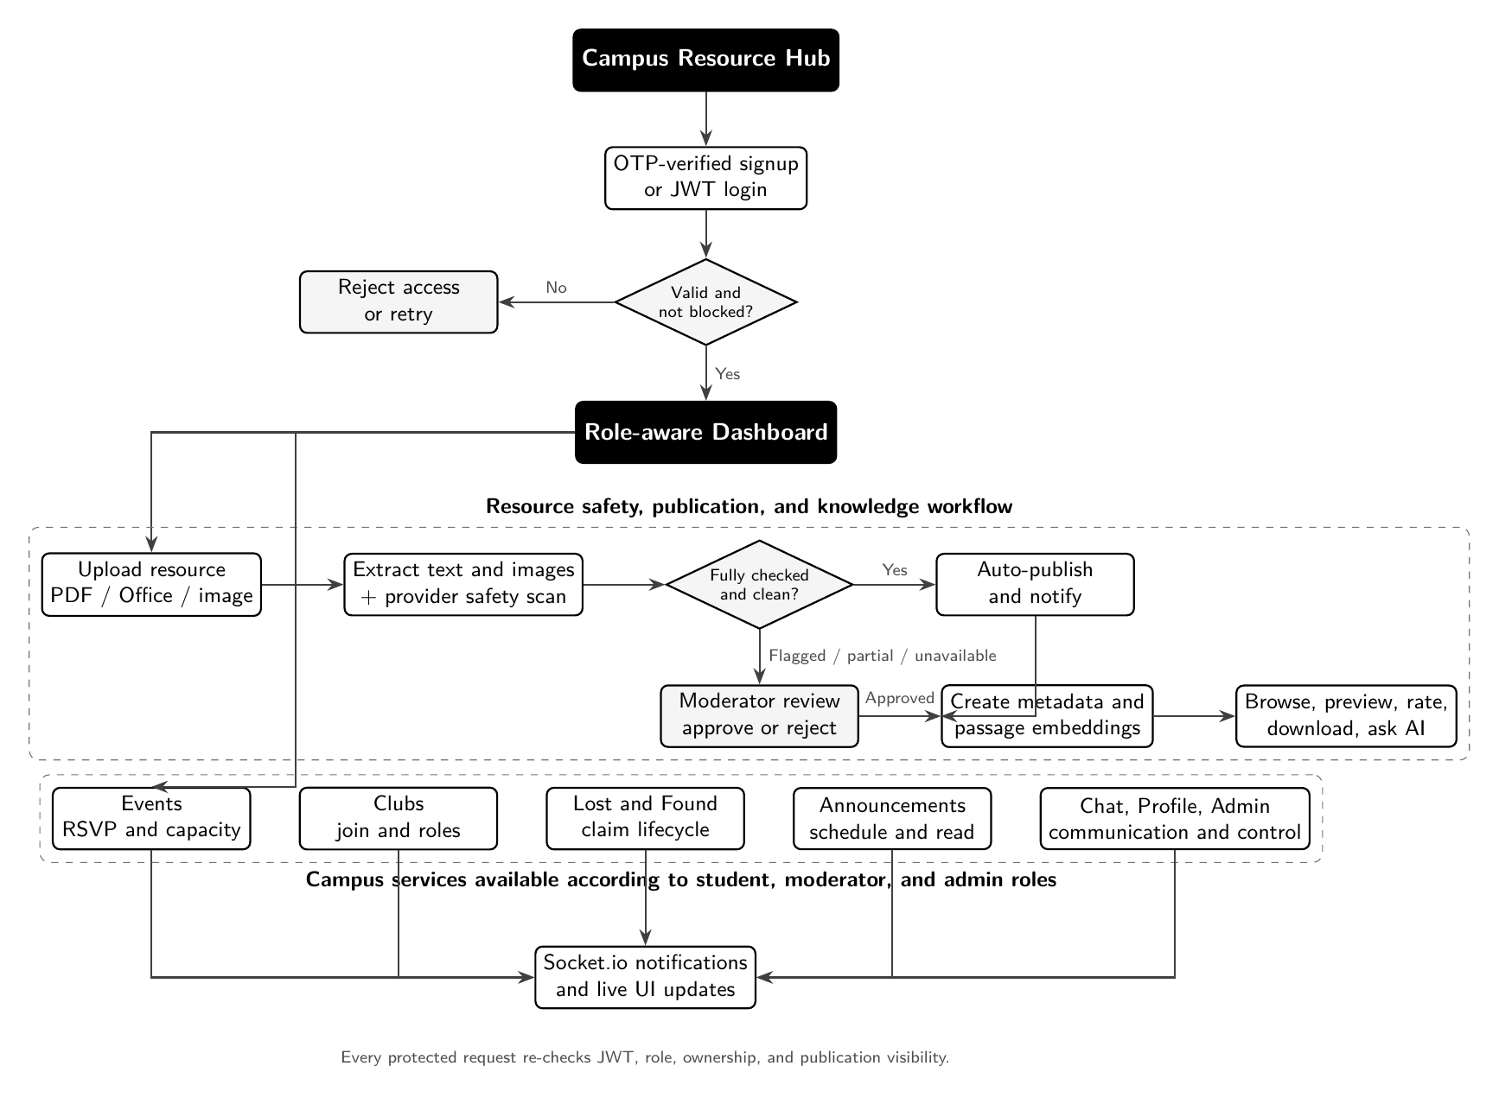
CAMPUS RESOURCE HUB
05
Verified access connects every workflow
OTP verification and JWT login route every user to a role-aware dashboard.
Resources follow fail-safe moderation.
Campus services enforce role and ownership rules.
Notifications update through Socket.io.
JWT, role, ownership and publication visibility are checked again on protected requests.
Notes:
Presenter cue: Walk from verified access to the role-aware dashboard, then explain the common create-scan-review-publish pattern and live updates.
[Sources]
- /Users/bayshorecommunication/Desktop/Office/crh/campus-resource-hub-frontend/project-documentation/report/main.tex
- /Users/bayshorecommunication/Desktop/Office/crh/campus-resource-hub-frontend/project-documentation/diagrams/system-workflow-documentation.txt
- /Users/bayshorecommunication/Desktop/Office/crh/campus-resource-hub-frontend/project-documentation/report/figures/workflow-diagram.pdf
- https://slidesgo.com/theme/cellular-respiration-and-its-impact-on-health-research-thesis-defense
[/Sources]
[Sources] - Project report and implementation evidence: /Users/bayshorecommunication/Desktop/Office/crh/campus-resource-hub-frontend/project-documentation/report/main.pdf - NUB logo asset: /Users/bayshorecommunication/Desktop/Office/crh/campus-resource-hub-frontend/project-documentation/report/figures/university-logo.png - NUB official brand reference: https://www.nub.ac.bd/ - Current workflow diagram: /Users/bayshorecommunication/Desktop/Office/crh/campus-resource-hub-frontend/project-documentation/report/figures/workflow-diagram.pdf [/Sources]

Slide 6
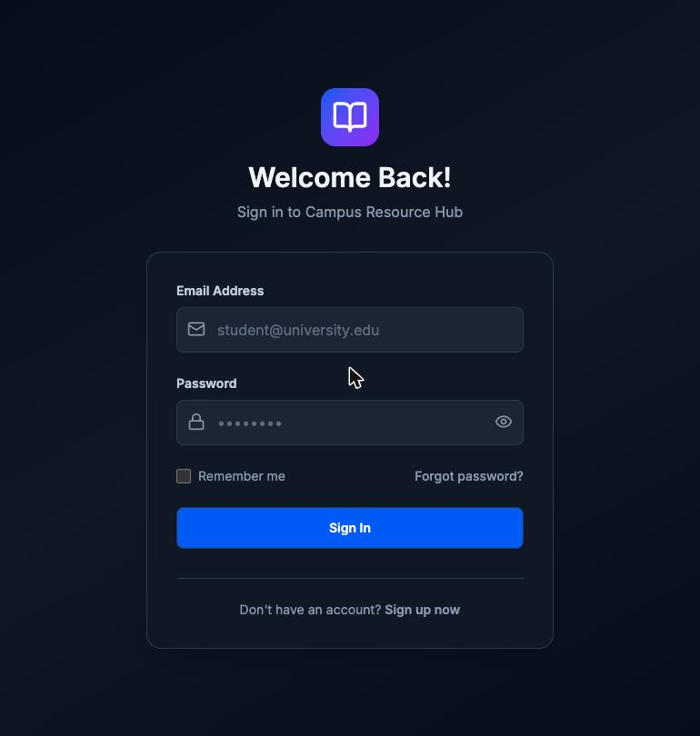
CAMPUS RESOURCE HUB
06
Access depends on identity and role
Signup → e-mail OTP → account creation
Login → signed JWT → role-aware dashboard
Student
Browse, upload, RSVP, join clubs, chat, claim items and manage a profile.
Moderator
Review content, create campus updates and manage community safety.
Admin
Manage roles and users, and view platform-wide controls.
Notes:
Presenter cue: Explain that OTP confirms e-mail ownership, JWT handles stateless sessions, and the same identity receives different capabilities based on role.
[Sources]
- /Users/bayshorecommunication/Desktop/Office/crh/campus-resource-hub-frontend/project-documentation/report/main.tex
- /Users/bayshorecommunication/Desktop/Office/crh/campus-resource-hub-frontend/project-documentation/report/figures/auth-login.png
- https://slidesgo.com/theme/cellular-respiration-and-its-impact-on-health-research-thesis-defense
[/Sources]
[Sources] - Project report and implementation evidence: /Users/bayshorecommunication/Desktop/Office/crh/campus-resource-hub-frontend/project-documentation/report/main.pdf - NUB logo asset: /Users/bayshorecommunication/Desktop/Office/crh/campus-resource-hub-frontend/project-documentation/report/figures/university-logo.png - NUB official brand reference: https://www.nub.ac.bd/ [/Sources]

Slide 7
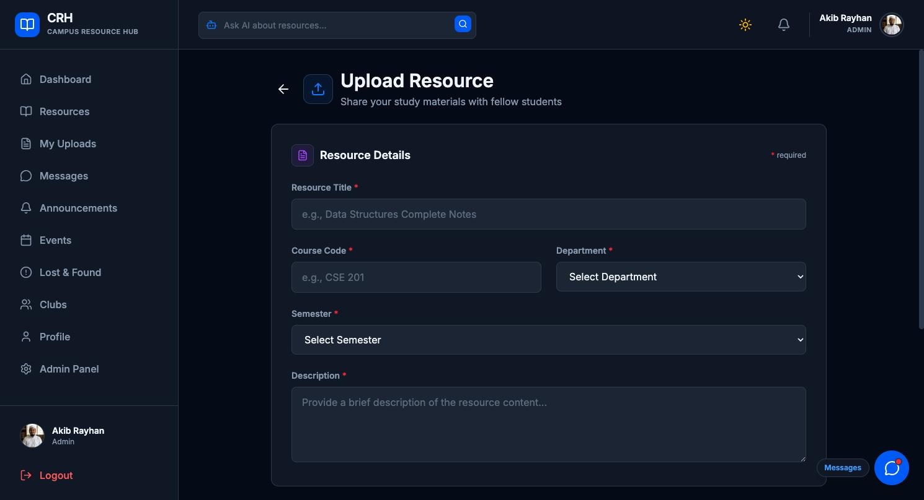
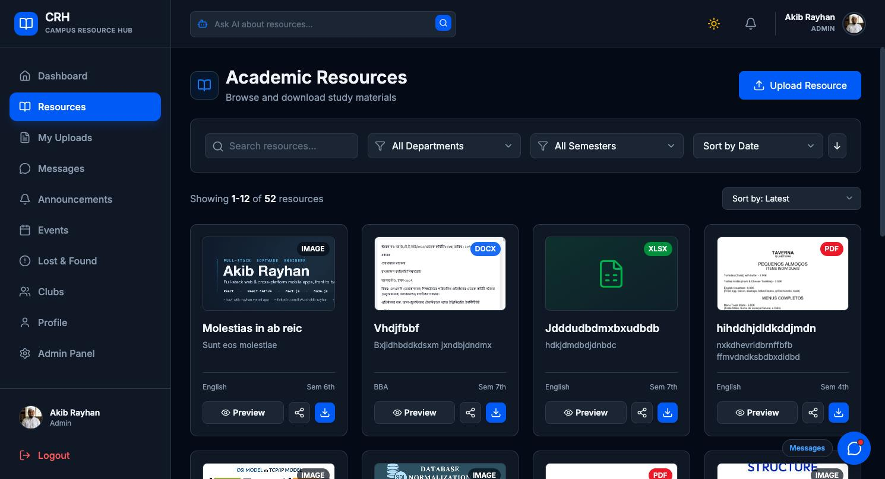
CAMPUS RESOURCE HUB
07
Every resource is checked before publication
UPLOAD
DISCOVER
Upload → extract & scan → review if needed → publish & index
Supported: PDF, DOCX, PPTX, XLSX and images
Flagged, partially inspected or provider-unavailable files stay unpublished for human review.
Notes:
Presenter cue: Show the full resource journey: academic metadata, cloud storage, extraction, AI safety scan, human review when needed, then browsing and indexing.
[Sources]
- /Users/bayshorecommunication/Desktop/Office/crh/campus-resource-hub-frontend/project-documentation/report/main.tex
- /Users/bayshorecommunication/Desktop/Office/crh/campus-resource-hub-frontend/project-documentation/report/figures/resource-upload.png
- /Users/bayshorecommunication/Desktop/Office/crh/campus-resource-hub-frontend/project-documentation/report/figures/resource-browse.png
- https://slidesgo.com/theme/cellular-respiration-and-its-impact-on-health-research-thesis-defense
[/Sources]
[Sources] - Project report and implementation evidence: /Users/bayshorecommunication/Desktop/Office/crh/campus-resource-hub-frontend/project-documentation/report/main.pdf - NUB logo asset: /Users/bayshorecommunication/Desktop/Office/crh/campus-resource-hub-frontend/project-documentation/report/figures/university-logo.png - NUB official brand reference: https://www.nub.ac.bd/ [/Sources]

Slide 8
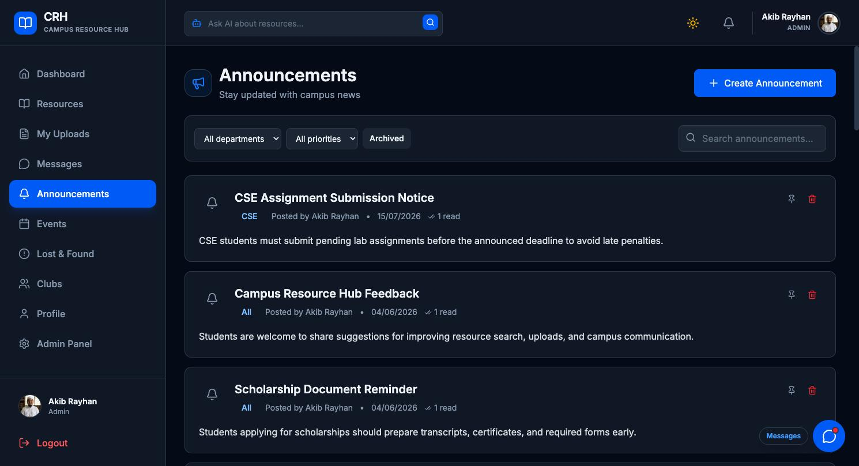
CAMPUS RESOURCE HUB
08
Campus updates should not get lost
ANNOUNCEMENTS
Priority, scheduled publishing, expiry, attachments and read tracking.
EVENTS
Going / maybe / declined RSVP, capacity limits, calendar view and cancellation notices.
CLUBS
Open or request-based joining, with member and officer roles.
One feed replaces scattered notices while keeping participation workflows structured.
Notes:
Presenter cue: Use the announcement screen as a realistic example, then explain how events and clubs use structured participation rules inside the same system.
[Sources]
- /Users/bayshorecommunication/Desktop/Office/crh/campus-resource-hub-frontend/project-documentation/report/main.tex
- /Users/bayshorecommunication/Desktop/Office/crh/campus-resource-hub-frontend/project-documentation/report/figures/announcements.png
- https://slidesgo.com/theme/cellular-respiration-and-its-impact-on-health-research-thesis-defense
[/Sources]
[Sources] - Project report and implementation evidence: /Users/bayshorecommunication/Desktop/Office/crh/campus-resource-hub-frontend/project-documentation/report/main.pdf - NUB logo asset: /Users/bayshorecommunication/Desktop/Office/crh/campus-resource-hub-frontend/project-documentation/report/figures/university-logo.png - NUB official brand reference: https://www.nub.ac.bd/ [/Sources]

Slide 9
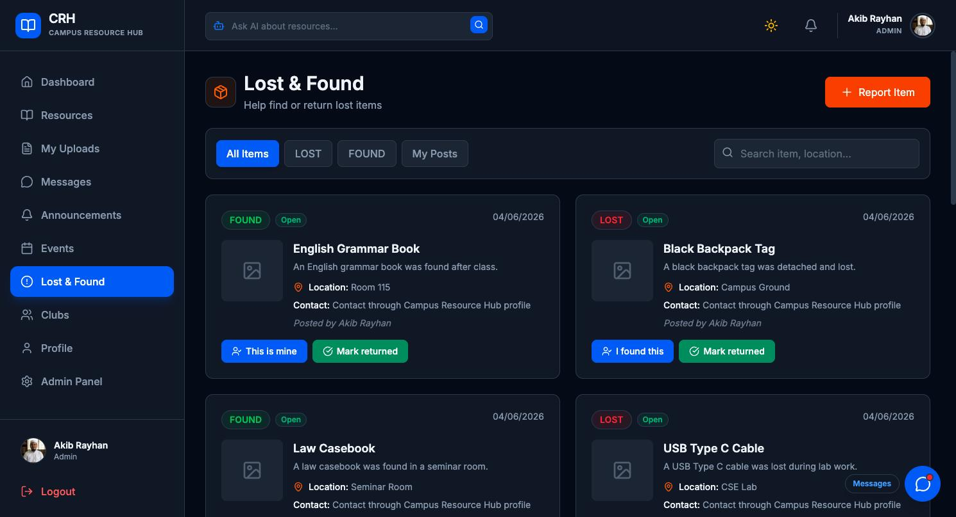
CAMPUS RESOURCE HUB
09
Lost-and-found protects contact details
1
Post an item
Add a lost/found description, location and photo.
2
Keep contact private
Personal contact information stays hidden.
3
Review the claim
The poster or moderator approves or rejects it.
4
Reveal after approval
Only the approved claimant can see contact details.
Open → Claimed → Resolved
The same safety scan applies before a post becomes visible.
Notes:
Presenter cue: Emphasize the privacy choice: contact information is not public and appears only after an approved claim, while the post itself still goes through moderation.
[Sources]
- /Users/bayshorecommunication/Desktop/Office/crh/campus-resource-hub-frontend/project-documentation/report/main.tex
- /Users/bayshorecommunication/Desktop/Office/crh/campus-resource-hub-frontend/project-documentation/report/figures/lostfound.png
- https://slidesgo.com/theme/cellular-respiration-and-its-impact-on-health-research-thesis-defense
[/Sources]
[Sources] - Project report and implementation evidence: /Users/bayshorecommunication/Desktop/Office/crh/campus-resource-hub-frontend/project-documentation/report/main.pdf - NUB logo asset: /Users/bayshorecommunication/Desktop/Office/crh/campus-resource-hub-frontend/project-documentation/report/figures/university-logo.png - NUB official brand reference: https://www.nub.ac.bd/ [/Sources]

Slide 10
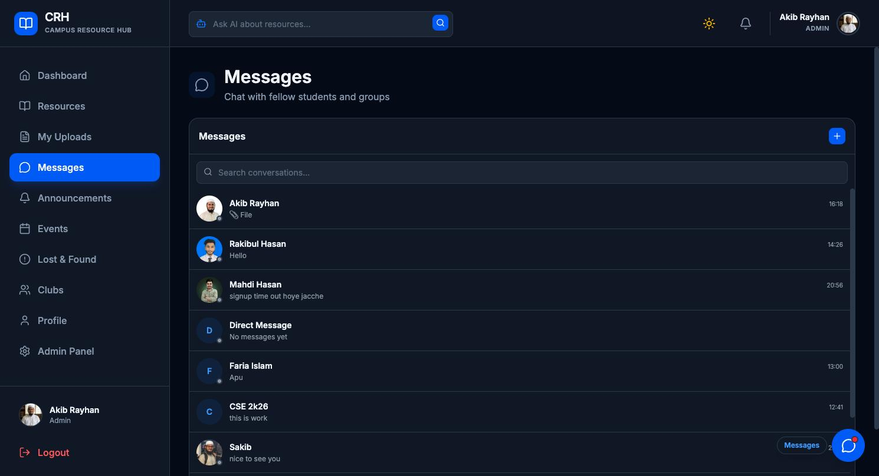
CAMPUS RESOURCE HUB
10
Real-time chat keeps coordination moving
Direct + group
Delivery + seen
Live notifications
Conversations, replies, edits and attachments.
Per-user delivery and read status.
Messages and important actions update instantly.
Notes:
Presenter cue: Explain how Socket.io supports direct and group conversations, delivery/seen receipts, and live notifications, while server-side membership checks protect every chat request.
[Sources]
- /Users/bayshorecommunication/Desktop/Office/crh/campus-resource-hub-frontend/project-documentation/report/main.tex
- /Users/bayshorecommunication/Desktop/Office/crh/campus-resource-hub-frontend/project-documentation/report/figures/chat.png
- https://slidesgo.com/theme/cellular-respiration-and-its-impact-on-health-research-thesis-defense
[/Sources]
[Sources] - Project report and implementation evidence: /Users/bayshorecommunication/Desktop/Office/crh/campus-resource-hub-frontend/project-documentation/report/main.pdf - NUB logo asset: /Users/bayshorecommunication/Desktop/Office/crh/campus-resource-hub-frontend/project-documentation/report/figures/university-logo.png - NUB official brand reference: https://www.nub.ac.bd/ [/Sources]

Slide 11
CAMPUS RESOURCE HUB
11
Search by meaning—not just keywords
384-D
“Find exam preparation notes even when the title uses different words.”
Local multilingual MiniLM embeddings with MongoDB Atlas Vector Search.
01
02
03
04
Content
→
Embedding
→
Vector search
→
AI answer
Titles, bodies and file passages
Multilingual MiniLM vector
MongoDB Atlas ranking
Numbered, clickable sources
CRH re-checks approval, ownership and role visibility before showing results.
Notes:
Presenter cue: Give a simple example of semantic search, then explain the four-stage retrieval flow and the visibility check that prevents unpublished content from leaking.
[Sources]
- /Users/bayshorecommunication/Desktop/Office/crh/campus-resource-hub-frontend/project-documentation/report/main.tex
- https://slidesgo.com/theme/cellular-respiration-and-its-impact-on-health-research-thesis-defense
[/Sources]
[Sources] - Project report and implementation evidence: /Users/bayshorecommunication/Desktop/Office/crh/campus-resource-hub-frontend/project-documentation/report/main.pdf - NUB logo asset: /Users/bayshorecommunication/Desktop/Office/crh/campus-resource-hub-frontend/project-documentation/report/figures/university-logo.png - NUB official brand reference: https://www.nub.ac.bd/ [/Sources]
[Sources] - Local multilingual MiniLM embedding implementation: /Users/bayshorecommunication/Desktop/Office/crh/campus-resource-hub-backend/utils/embeddingService.js - MongoDB Atlas vector-search implementation and deterministic fallbacks: /Users/bayshorecommunication/Desktop/Office/crh/campus-resource-hub-backend/utils/semanticSearch.js [/Sources]

Slide 12
CAMPUS RESOURCE HUB
12
A three-tier stack keeps CRH maintainable
PRESENTATION
APPLICATION
DATA
React + Vite
→
Node.js + Express
→
MongoDB Atlas
+ Cloudinary
Single-page application
Protected, responsive UI
REST API + Socket.io
Business rules and live updates
Documents + vector index
Files and images
External services
Cloud deployment
Google Cloud (Gmail API with OAuth 2.0) for signup and password-reset OTP.
Groq-led AI moderation with resilient provider fallbacks and human review when needed.
HTTPS / WSS between browser, API and live gateway.
Frontend: Vercel
Backend: Vercel
Database and vector search: MongoDB Atlas
File storage: Cloudinary
Notes:
Presenter cue: Explain the three independently deployable tiers and how external e-mail, AI and storage services keep the application server focused on API and real-time logic.
[Sources]
- /Users/bayshorecommunication/Desktop/Office/crh/campus-resource-hub-frontend/project-documentation/report/main.tex
- /Users/bayshorecommunication/Desktop/Office/crh/campus-resource-hub-frontend/package.json
- https://slidesgo.com/theme/cellular-respiration-and-its-impact-on-health-research-thesis-defense
[/Sources]
[Sources] - Project report and implementation evidence: /Users/bayshorecommunication/Desktop/Office/crh/campus-resource-hub-frontend/project-documentation/report/main.pdf - NUB logo asset: /Users/bayshorecommunication/Desktop/Office/crh/campus-resource-hub-frontend/project-documentation/report/figures/university-logo.png - NUB official brand reference: https://www.nub.ac.bd/ [/Sources]
[Sources] - Current OTP provider implementation (Gmail API via Google Cloud OAuth 2.0): /Users/bayshorecommunication/Desktop/Office/crh/campus-resource-hub-backend/utils/email.js - Gmail OAuth setup helper: /Users/bayshorecommunication/Desktop/Office/crh/campus-resource-hub-backend/scripts/get-gmail-refresh-token.js - Current backend Vercel configuration: /Users/bayshorecommunication/Desktop/Office/crh/campus-resource-hub-backend/vercel.json - Vercel Function entry point: /Users/bayshorecommunication/Desktop/Office/crh/campus-resource-hub-backend/api/server.js [/Sources]
[Sources] - Groq-led moderation provider chain and fail-safe behavior: /Users/bayshorecommunication/Desktop/Office/crh/campus-resource-hub-backend/utils/moderationService.js - Human-review hold policy for incomplete or unavailable moderation: /Users/bayshorecommunication/Desktop/Office/crh/campus-resource-hub-backend/utils/moderationPolicy.js [/Sources]

Slide 13
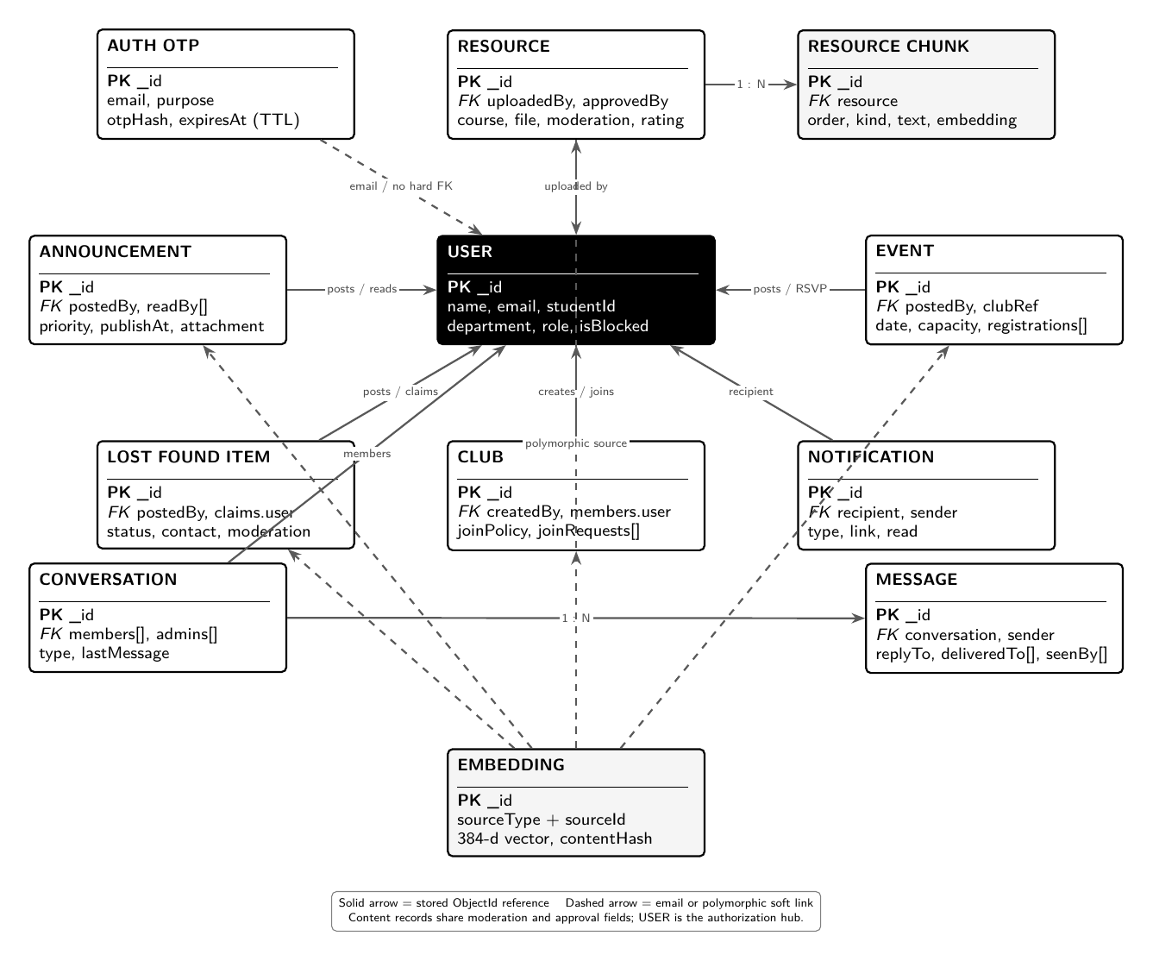
CAMPUS RESOURCE HUB
13
The data model supports services and AI
12
MongoDB collections
User is the authorization hub for most relationships.
Content collections share moderation and approval fields.
Embedding + ResourceChunk support semantic and passage-level retrieval.
Conversation + Message separate thread membership from message history.
Solid lines show stored references; dashed lines show soft or polymorphic links.
Notes:
Presenter cue: Point to User as the central authorization record, then show how resource chunks and embeddings extend the normal campus-service schema for AI retrieval.
[Sources]
- /Users/bayshorecommunication/Desktop/Office/crh/campus-resource-hub-frontend/project-documentation/report/main.tex
- /Users/bayshorecommunication/Desktop/Office/crh/campus-resource-hub-frontend/project-documentation/report/figures/erd-diagram.pdf
- https://slidesgo.com/theme/cellular-respiration-and-its-impact-on-health-research-thesis-defense
[/Sources]
[Sources] - Project report and implementation evidence: /Users/bayshorecommunication/Desktop/Office/crh/campus-resource-hub-frontend/project-documentation/report/main.pdf - NUB logo asset: /Users/bayshorecommunication/Desktop/Office/crh/campus-resource-hub-frontend/project-documentation/report/figures/university-logo.png - NUB official brand reference: https://www.nub.ac.bd/ - Current 12-collection ERD: /Users/bayshorecommunication/Desktop/Office/crh/campus-resource-hub-frontend/project-documentation/report/figures/erd-diagram.pdf [/Sources]

Slide 14
CAMPUS RESOURCE HUB
14
The reported tests support the core build
6/6
54
8 / 0
PASS
backend unit tests passed
approved resources indexed
with 0 extraction failures
visible / unauthorized sources
in the authorization check
frontend production build
What was verified
OTP and JWT access • five upload formats • fail-safe moderation • events and clubs • private lost-and-found claims • real-time chat • semantic search • admin approvals
All major feature groups were checked across student, moderator and admin roles.
Notes:
Presenter cue: Present these as reported verification results, not live production adoption metrics. Mention that the build, indexing and authorization checks all completed successfully.
[Sources]
- /Users/bayshorecommunication/Desktop/Office/crh/campus-resource-hub-frontend/project-documentation/report/main.tex
- https://slidesgo.com/theme/cellular-respiration-and-its-impact-on-health-research-thesis-defense
[/Sources]
[Sources] - Project report and implementation evidence: /Users/bayshorecommunication/Desktop/Office/crh/campus-resource-hub-frontend/project-documentation/report/main.pdf - NUB logo asset: /Users/bayshorecommunication/Desktop/Office/crh/campus-resource-hub-frontend/project-documentation/report/figures/university-logo.png - NUB official brand reference: https://www.nub.ac.bd/ [/Sources]

Slide 15
CAMPUS RESOURCE HUB
15
CRH is ready for a department-scale pilot
50–100
Next improvements
Background job queue for AI scans and embeddings.
Mobile app + push notifications for wider daily use.
University SSO, Bangla and accessibility for inclusive adoption.
Paid compute and database tiers for 500+ active users.
concurrent active users
200–300
connected users including idle sessions
$0
current recurring cost on free cloud tiers
Main current bottleneck: upload-time AI scanning and embedding work on free CPU.
Student-built. Full-stack. Real-time. AI-assisted. Designed for everyday campus use.
Notes:
Presenter cue: Close by positioning the current build as department-scale, state the free-tier capacity and cost, and show a realistic path to campus-wide scale.
[Sources]
- /Users/bayshorecommunication/Desktop/Office/crh/campus-resource-hub-frontend/project-documentation/report/main.tex
- /Users/bayshorecommunication/Desktop/Office/crh/campus-resource-hub-frontend/project-documentation/diagrams/system-capacity-analysis.txt
- https://slidesgo.com/theme/cellular-respiration-and-its-impact-on-health-research-thesis-defense
[/Sources]
[Sources] - Project report and implementation evidence: /Users/bayshorecommunication/Desktop/Office/crh/campus-resource-hub-frontend/project-documentation/report/main.pdf - NUB logo asset: /Users/bayshorecommunication/Desktop/Office/crh/campus-resource-hub-frontend/project-documentation/report/figures/university-logo.png - NUB official brand reference: https://www.nub.ac.bd/ [/Sources]

Slide 16
CAMPUS RESOURCE HUB
Thank you
A student-built platform for secure resources, campus services and real-time communication.
Department of Computer Science & Engineering
Northern University Bangladesh
Notes:
Presenter cue: Thank the audience and invite questions about the project, implementation and next steps.
[Sources]
- /Users/bayshorecommunication/Desktop/Office/crh/campus-resource-hub-frontend/project-documentation/report/main.tex
- /Users/bayshorecommunication/Desktop/Office/crh/campus-resource-hub-frontend/project-documentation/report/figures/university-logo.png
- /Users/bayshorecommunication/Desktop/Office/crh/campus-resource-hub-frontend/public/favicon.svg
- https://slidesgo.com/theme/cellular-respiration-and-its-impact-on-health-research-thesis-defense
[/Sources]
[Sources] - Project report and implementation evidence: /Users/bayshorecommunication/Desktop/Office/crh/campus-resource-hub-frontend/project-documentation/report/main.pdf - NUB logo asset: /Users/bayshorecommunication/Desktop/Office/crh/campus-resource-hub-frontend/project-documentation/report/figures/university-logo.png - NUB official brand reference: https://www.nub.ac.bd/ [/Sources]

