Slide 1
CSI 121: Structured Programming Language An Overview of Computers and Programming Salekul Islam United International University

Slide 2
Overview
The three basic structures—sequence, selection, and loop
Using these structures more examples on Pseudocode and Flowchart

Slide 3
Understanding the Three Basic Structures
Structure
Basic unit of programming logic
Sequence
Perform actions in order
No branching or skipping any task
Selection (decision)
Ask a question, take one of two actions
Dual-alternative or single-alternative ifs
Loop
Repeat actions based on answer to a question

Slide 4
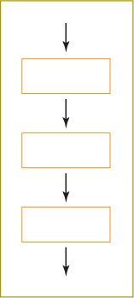
Understanding the Three Basic Structures
Sequence structure

Slide 5
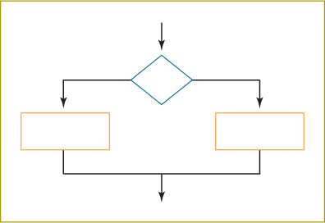
Understanding the Three Basic Structures (continued)
Selection structure

Slide 6
Understanding the Three Basic Structures (continued)
Dual-alternative if
Contains two alternatives
If-then-else structure
if someCondition is true then
do oneProcess
else
do theOtherProcess

Slide 7
Understanding the Three Basic Structures (continued)
Single-alternative if
Else clause is not required
null case
Situation where nothing is done
if student answers the bonus questions correctly
then add extra 5 marks

Slide 8
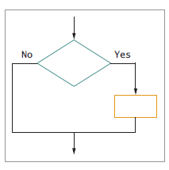
Understanding the Three Basic Structures (continued)
Single-alternative selection structure

Slide 9
Understanding the Three Basic Structures (continued)
Loop structure
Repeats a set of actions based on the answer to a question
Loop body
Also called repetition or iteration
Question is asked first in the most common form of loop
while … do or while loop

Slide 10
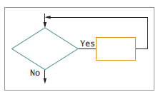
Understanding the Three Basic Structures (continued)
Loop structure

Slide 11
Understanding the Three Basic Structures (continued)
Loop structure
while testCondition continues to be true
do someProcess
while temperature is high
keep the cooler running

Slide 12
Understanding the Three Basic Structures (continued)
All logic problems can be solved using only these three structures
Structures can be combined in an infinite number of ways
End-structure statements
Indicate the end of a structure
The endif statement ends an if-then-else structure
The endwhile ends a loop structure

Slide 13
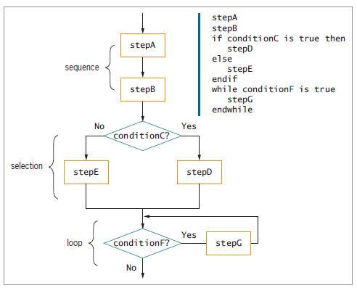
Understanding the Three Basic Structures (continued)
Structured flowchart and pseudocode with three stacked structures

Slide 14
Understanding the Three Basic Structures (continued)
Any individual task or step in a structure can be replaced by a structure
Nesting
Placing one structure within another
Indent the nested structure’s statements
Block
Group of statements that execute as a single unit

Slide 15
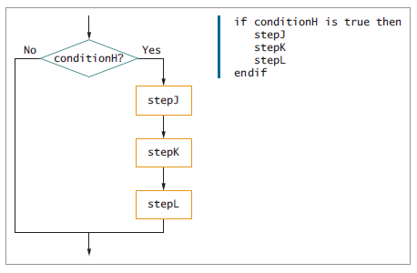
Understanding the Three Basic Structures
Flowchart and pseudocode showing nested structures—a
sequence nested within a selection

Slide 16
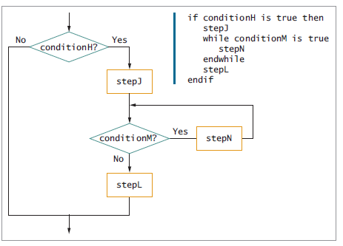
Understanding the Three Basic Structures
Flowchart and pseudocode showing nested structures—a loop nested within a sequence, nested within a selection

Slide 17
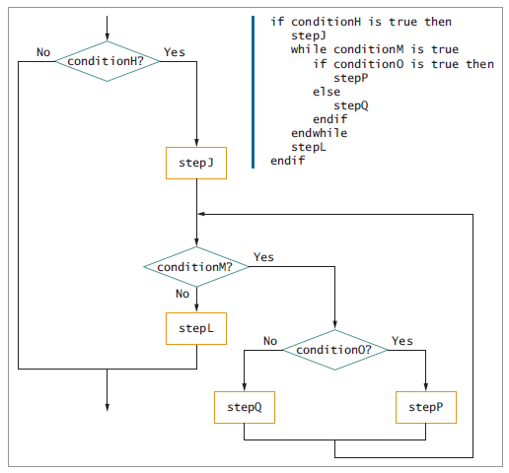
Understanding the Three Basic Structures
Flowchart and pseudocode for loop within selection within sequence within selection

Slide 18
Understanding the Three Basic Structures (continued)
Structured programs have the following characteristics:
Include only combinations of the three basic structures
Each of the structures has a single entry point and a single exit point
Structures can be stacked or connected to one another only at their entry or exit points
Any structure can be nested within another structure

Slide 19
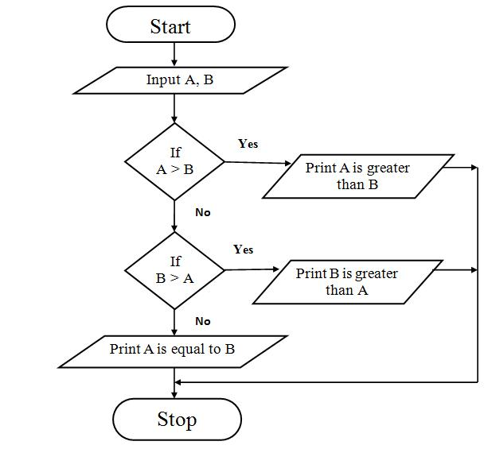
Flow chart to find the larger of two numbers.
Pseudocode
Step1: Start
Step 2: Enter two numbers A and B
Step 3: Check if A is greater than B if yes go to Step 4 else go to Step 5
Step 4: Print A is greater than B
Step 5: Check if B is greater than A if yes go to Step 6 else go to Step 7
Step 6: Print B is greater than A
Step 7: Print A is equal to B
Step 8: Stop

Slide 20
Flowchart: find the sum of 1 to 10
Flowchart
Pseudocode

Slide 21
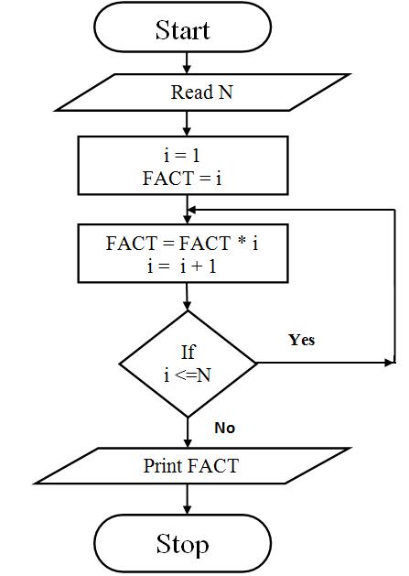
Flowchart: Find the factorial of a number
Pseudocode
Step 1: Start
Step 2: Read N
Step 3: [Initialize all counters]
Set FACT= 1, i = 1
Step 4: Compute Fact = Fact * i
Increment i
Step 5: Check if i < = N
if true repeat step 4
if false go to step 6
Step 6: Print fact
Step 7: Stop

