Slide 1
Welcome

Slide 2

Presenting YoJobs!

Slide 3
Overview
What is YoJobs!
Requirements for the project
How we implemented the project
Future Work
Conclusion
Demonstration of Yojobs Beta!

Slide 4
What YoJobs is !
YoJobs
Features
An online job-portal
Onlne platform for posting and applying for jobs
User Creation as Jobseeker and Employer
Profile update
User Dashboard
Job Post
Job Apply

Slide 5
Requirement For The Project
User Story
Stake holders
Functional requirements
Non Functional Requirements

Slide 6
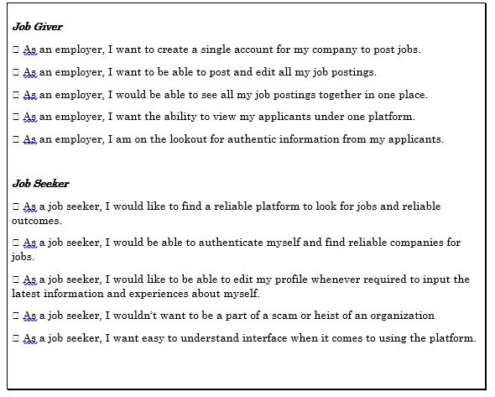
User Story

Slide 7
Stakeholder List
Job Givers (Companies and Employers)
Job Seekers
Administration of YoJobs
System Designer
Back-End Website Developer
Front-End Website Designer
Technical Writing Executives
SQA Officers

Slide 8
Functional & Non Functional Requirements
Functional Requirements
Non-Functional Requirements
User login
Sign up new user
Search Job Postings
Apply to Job Postings
Add Job Postings
Update Job Postings
Records
Efficiency requirements
Reliability requirements
Usability requirements
Safety requirements
Security requirements
Maintainability requirements
Portability requirements

Slide 9
How we implemnted
Project Management
S/W tools & languages
H/W properties
SCRUM APPROACH
Analysis
System Design
Maintenance
System Development
Implementations
PHP, HTML, Bootstrap and CSS, JavaScript
My SQL
XAMPP
Brackets
Intel corei5
RAM 12GB Future scope
2 GB NVDIA Graphics Card

Slide 10
Future Work
Features to be introduced
To Ease of Future Work
Admin Panel – to approve verified job postings only (to avoid scam and any illegal activity)
Customized CV made for users (Payment Required – Job Seekers)
Hot Jobs Offer highlighted above all (Payment Required – Job Employers)
Extensibility
Reusability
Understandability
Cost-effectiveness

Slide 11
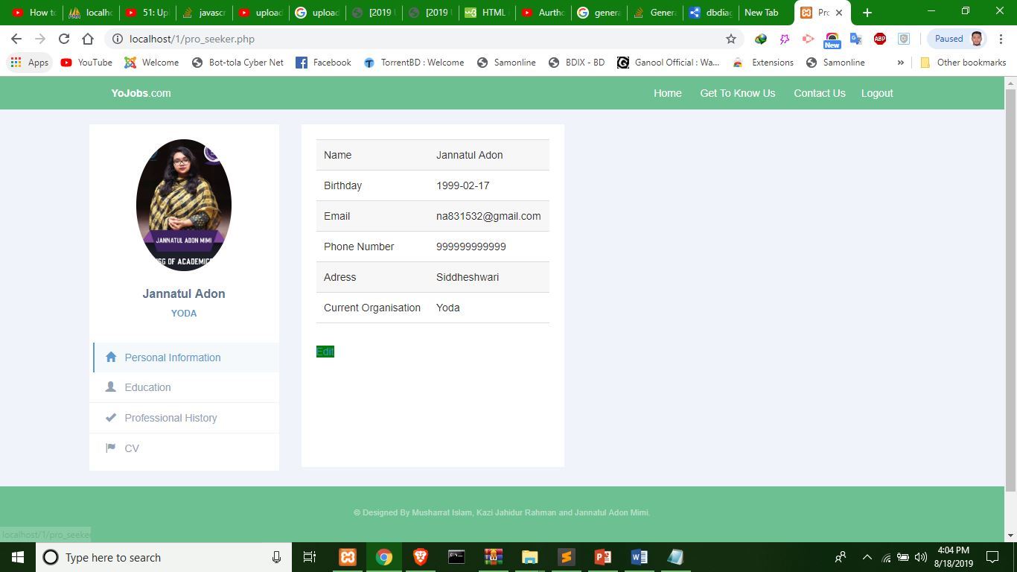
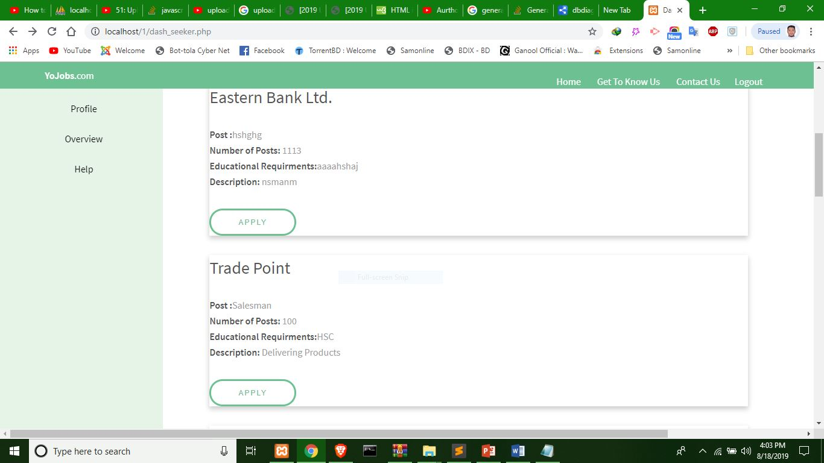
Demonstration

Slide 12
Conclusion
This project is designed to benefit students and fresh graduates
This is a beta version of our full plan, we hope to execute with the right amount of investors and times
The project is a secured version on an online portal and we hope to see better outcome in the coming year

Slide 13
THANK YOU ALL!!!

