Slide 1
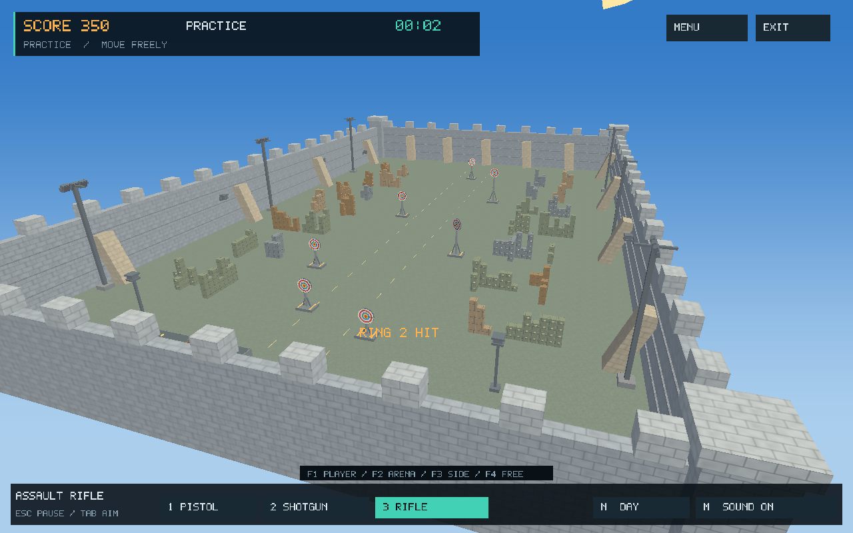
3D Target Shooter
An interactive graphics project
Kazi Rifat Al Muin
Roll: 2107042
CSE 4102: Computer Graphics and
Image Processing Laboratory
Khulna University of Engineering & Technology
Notes:
Project sources: report/report.tex; README.md

Slide 2
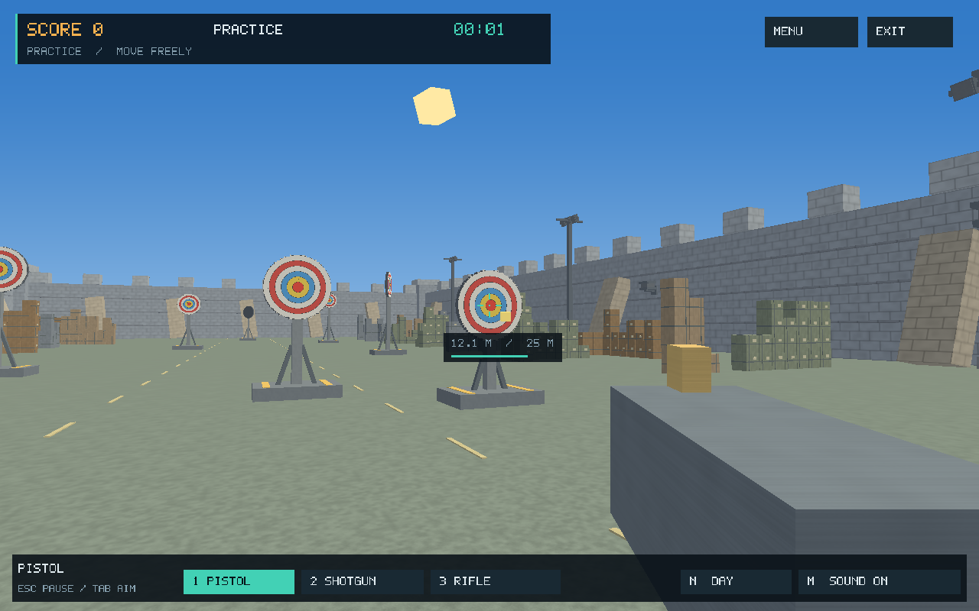
Game View
Player view — aiming, targets and HUD
Arena view — walls, cover and firing lanes
Notes:
Project sources: report/report-sections.tex, Sections 1–2

Slide 3
All seven Challenge levels
Level | Targets | Walking | Motion / cover | NPCs
1 | 3 | Locked | Stationary targets | None
2 | 3 | Locked | Centre target moves horizontally | None
3 | 4 | Locked | Separate X, Y and Z motion | None
4 | 6 | Enabled | Cargo cover, longer range and rotation | None
5 | 8 | Enabled | Compound target trajectories | 8 birds
6 | 10 | Enabled | Faster three-axis trajectories | 16 birds
7 | 12 | Enabled | Final pair: faster motion and spin | 48 birds; 36 humans
46 targets across seven levels; movement unlocks from Level 4.
Notes:
Project sources: report/report-sections.tex, Section 2.2

Slide 4
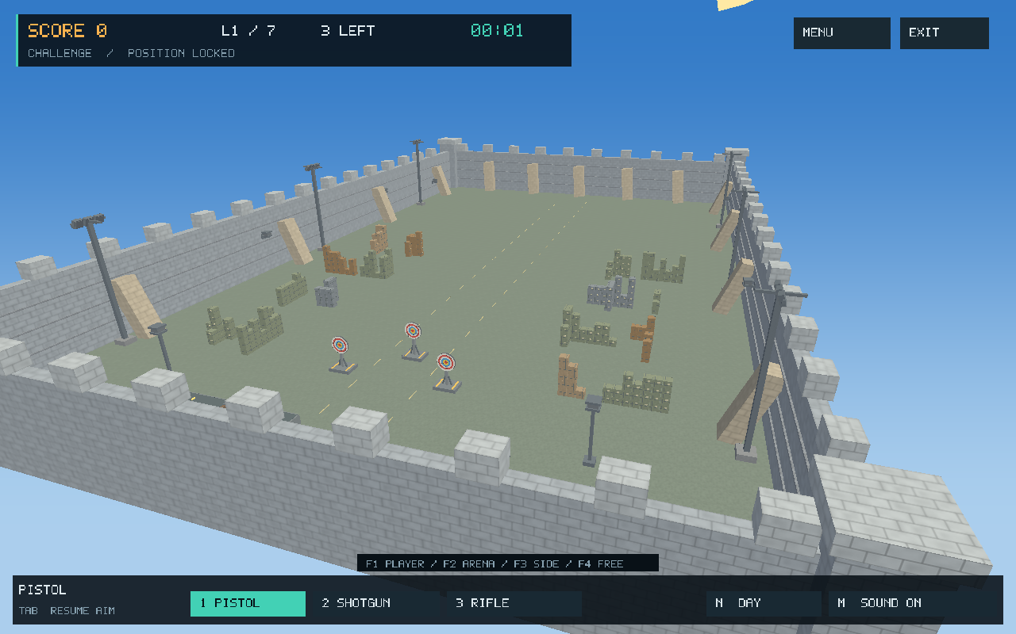


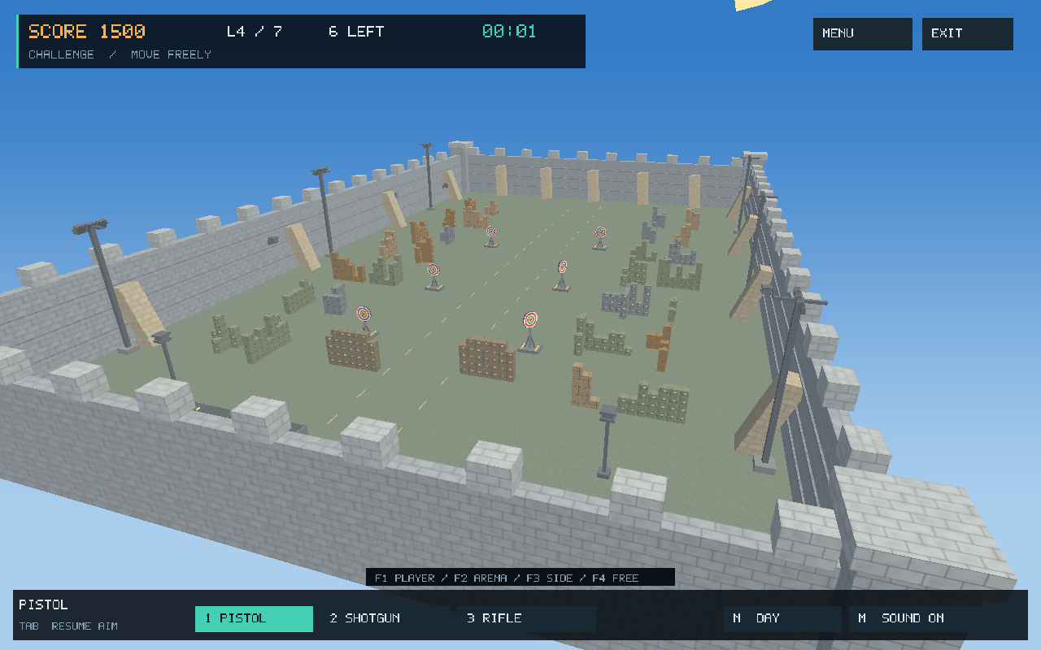


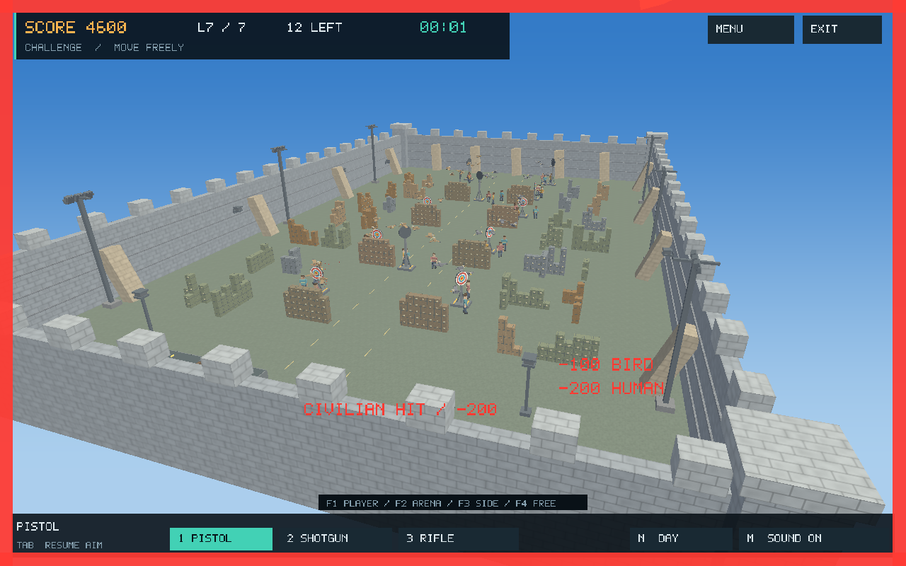
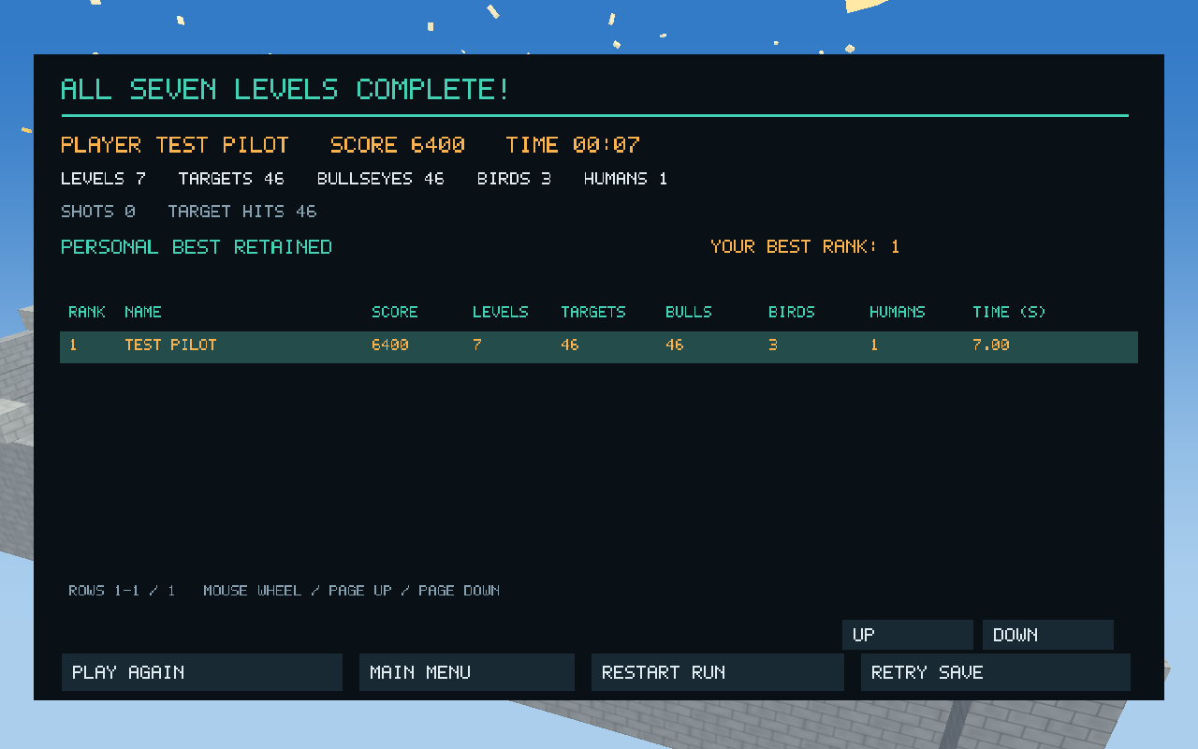
Seven levels in pictures
1 Stationary
2 Horizontal motion
3 Separate motion axes
4 Cover + rotation
5 Compound motion + birds
6 Faster motion
7 Birds + humans
Final-level results
Notes:
Project sources: docs/images/release-level-1.png through release-level-7.png

Slide 5
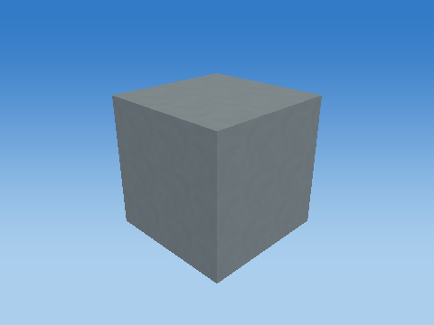
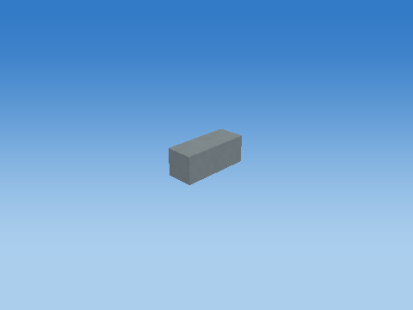
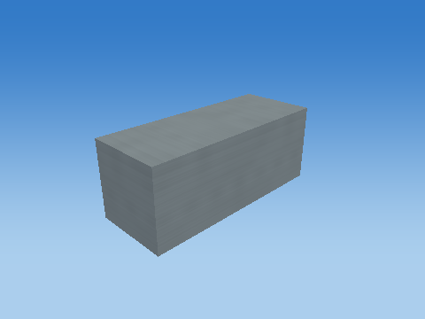
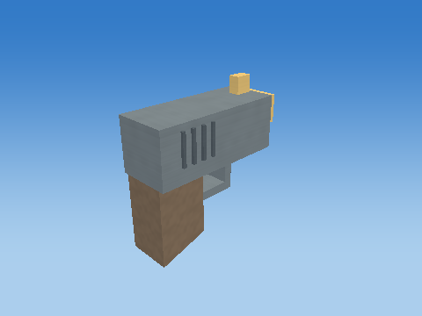
Object Construction using 3D Transformation
Unit cube
Scaled component
Placed component
Complete pistol
M = T Rz Ry Rx H S
Notes:
Project sources: objects/weapon-pistol/; report/report-sections.tex, Section 3

Slide 6
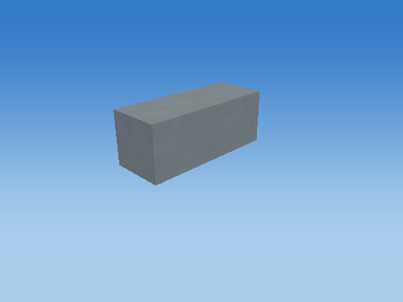
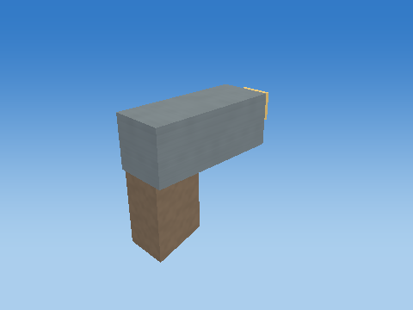



Pistol: from first part to complete model
Assembly after 1 parts
Assembly after 3 parts
Assembly after 5 parts
Assembly after 7 parts
Assembly after 9 parts
11 parts — complete pistol
Notes:
Project sources: objects/weapon-pistol/; report/report-sections.tex, Section 3.5

Slide 7
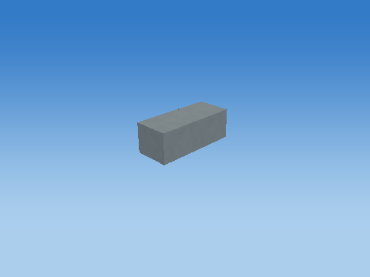
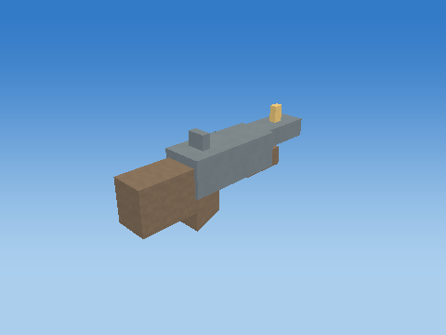
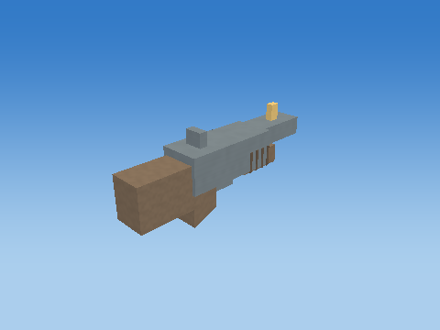
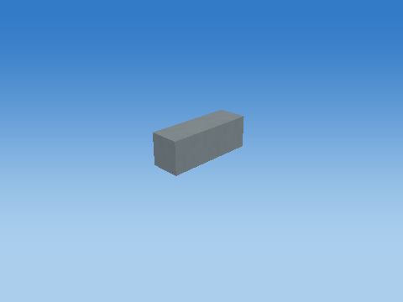
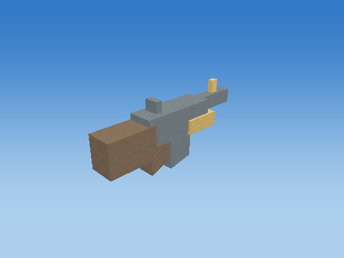
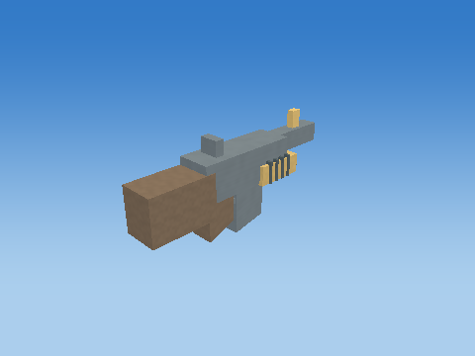
Shotgun and Rifle: complete assemblies
Shotgun • first part
Shotgun • 7 parts
Shotgun • complete, 14 parts
Rifle • first part
Rifle • 8 parts
Rifle • complete, 15 parts
Notes:
Project sources: objects/weapon-shotgun/; objects/weapon-rifle/; report/report-sections.tex, Section 3.6

Slide 8
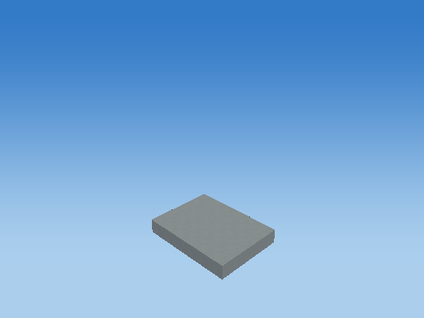
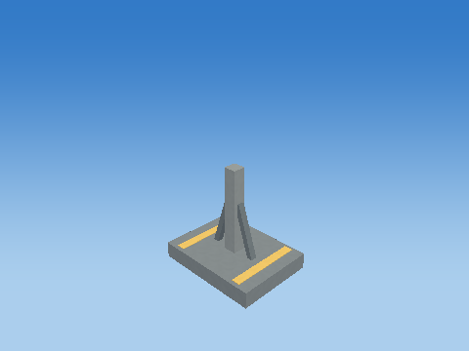
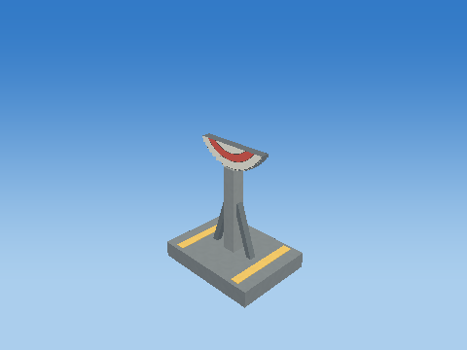
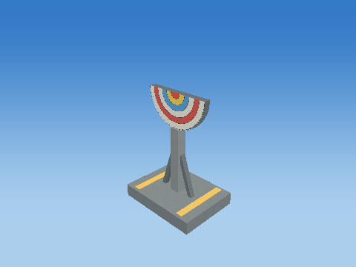
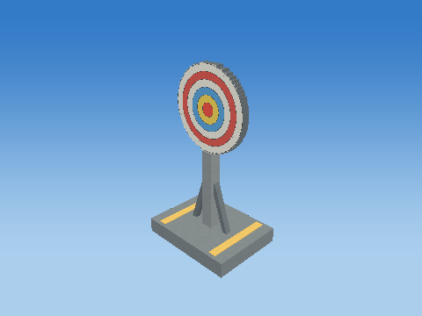
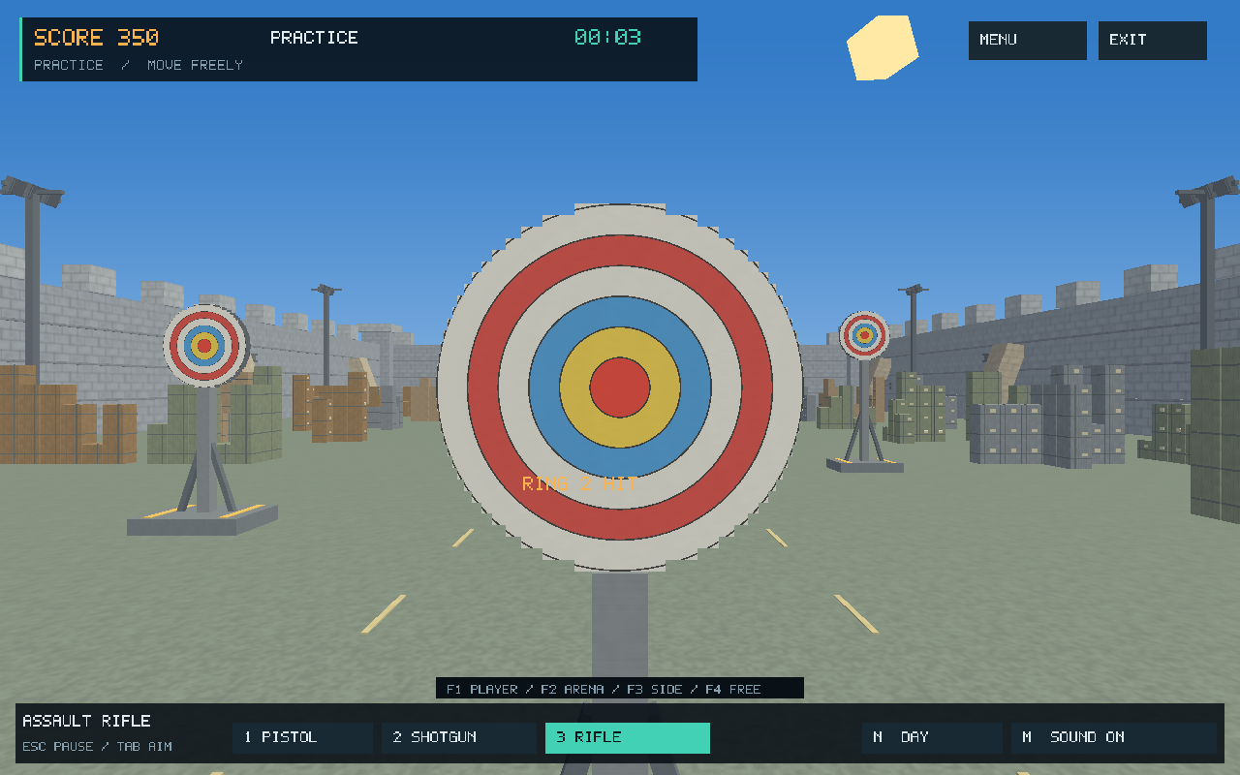
Target: stand, slices and scoring rings
Base
Complete stand
First 8 plate slices
First 16 plate slices
38 parts — complete target
Six shader-generated rings
32 plate slices: width = 2√(r² − y²)
Notes:
Project sources: objects/target/; report/report-sections.tex, Section 3.7

Slide 9
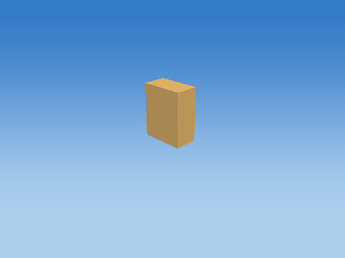
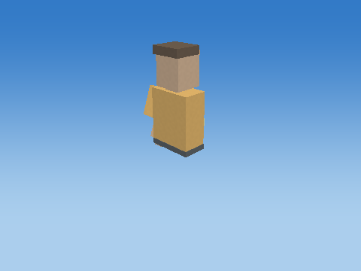
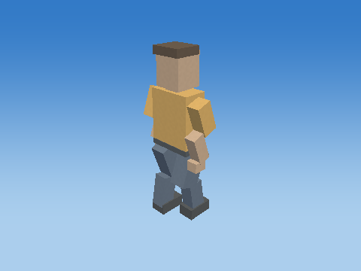
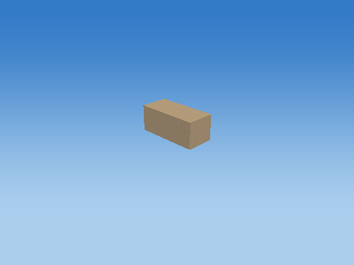
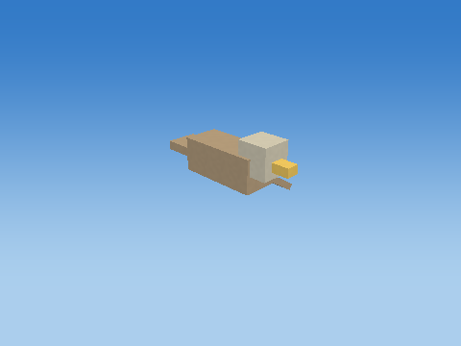
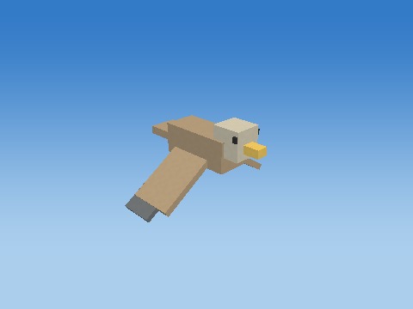
Human and Bird: multipart construction
Human • first part
Human • 10 parts
Human • complete, 21 cuboids
Bird • first part
Bird • 5 parts
Bird • complete, 10 cuboids
Notes:
Project sources: objects/human/; objects/bird/; report/report-sections.tex, Section 4.2

Slide 10
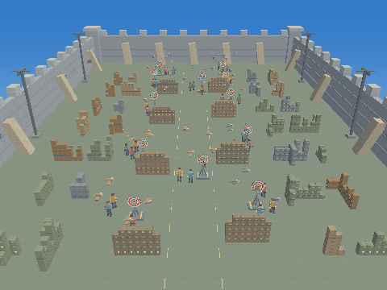
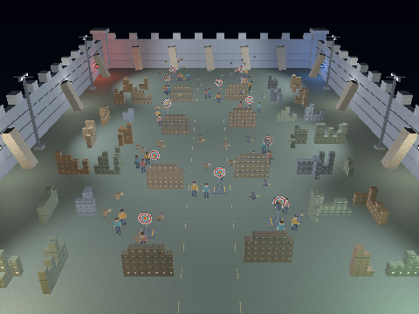
Lighting: Day and Night
Day : ambient fill and directional sunlight
Night : ambient fill, 8 point lamps and 6 spotlights
Same scene and camera; different source intensities.
Notes:
Project sources: report/report-sections.tex, Section 7; lighting/day-2-mask-15.png; lighting/night-2-mask-15.png

Slide 11
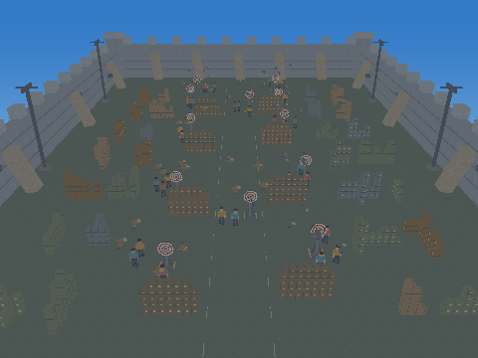
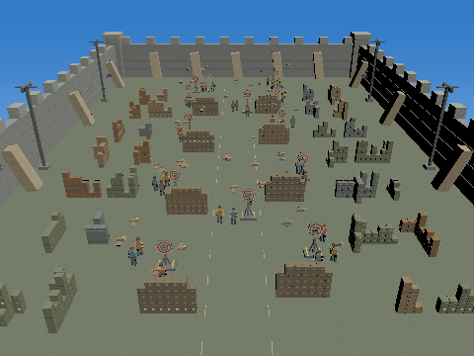
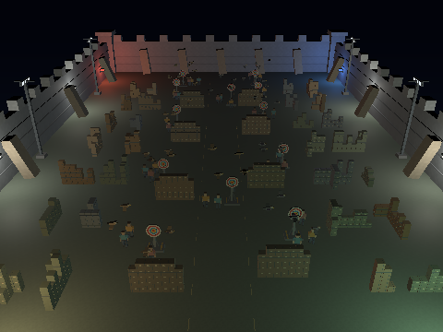
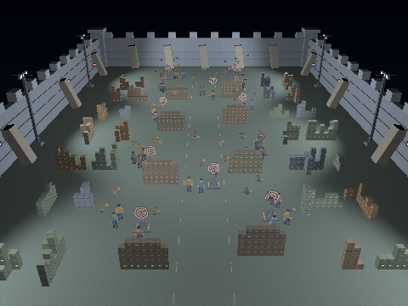
Lighting: Source-by-source comparison
Ambient — constant background fill
Directional — orientation-dependent sunlight
Point lamps — local light with distance falloff
Spotlights — focused beams with soft cone edges
Notes:
Project sources: report/report-sections.tex, Sections 7.1–7.2; lighting/

Slide 12
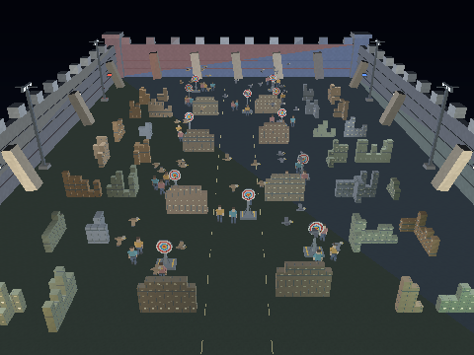
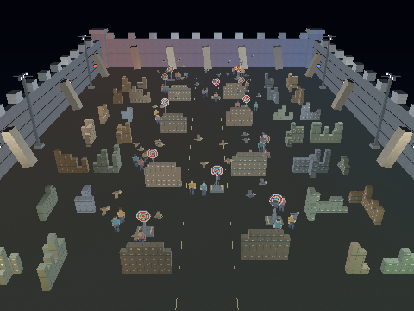
Shading: Flat, Gouraud and Phong
Flat: one lighting value per triangle
Gouraud: interpolated vertex lighting
Phong: lighting evaluated per fragment
Flat | Gouraud | Phong
Constant triangle regions | Smooth vertex-to-vertex variation | Detailed local light and highlights
Notes:
Project sources: report/report-sections.tex, Section 7.3; lighting/night-*-mask-15.png

Slide 13
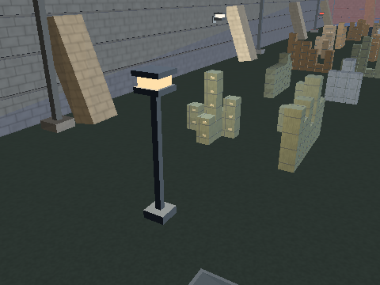
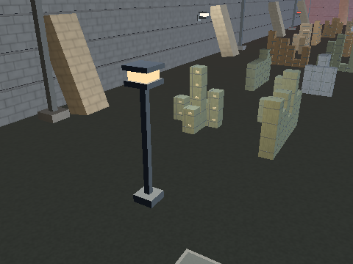
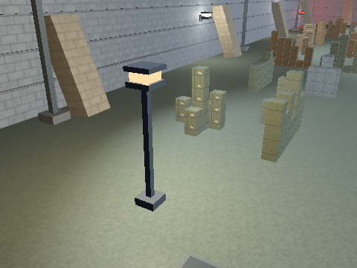
Shading: Close-up comparison
Flat — triangle boundaries are visible
Gouraud — light blends between vertices
Phong — light responds at each fragment
Same camera, geometry and lights; only the shading method changes.
Diffuse ∝ max(N · L, 0) | Specular ∝ max(R · V, 0)ⁿ
Notes:
Project sources: report/report-sections.tex, Section 7.3; lighting/night-*-mask-15-close.png; shaders/lighting.glsl

Slide 14
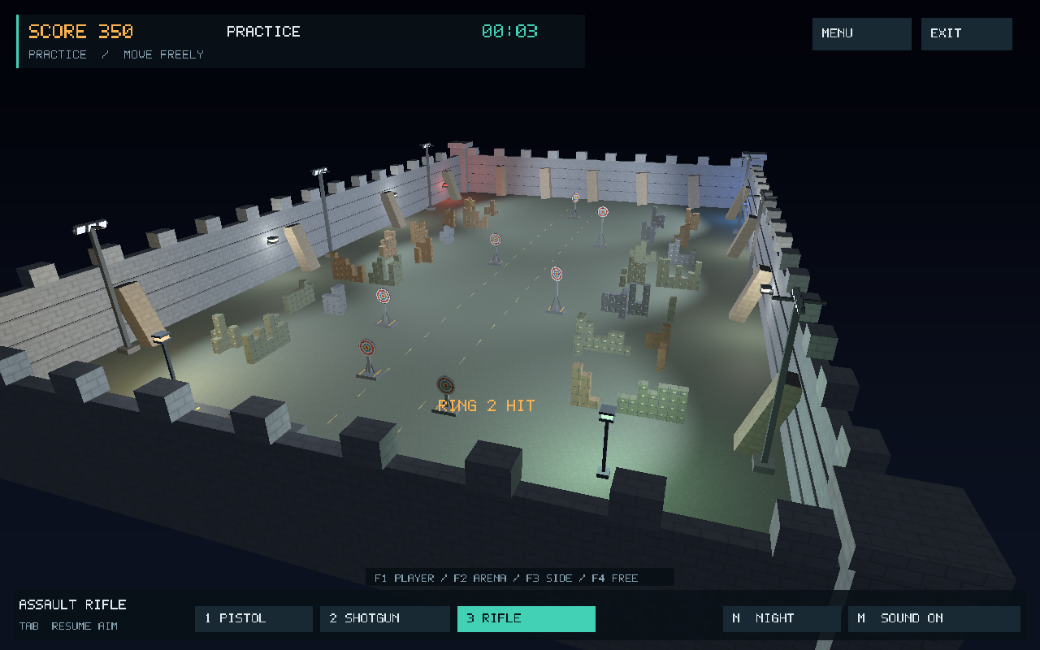
Conclusion
One reusable cube.
Complete 3D assemblies.
Seven progressive levels.
Three shading methods.
Modelling, animation, and lighting combined in one interactive project.
Notes:
Project sources: report/report-sections.tex, Conclusion

Slide 15
Thank You

