Slide 1
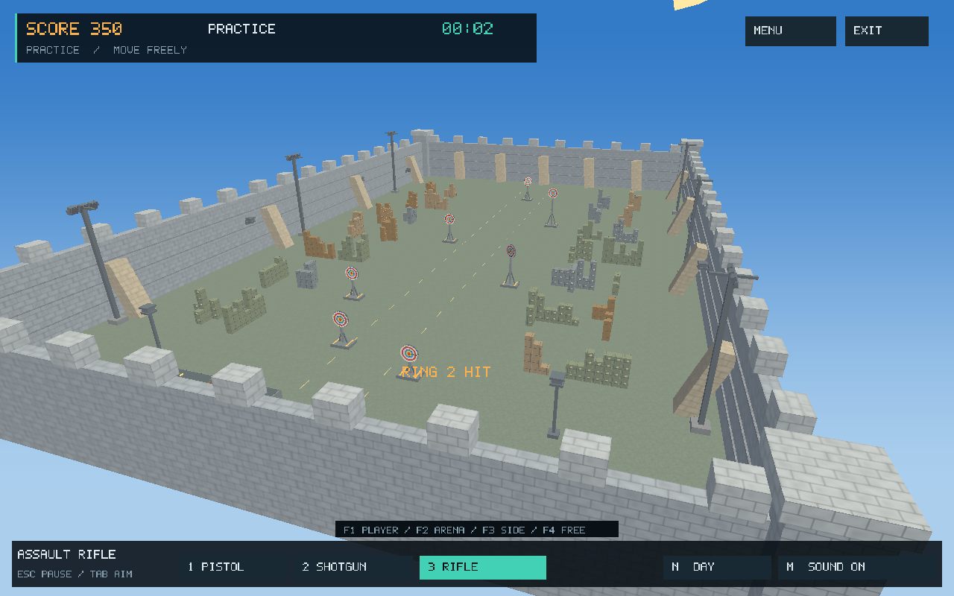
3D Target Shooter
An interactive graphics project
Cube-based modelling • animation
lighting • collision • user interaction
Kazi Rifat Al Muin
Roll: 2107042
CSE 4102
Computer Graphics and Image Processing Laboratory
Khulna University of Engineering & Technology
Actual project capture: the completed arena.
3D TARGET SHOOTER / CSE 4102
01 / 18
Notes:
Project sources: README.md; report/report.tex

Slide 2
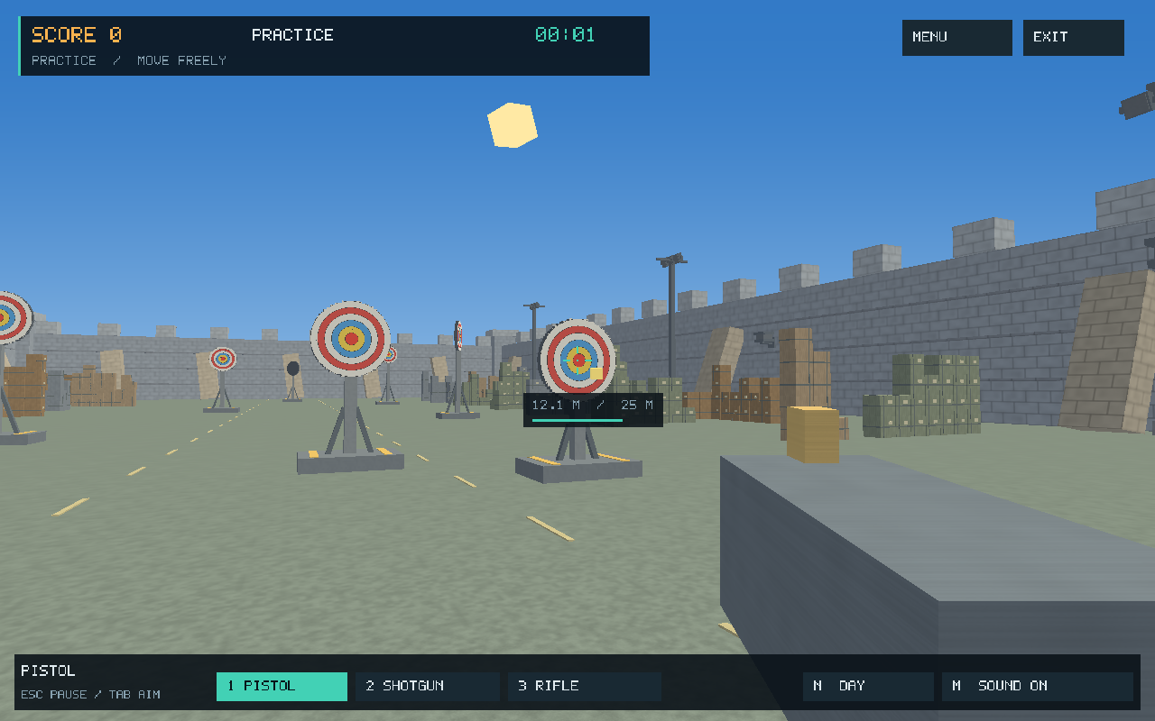
Introduction and objectives
•
Build a complete, interactive 3D scene from a shared primitive.
•
Demonstrate scale, shear, rotation, translation and perspective projection.
•
Combine textures, lighting, animation and exact geometric collision.
•
Keep the implementation modular and calculations reproducible.
Player view combines the world, aiming and HUD.
3D TARGET SHOOTER / CSE 4102
03 / 18
Notes:
Project sources: report/report-sections.tex, Section 1

Slide 3
System design and rendering pipeline
Input & mode
→
Simulation
→
Scene objects
→
GPU shaders
→
Frame + HUD
Layer | Responsibility
GLFW + GLAD | Window/input and OpenGL function loading
C++ modules | Levels, transforms, camera, gameplay, world, UI and persistence
Object shaders | Model/view/projection, textures and lighting
Sky + UI shaders | Sky gradient and screen-space interface
3D TARGET SHOOTER / CSE 4102
04 / 18
Notes:
Project sources: README.md; src/; shaders/

Slide 4
Gameplay modes and level progression
Mode | Purpose
Challenge | Seven levels; 46 targets in total
Free | 180 seconds; targets respawn after 30 s
Developer | Inspect and restart individual levels
Bird’s-Eye | Overview and click-to-observe camera
Practice | Seven targets; 1.8 s respawn
Increasing difficulty
L1–3 Stationary → separate motion axes
L4 Cover, rotation, and walking
L5–6 Compound motion and birds
L7 Faster targets and human NPCs
Player movement is locked in Levels 1–3 and enabled in Levels 4–7.
3D TARGET SHOOTER / CSE 4102
05 / 18
Notes:
Project sources: report/report-sections.tex, Section 2

Slide 5
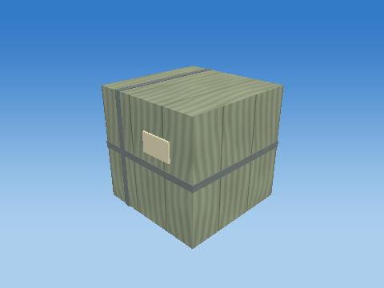
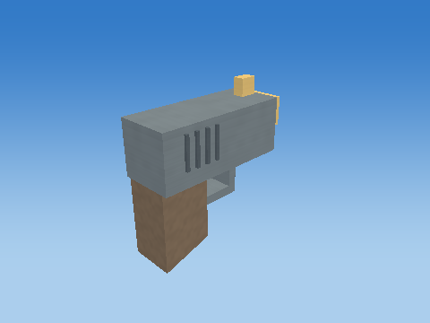
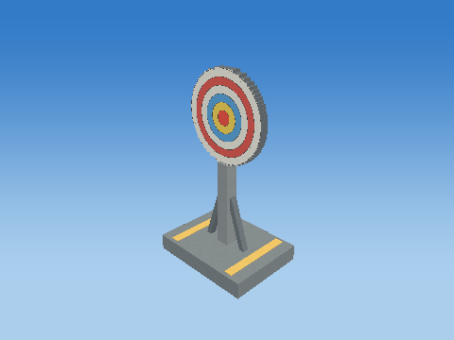
03 / GRAPHICS IMPLEMENTATION
Object construction from a unit cube
One mesh: 8 corners → 12 triangles → 36 face-normal vertices
Cargo crate
Pistol assembly
Target and stand
Parts are scaled, sheared, rotated and placed independently. The circular-looking target uses 32 cube slices; its six rings are shader-generated.
3D TARGET SHOOTER / CSE 4102
06 / 18
Notes:
Project sources: report/report-sections.tex, Section 3; objects/

Slide 6
03 / TRANSFORMATIONS
Main formula: model-to-screen transformation
M = T Rz Ry Rx H S
pworld = M plocal • pclip = P V M plocal
pNDC = pclip.xyz / pclip.w
S scale H shear
Rx, Ry, Rz rotations
T translation
V view P projection
Column vectors: scale is applied first, translation last.
The same model transforms support geometry and collision.
3D TARGET SHOOTER / CSE 4102
07 / 18
Notes:
Project sources: src/core/Transform.h; shaders/object.vert; report/report-sections.tex

Slide 7
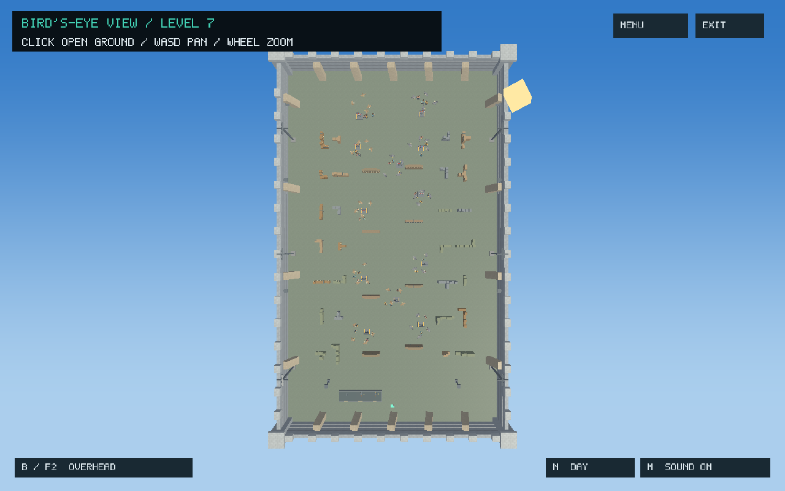
03 / CAMERA & INTERFACE
Camera, interaction and screen-space UI
Multiple views
Player, arena, side and movable views expose the same world from different positions.
x′ = 2x / 1280 − 1
y′ = 1 − 2y / 800
Overhead view reveals arena layout and observation positions.
UI vertices map from the 1280 × 800 logical canvas to normalized coordinates; Y is flipped.
3D TARGET SHOOTER / CSE 4102
08 / 18
Notes:
Project sources: src/camera/; shaders/ui.vert; report/report-sections.tex, Section 5

Slide 8
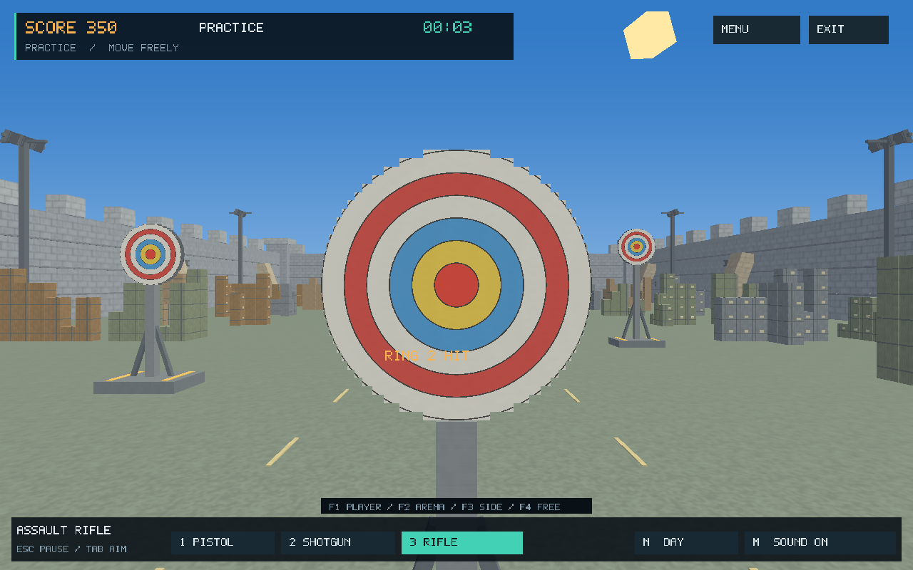
03 / ANIMATION
Target animation and scoring
pj(t) = bj + aj sin(ωj t + φj)
θy(t) = (s t) mod 360°
D(r) = 60 / (r + 1), r = 0, …, 5
b: base position a: amplitude ω: angular frequency
φ: phase s: spin speed r: ring index
Six concentric scoring regions.
60 health; ring damage = 60, 30, 20, 15, 12, 10.
Only front-face hits score. One shotgun trigger applies its best ring damage once per target.
3D TARGET SHOOTER / CSE 4102
09 / 18
Notes:
Project sources: src/world/; report/report-sections.tex, Section 2; shaders/object.frag

Slide 9
03 / SIMULATION
Shooting and collision detection
ℓ = min(v Δt, range − travelled)
Ray–box slab test
Transform the ray into each part’s local space. Keep the transformed direction unnormalized.
Intersect the three [−0.5, 0.5] slabs; accept if entry ≤ exit.
Use the nearest contact to stop travel, including cover and NPCs.
pnew = pold + ℓ d
ol = A⁻¹(o − t), dl = A⁻¹d
v: projectile speed d: unit firing direction
A, t: object linear transform and translation
Camera-to-muzzle parallax is handled; a clear camera view does not imply a clear muzzle.
3D TARGET SHOOTER / CSE 4102
10 / 18
Notes:
Project sources: report/report-sections.tex, Section 4; src/gameplay/

Slide 10
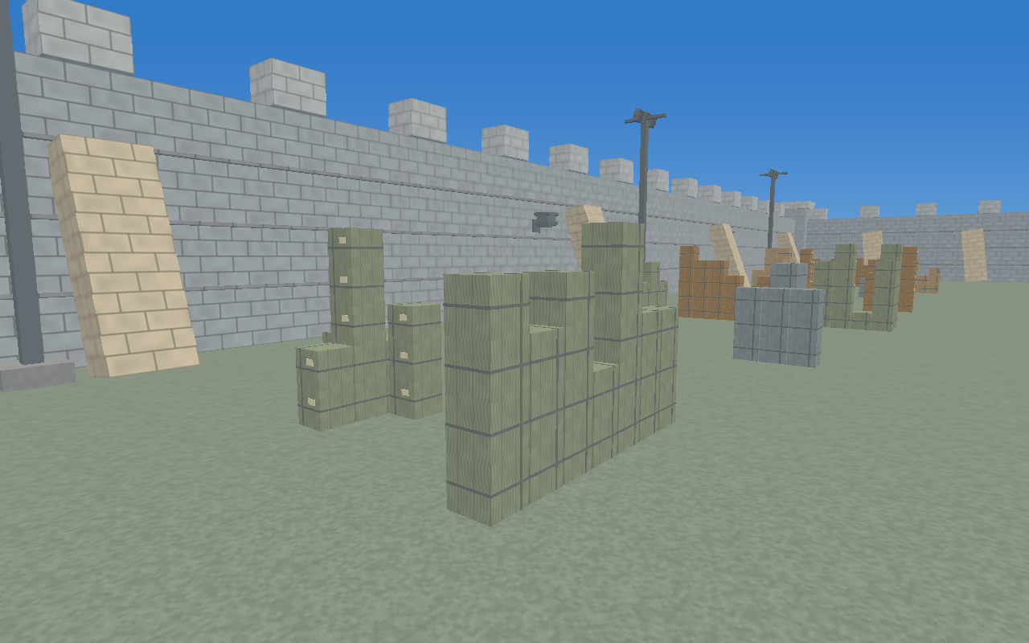
03 / SURFACE APPEARANCE
Texture techniques and materials
•
Nine 256 × 256 material maps are stored in a texture array.
•
Face-local planar UVs keep textures aligned through rotation and shear.
•
One texture sample combines with the object colour before lighting.
Cbase = Cobject × texture(UV, layer)
Procedural materials distinguish surfaces throughout the arena.
3D TARGET SHOOTER / CSE 4102
11 / 18
Notes:
Project sources: tools/generate_textures.cpp; shaders/object.vert; shaders/object.frag

Slide 11
03 / LIGHTING
Main formula: ambient, diffuse and specular light
Clinear = Cbase ⊙ (A + Σ Ii max(N · Li, 0))
+ Σ Ii ks max(Ri · V, 0)ⁿ
A ambient colour Ii effective light colour / intensity
N unit normal Li direction toward the light
V direction to viewer Ri reflected incoming light
ks specular strength n shininess
Phong reflection
Specular is added only when N · Li > 0. Normals use the inverse-transpose transform.
Nworld ∝ (M3×3⁻¹)ᵀ Nlocal
3D TARGET SHOOTER / CSE 4102
12 / 18
Notes:
Project sources: shaders/lighting.glsl; shaders/object.frag

Slide 12
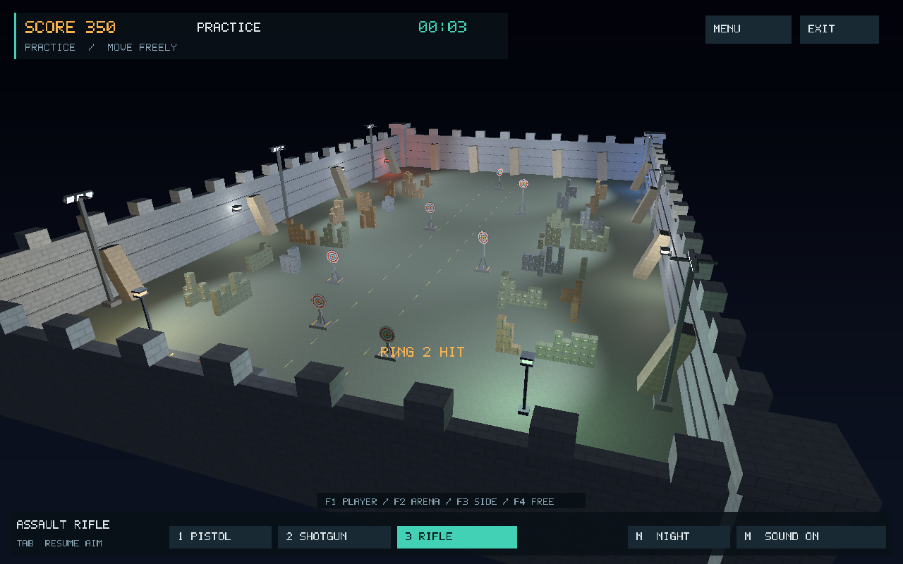
03 / LIGHTING & SHADING
Day/night lighting and shading methods
Light rig
Ambient + directional
8 point lamps
6 soft-edged spots
Day: directional fill and material detail.
Night: lamps and spotlight cones.
Point attenuation = 1 / (1 + 0.09d + 0.032d²)
Flat: one value per triangle • Gouraud: interpolated vertex lighting
Phong shading: lighting per fragment • Display gamma: Cdisplay = clamp(Clinear)^(1/2.2)
3D TARGET SHOOTER / CSE 4102
13 / 18
Notes:
Project sources: shaders/lighting.glsl; docs/images/release-shading-*; docs/images/release-night-arena.png

Slide 13
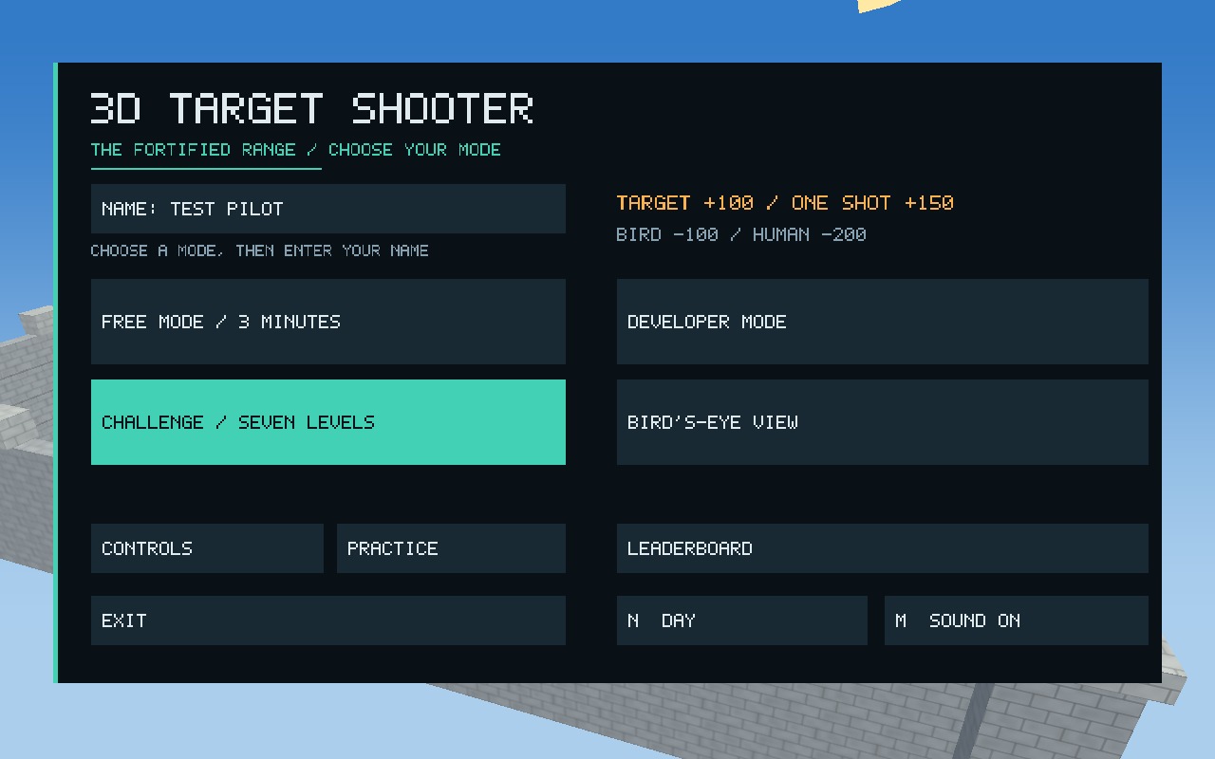
04 / IMPLEMENTATION
Implementation and advanced features
•
Separate modules manage rendering, gameplay, world construction, camera, UI and persistence.
•
Shared scene builders keep rendered parts and collision geometry consistent.
•
Seeded layouts and transform logs support repeatable inspection.
•
Cached lighting rigs and redundant-uniform suppression reduce renderer overhead.
Five modes share one graphics and gameplay system.
Persistent CSV leaderboards
Generated font and synthesized audio
Menus, pause, instructions and results
3D TARGET SHOOTER / CSE 4102
14 / 18
Notes:
Project sources: src/; README.md; docs/release-verification.md

Slide 14
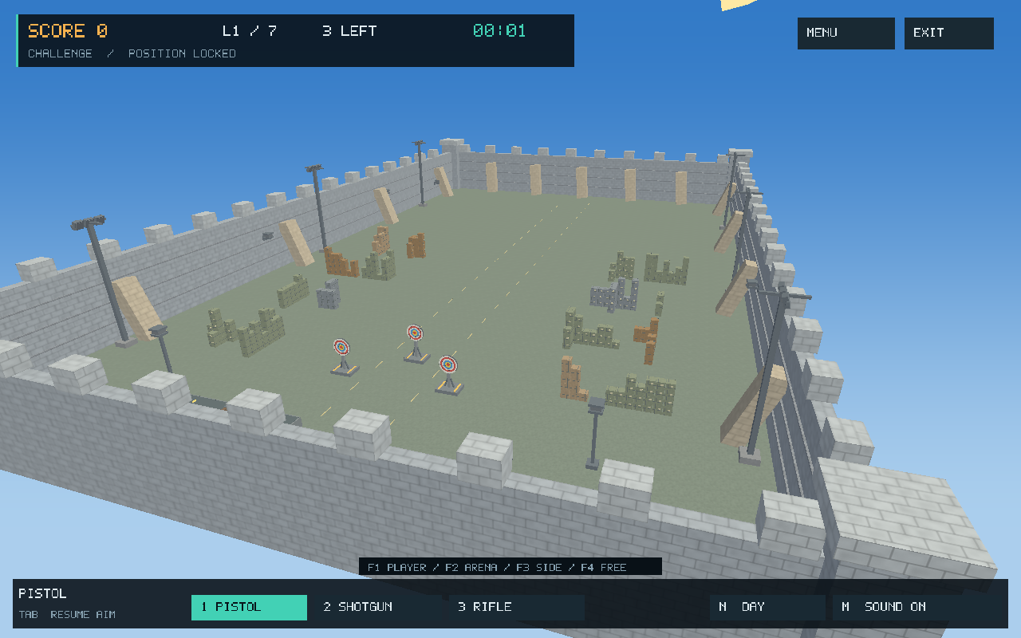
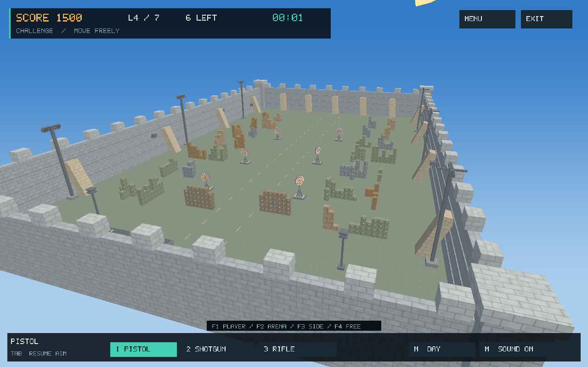
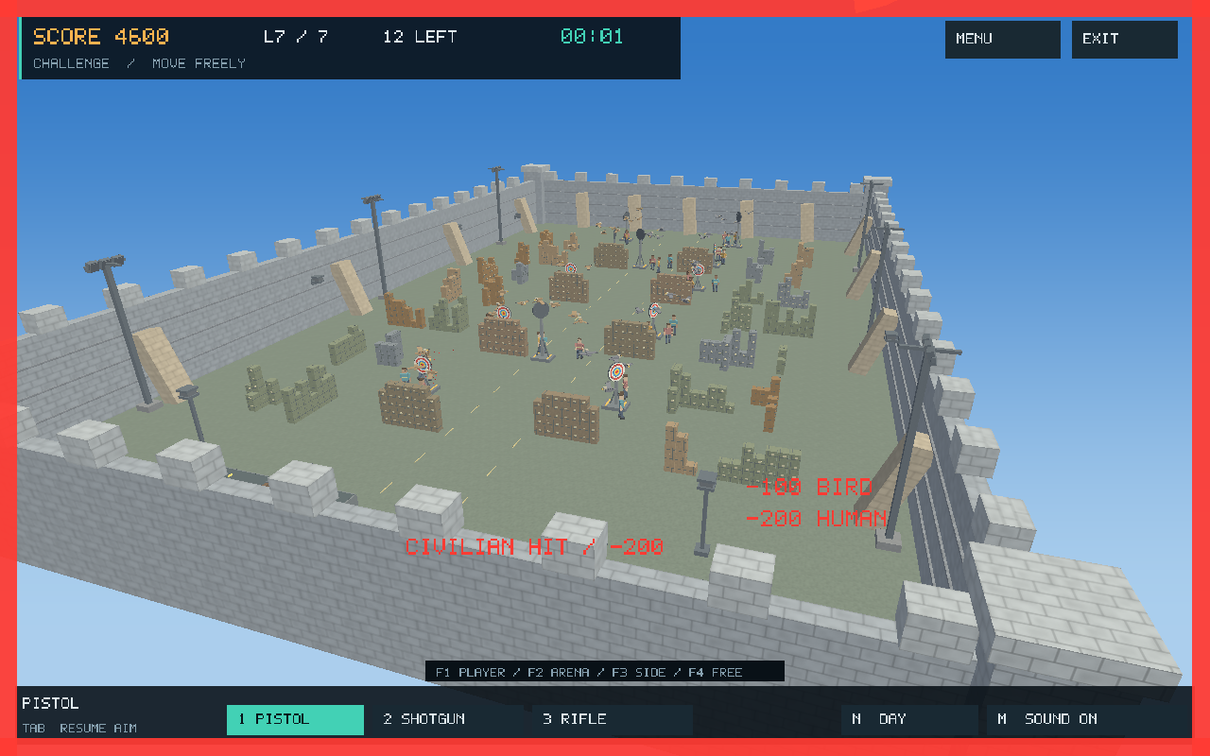
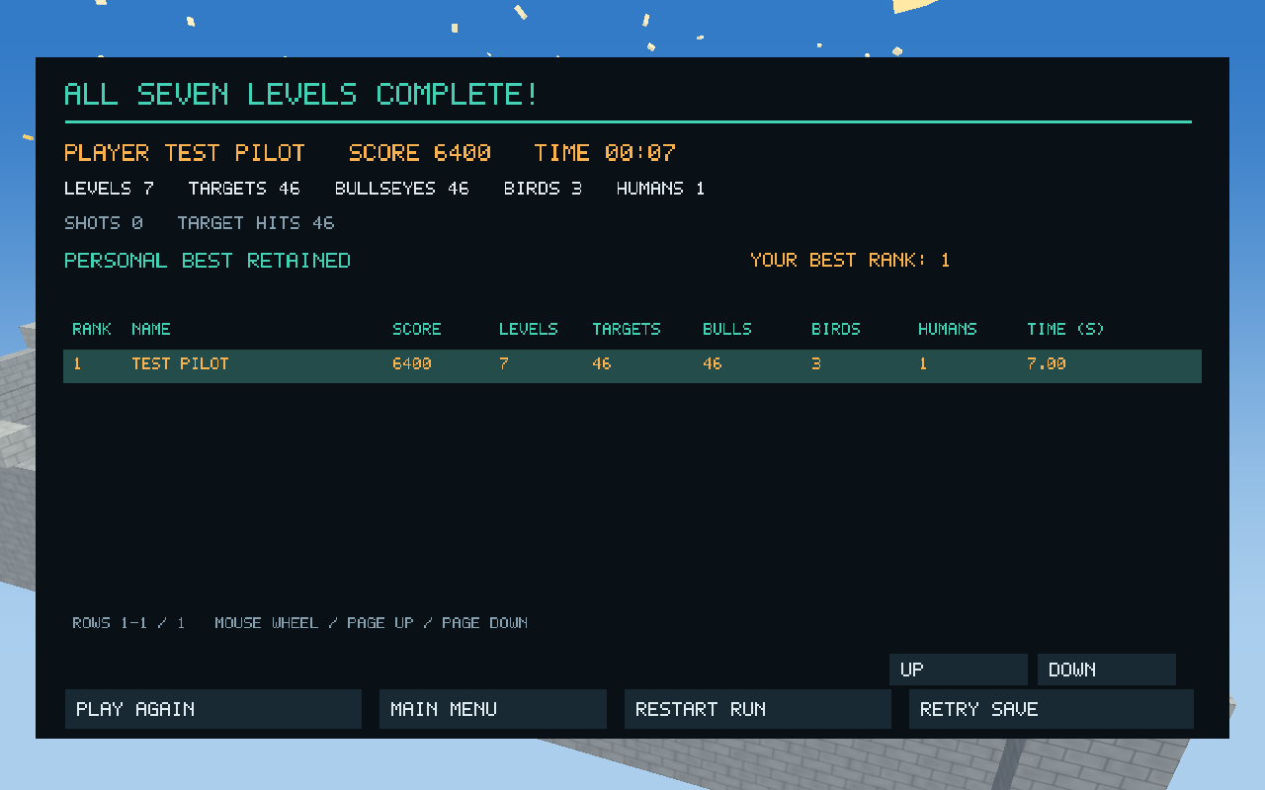
04 / RESULTS
Visual results: progressive arena complexity
Level 1 — stationary targets
Level 4 — cover and movement
Level 7 — combined motion and NPCs
Final-level results and session feedback
3D TARGET SHOOTER / CSE 4102
15 / 18
Notes:
Project sources: docs/images/release-level-1.png; release-level-4.png; release-level-7.png; release-level-7-results.png

Slide 15
04 / EVALUATION
Verification and measured performance
Recorded project verification • 3 October 2026
•
Core, Challenge, mode and release test suites were reported as passed.
Median render time | Before | After
Day | 6.40 ms | 5.32 ms
Night | 7.34 ms | 5.60 ms
•
Render checks covered shaders, OpenGL errors and day/night/shading differences.
•
Independent calculation checks verified 56,712 unique observed cube rows.
Level 7 • 5,349 cube instances
1280 × 800 • AMD Radeon Graphics
200 measured frames per condition
Render-pass measurements only. Long-tail stalls remain; these figures do not establish total gameplay FPS or performance on other hardware.
3D TARGET SHOOTER / CSE 4102
16 / 18
Notes:
Project sources: docs/release-verification.md (2026-10-03). Historical project results, not rerun for this presentation.

Slide 16
05 / CONCLUSION
Discussion, limitations and conclusion
What the project demonstrates
Limitations and future work
•
A full graphics pipeline built around reusable cube geometry.
•
Curves are approximated; target disks use cube slices.
•
Visible links between mathematical transforms, lighting and interaction.
•
Visibility validation samples time and space rather than proving every instant.
•
Progressive gameplay supported by repeatable validation.
•
Future work: smoother curved meshes, batching and investigation of render stalls.
The result is a playable application and a concrete demonstration of core 3D graphics concepts.
3D TARGET SHOOTER / CSE 4102
17 / 18
Notes:
Project sources: README.md; report/report-sections.tex, Discussion and Conclusion; docs/release-verification.md

Slide 17
REFERENCES
References and project evidence
01
Project report
report/report.tex and report/report-sections.tex
02
Implementation overview
README.md — scope, architecture, levels and controls
03
Graphics formulas
shaders/object.vert, object.frag, lighting.glsl and ui.vert
04
Evaluation evidence
docs/release-verification.md — dated tests and benchmark limits
05
Pictures and model assemblies
docs/images/, objects/ and report/images/
All pictures are existing captures from this project. Equations summarize the implemented code.
Detailed source notes are included in the PowerPoint speaker notes.
3D TARGET SHOOTER / CSE 4102
18 / 18
Notes:
Project sources: Local repository sources used throughout the presentation.

