Slide 1
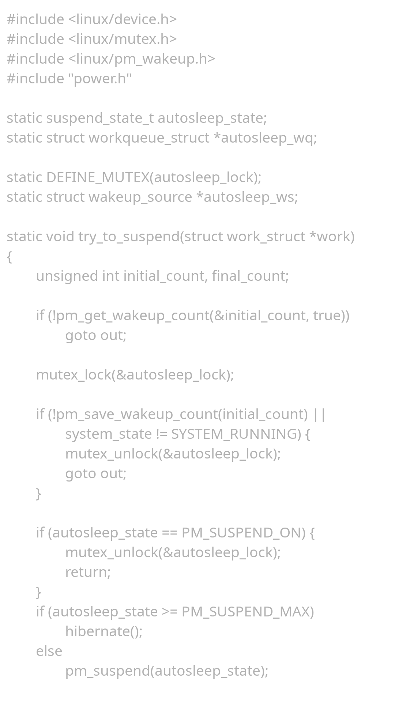

Welcome! The Success of an Accidental Revolution
Kazi Rifat Morshed Student ID: 230220 B.Sc. Engineering in Computer Science and Engineering, Khulna University, Khulna – 9208.
Email: 230220@ku.ac.bd Website: www.kazirifatmorshed.github.io
Source Code: https://github.com/torvalds/linux Picture: Larry Ewing, Simon Budig, Garrett LeSage - https://isc.tamu.edu/~lewing/linux/, http://www.home.unix-ag.org/simon/penguin/, garrett/Tux on GitHub
Notes:
We all have heard of different operating systems like MS Windows, Apple Mac, Android, and Most familiarly Linux.
.
Today, I am going to share the success of Linux in short. So, Say HI to Tux, the adorable mascot of Linux and Let's Start.

Slide 2
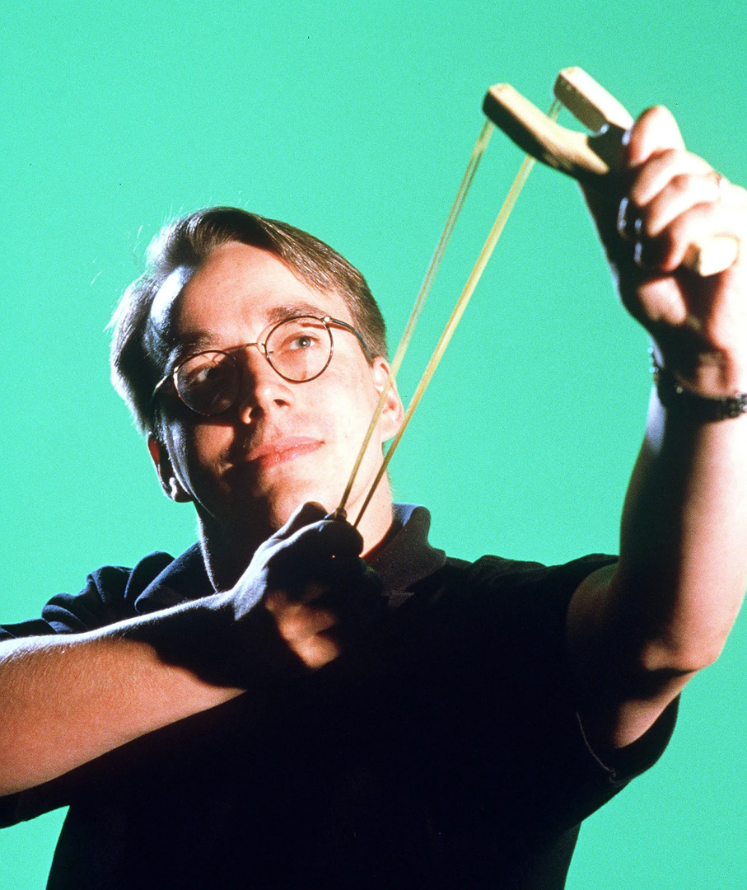
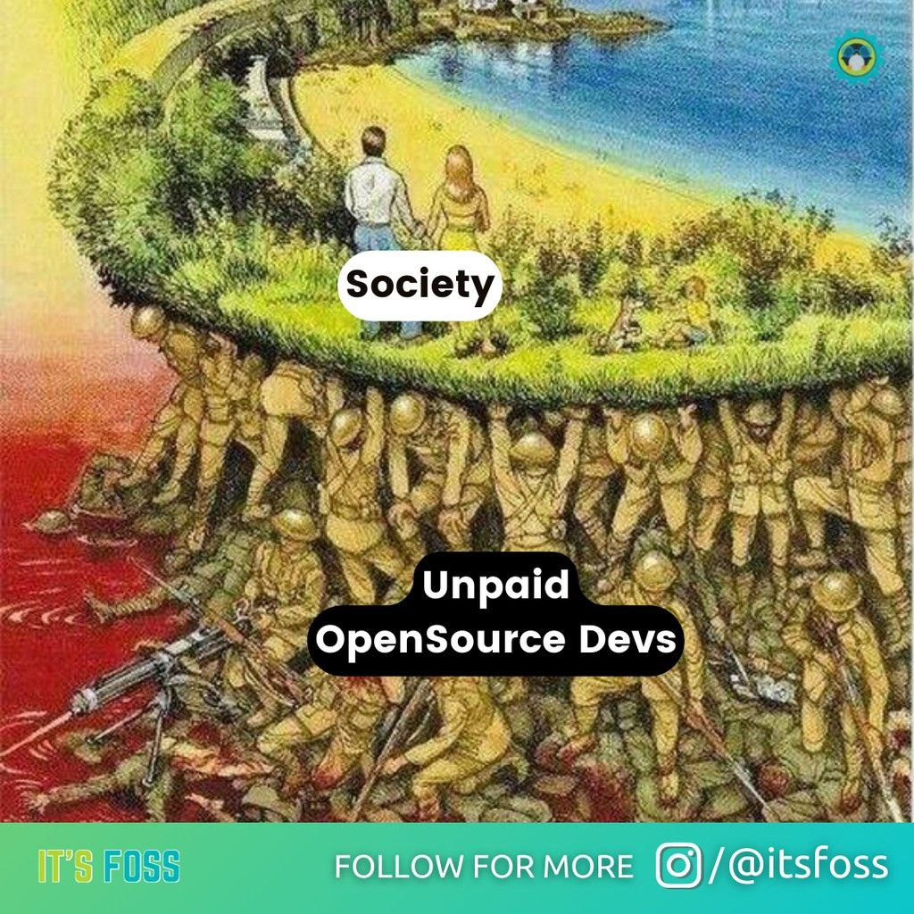
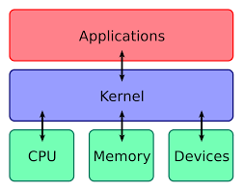
What is GNU/Linux🐧?
Linux is a kernel, a program that interacts between hardware and software
GNU/Linux is a packaged Operating System along with the Linux kernel which is Free (free of cost) and Open Source
Linus Torvalds introduced Linux on August 25, 1991, as a hobby project. [1]
More than 15,000 Open-Source Volunteer Developers all over the world have made 50,000 commits in the mainstream GitHub repository.[2]
Reference: [1] https://en.wikipedia.org/wiki/Linus_Torvalds ; [2] https://github.com/torvalds/linux/pulse Images: https://en.wikipedia.org/wiki/File:Kernel_Layout.svg ; www.itsfoss.com , www.reddit.com/r/linuxmeme
Notes:
Long story short : Linux is a kernel …. what is a kernel
…
Packaged operating system: file explorer, browser, notepad, multimedia player, basic programs like Calendar, Calculator etc.
… Commit, Change or Improvement …
As a CS student at University of Helsinki, he started making a hobby project almost 32 years old which is now WIDELY known as linux.
Who made linux ? ALL OVER THE WORLD … … Together

Slide 3
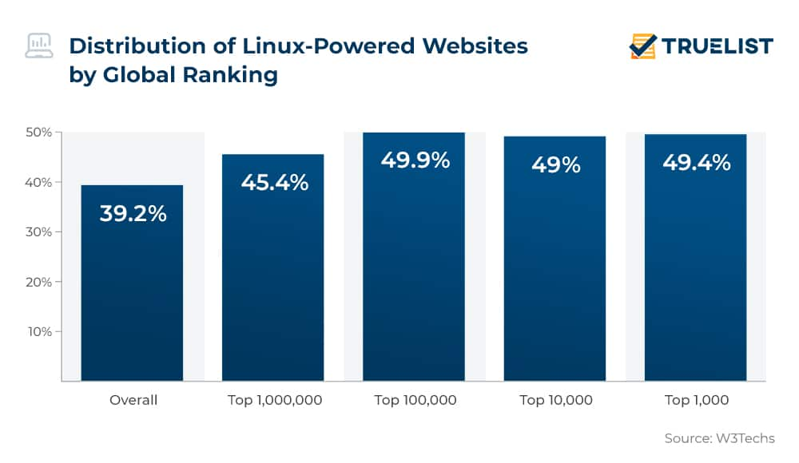
Where is Linux ? (Better ask, where isn't🤯!)
3.6 billion Android smartphone users in 2023, which is 85% of the smartphone market. [3]
92% of the world's high-performing computing system runs on Linux. [4]
96.3% of the top one million web servers are running Linux. (ZDNet) [5]
47% of professional developers use Linux-based operating systems. (Statista) [5]
Reference: [3] https://www.bankmycell.com/blog/how-many-android-users-are-there [4] [YouTube] What the Tech Industry Has Learned from Linus Torvalds: Jim Zemlin at TEDxConcordiaUPortland [5] https://truelist.co/blog/linux-statistics/
Notes:
We all use smartphone everyday, right ? Inside android, it's program that keeps a phone functioning is Linux.
Hand Gestures
Look at your audience

Slide 4
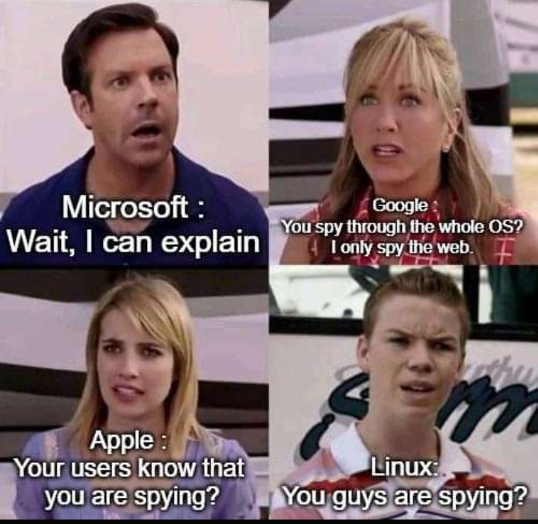
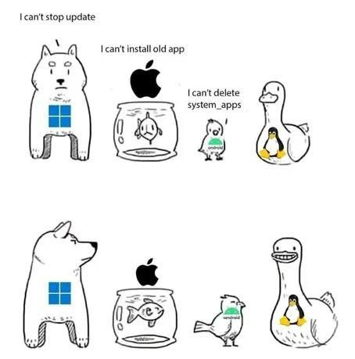
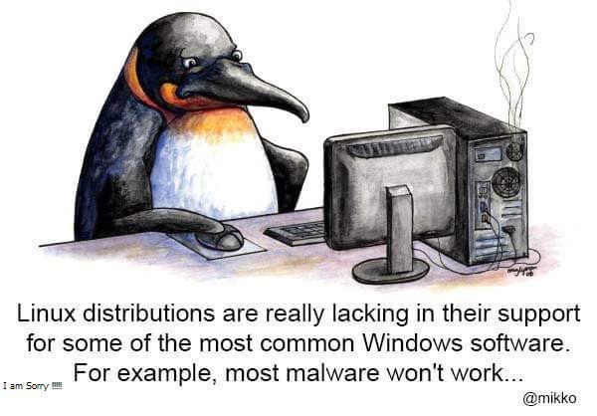
Why should we use GNU/Linux 🤔?
Completely Free 🤩
Customization and Flexibility (user is the master of his machine)
Secured (far better than Windows 🤐)
Performance (Best to revive old machines)
Stability/Reliability
No Viruses (no malware, no worry of ransomware)
Privacy ( one of the key features !)
Information Source: [online] https://www.educba.com/advantages-of-linux/; [Book] Rajib Choudhury, Moulik Linux ; Photos: [online] www.reddit.com/r/linuxmemes
Notes:
Why I will use a Linux based operating system ???
Performance – why a software wouldn't be best when it is made by 15 thousands minds ! It is fast, it consumes about 1.5 Gigs of ram where Windows wants almost 4 Gigs.
Virus - [ photo no 2 ]
Privacy – Photo no 3
Open Source developers respect your privacy. Better, we can say, it is a operating systen OF THE PEOPLE, FOR THE PEOPLE, BY THE PEOPLE, not by any profit hungry company.

Slide 5

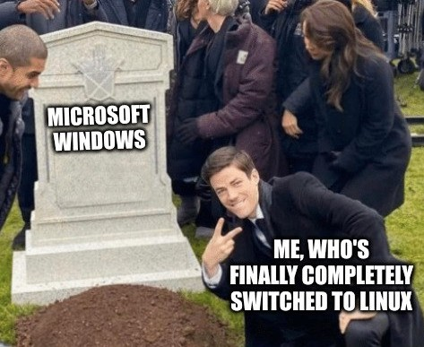
"All the best people in life seem to like LINUX."
- Steve Wozniak (Co-founder of Apple Inc.)
Notes:
THE END
Last: CSE Discipline as well as other 3 sister discipline of KU started its academic activity on 30 August 1991 which is 5 days after the birth of Linux.

