Slide 1

Person-Student Management System
Submitted by: Kazi Rifat Morshed (Student ID: 230220) Md Rimon Islam (Student ID: 230236)
1st Year 2nd Term
Computer Science and Engineering Discipline Khulna University, Khulna
Notes:
Good morning everyone, this is Kazi Rifat Morshed, and, MD Rimon Islam, first year undergraduate students of Computer Science and Engineering Discipline of Khulna University, presenting our JAVA Graphical User Interface Project on Person-Student management System.

Slide 2
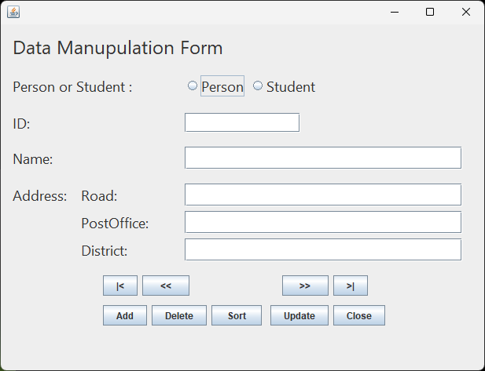
Project: Person-Student Management System in Java using Java Swing
Features:
Simple and User-friendly UI
Person or Student selection radio button
Add, Delete or Update Person or Student Information
Sort alphabetically in ascending order
Save to local memory
Automatic load from local memory
Notes:
With Java Swing Library, we made a simple and user friendly program to manage a database of Person and student with add, delete, sorting operations. Our program uses সিরিয়ালাইজার and ডিসিরাইলাইজার to save data into local memory and load from local memory.

Slide 3
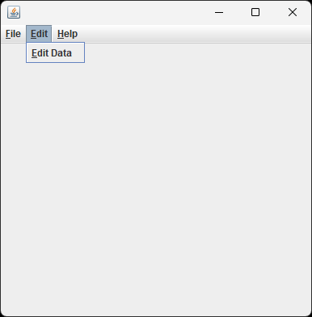
Project Demonstration
Notes:
When the program in launched, a new window appears with a menu bar. In the menu “Edit”, we have an option named “Edit Data”. This opens a new wondow, our Data Manipulation form.

Slide 4
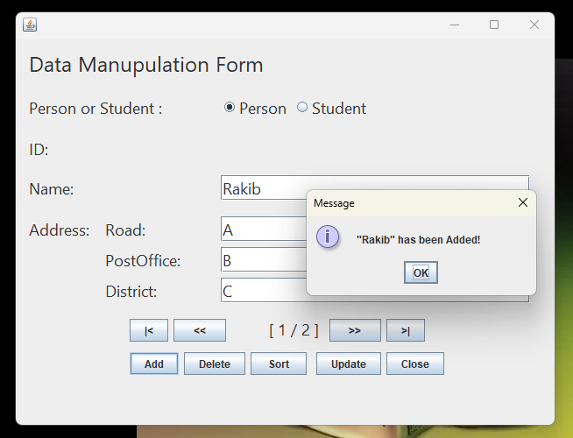
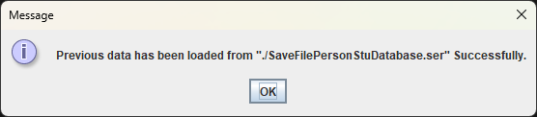
Project Demonstration
Notes:
While opening the second window, if a save file is found in present directory, the program will load the data. The add button adds creates an object, add it to the arrayList and shows conformation message.

Slide 5
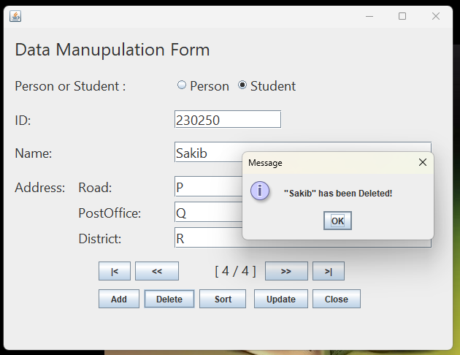
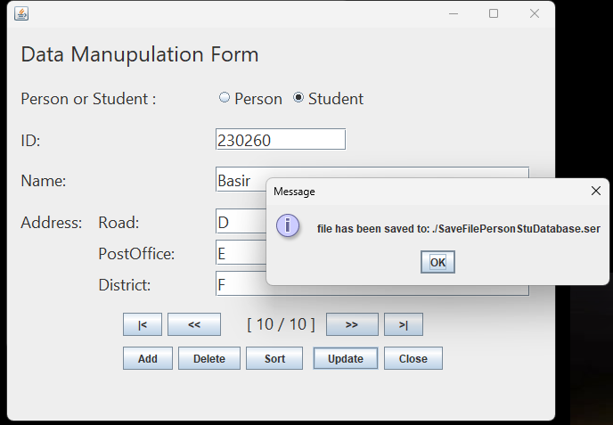
Project Demonstration
Notes:
Delete button deletes the presently showing entry from the arraylist. Update button updates the edit and saves a file into local memory such as Hard Disk. Or SSD.

Slide 6
Step by Step Procedure
Raugh Drawing of UI Interface to determine necessary Swing components
Identifying necessary classes and Drawing UML Class Diagram according to requirement
Writing Basic Classes (Address, Person, Student, Database, …) as base of back-end side
Drag and Drop GUI Components to design front-end User Interface (UI)
Defining instructions(code) for GUI components in respective method blocks
Implement ActionListener Interface
Implement Serialization and Deserialization
Continuous Testing and Bug Fixing
Export to executable JAR file
Notes:
How did we do it ?

Slide 7
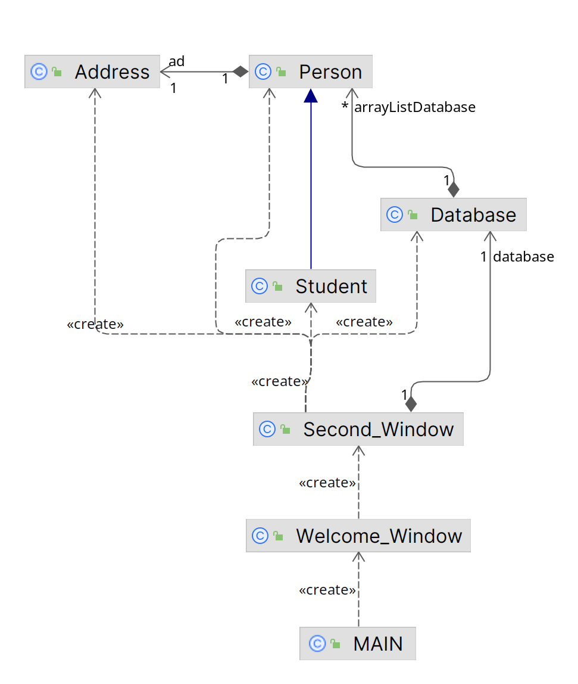
UML Class Diagram (Class name and relations only)

Slide 8
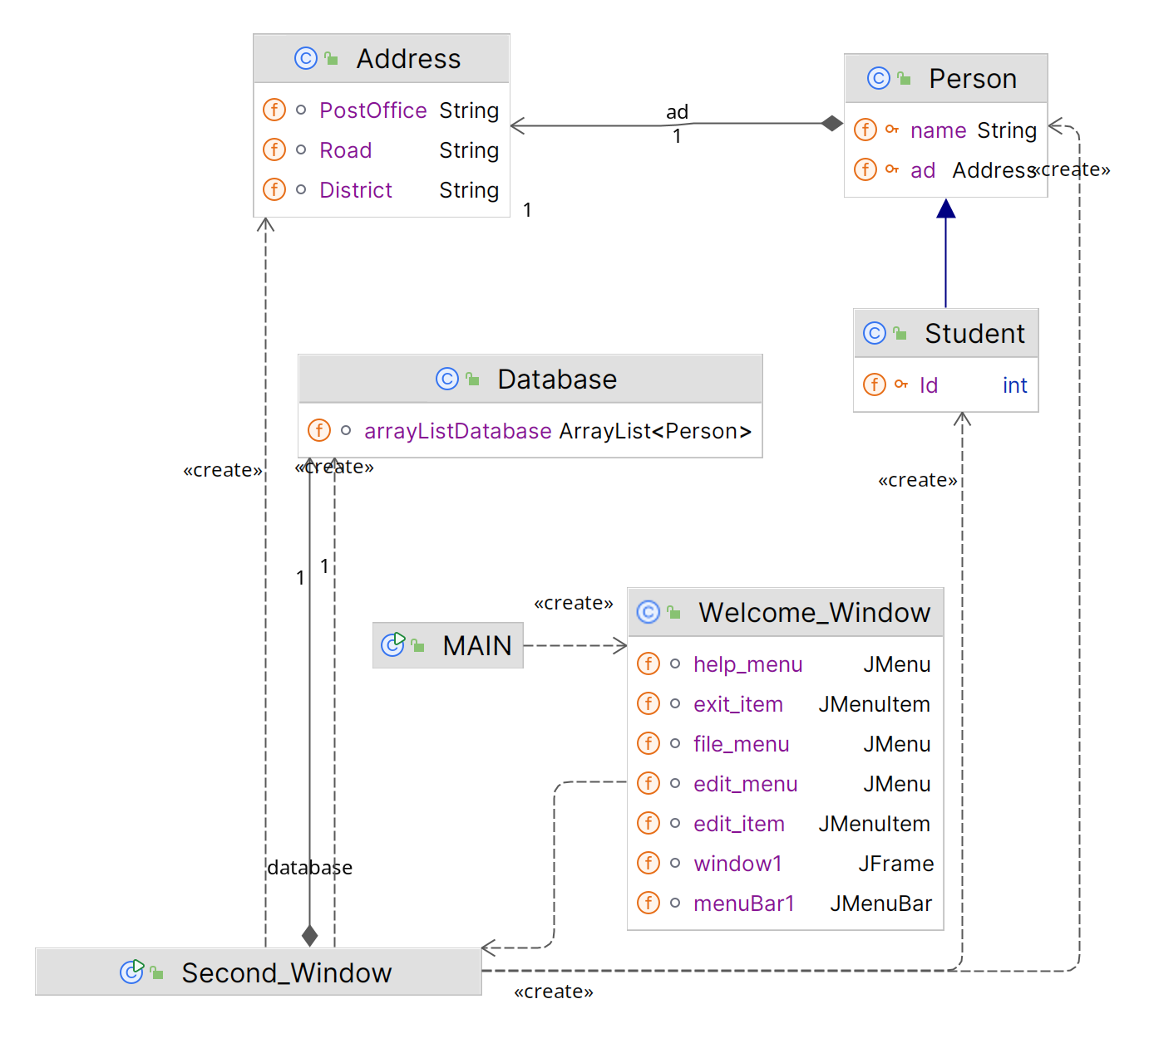
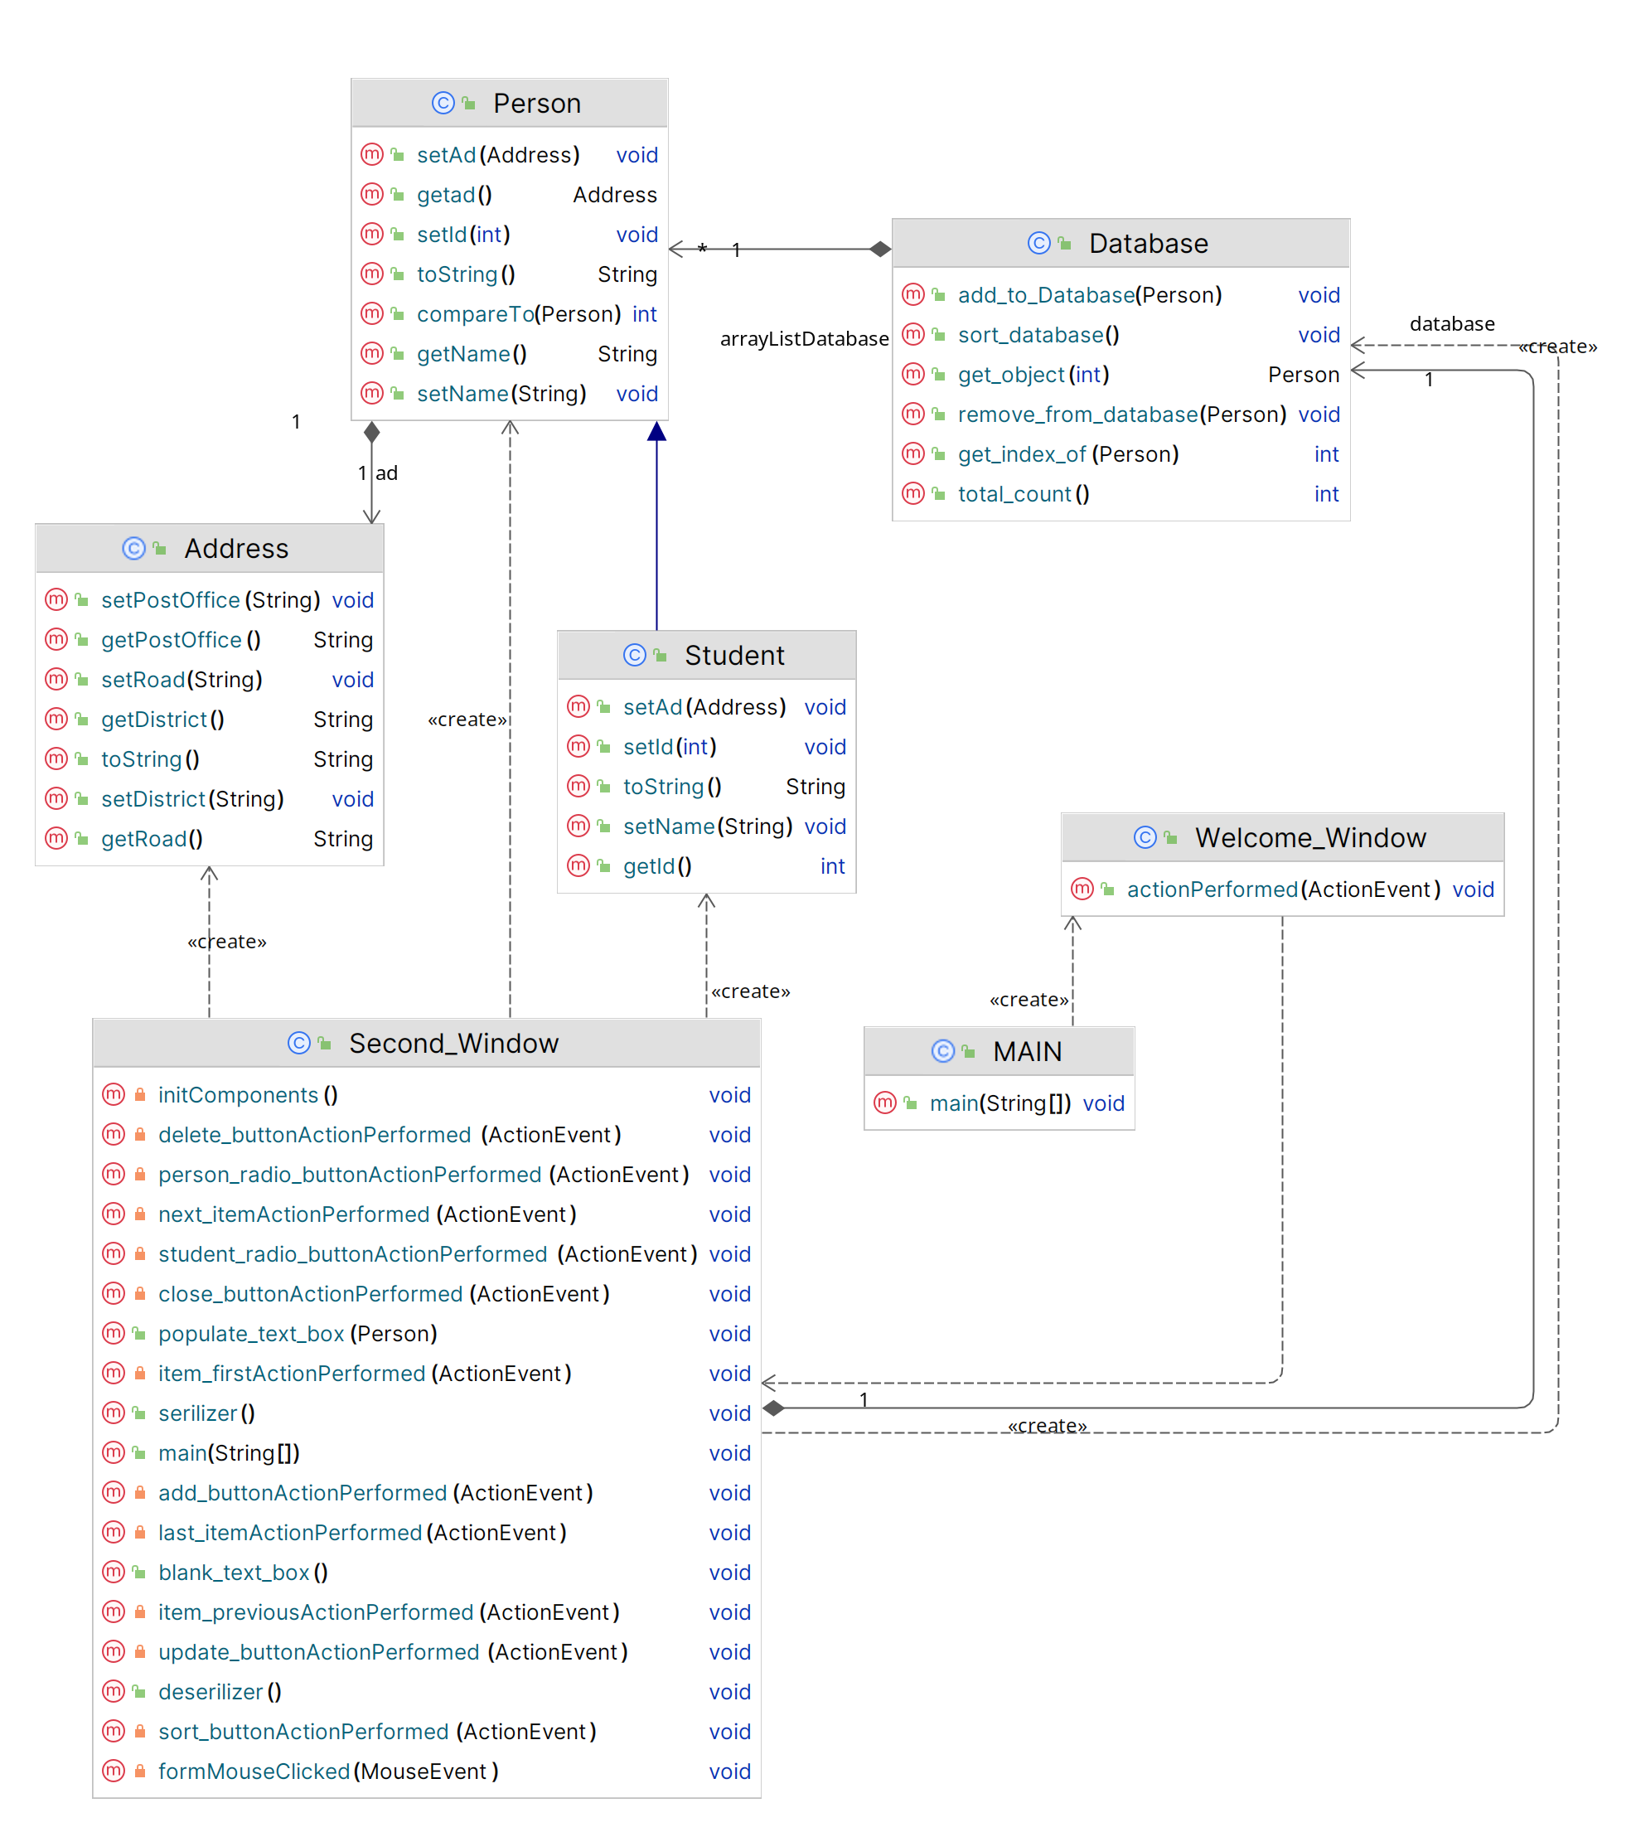
UML Class Diagram

Slide 9
Essential Swing Components
JFrame: JFrame represents a window on the screen and holds all the other GUI components.
JLabel: JLabel displays a text or image on the screen.
JButton: Jbutton is a clickable button that triggers an action when pressed.
JMenuBar: JMenuBar is a horizontal bar that holds multiple JMenu objects and appears at the top of the JFrame by default.
JMenu: An individual menu within a menu bar. It holds a list of menu items.
JRadioButton: A button that represents selection of one option from a set of choices.
JTextField: JTextField is a component used in Java Swing to allow users to input or edit a single line of text.

Slide 10
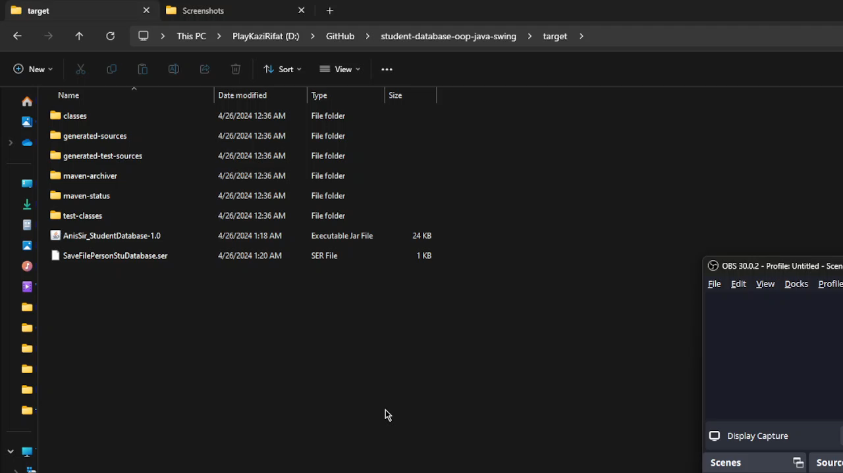
Project Demonstration (Video)

Slide 11
Questions & answers

Slide 12
Thank you very much

