Slide 1

Weka
A Machine Learning Tool

Slide 2
Weka
Waikato Environment for Knowledge Analysis
Fully Java-based (Weka 3)
Includes
Tools for data visualization
Algorithm for data analysis

Slide 3
What Can Be Done
Weka supports data processing, clustering, classification, regression, visualization, and feature selection
Data must be provided in one flat file or relation
Weka provides access to SQL database using Java Database Connectivity

Slide 4
Why Weka
Free availability under GNU public license
Portability
Comprehensive collection of data processing and modeling techniques
Easy to use graphical interface along with library
Extension packages

Slide 5
Example Using GUI
Suppose, we want to classify some data using NaiveBayes Classification.
We need the data in CSV format. Here is a row of my CSV file:
3.21,2.44,0.77,1.22,0.66,a
Here the last value a indicates its class. The remaining values are feature values

Slide 6
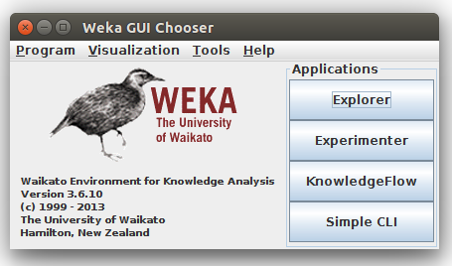
Example Using GUI (Cont.)
Open Weka GUI
Click on Explorer

Slide 7
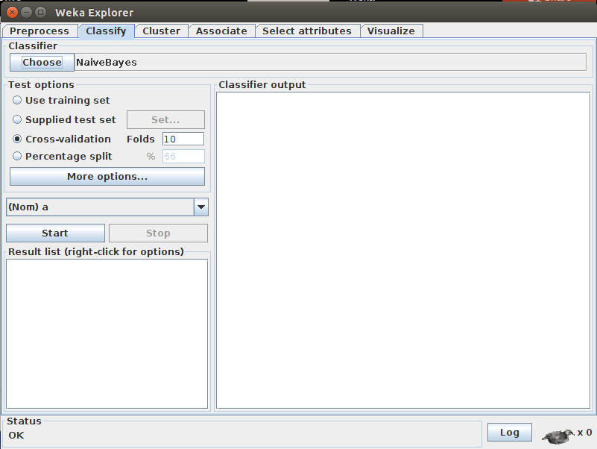
Example Using GUI (Cont.)
Click on Open File in Preprocess tab. Select the CSV file
Click on Classify tab and Choose NaiveBayes

Slide 8
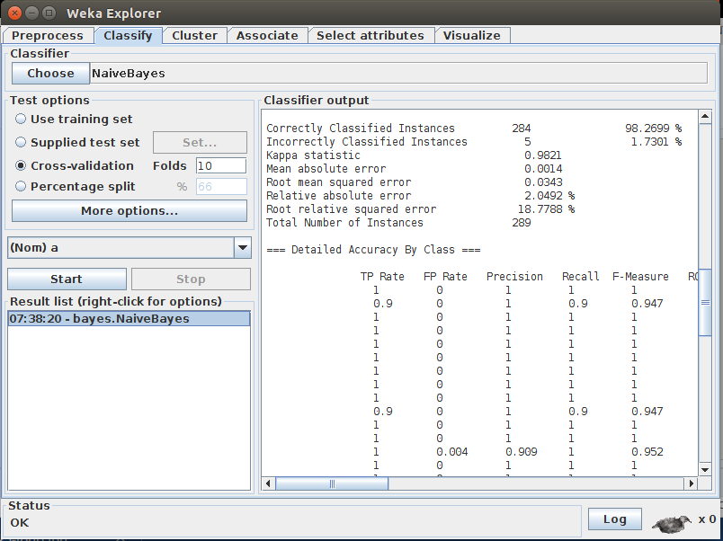
Example Using GUI (Cont.)
Click on start and we will get the result and summary statistics

Slide 9
Thank You!
Kazi Hasan Zubaer
1105024

