Slide 1
Welcome!

Slide 2
Who am I and what is this?

Slide 3
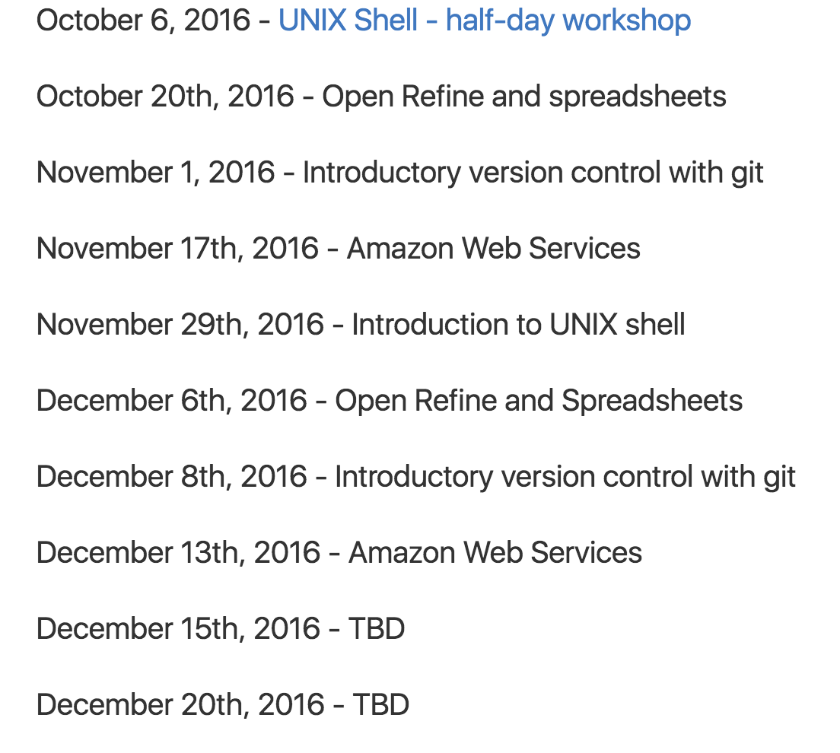
Training workshop series!
Fall training workshops:
~10 workshops in the fall, all introductory.
Office hours every Wednesday ~3:15-5:30pm over in CCAH.
All of this will be announced on the dib-training mailing list, to which I will send you a link after the workshop.

Slide 4
Code of Conduct
http://software-carpentry.org/conduct/
tl;dr? Don’t be a jerk.
No one knows everything &, even when you do,
being friendly and helpful is a great approach anyway:)

Slide 5
Stickies
Yellow sticky: done!
Red sticky: need help!
No sticky: work in progress…

Slide 6
Training workshop series!
Fall training workshops:
~10 workshops in the fall, all introductory.
Office hours every Wednesday ~3:15-5:30pm over in CCAH.
All of this will be announced on the dib-training mailing list, to which I will send you a link after the workshop.

Slide 7
Other training on campus!
Bioinformatics core
HPC training (for on campus compute)
Davis R Users Group (DRUG)
I can point you towards these, and I also will forward announcements on to the dib-training list.

