Slide 1

LAPTOP PRICE PREDICTION
Information Technology
SEM-VI MINI PROJECT

Slide 2
Guided by:-
Prof. Swati Powar
Team Members:-
Baseema Irfan Kazi
Sanika Rajendra Kalyankar
Sakshi Janardan Kanar

Slide 3
OVERVIEW
Contents
Introduction
Methodology
Algorithms
Applications
Flowchart

Slide 4
INTRODUCTION
Laptop Price Prediction is a challenging task due to the dynamic nature of the market and the many factors that can affect pricing. The goal of this model is to accurately predict the prices of laptops based on various features.
Laptop Price Prediction is important for both buyers and sellers. Buyers can use the model to predict the prices of the laptops and make informed purchasing decisions ,while sellers can use the model to set appropriate prices for their products.

Slide 5
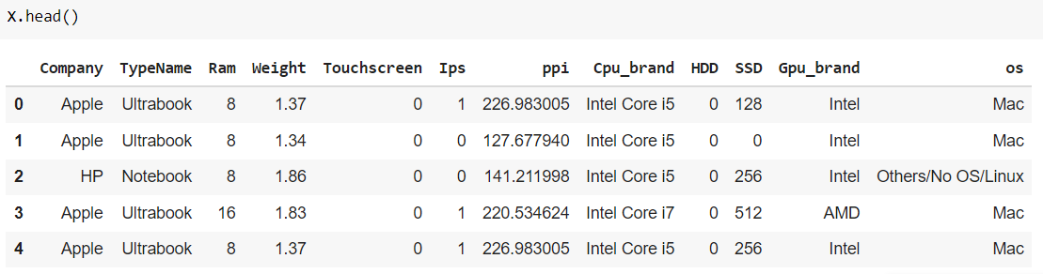
Methodology
To support the application of machine learning using the Decision Tree algorithm, of course the sample data is needed. Table below contains data about various laptops and their prices depending on their configuration.
Dataset

Slide 6
Algorithms :
Random Forest
Decision Tree
SVM
Linear Regression
This algorithm (used as a Decision Tree Classifier which can be employed to generate a decision, based on sample dataset) starts with the process of selecting the highest gain attribute as the root of the tree, then creates a branch for each value, then divides the case in branches, then repeats the process for each branch until all cases in the branch have the same class.

Slide 7
Random Forest Algorithm
Random Forest is a versatile machine learning method capable of performing both regression and classification tasks. It is a type of ensemble learning method, where a group of weak models combine to form a powerful model.
How does it work?
Assume that the user knows about the construction of single classification trees. Random Forests grows many classification trees. To classify a new object from an input vector, put the input vector down each of the trees in the forest. Each tree gives a classification, and we say the tree" votes forthatelass The forest chooses the classification having the most votes (overall the trees in the forest).

Slide 8
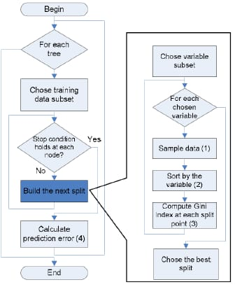
Flowchart

Slide 9
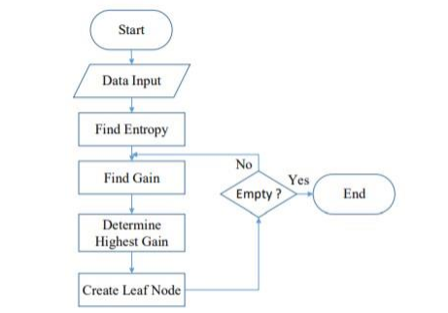
Decision Tree Algorithm
This algorithm (used as a Decision Tree Classifier which can be employed to generate a decision, based on sample dataset) starts with the process of selecting the highest gain attribute as the root of the tree, then creates a branch for each value, then divides the case in branches, then repeats the process for each branch until all cases in the branch have the same class.

Slide 10


To get accurate calculation results, calculations used Entropy and Gain for each variable. Entropy measures uncertainty between random variables in a data. The high Entropy value will affect the classification process.
The equation used to calculate Entropy and Gain, as follows:
S: Case set
k: Number of S partition
Pj: Probability obtained from the total (Yes / No) divided by the total case
S: Case set
A: Attribute
n: Number of A attribute partition
|Si|: Number of cases on the i partition
|S|: Number of S partition

Slide 11
APPLICATIONS
Market Analysis
Financial investment
Retail inventory Management
Price Comparison Websites
E-commerce Pricing Strategy
Budget Planning

Slide 12
FUTURE SCOPE
Improve Accuracy
Real Time Updates
Market Insights
Customization

Slide 13

THANK YOU

