Slide 1
TEAM CLICKBAIT / CCNY
Campus
Resource Finder
A clearer way to find student support at City College
CSc 47300 · Fall 2026
HTML · CSS · TypeScript · frontend demonstration
Notes:
Hi everyone. We’re Team Clickbait, and this is Campus Atlas, our Campus Resource Finder for CCNY. The goal is to give students one clear place to begin when they are looking for campus support. I’ll walk through the interface, show how each assigned feature fits into it, and be clear about what this frontend prototype does today.

Slide 2
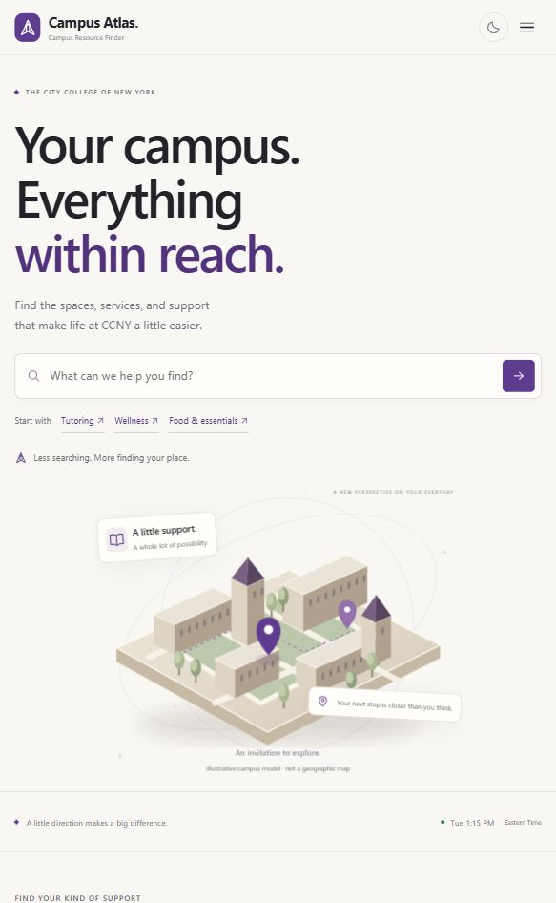
THE EXPERIENCE
One place to start
Search first. Browse when you need a starting point.
Search and browse
Find a resource by name, type, or need.
Narrow the list
Choose a category, check what is open, or view saved places.
Read before you go
See location, example hours, and reporting options on each result.
CAMPUS ATLAS · CCNY
02
Notes:
This is the current interface. Search sits at the top, and the discovery links offer a few common ways to browse. The results area combines category, open-now, and saved-resource filters. The campus artwork is illustrative only; it is labeled in the site so viewers do not mistake it for a real map.

Slide 3
SEARCH AND DISCOVERY
From a need to a useful result
01
02
03
Search
Refine
Choose
Type a resource name, service, or category. Suggestions can be selected by keyboard.
Combine a category with “Open now,” or switch to saved resources.
Open weekly hours, check the location, or save the result for later.
Search matches names and resource descriptions; results use the bundled classroom dataset.
CAMPUS ATLAS · CCNY
03
Notes:
The search supports resource names and types, and the suggestion list helps people narrow the query before opening a result. The category and open-now controls work together with search. A saved tab collects bookmarks. For the live demo, I’ll search for tutoring, choose a result, and then show the filters. Resource records are still bundled examples, not an official CCNY directory.

Slide 4
RESOURCE DETAILS
Useful details, with scope stated plainly
HOURS & AVAILABILITY
SAVED PLACES
Open status uses the sample weekly schedule and Eastern Time. Expand a result to see all seven days.
Bookmarks stay in this browser, so familiar resources are easy to revisit on this device.
REPORT AN ISSUE
Choose a reason and add optional details. The report appears in this browser’s local log; it is not sent to CCNY.
CAMPUS ATLAS · CCNY
04
Notes:
The hours feature compares the current time in the campus timezone with the example hours on each resource. People can expand the card for the weekly schedule. Bookmarks also persist locally. A student can report an issue by selecting a reason and optionally adding a note, but this is a frontend-only project. The report is saved on the current device; staff do not receive it.

Slide 5
TEAM RESPONSIBILITIES
Four assigned features
01
Ferdosi Hossain
Search by name or type
src/search.ts
02
Kazi Mehzabin
Hours and open-now status
src/hours.ts
03
Aung Latt
Report outdated information
src/report.ts
04
ATM Rahat Hossain
Responsive layouts and mobile navigation
css/styles.css · src/responsive.ts
CAMPUS ATLAS · CCNY
05
Notes:
The project README assigns these four core features to the named teammates. The search, hours, and reporting modules contain the respective feature code. Rahat’s responsive work is mainly in the CSS breakpoints, with the mobile menu and back-to-top behavior in responsive.ts. Each assignment has a visible, working frontend path in the current project. The reporting workflow remains local because there is no backend.

Slide 6
HOW THE PROTOTYPE WORKS
A native frontend, with no backend
HTML
+
CSS
+
TypeScript
esbuild compiles the TypeScript into the browser bundle.
Browser
↔
This browser only
UI + sample resource data
Bookmarks · theme · report log
No React · no UI libraries · no database · no API connection
CAMPUS ATLAS · CCNY
06
Notes:
The project is written in HTML, CSS, and plain TypeScript. esbuild bundles the TypeScript for the browser. There is no React, UI framework, backend, database, or API connection. The example resource data ships with the page, and bookmarks, theme choice, and reports use this browser’s local storage. A local static server only serves the files; it does not supply application data.

Slide 7
PRESENTATION DEMO
A short path through the app
1
Search “tutoring” and choose a suggestion
2
Open weekly hours and check the current status
3
Filter by category or “Open now”
4
Save a resource, then switch to Saved
5
Toggle dark mode; show the local report form
Demo data only · the report stays in this browser
CAMPUS ATLAS · CCNY
07
Notes:
For the demo, start at the search field and enter tutoring. Select a suggestion and point out the matching resource card. Expand weekly hours and read the open status. Then try a category or open-now filter. Bookmark one result and switch to Saved. Use the moon button in the header to show dark mode. Finally, open a report form and explain that submitting it stores a local demo entry; it does not contact the college.

Slide 8
SCOPE AND NEXT STEPS
What a real campus launch needs
TODAY
NEXT
The interface works with sample records. Hours and locations should be checked with CCNY before anyone relies on them.
Connect a verified resource source and a shared reporting process if the project is extended beyond a class demo.
Questions?
Campus Atlas · Team Clickbait
CAMPUS ATLAS · CCNY
08
Notes:
The prototype shows the assigned interface features, but the records and weekly schedules are examples. The illustration is not a map, and hours do not include holiday exceptions. Before this could be used as a real campus service, the team would need verified information and a shared report-handling process. Thank you. We’re happy to take questions.

