Slide 1

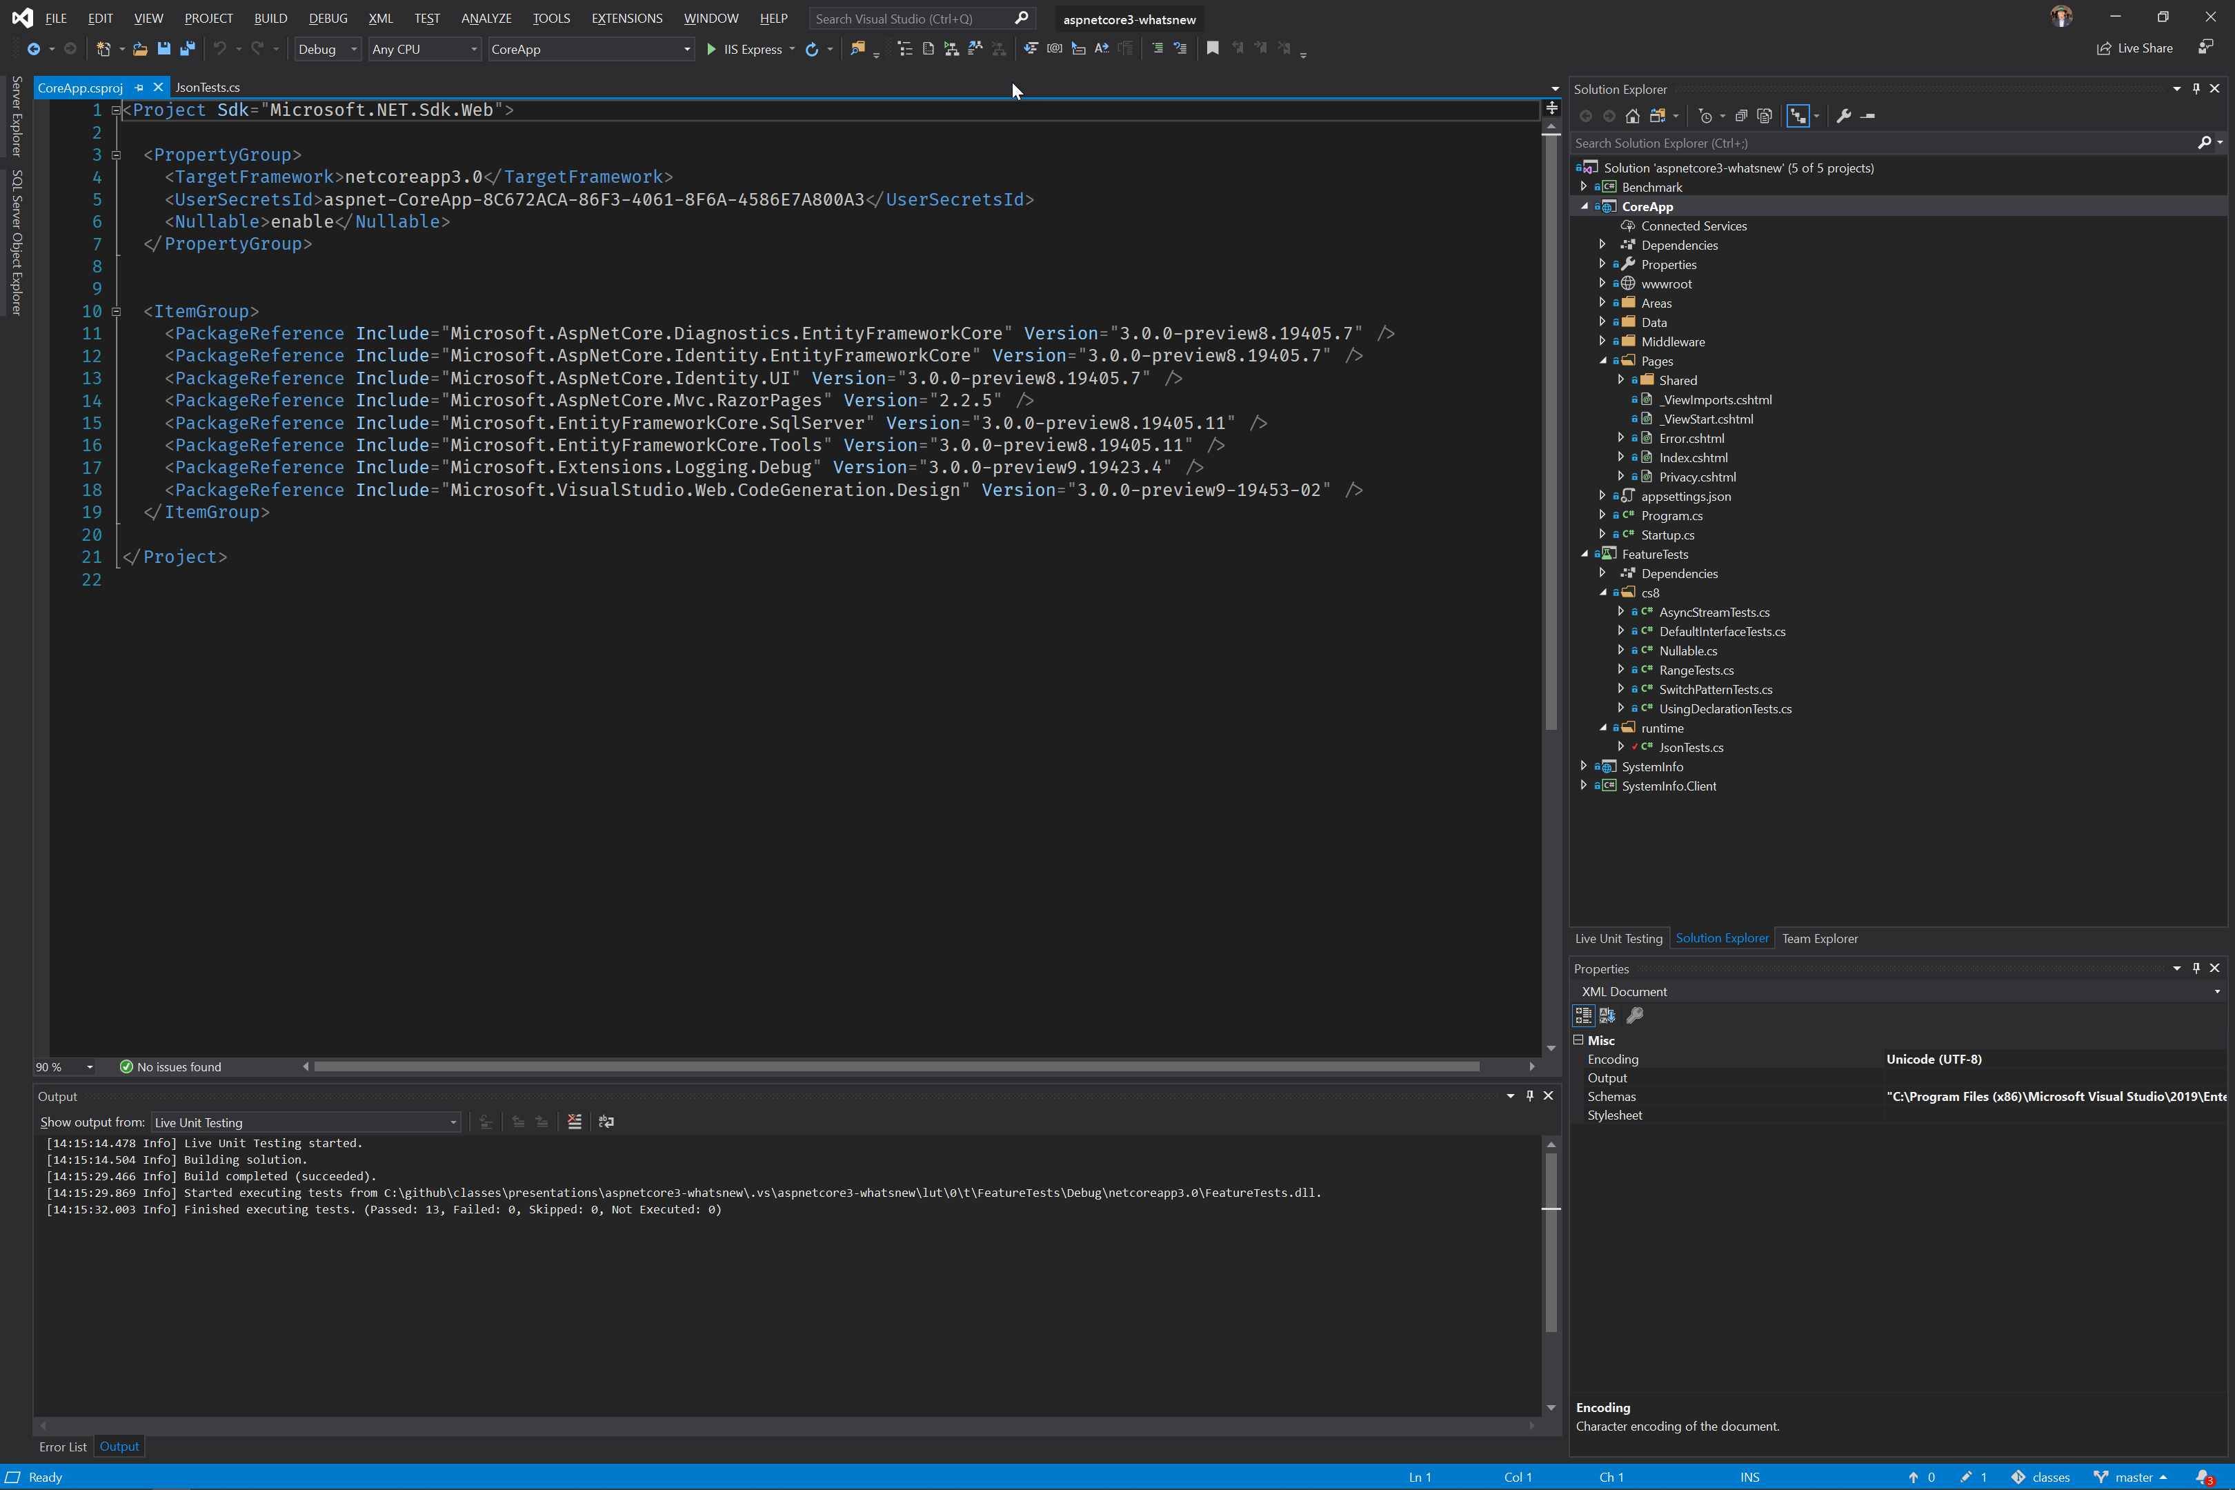


ASP.NET Core 3 Building Apps & Services . . . Whats New!?
K. Scott Allen
@OdeToCode

Slide 2
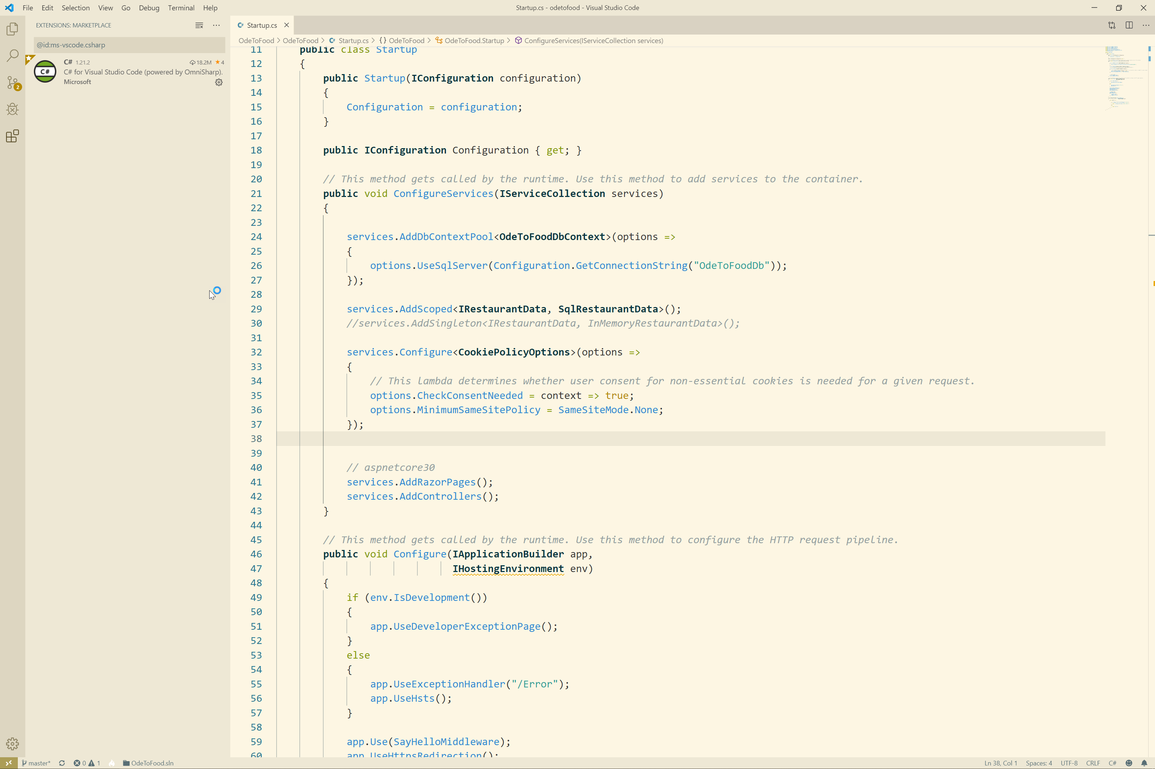
Agenda

